Slide 1
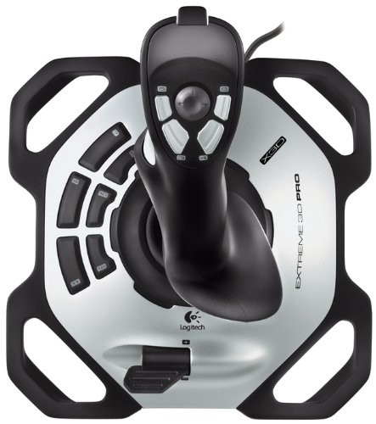
Close Gripper
Open Gripper
Upper Joint
Lower Joint
Enable Rotate
Enable Lower
Enable Upper
Base Joint
Speed
Lock/Unlock Speed

Slide 2
Commands sending to the Arduino
Description | Mode | Value - | Value + | Note
Rotate Velocity | 0 | Rotate - | Rotate+
Lower Velocity | 1 | Lower - | Lower +
Upper Velocity | 2 | Upper - | Upper +
Gripper Velocity | 3 | Gripper - | Gripper +
Rotate Position | 4 | Angle_H | Angle_L | Angle(0,65536)
Lower Position | 5 | Angle_H | Angle_L
Upper Position | 6 | Angle_H | Angle_L
 | 7
 | 8

