Slide 1
CSC490 Final Presentation
Project GetThisBread
Richard Abrams, Michael Calvo, Ronald Abrams
Emily Ashburn, Jason Manning, Ian Wilhelmsen

Slide 2
Our Project
Point of Sales Suite application that supports business management tasks.

Slide 3
Subsystems
Inventory Management
Google SSO Login
Point of Sale System
Scheduling Management
Database Subsystem

Slide 4








Tools
Angular
Bootstrap
TypeScript
HTML
CSS
JavaScript
PHP
MySQL

Slide 5
Richard Abrams
Inventory Management

Slide 6
Inventory - Richard Abrams
Handles things like showing a current listing of Menu Items.
Utilizes Angular CLI 11.2 framework for front end which includes specific components and a dedicated service.
Also able to modify if a menu item is active or not as well as add items.

Slide 7
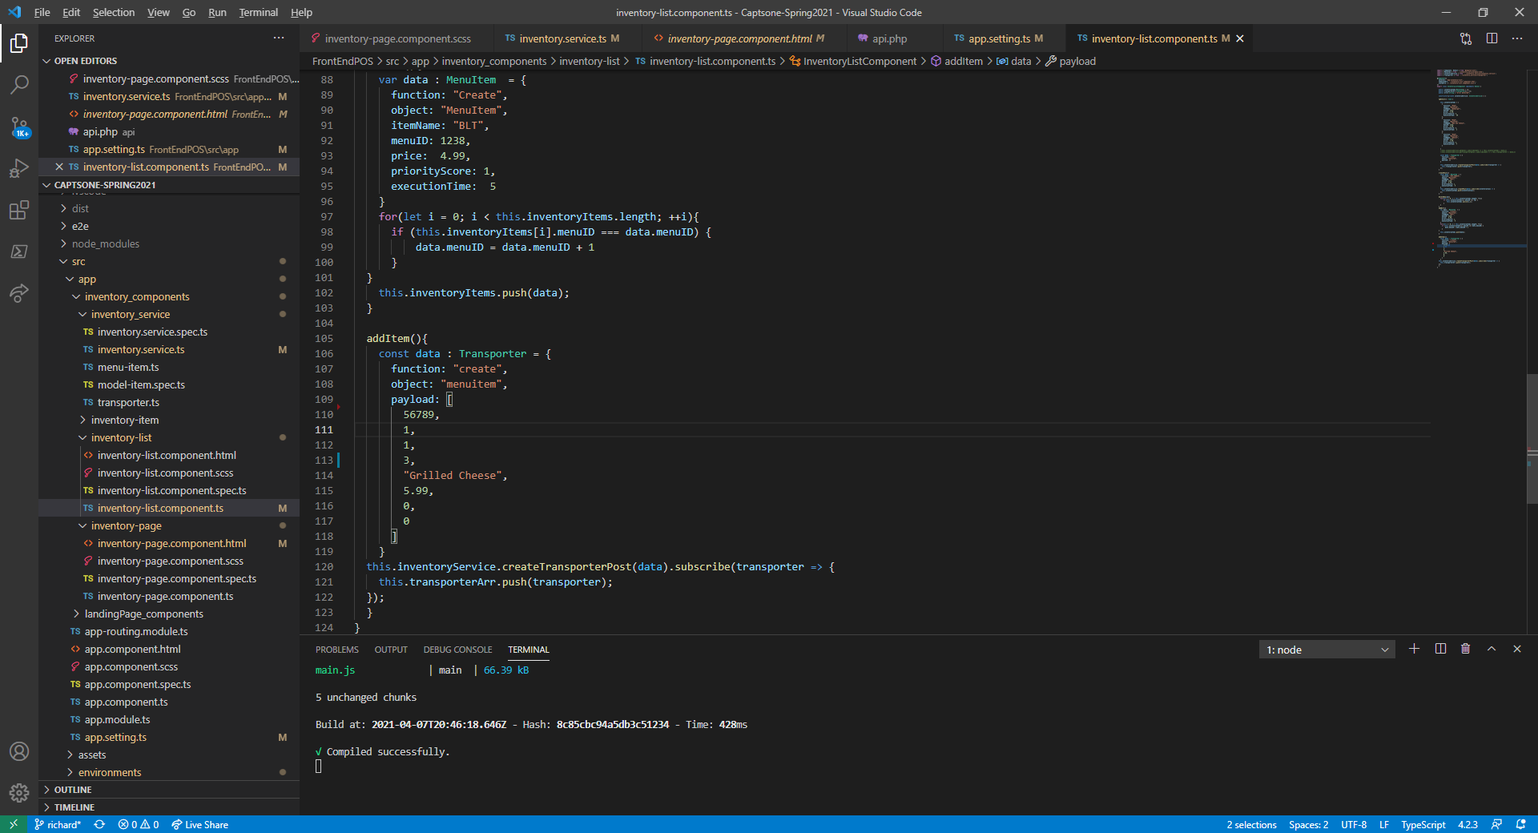
Inventory - Richard Abrams
Utilizes an inventory page component for main styling and routing
Has an inventory list component that deals with the HTML table for display as well as button operations.
Uses an inventory service to call to the backend using a transporter class.

Slide 8
Ronald Abrams + Mike Calvo
Google SSO Login Subsystem

Slide 9
Background Note
The premise is that ultimately, the user will only login in using a Google Account, and that this will return a user and its authority level in the SQL database, assuming that user and authority level exists in the SQL database, which will determine what the user can access and see on the Front-End. If the user is an Admin, then that user can create other users from an accessible page.

Slide 10
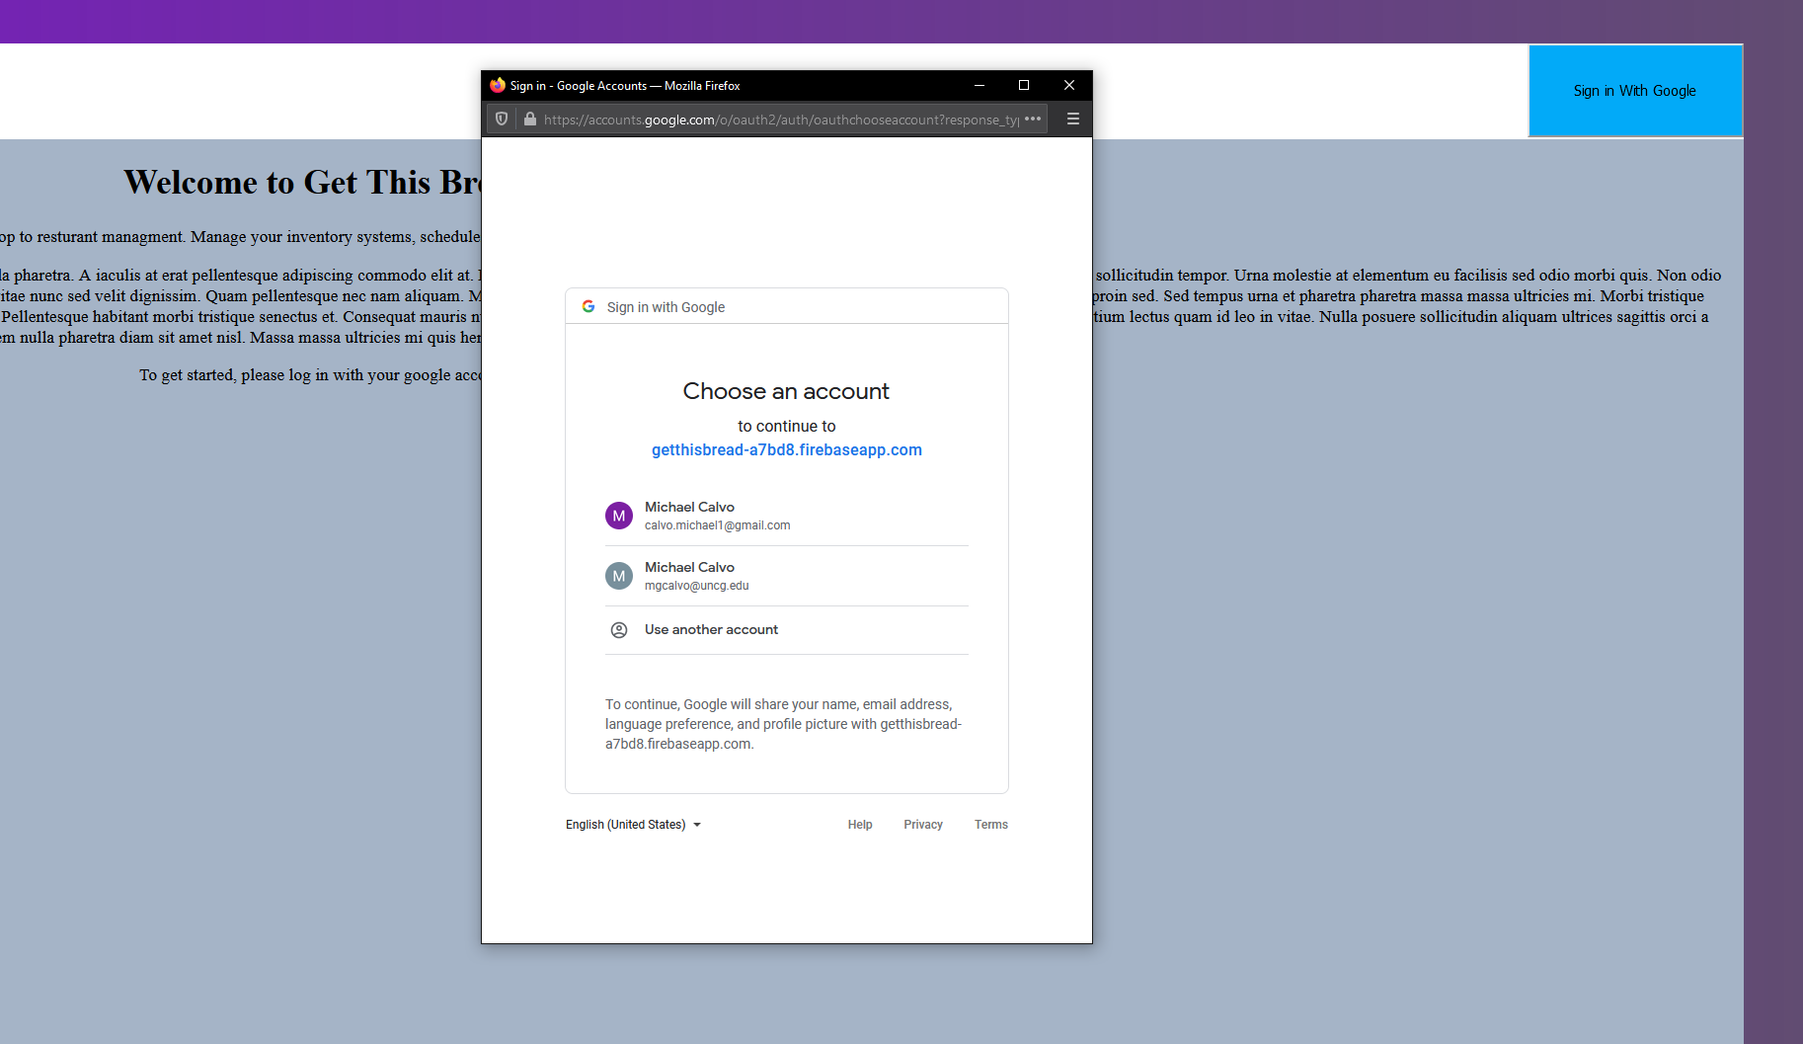
Google SSO Using Firebase
Using @angular firebase, users are able to log in with their google account.

Slide 11
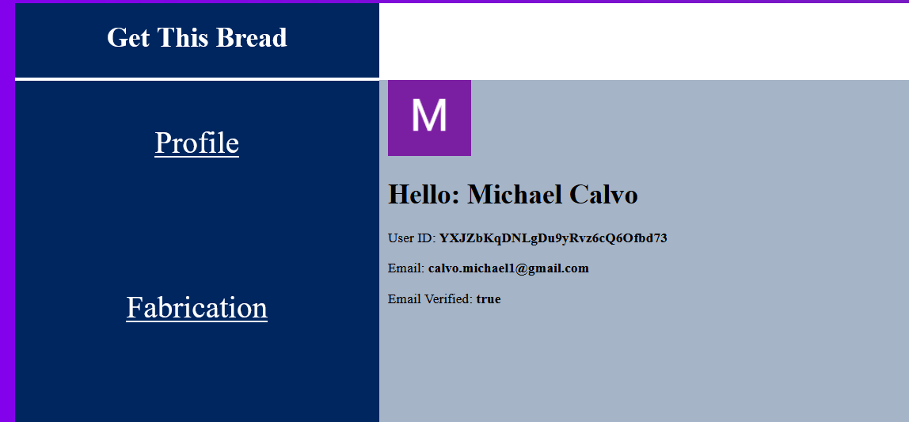
Google SSO Using Firebase
Using angular firebase, users are able to log in with their google account.

Slide 12
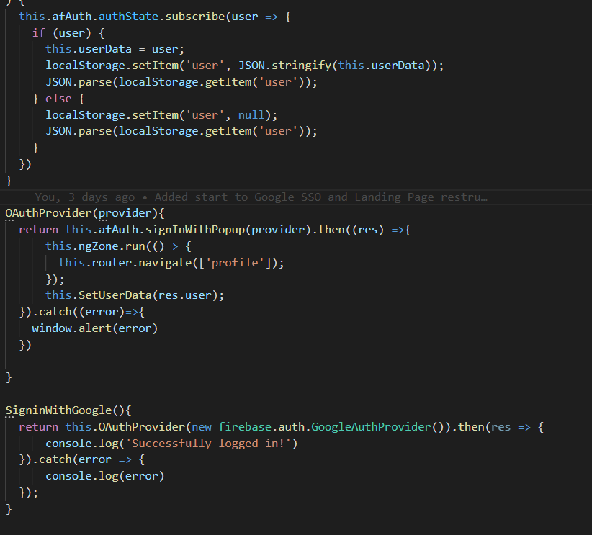
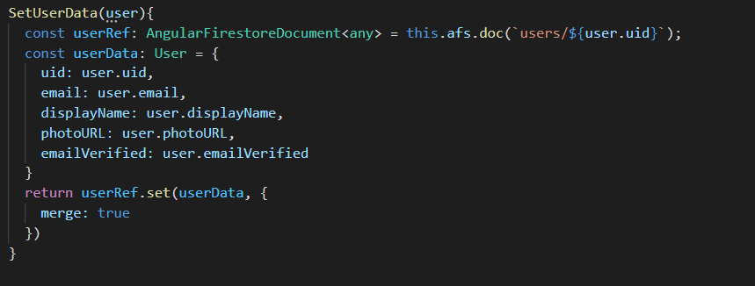
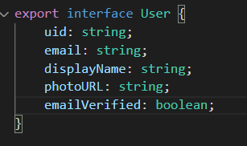
Google SSO Using Firebase
Angular firebase uses a popup and a google login function to create a user at login.

Slide 13
Google SSO to DB
After the user is signed in via google sso, the google email is split to give a username that correlates with the DB. That is pulled to give the rest of the user info.

Slide 14
Emily Ashburn
Point of Sale Subsystem

Slide 15
Point of Sale
Facilitates the ordering of product within a business
Pulls menus from store via StoreID and populates the menu tabs with menuitem vars
(For later implementation)
Makes calculations of each ticket placed to allow purchase of items
(For later implementation)
Allows host to view available seating/unavailable seating/customers waiting-on-order.
Available seating
Unavailable seating
In-progress seating

Slide 16
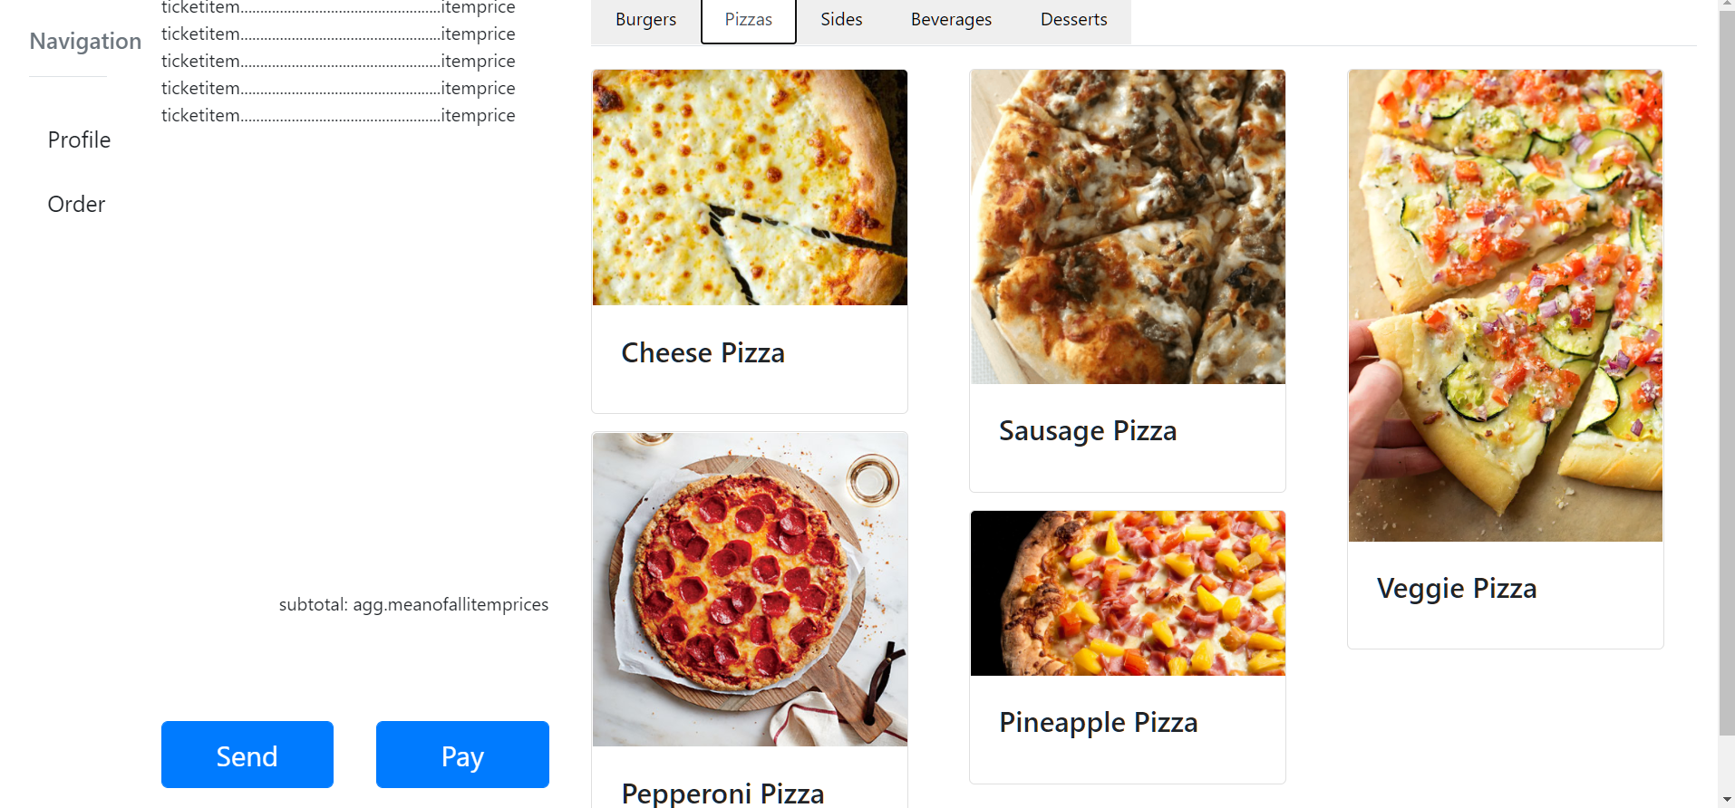
Point of Sale - Order View

Slide 17
Jason Manning
Scheduling Subsystem

Slide 18
Scheduling - Jason Manning
Creating the front end with the Angular CLI 11.2 framework, we can create components within the subsystem to handle different tasks such as scheduling and payroll tasks.
The scheduling subsystem will have components for viewing employee schedules as well as a time clock function for employees to use to clock in and out for their shifts.
In the future, the scheduling subsystem will include components for editing schedules, requesting time off and switching schedules with another employee and send such requests to the appropriate manager.

Slide 19
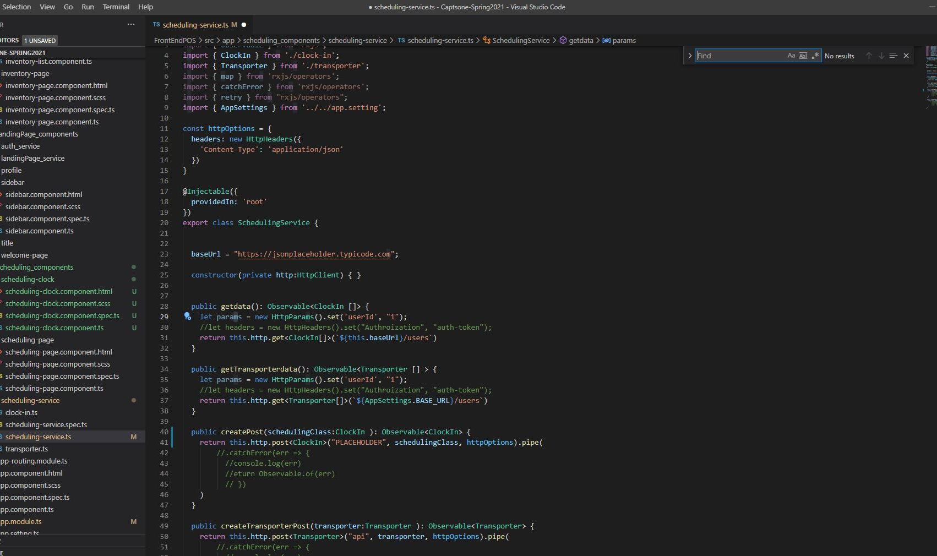
Scheduling - Jason Manning
The scheduling page component is the main scheduling page displaying the options for time clock and schedule.
A scheduling-clock component handles the time clock tasks such as clocking in and out for the given shift.
The view-schedule component handles viewing the current employee schedule.

Slide 20
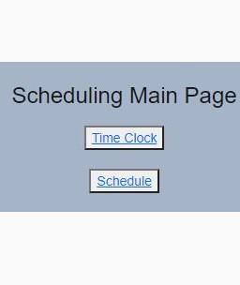
Scheduling and Time Clock Visualization
-The Time Clock displays the current date and time showing the employees the exact time they would be clocking in or out.
-The Schedule displays the current employee schedule.

Slide 21
Ian Wilhelmsen
Database Subsystem

Slide 22
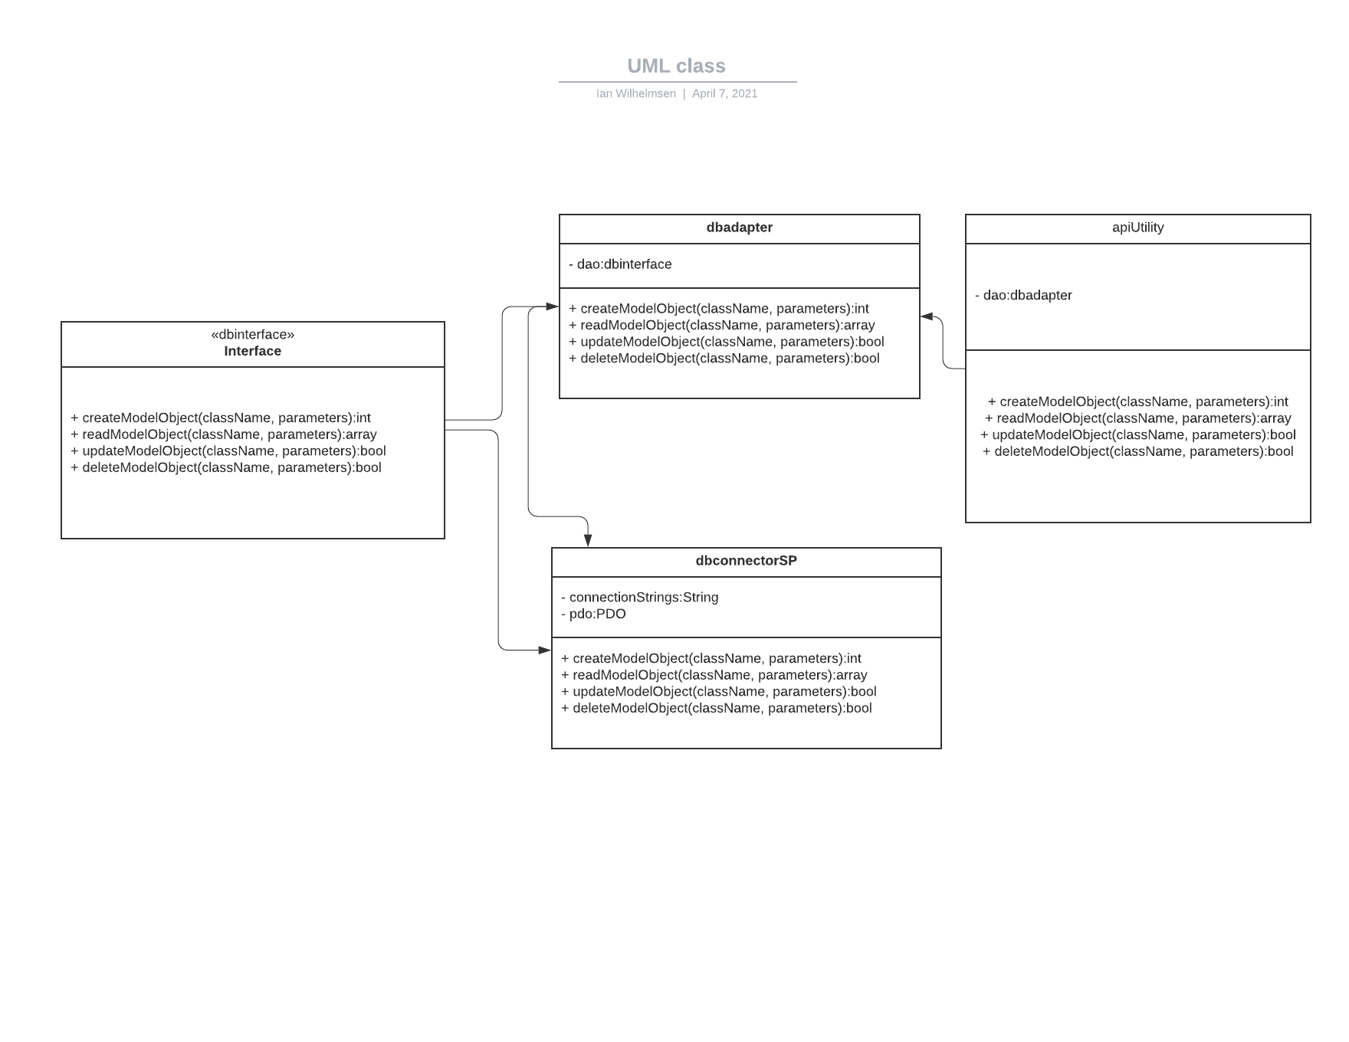
Single Page CRUD API
Simple
Precise
Easy to use
Easy to Debug

Slide 23
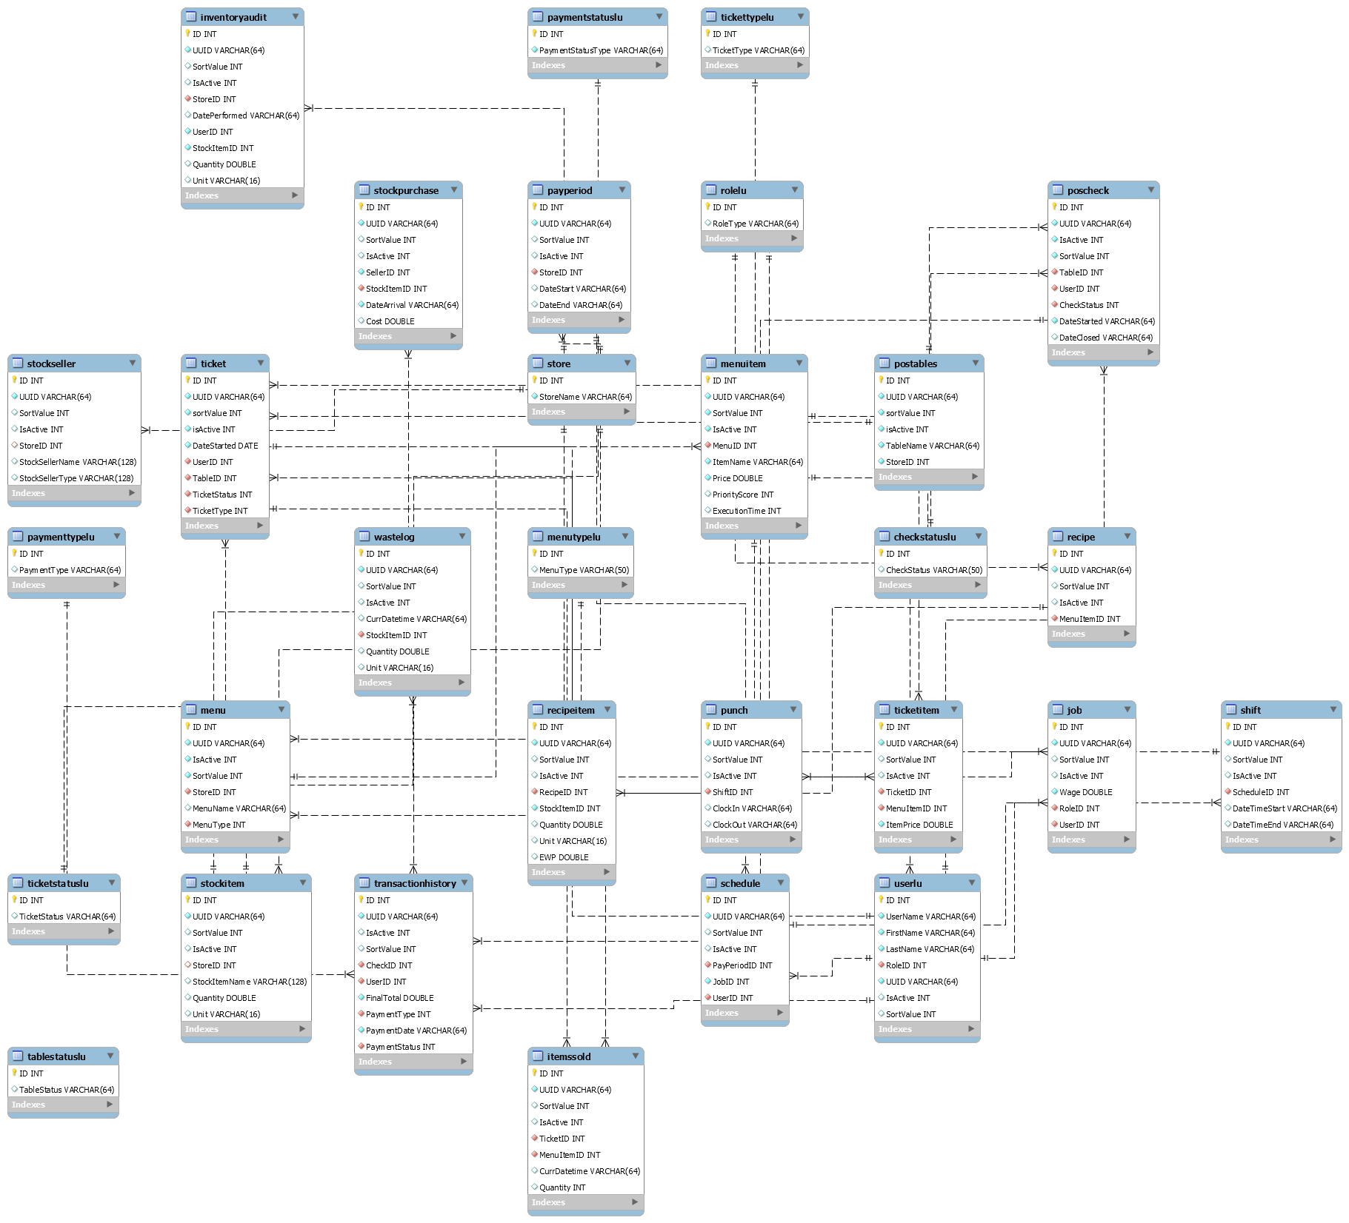
ER of CRUD
Relational CRUD DB
Supports all subsystems
Matches all the models in the other subsystems

Slide 24
Single Page API Design
Pros:
Convenient for devs
Easy for additional subsystems to tack on.
Relatively Safe
Easy to debug request errors.
Easier to spin up more instances.
Cons:
Slows down large scale traffic
Less scalability
API traffic congestion
Doesn’t conform to the modern design models

Slide 25
Prepared CRUD SP Executables
Pros:
Cons:
Very Secure
The parameters are very secure.
Easy to build an API skeleton around
Can use and freely pass around LUs
Decreases spin up time of the next instance.
Highly scriptable and easily testable.
Limits types of API calls.
No speciality calls
Doesn’t support very specific functionality.
Slower O(n)

Slide 26
Questions?

