Slide 1
Progress 4/7/2023

Slide 2
A More Refined Problem Statement
Quadrotors can use the wind created by their propellers to shake leaves and flowers of plants to spread pollen between them.
A simple 2-dimensional model of this problem is to consider the drones and flowers to be points on a plane. The flowers being shaken by a drone are the flowers within a set radius of that drone.
Flowers should be shaken for a specified amount of time to be considered pollinated.

Slide 3
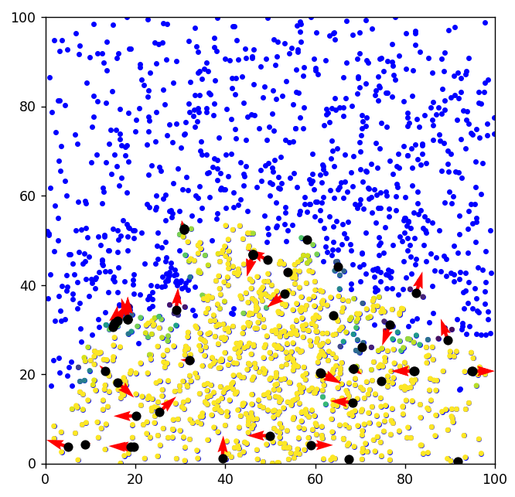
Creating a Simulation
Much of this week was spent writing the code for a basic simulation of this problem.

Slide 4
Mean-Shift Clustering
As I mentioned last week, I’ve been looking into the mean-shift clustering algorithm for this problem.
I created a weighted version of this algorithm, as it helps the drones to not get stuck in one place.

Slide 5
Creating a Simulation
Each flower is considered to be fully shaken after 5 seconds.
The weight of each flower is how far it is from being fully shaken.
Newly discovered flowers are weighted highest, and fully shaken flowers are given no weight at all.

Slide 6
Creating a Simulation
The yellow flowers are fully shaken.
The blue flowers are not shaken at all.
The colors in between represent some amount of shaking between 0-5 seconds.
The black dots are the drones.
The red vectors are the drone’s velocities

Slide 7
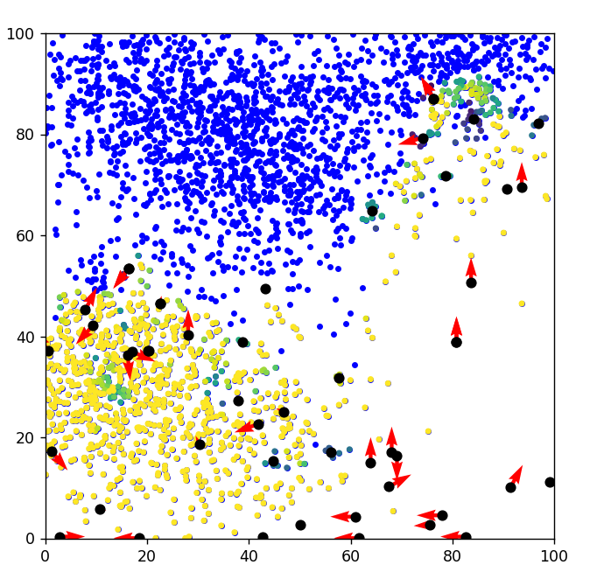
Results
Once a cluster has been discovered, the algorithm does very well at sweeping through it and fully shaking those flowers.
However, there are many times in which drones wander aimlessly while simply searching for a point to linger around.

Slide 8
Continuing From Here
This can be solved using Particle Swarm Optimization (PSO).
The basic idea behind this is that each drone’s velocity is affected by the weights of the flowers that other drones are seeing, as well as the past flowers this drone has seen.

Slide 9
Continuing From Here
For example, some drones which are just wandering here in the bottom right corner could have some influence in their velocity toward the top right corner to begin sweeping this large cluster at the top.

