Slide 1
Firmware Extraction and Static Analysis
of a Home Router — CY376 Red Team Presentation
Essien Michael Obimpeh – FCM.41.018.133.23 BSc Cybersecurity — University of Mines and Technology (UMaT), Tarkwa Target: TP-Link Archer C7 v2 — Firmware v260427 (April 2026)

Slide 2
OBJECTIVE
Can real weaknesses be found without touching a live device?
Question
Method
Scope
Can firmware analysis alone — no live device, no network traffic — surface real security weaknesses in a home router?
Acquire the vendor's own public firmware image, extract it, and search the filesystem manually and with automated tooling.
Static analysis only. No live device probed. All work isolated inside a Kali VM, per the course's Red Team lab requirement.
Target device: TP-Link Archer C7 v2 — dual-band consumer router, firmware v260427 (April 2026 release)
2

Slide 3
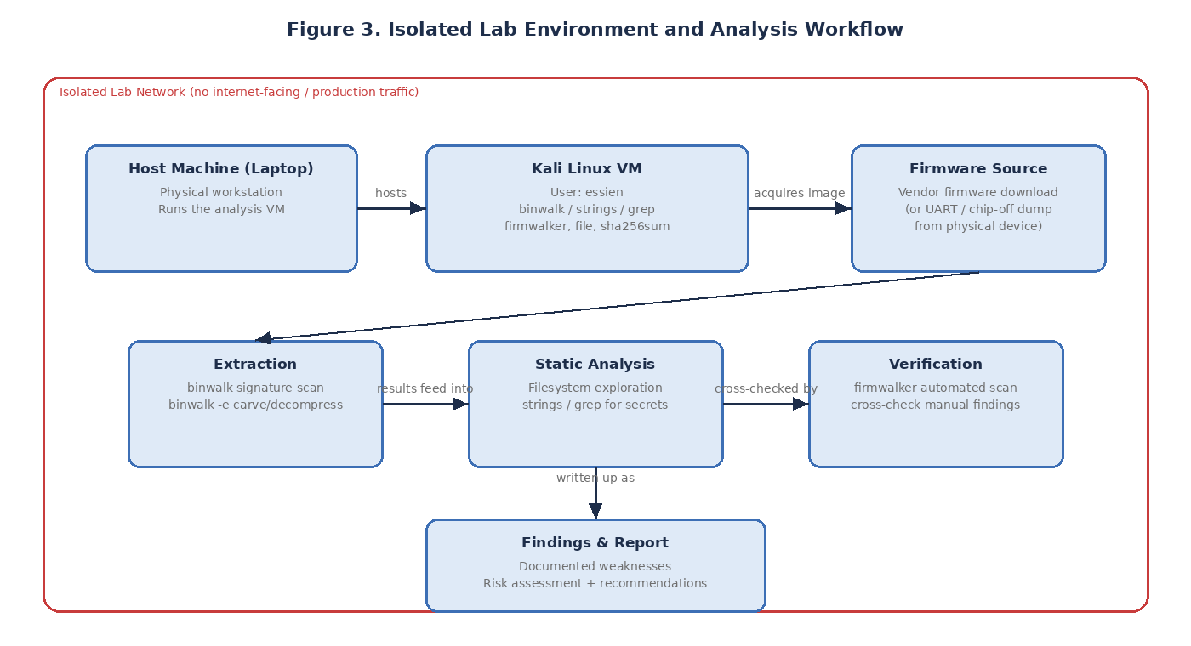
METHODOLOGY
Isolated Lab Environment and Threat Model
3

Slide 4
METHODOLOGY
Six-Step Analysis Pipeline
1
Acquire & Verify
2
Binwalk Scan
3
Extract
Download firmware, SHA-256 checksum
Identify header, bootloader, SquashFS offset
binwalk -e unpacks squashfs-root
4
Explore
5
Search
6
Firmwalker
Confirm architecture, layout, file types
grep/strings for credentials, secrets, debug flags
Automated cross-check of every manual finding
4

Slide 5
EVIDENCE — STEP 1
Acquisition and Integrity Check
Talking points
Downloaded directly from TP-Link's support page — the same image every unit of this model ships with.
SHA-256 checksum proves the file wasn't altered in transit.
5

Slide 6
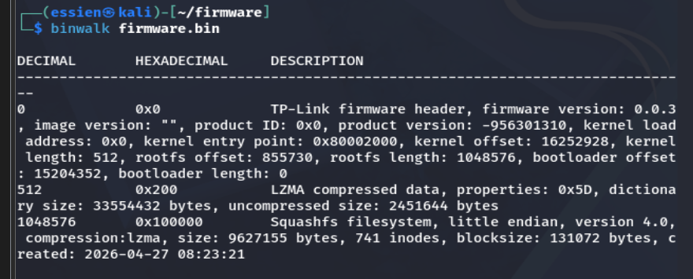
EVIDENCE — STEP 2
Binwalk Signature Scan
Talking points
Identified a TP-Link header, U-Boot bootloader string, and a SquashFS filesystem at a specific offset.
That offset is the target for extraction in the next step.
6

Slide 7
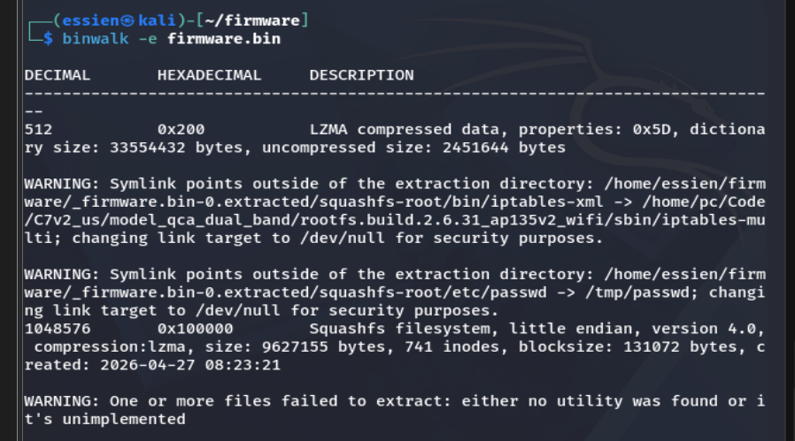
EVIDENCE — STEP 3
Binwalk Extraction
Talking points
binwalk -e carved out and decompressed the SquashFS image into a working squashfs-root directory.
Binwalk's own security warnings show it redirected two symlinks that pointed outside the extraction directory — expected on real-world firmware.
7

Slide 8
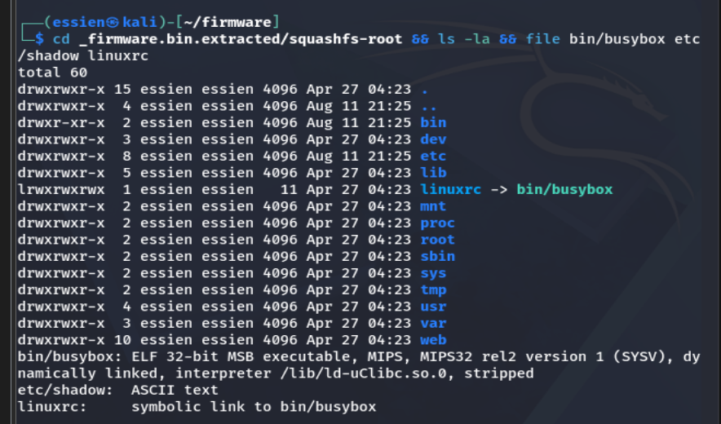
EVIDENCE — STEP 4
Root Filesystem Exploration
Talking points
Standard Linux layout: bin, etc, lib, usr, var.
Confirmed MIPS32 architecture, and that etc/shadow is plain text — normally unreadable on a live system.
linuxrc is a symlink to busybox, not a separate init binary — a normal embedded-Linux pattern.
8

Slide 9
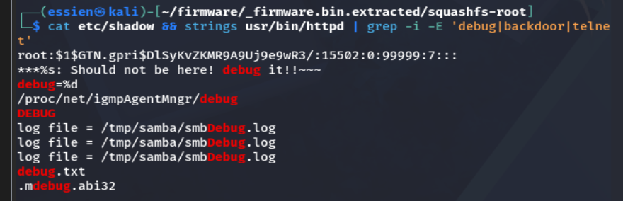
EVIDENCE — STEP 5 · KEY FINDING
Hardcoded Root Password Hash
Talking points
etc/shadow contains one hardcoded root password hash, using the weak MD5-crypt scheme ($1$).
Ships inside the public firmware image — anyone can extract it and attempt to crack it offline.
Searched usr/bin/httpd for "debug", "backdoor", "telnet" — found only mundane logging strings, no hidden shell.
That's a genuine, tested-for negative result — not an assumption.
9

Slide 10
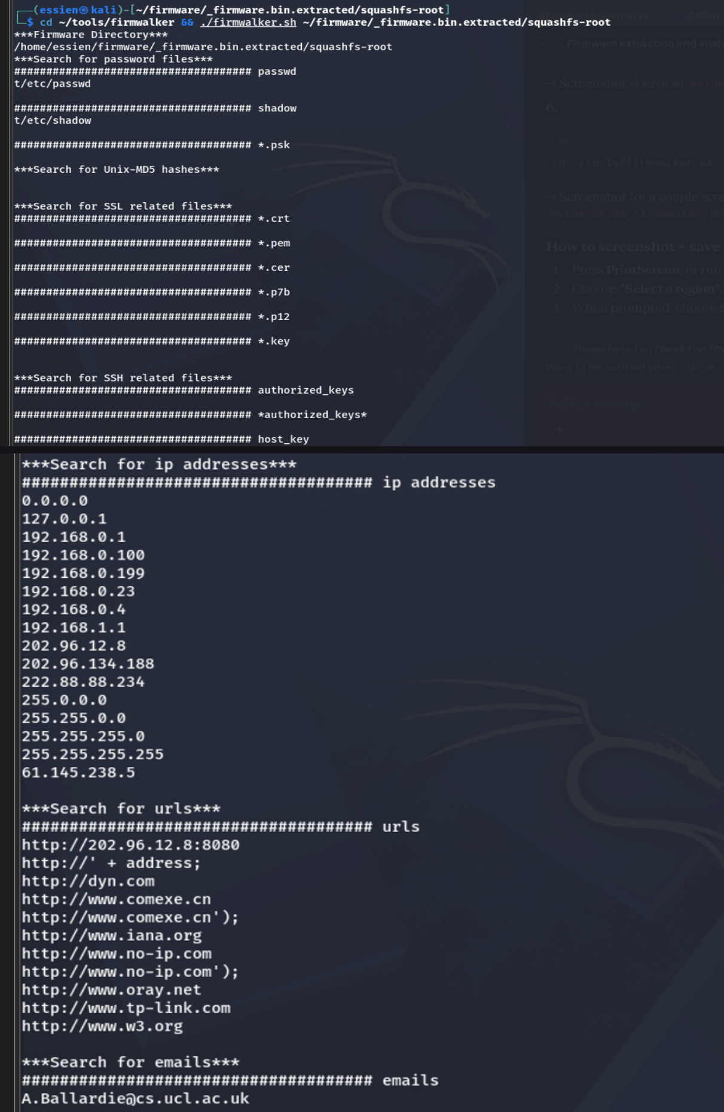
EVIDENCE — STEP 6
Firmwalker: Automated Cross-Check
Talking points
Confirmed the password/shadow finding independently.
SSL/SSH key searches (.pem, .key, .crt, id_rsa, authorized_keys) all came back empty — no private keys at rest.
No telnetd binary found anywhere — corroborates the manual search.
Found dropbear, scp, vsftpd, tftp — a broader service set than strictly necessary.
One false positive flagged: an embedded email from open-source routing code, not a leaked credential.
10

Slide 11
RESULTS
Findings & Risk Summary
Finding | Severity | Type
Hardcoded root password hash (weak MD5-crypt) | High | Positive
Bundled remote-access services (SSH, FTP, TFTP, SMB) | Medium | Positive
No private keys/certificates found at rest | Informational | Negative
No telnet/debug backdoor found | Informational | Negative
The mix of one real positive finding and two honestly reported negatives is a more credible outcome than a report that only ever confirms what it set out to find.
11

Slide 12
CLOSE
Recommendations & Conclusion
Recommendations
Conclusion
Device-unique root password / key-based login at first boot
Upgrade MD5-crypt to SHA-512-crypt or bcrypt
Disable unencrypted legacy services (TFTP, FTP) by default
Keep the good practice: no static private keys in firmware
Sign firmware images; verify signatures on-device
Static firmware analysis alone — no live device, no network traffic — surfaced one genuine, actionable weakness and two carefully tested negative results. That combination is a more defensible outcome for a Red Team exercise than a report that only confirms what it went looking for.
12

