Slide 1



Summary

Slide 2
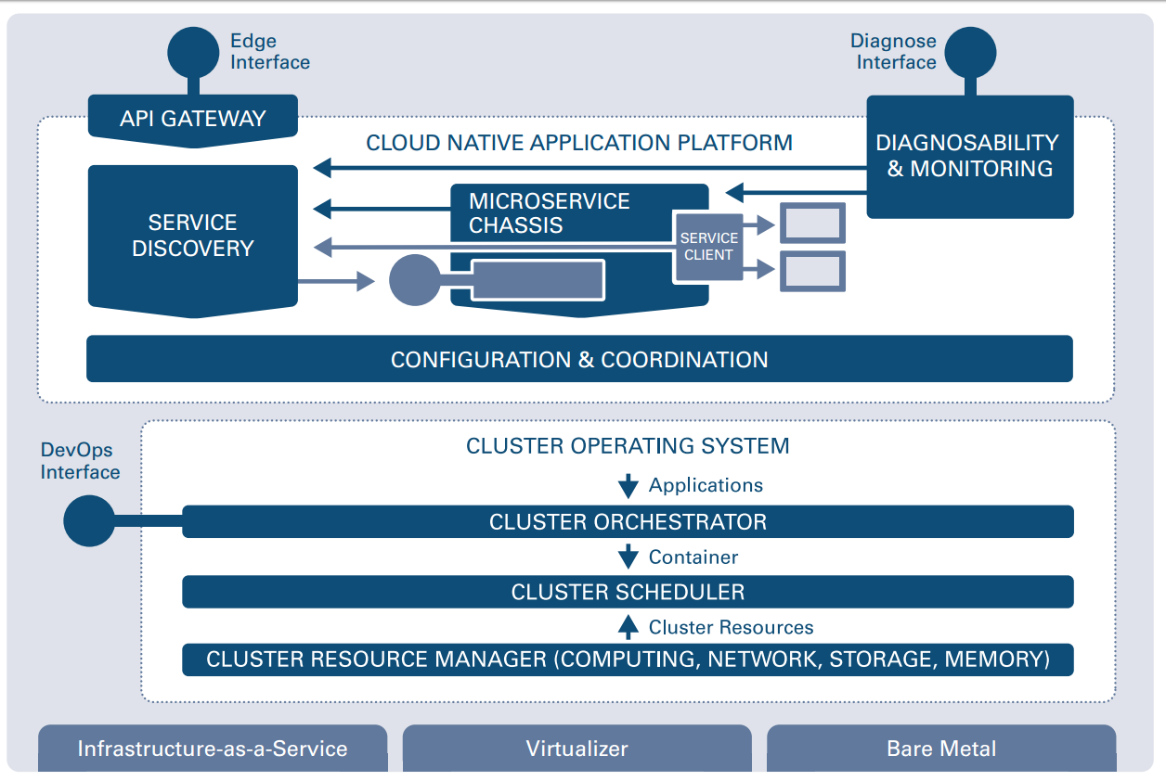
How to provide cluster-wide configuration and consensus?
How to access endpoints from the outside?
How to detect and resolve operational anomalies?
How to expose and find endpoints?
How to call other endpoints resilient and responsive?
How to execute an ops component?
How to run (containerized) applications on a cluster? How to automate standard operations procedures?
How to decouple from physical hardware?
How to provide the right resources for container execution? (e.g. for high utilization)

Slide 3
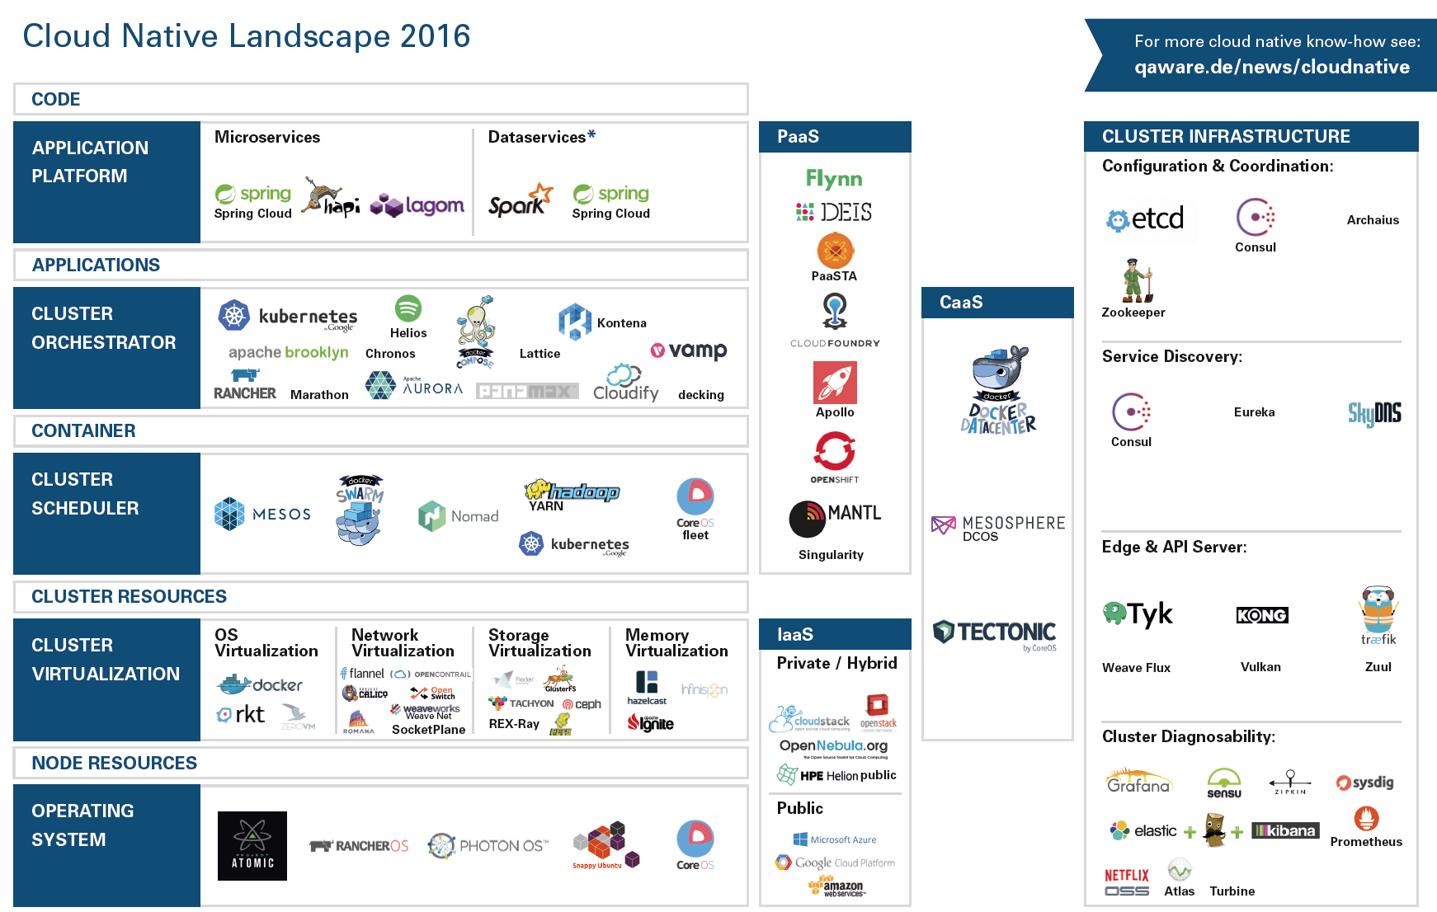

Slide 4
Sneak Preview: Kubernetes
Metadata
Basic abstractions
How to get a running cluster
Where to start

Slide 5
Sneak Preview: OpenShift v3
Metadata
Basic abstractions
How to get a running cluster
Where to start

Slide 6
Sneak Preview: Kontena
Metadata
Basic abstractions
How to get a running cluster
Where to start

Slide 7
Sneak Preview: Gestalt
Metadata
Basic abstractions
How to get a running cluster
Where to start

Slide 8

Play hard!

