Slide 1




Slide 2

GOALS
You are aware of the basic principles of Cloud Native Computing
You know how to use Docker as a Dev guy
You know how to use DC/OS as a Dev guy
You basically know how to use DC/OS as an Ops guy

Slide 3
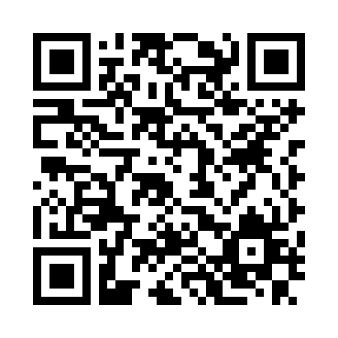
https://github.com/qaware/hitchhikers-guide-cloudnative
https://github.com/qaware/cloudnative-bootcamp
Notes:
Organizational notes:
Coffee break will be provided within AREA 42
Lunch break will be in our bistro right next to the area. Vouchers to get the lunch will be provided.
If ”normal” work interrupts you: you can use the other facilities of the area (lounge area with fat boys or other meeting rooms)

