Slide 1



Microservices

Slide 2
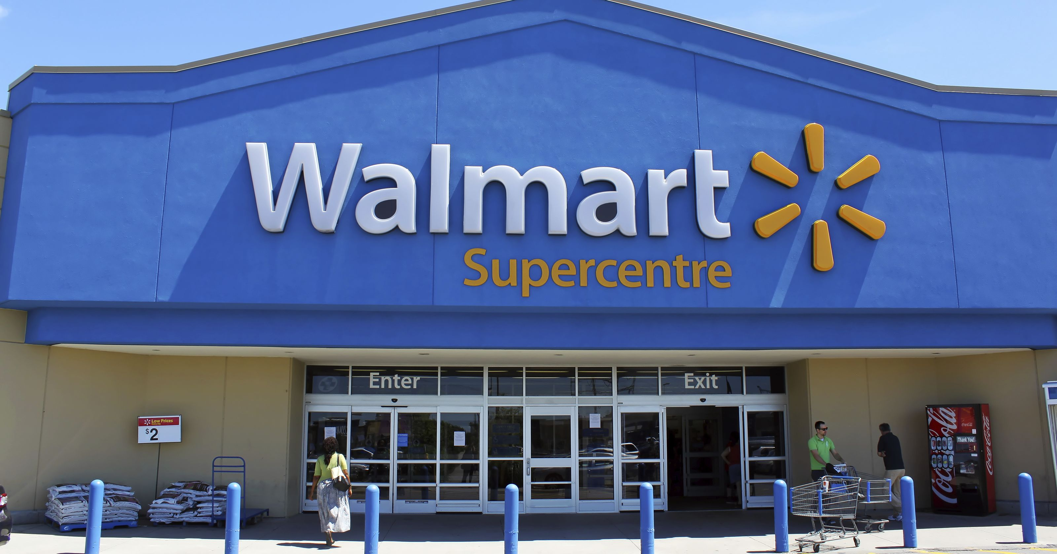

Slide 3
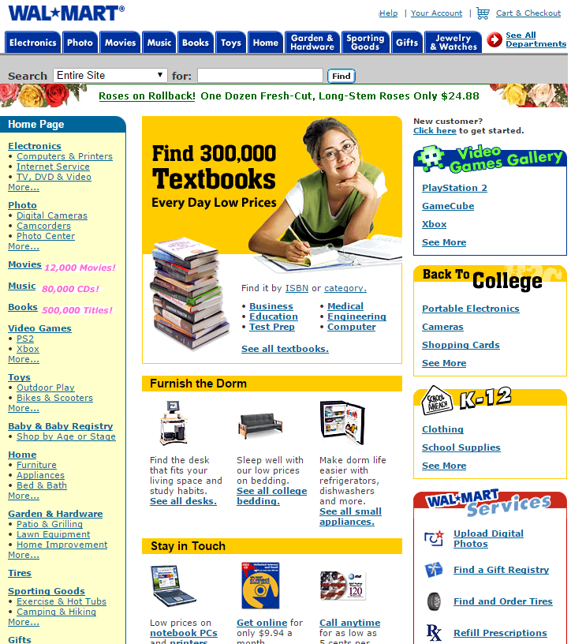
2002
Buying
Kaufprozess
Items

Slide 4
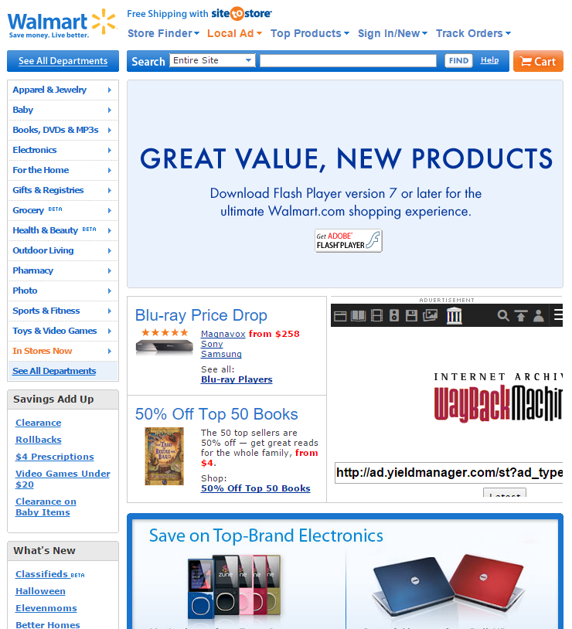
2008
Additional services

Slide 5
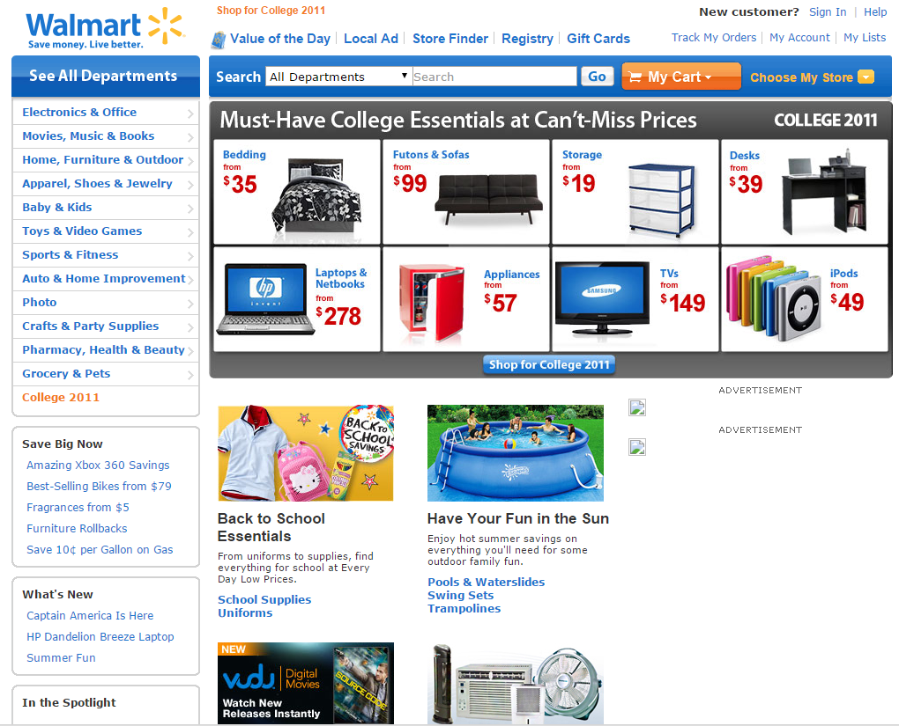
2011
Additional services (personalized)

Slide 6
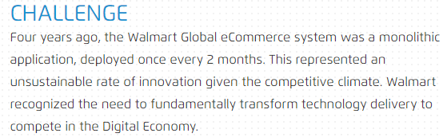
Long Change-to-Production
Walmart auf http://www.oneops.com
“[…] it was unable to scale for 6 million pageviews per minute and was down for most of the day during peak events.”
“This is the multi-million dollar question which the IT Department of Walmart Canada had to address after they were failing to provide to their users on Black Fridays for two years in a row.”
https://blog.risingstack.com/how-enterprises-benefit-from-microservices-architectures
Lacking scalability and elasticity

Slide 7
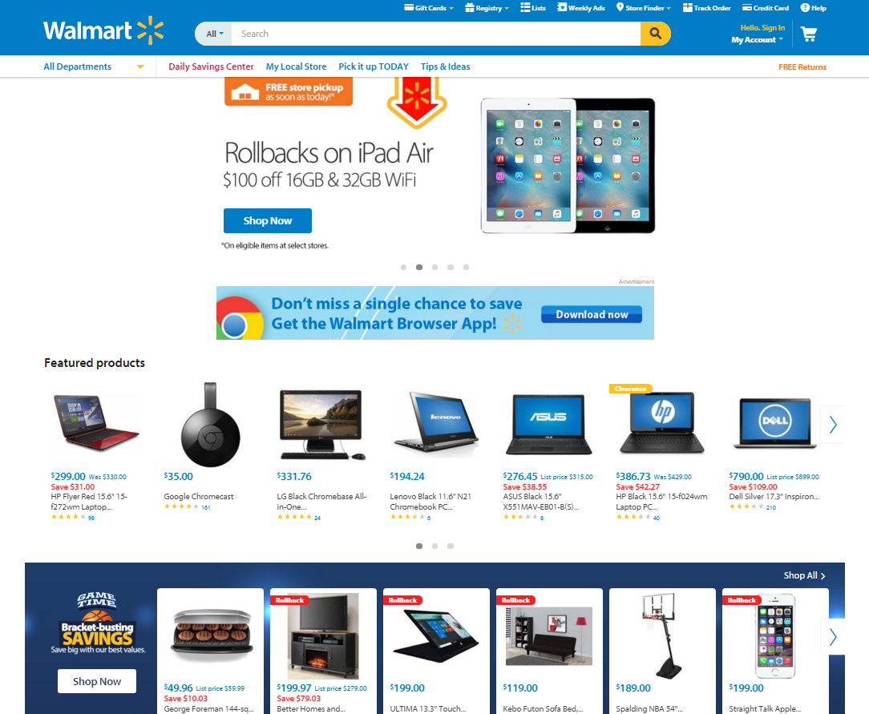
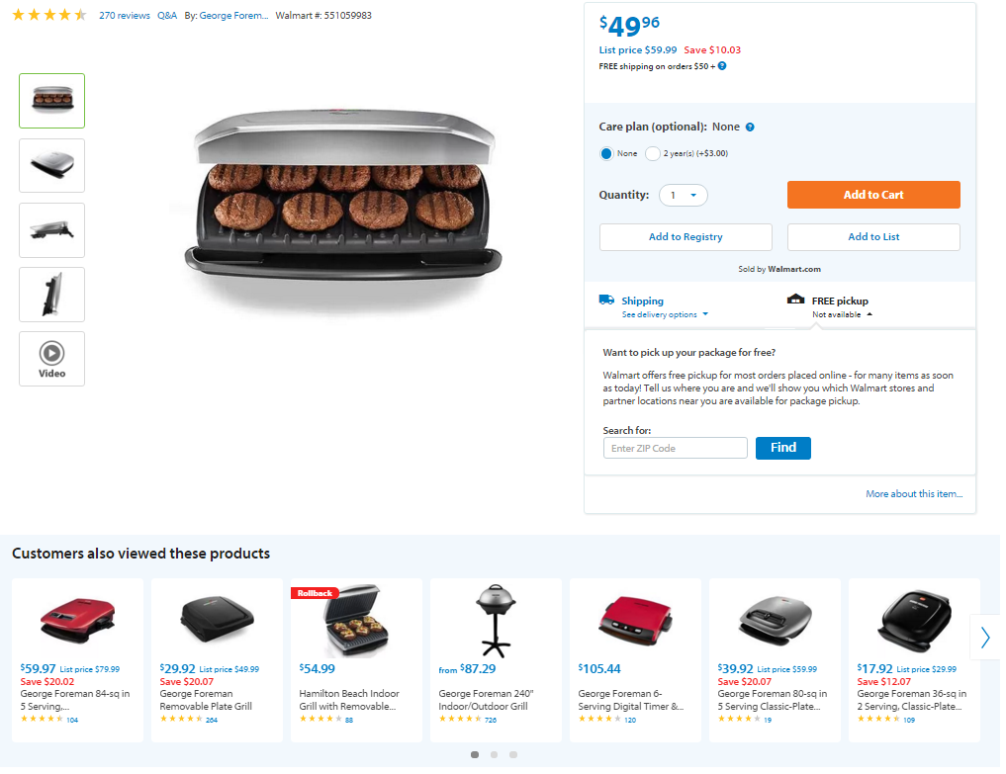
2016
Additional services
Zusätzliche Dienste (z.T. personalisiert)

Slide 8
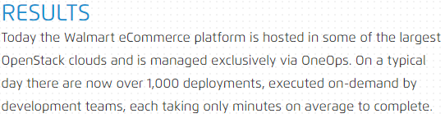
1,000 deployments a day
… triggered by dev teams
Walmart auf http://www.oneops.com
“They wanted to prepare for the world by 2020, with 4 billion people connected, 25+ million apps available, and 5.200 GB of data for each person on Earth.
Walmart replatformed […] with the intention of achieving close to 100% availability with reasonable costs.”
https://blog.risingstack.com/how-enterprises-benefit-from-microservices-architectures
~100% availability
“In fact, the organization reports that some 3,000 engineers […] drive 30,000 changes per month to Walmart software.”
“Those new applications, which span everything from mobile devices to the Internet of things (IoT), are crucial weapons in a global e-commerce contest that pits Walmart against the likes of Amazon and Alibaba, as well as a host of other rivals that are emerging as the cost of entry into the online retail sector continues to decline in the age of the API economy.”
http://www.baselinemag.com/enterprise-apps/walmart-embraces-microservices-to-get-more-agile.html
Enabled new kinds of applications (IoT, mobile, APIs) to compete globally
Resource efficiency
“The Walmart […] servers […] were able to handle all mobile Black Friday traffic with about 10 CPU cores and 28Gb RAM.”
“On Thanksgiving weekend, Walmart servers processed 1.5 billion requests per day. 70 percent of which were delivered through mobile.”
http://techcrunch.com/2014/12/02/walmart-com-reports-biggest-cyber-monday-in-history-mobile-traffic-at-70-over-the-holidays
Suitable scalability

Slide 9
What did they do?

Slide 10
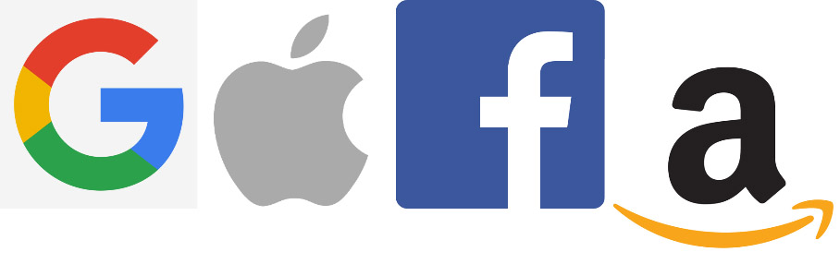
The GAFA inspiration
Elastically scale-out (hyperscale) in terms of traffic and data
Pay-as-you go: No opportunity costs (<10% ➔ 40-50% utilization; automate everything)
Feature race (continuous delivery): Develop, launch and operate a variety of features continuously

Slide 11
Step 1: Decomposition

Slide 12
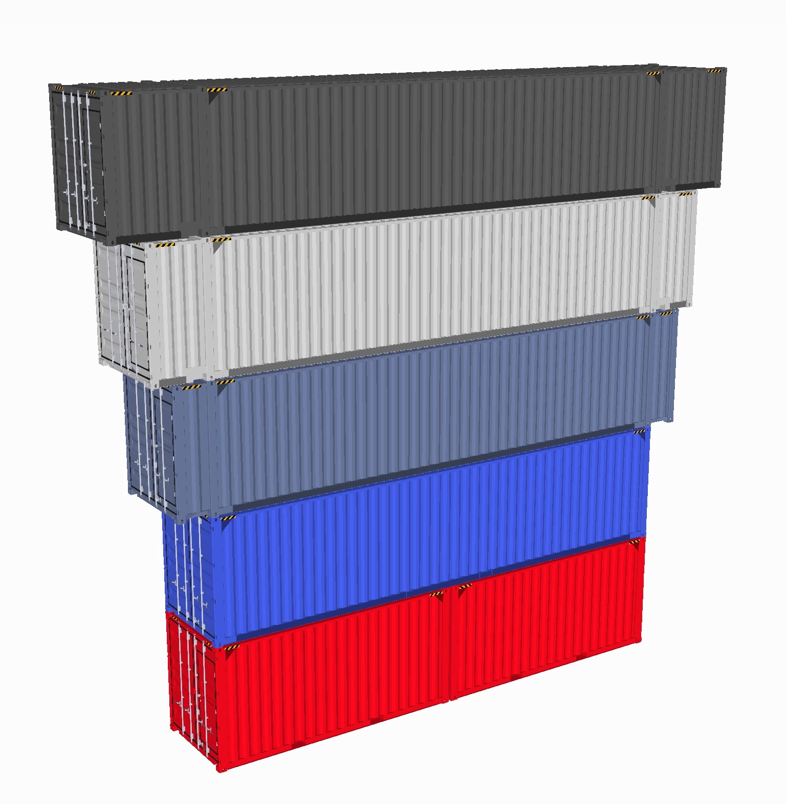
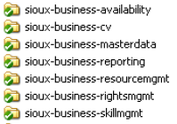
Components along the Software Lifecycle
DESIGN
BUILD
RUN
NEW!
Design Components
Dev Components
Ops Components
1:1
?:1
Complexity unit
Data integrity unit
Coherent and cohesive features unit
Decoupled unit
Planning unit
Team assignment unit
Knowledge unit
Development unit
Integration unit
Release unit
Deployment unit
Runtime unit (crash, slow-down, local access)
Scaling unit

Slide 13
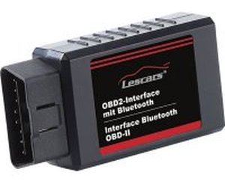

The Anatomy of an Ops Component
Internet Protocol
Container
Application
Diagnose Interface
Starting Inteface
Internet Protocol
Contraints:
Application does not use kernel space APIs (e.g. Oracle)
Application does not listen on random ports (e.g. RMI)
Application does not require an exotic operation system (e.g. z/OS)
Application uses endpoints (IPs and Ports) which can not be changed by file/envvar

Slide 14
Dev Components
Ops Components
?:1
Good starting point
System
Monolith
Subsystems
Macroservices
Components
Microservices
Services
Nanoservices
+
Decomposition trade-off
-
More flexible to scale
Runtime isolation (crash, slow-down, …)
Independent releases and deployments
Higher utilization possible
Distribution debt: Latency
Increasing infrastructure complexity
Increasing troubleshooting complexity
Increasing integration complexity

Slide 15

Step 2: Platformization
-
Distribution debt: Latency
Increasing infrastructure complexity
Increasing troubleshooting complexity
Increasing integration complexity
Good Infrastructure Stack!

Slide 16
The Cloud Native Stack
Cloud Native App Platform
Services
Classical Applications
Cluster Orchestrator
Applications
Cluster Scheduler
Container
Virtualization
Resources

Slide 17
The Cloud Native Stack
Cloud Native App Platform
Services
Classical Applications
Cluster Orchestrator
Applications
Cluster Scheduler
Container
Virtualization
Resources

Slide 18
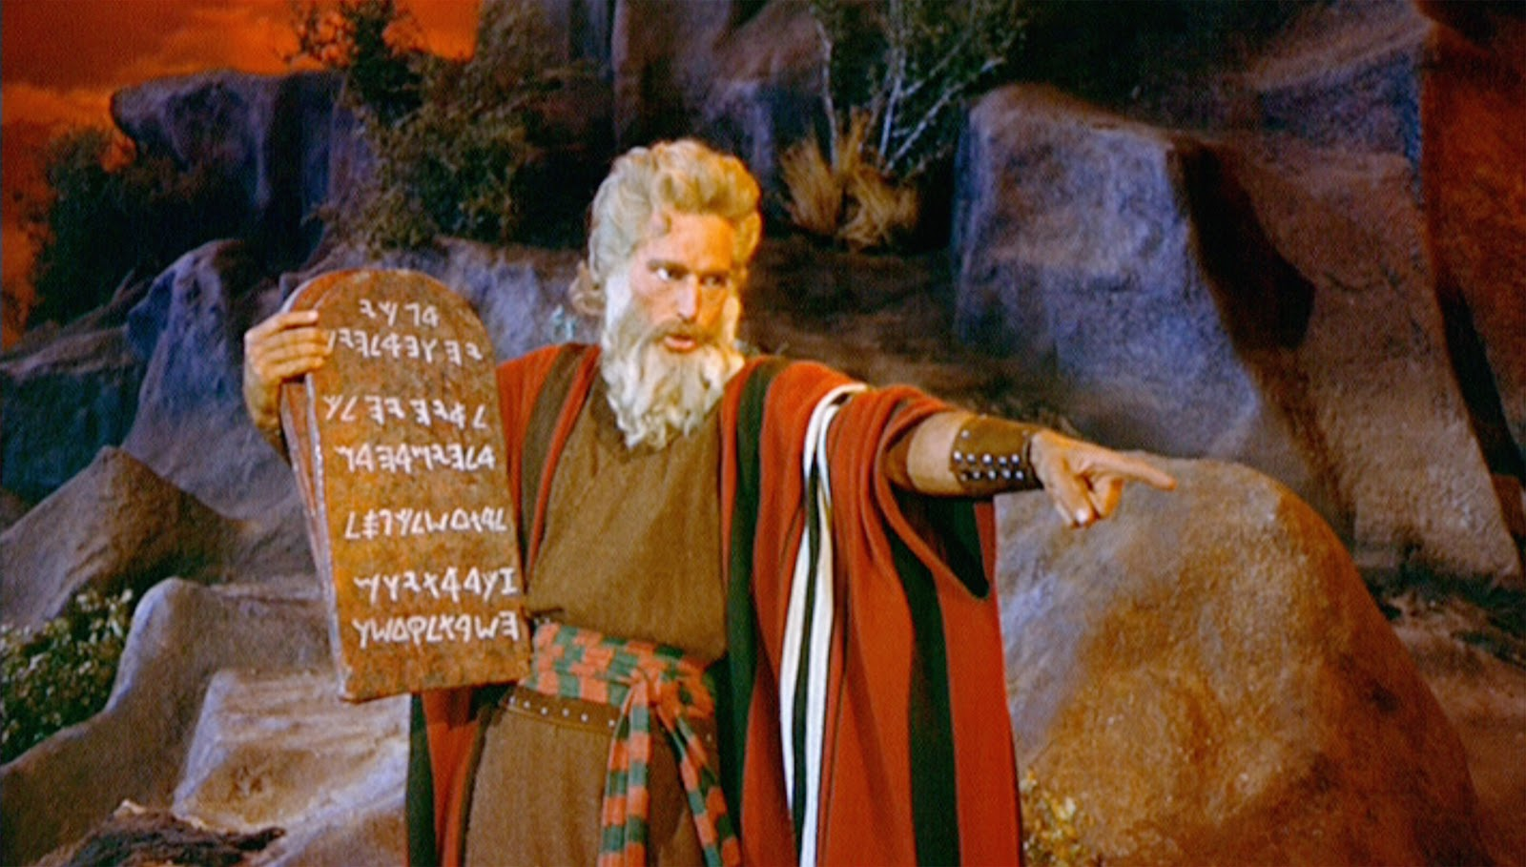
The 3 Cloud Commandments:
Everything Fails All The Time
Focus on MTTR not MTTF
Scale out not up

Slide 19
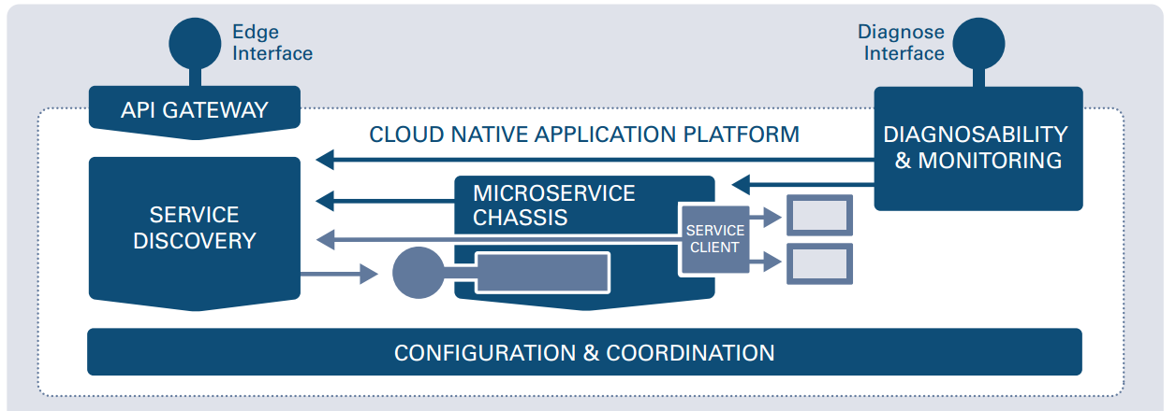
How to provide cluster-wide configuration and consensus?
How to access endpoints from the outside?
How to detect and resolve operational anomalies?
How to expose and find endpoints?
How to call other endpoints resilient and responsive?
How to execute an ops component?

Slide 20
The Cloud Native Stack
Cloud Native App Platform
Services
Classical Applications
Cluster Orchestrator
Applications
Cluster Scheduler
Container
Virtualization
Resources

Slide 21
Ops Components can also be carved out of Classical Software.
Sample:
Ops component
NGINX
Ops component but has to be integrated into the cloud infrastructure
Replace with cloud infrastructure
Tomcat
Ops component. Possible modifications:
Configure used endpoints by environment variables
Remove cross-instance state
MySQL
Single instance
Use a cluster-version like Galera or Vitess
Operate outside of the cloud

Slide 22
Step 3: Establish Continuous Delivery

Slide 23
Continuous Delivery
Process
Dev
Ops
CI
Containerize
Orchestrate
Code
Package
Package
App
Organization
Infrastructure
Cluster Operating System

