Slide 1

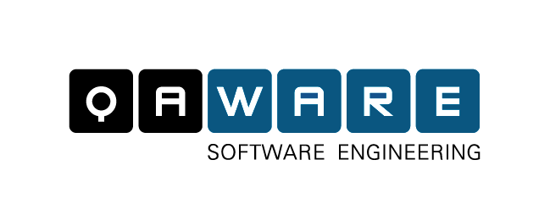
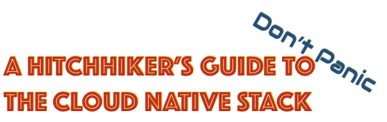
Summary

Slide 2
The Cloud Native Stack
Cloud Native Application Platform
Classical Applications
Cloud Native App
Cluster Operating System
Cluster Orchestrator
Applications
Cluster Scheduler
Container
Cluster Virtualization
Resources

Slide 3
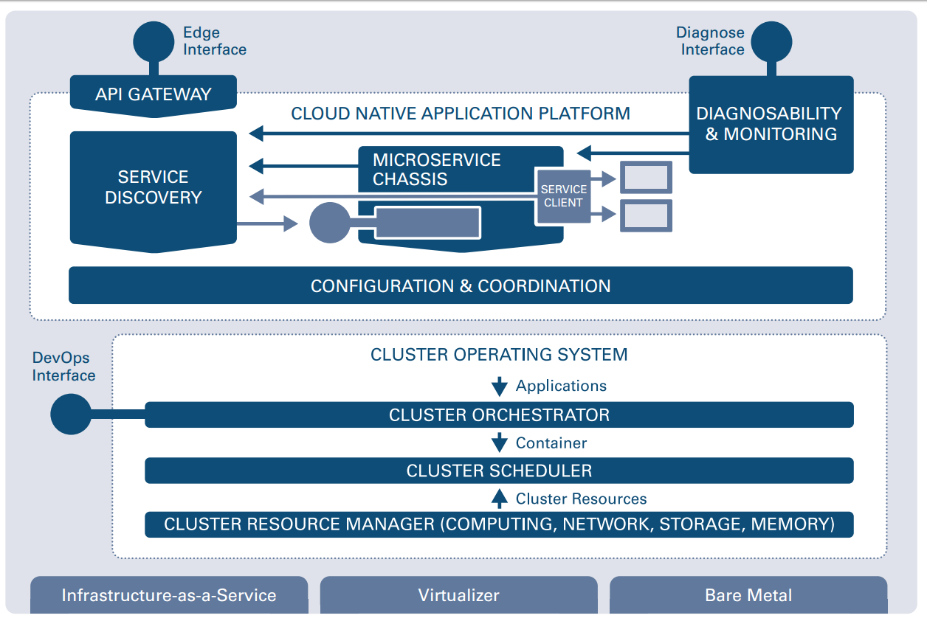
How to provide cluster-wide configuration and consensus?
How to access endpoints from the outside?
How to detect and resolve operational anomalies?
How to expose and find endpoints?
How to call other endpoints resilient and responsive?
How to execute an ops component?
How to run (containerized) applications on a cluster? How to automate standard operations procedures?
How to decouple from physical hardware?
How to provide the right resources for container execution? (e.g. for high utilization)

Slide 4
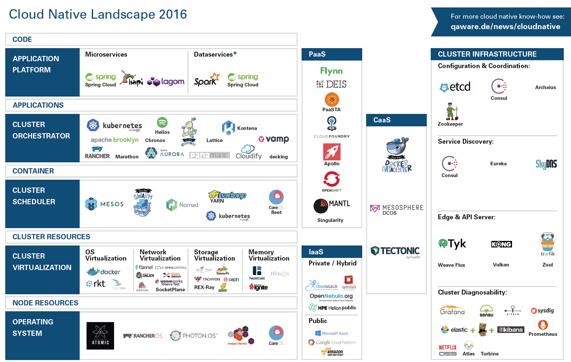

Slide 5
Sneak Preview: Kubernetes

Slide 6
Sneak Preview: OpenShift v3

Slide 7
Sneak Preview: Kontena

Slide 8
Sneak Preview: Gestalt

