Slide 1

QUANTITATIVE WEATHER PREDICTION ON POLYMARKET
Seattle Weather Forecast
Project Presentation

Slide 2
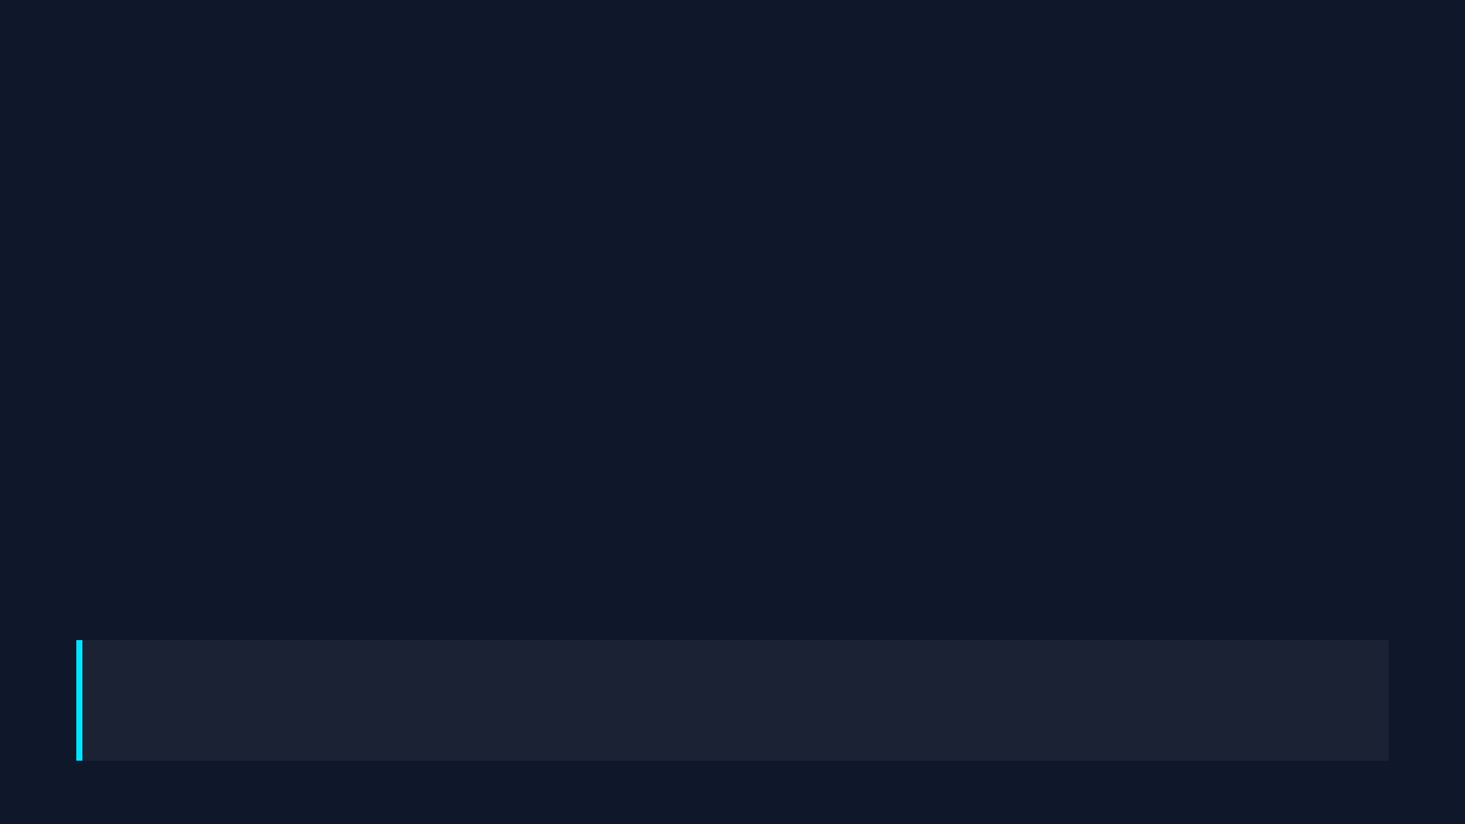
Background: Climate Derivatives & Polymarket
Why target weather on Polymarket?
Opportunities in Current Pricing
• The "Seattle High Temp" market resolves daily based on exact degree increments (e.g., 58-59°F).
• Many participants rely on consumer-grade apps or local news, which often have slight delays in updates.
• High retail participation can create short-term pricing inefficiencies, especially during seasonal transitions.
• This creates a window where algorithmic models can identify and act on latency gaps.
Goal: Leveraging Machine Learning to build a data-driven informational advantage and capture consistent returns.

Slide 3



Data Acquisition: Challenges & Current State
Early Challenges
Current Architecture
Web-scraping limitations:
Aviation Channels (KSEA):
• Initial attempts to scrape consumer weather sites resulted in delayed, low-resolution data.
• Transitioned to the professional Aviation Weather Center (AWC) APIs targeting Seattle-Tacoma.
Incompatible Archives:
• Historical data packages frequently contained mismatched timestamps and units.
Raw METAR Text:
• Ingesting raw terminal text strings directly to ensure low-latency, accurate measurements.
Data continuity issues:
• Unpredictable data gaps disrupted time-series modeling.

Slide 4
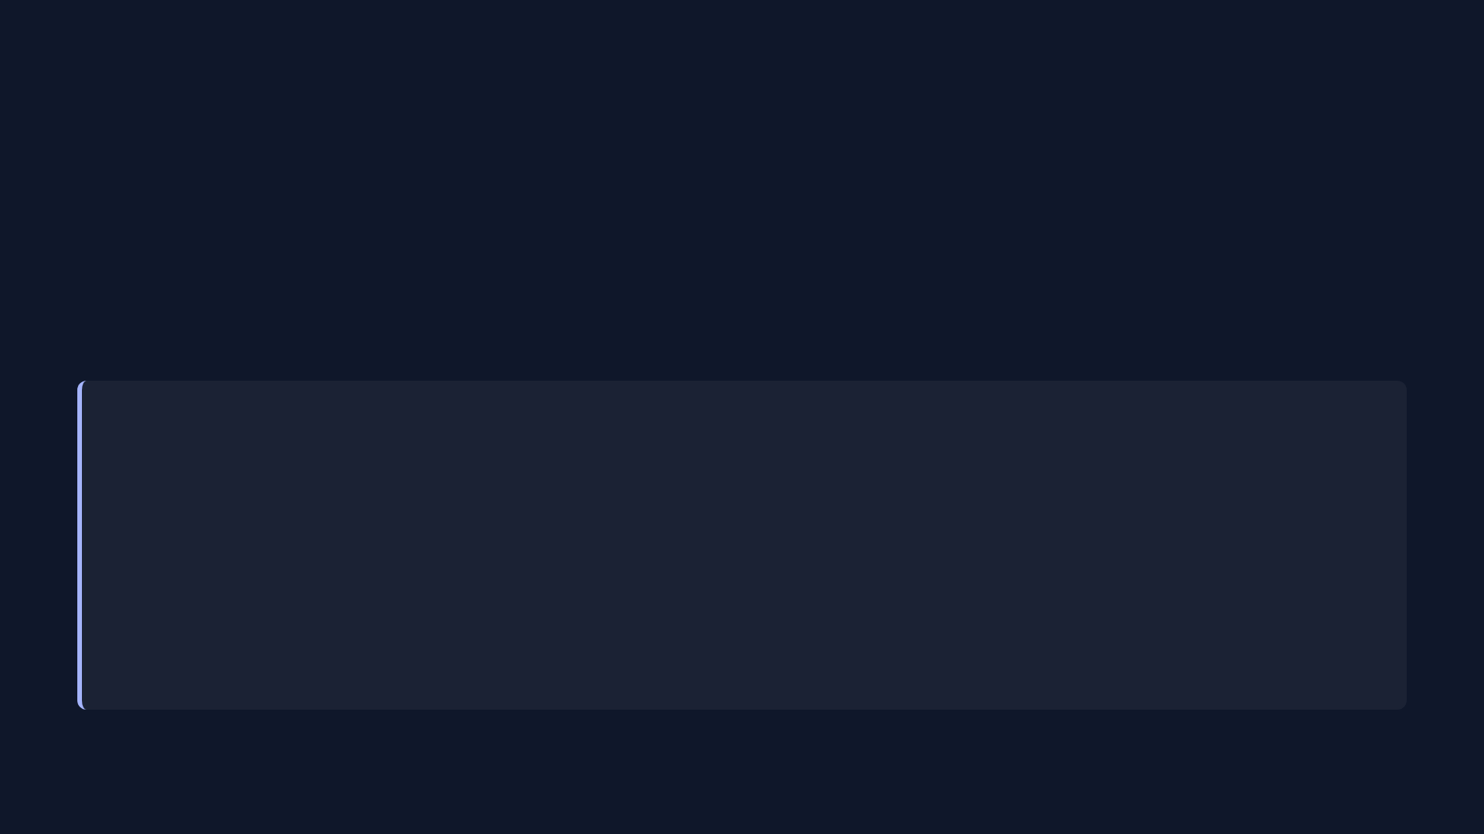
Feature Engineering & Signal Extraction
Parsing the Data
METAR strings contain dense meteorological data. Standardized parsing pipelines extract temperature, pressure, and wind into clean numerical vectors.
Core Engineered Features
Pressure Trends:
Dew Point Spread:
• 3-hour trailing slopes to identify approaching high-pressure systems.
• Estimating saturation risk for fog formation vs. clear-sky conditions.
Wind Shear Translation:
Solar Radiation Windows:
• Converting polar degrees into continuous Sine/Cosine vector components.
• Aggregating cloud-cover codes into a continuous solar radiation impact index.

Slide 5

Data Pipeline & Normalization
Local Data Architecture
To ensure responsive UI performance without hitting API rate limits, METAR histories are synchronized to a local SQLite database (`app_database.db`).
Data Preprocessing
Before entering the model, missing intervals are patched via forward-filling and polynomial interpolation to preserve interval spacing.
Feature Normalization
Engineered features undergo Z-score normalization and clipping to provide standardized inputs, which ensures stable gradient descent during training.

Slide 6
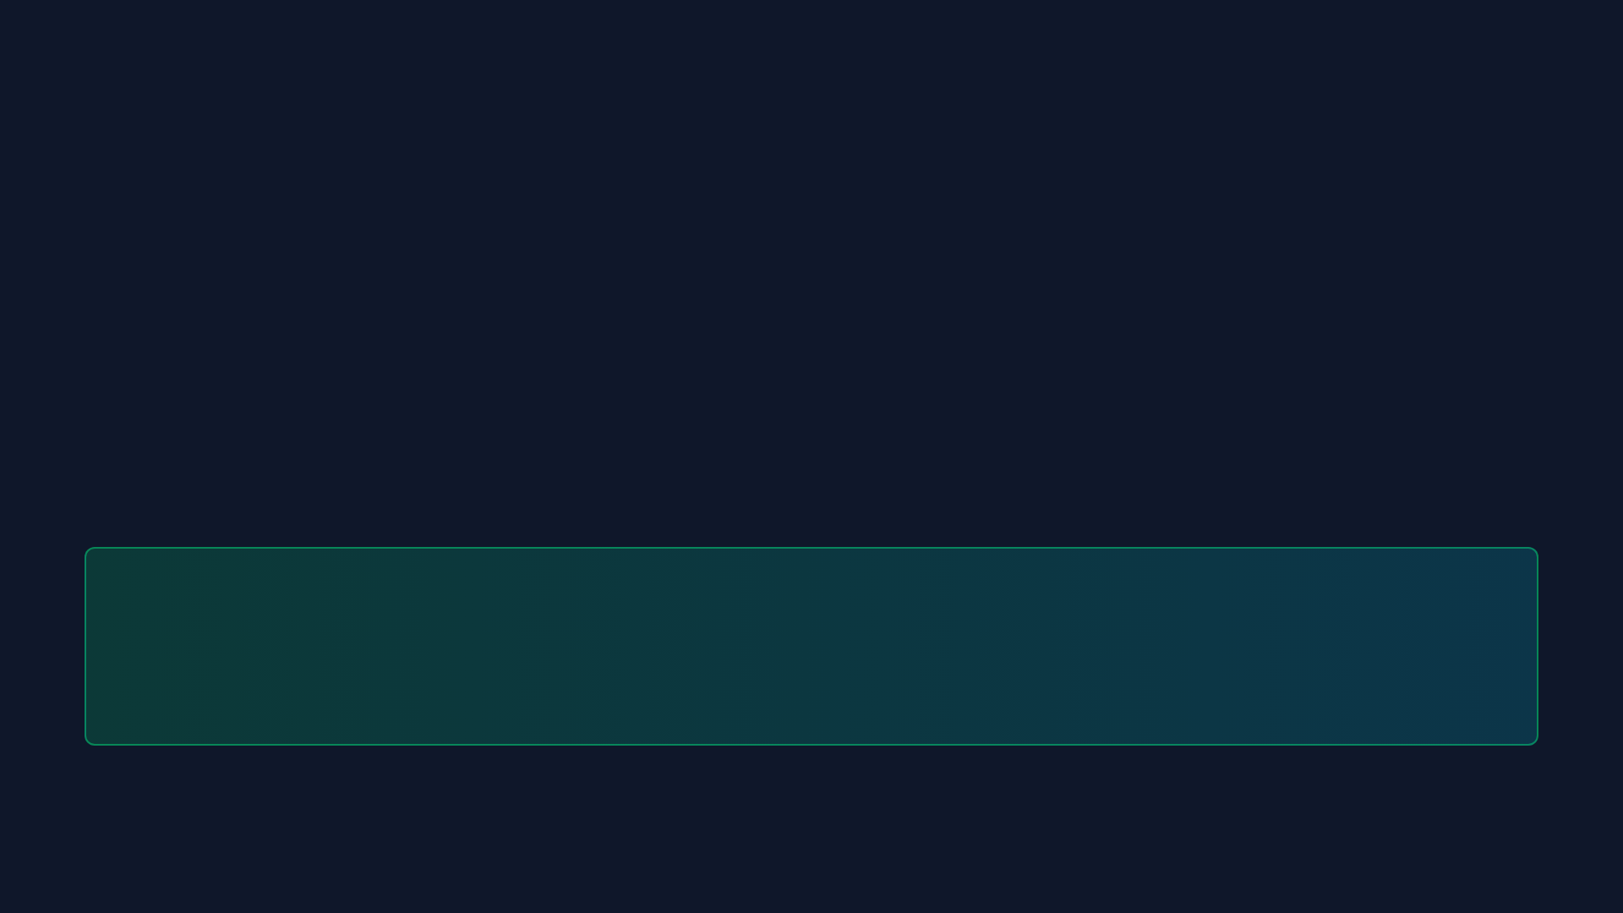
Model Strategy: Why this Stack?
Limitations of LSTMs Alone
Limitations of Trees Alone
While excellent at recognizing multi-day momentum (e.g., a continuous warming trend), recurrent networks can struggle to react quickly to abrupt, immediate environmental changes.
Decision trees natively excel at modeling instantaneous non-linear interactions but lack built-in temporal sequence memory to track weather fronts progressing over multiple days.
The Synthesis
A stacked approach: The LSTM handles temporal sequence representations, passing its rolling outputs as features into a final LightGBM layer to form a more robust unified model.

Slide 7
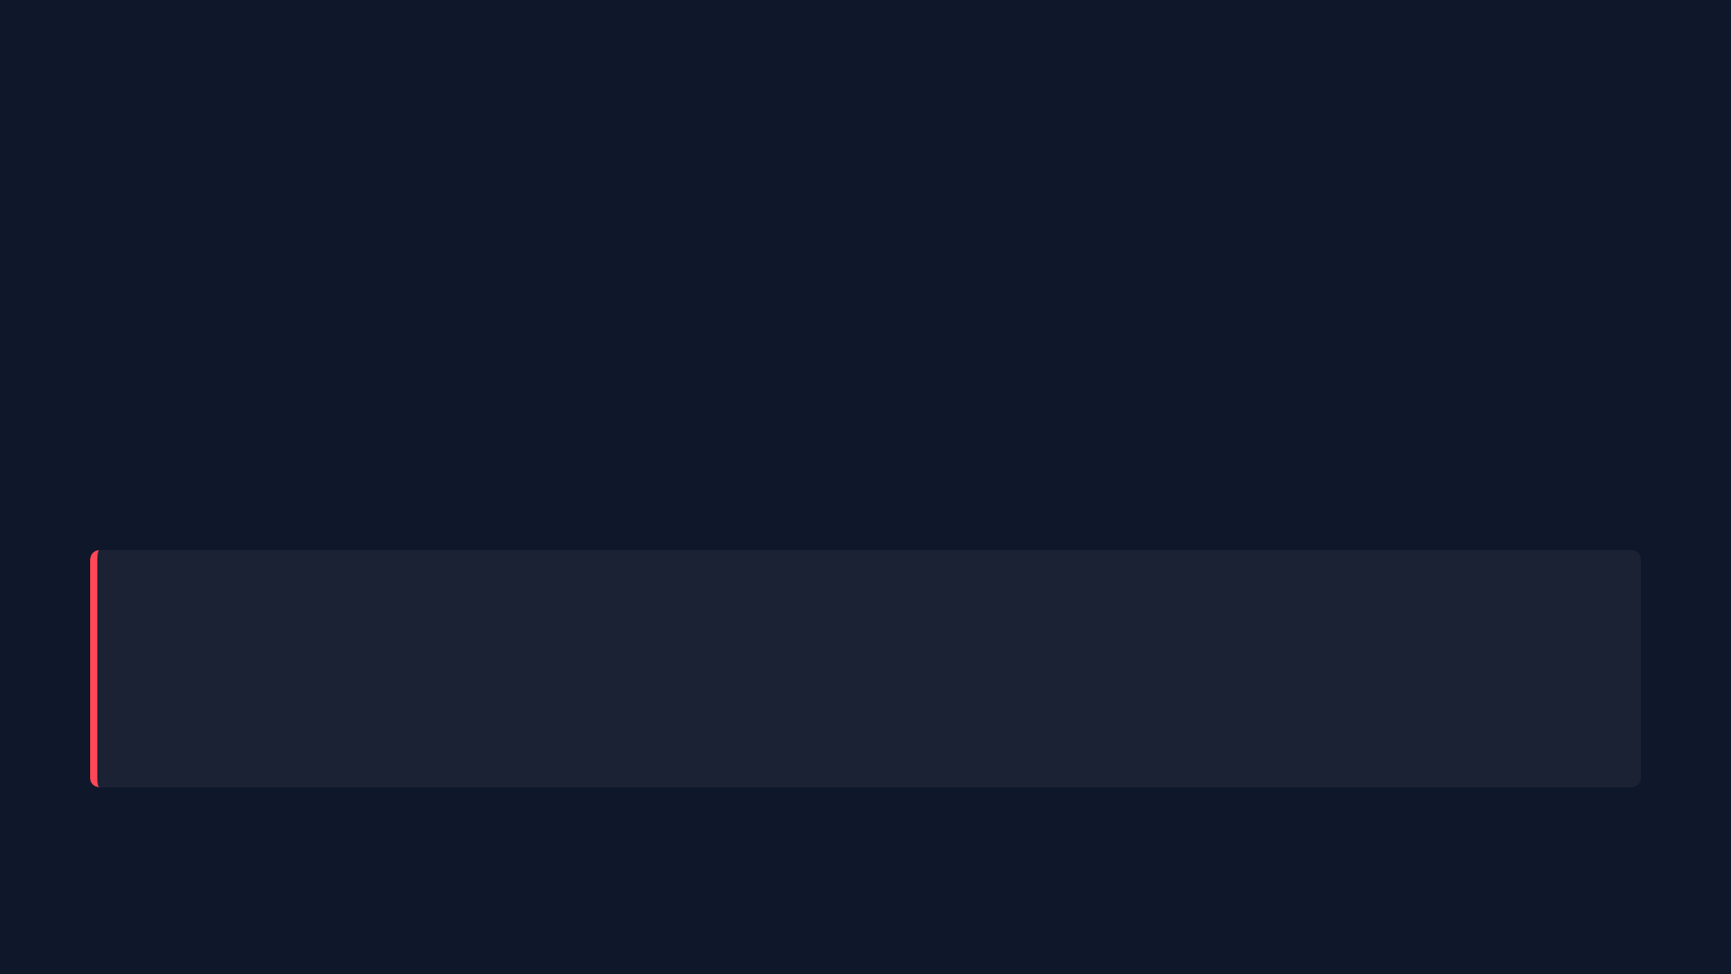
Model Architecture Execution
Component 1: Long Short-Term Memory (LSTM) Embeddings
Process the last 120 hours of meteorological data via a recurrent network to generate base thermal predictions.
Component 2: LightGBM Residual Corrector
LGBM models the residuals (errors) from the LSTM, utilizing current hour readings to refine the final output prediction.
Production Readiness
The entire stacked pipeline is serialized into static artifacts to ensure consistent daily operations and rapid deployment.

Slide 8

Model Performance & Achievements
FINAL TEST SET MAE
0.58 °C
Operational Significance:
• Polymarket resolves brackets in nominal 1-degree (Fahrenheit) intervals. Maintaining narrow error bounds is critical for accurate modeling.
The Final Assessment:
• Achieving a sub-0.6 degree MAE provides a statistical edge over standard public meteorological models, creating consistent expected value in prediction markets.

Slide 9
Terminal UI: Operator Focus (1/5)
Moving Beyond Notebooks
Signal Clarity
• Standard data science notebooks can be inefficient for the real-time tracking requirements of active trading.
• Focusing exclusively on actionable metrics: identifying market mismatches and validating model reasoning.
• Transitioned to a structured UI layout tailored for live monitoring and clear information hierarchy.
• Using high-contrast deltas on a monospaced layout to ensure readability.

Slide 10

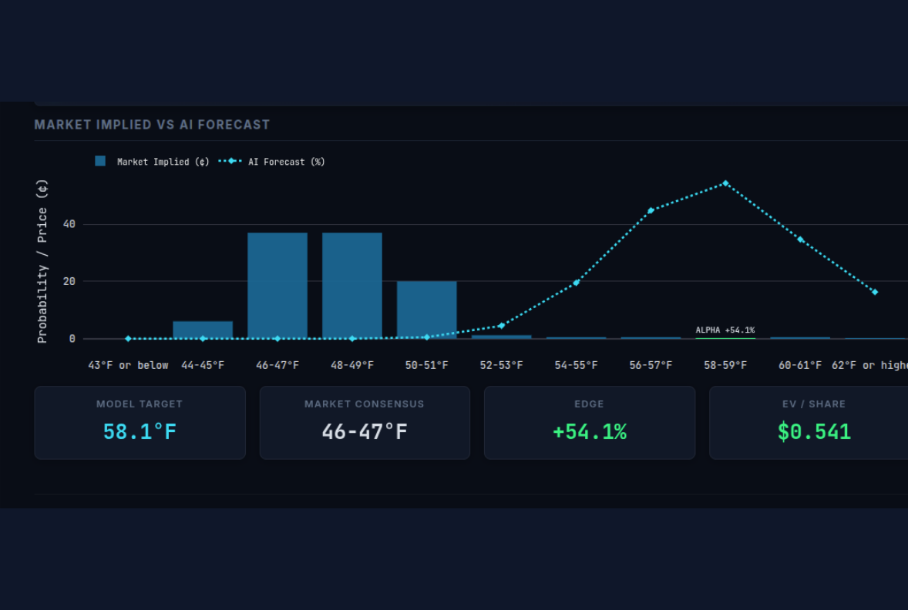
Terminal Drilldown: Identifying Opportunities (2/5)
The Probability Layering:
• Comparing the Market Implied probability (Solid Blue Bars) directly against the Model Probability Distribution (Cyan Dashed Line).
Opportunity Calculation:
• Automated calculation of expected Edge and overall Expected Value per share.
Signal Detection:
• Visually identifying specific brackets where market pricing significantly deviates from the model's forecast.

Slide 11
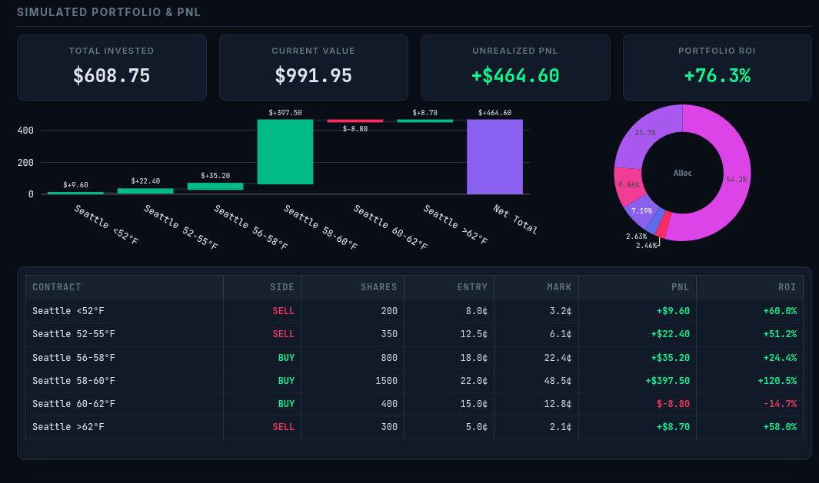
Terminal Drilldown: Position Management (3/5)
PnL Waterfall Chart:
• Visualizing performance breakdown across varying contracts.
Allocation View:
• Capital clustering segmented for quick verification of asset distribution limits.
Live Updates:
• Real-time execution details and PnL tracking updated natively without requiring manual page reloads.

Slide 12

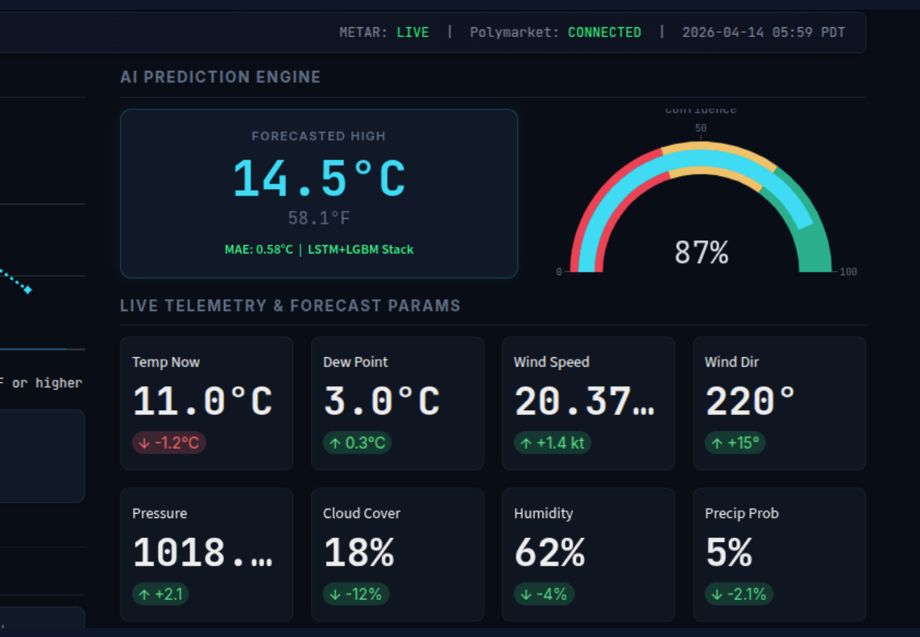
Terminal Drilldown: Diagnostic Radar (4/5)
Confidence Gauge:
• Displaying the model's confidence ranking for current targets, providing context beyond a single deterministic output.
Live Telemetry Grid:
• Providing immediate situational awareness of physical measurements.
Delta Mapping:
• Displaying current versus previous values directly under primary metrics to highlight significant recent changes in environmental conditions.

Slide 13
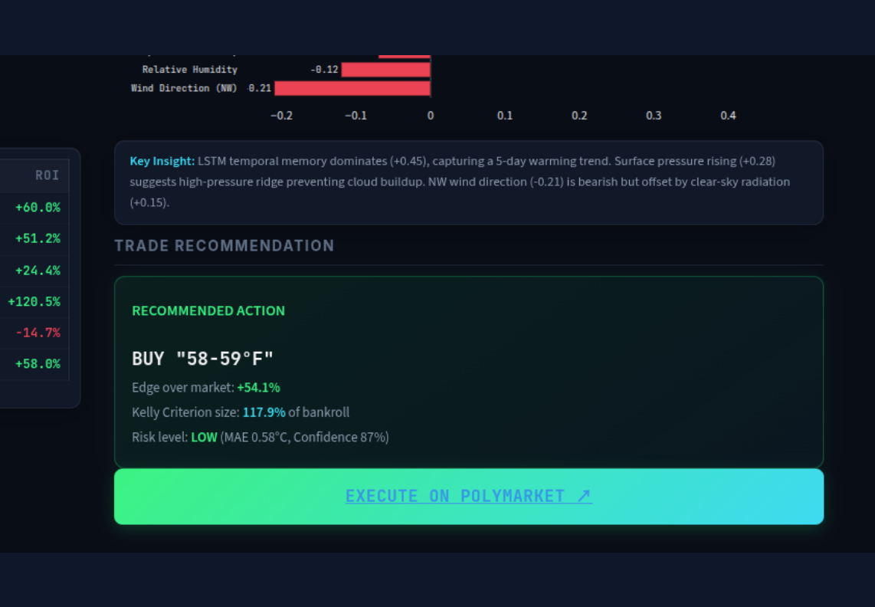
Terminal Drilldown: Trade Execution (5/5)
Decision Transparency:
• Providing insight into which meteorological features are driving the current prediction via the Decision Matrix.
Sizing Guidance:
• Utilizing the Kelly Criterion to estimate statistically optimal bet sizing to manage bankroll risk.
Direct Market Access:
• Integrated links direct users to the specific Polymarket contract for seamless execution.

Slide 14
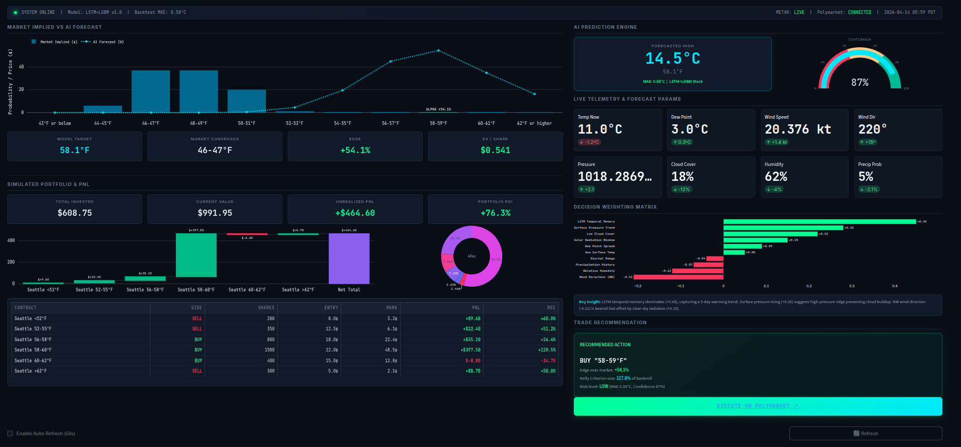
Terminal Full view

Slide 15

Future Roadmap: Project Expansion
V2 Phase: Multi-City Coverage
V3 Phase: Automated Execution
• Scaling data pipelines to encompass additional high-volume betting geographies, like Chicago, New York, and Austin.
• Exploring radar and satellite imagery parsing for enhanced local modeling.
• Integrating Web3 APIs to enable automated limit-order execution directly from the Python backend.

Slide 16

Q & A
DEMONSTRATION CONCLUDED

