Slide 1

P e a r

Slide 2

P e a r

Slide 3

P e a r
A nutrition recording app

Slide 4


梨子滞销
帮帮我们

Slide 5

Perfect Eating Audition Rehearsal
TAP TO TAKE PICS
1588 Kcal
+

Slide 6



v
MY PEAR
Sign in/sign up
Set my goals
TAP TO TAKE PICS
Track my diets
More tools
About PEAR
Quick search

Slide 7

vs
MY PROFILE
SET MY GOALS
What is your goal?
Height
Lose weight
Weight
Maintain weight
Waist Circumference
Gain weight
Just self-monitoring

Slide 8
TRACK MY DIETS
MORE TOOLS
1588 Kcal
BMI Calculator
Total Energy Intake
REE Calculator
Carbohydrates
245 g
Waist-Hip Ratio
Protein
45 g
Water Intake Calculator
Fat
29 g

Slide 9
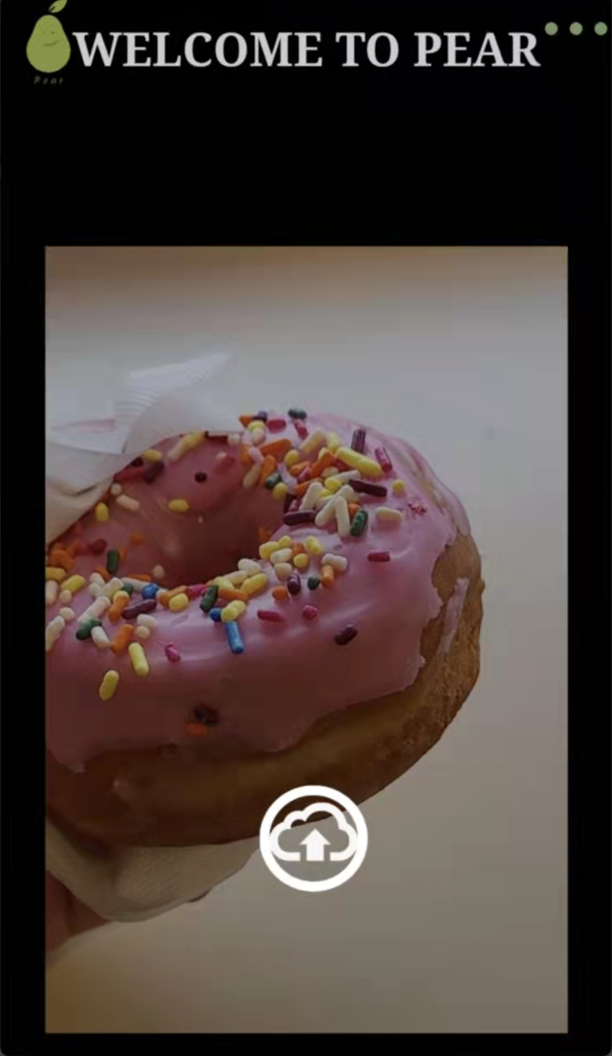
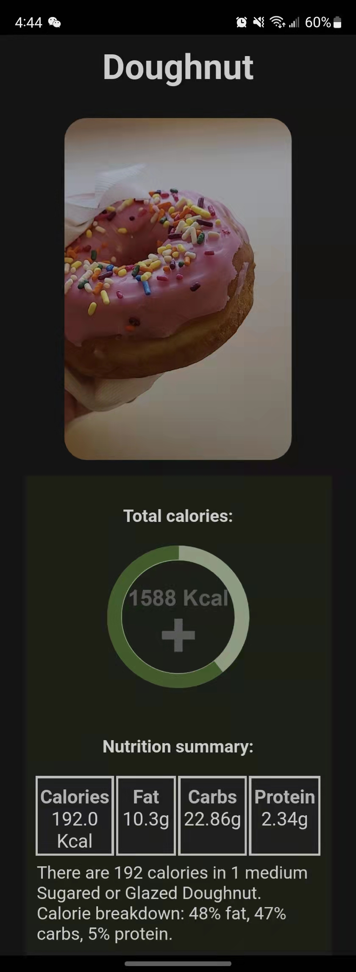

Slide 10
vs
MY PEAR
MY PROFILE
MORE TOOLS
Sign in/sign up
Set my goals
Height
BMI Calculator
Track my diets
Weight
REE Calculator
More tools
Waist Circumference
Waist-Hip Ratio
About PEAR
Water Intake Calculator
Quick search

Slide 11
TRACK MY DIETS
SET MY GOALS
What is your goal?
1588 Kcal
Lose weight
Total Energy Intake
Maintain weight
Carbohydrates
245 g
Gain weight
Protein
45 g
Just self-monitoring
Fat
29 g

Slide 12

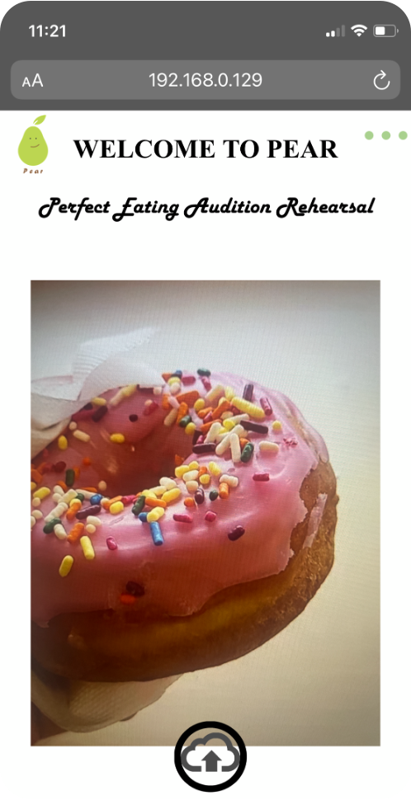

Slide 13



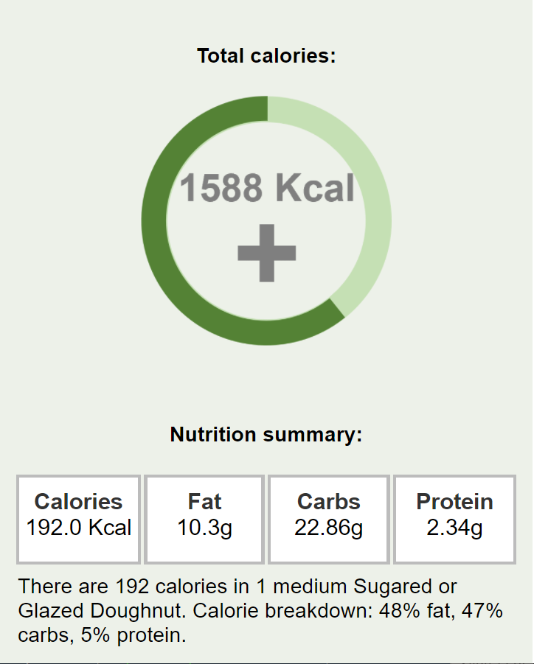
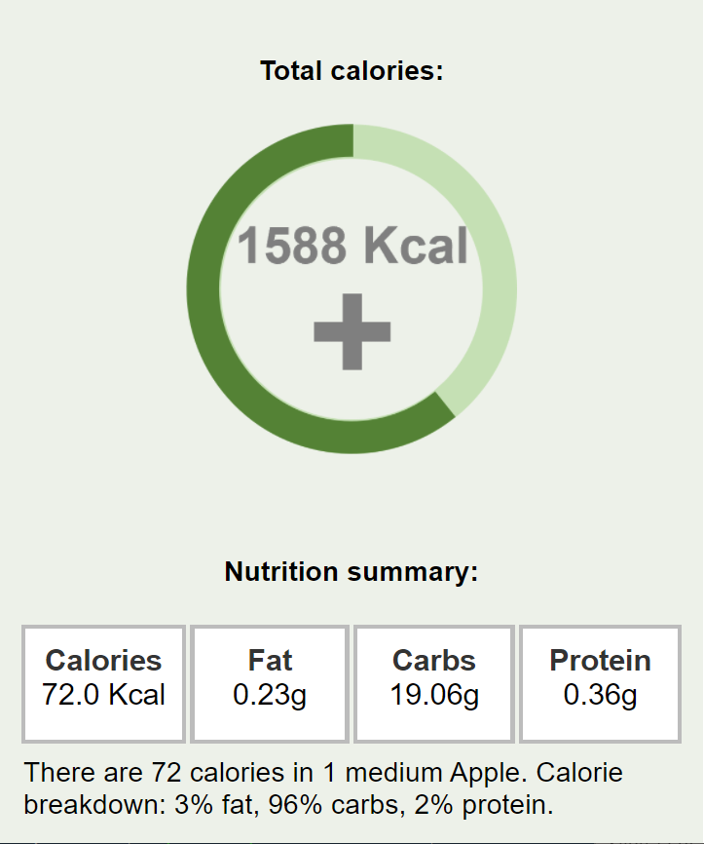
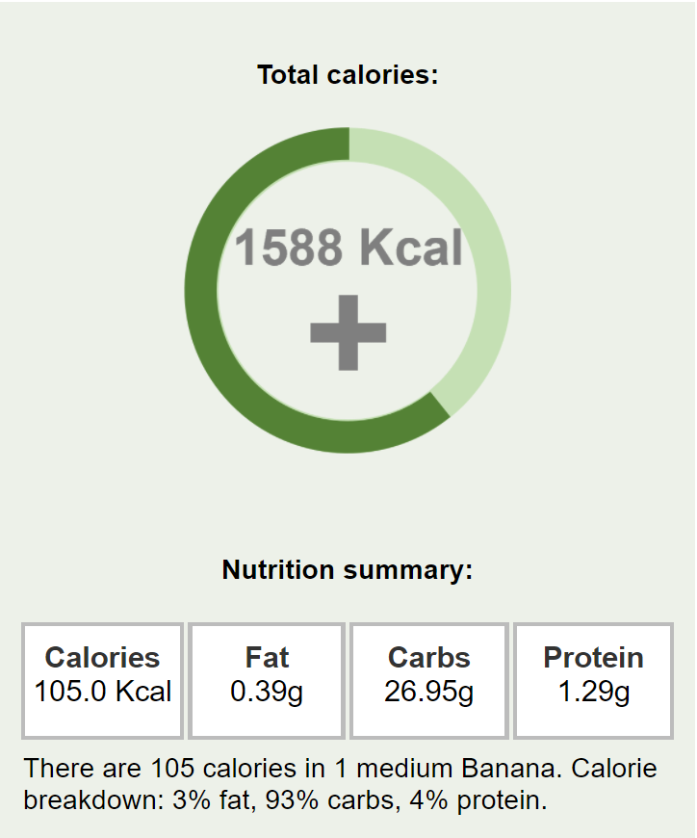

Slide 14
