Slide 1

P e a r

Slide 2

P e a r

Slide 3

P e a r
A nutrition recording app

Slide 4

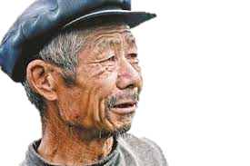
梨子滞销
帮帮我们

Slide 5

Perfect Eating Audition Rehearsal
TAP TO TAKE PICS

