Slide 1
PointNet: 3D Classification and Segmentation
Michael Hodges, Rishabh Shukla
Notes:
Add drawing cartoon

Slide 2
Agenda
Introduction
Detailed Implementation
Results. Do they match expectations
Differences and improvements compared to previous works
Challenges met and solutions
Contributions of each team member
Notes:
Slide for reference while developing only

Slide 3
Agenda
Introduction
Detailed Implementation
Results. Do they match expectations
Differences and improvements compared to previous works
Challenges met and solutions
Contributions of each team member

Slide 4

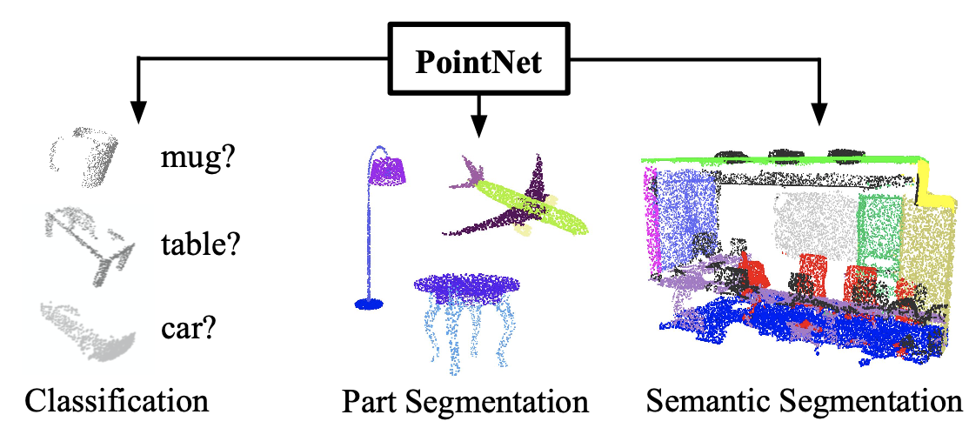
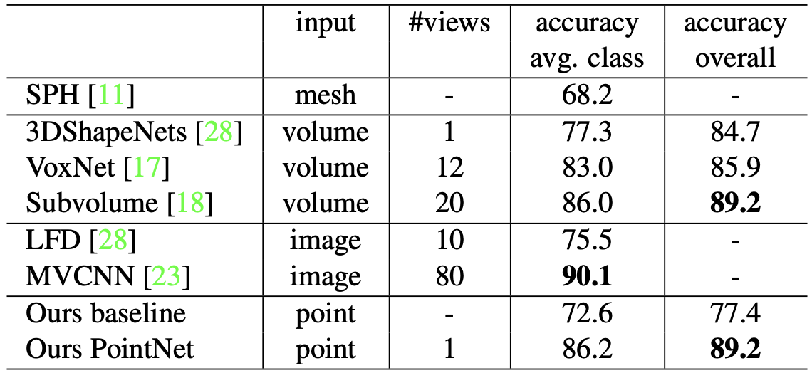
Introduction
Point clouds are an important way of representing geometric data by a collection of points in
Traditional methods transform these points into voxel grids or a collection of images that makes the data take up more volume.
PointNet avoids this transformation and can still perform at state of the art levels with classification, part segmentation, and Semantic Segmentation

Slide 5
Motivation
Why?
Point cloud are used in a variety of applications including robotics and self driving cars with the data generated from RGB-D(epth), Stereo, and LiDAR
Developing lightweight deep learning implementations that consume point cloud data will be useful for autonomous systems in performing segmentation and classification.
Goals
Implement PointNet in PyTorch
Achieve similar accuracy as paper with ShapeNet Dataset
Apply to Lyft dataset

Slide 6
Properties of Point Sets
Given a collection of points in R^n:
Unordered: Set of points without specific order. Given N points the network needs to be invariant to N! permutations
Interaction among points: points are not isolated and neighboring points form a meaningful subset.
Invariance under transformation: rotating and translating all points together should not modify the global point cloud category nor the segmentation of points.
Notes:
In R^n

Slide 7
Agenda
Introduction
Detailed Implementation
Results. Do they match expectations
Differences and improvements compared to previous works
Challenges met and solutions
Contributions of each team member

Slide 8
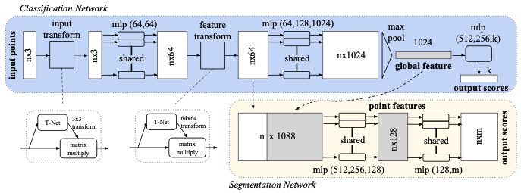
Implementation: Architecture Overview
Inputs: Point clouds
Outputs: class labels for entire input or per point segment/part label for each point

Slide 9
Implementation: Input Transform
Details on Input Transform

Slide 10
Implementation: Feature Transform
Details on Feature Transform

Slide 11
Implementation: Overview
Network learns set of optimization functions/criteria that select interesting or informative points of the point cloud and encode the reason for their selection
Fully connected layers of the network aggregate learnt optimal values into the global descriptor for entire shape (shape classification) or are used to predict per point labels (shape segmentation)
Easy to add transformations as each point transforms independently

Slide 12
Implementation: Overview
Symmetry Function for Unordered Input:
For invariance to input permutation
Aggregate each input into a vector that is invariant to input order by using + and * operators.
Local and Global Information Aggregation:
Used for segmentation
Joint Alignment Network:
Used for segmentation
Notes:
Choices for input invariance: Sort list (doesn’t scale and bad with pertubations), Use RNN (doesn’t scale)

Slide 13
Benefits
Network can approximate any set of function that is continuous
Network learns to summarize an input point cloud by a sparse set of key points aka the skeleton of the object
Robust to small perturbation of input points as well as corruption to outliers and missing data
Fast training time due to less voluminous data compared to voxel grids or collection of views

Slide 14
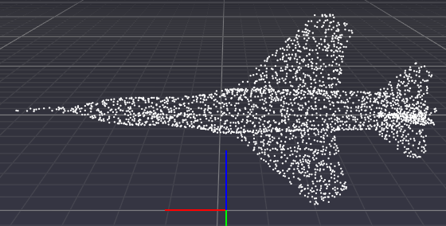
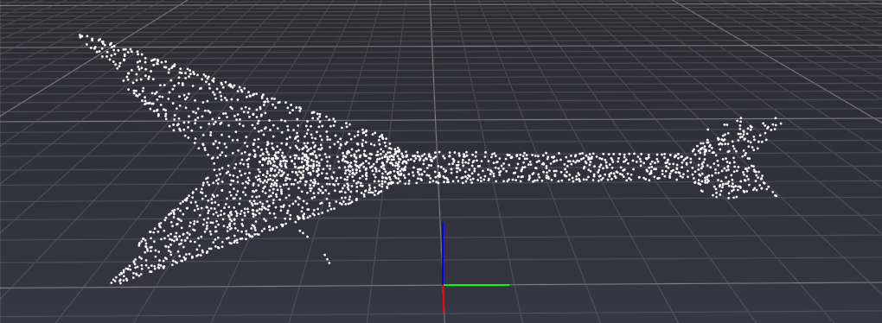
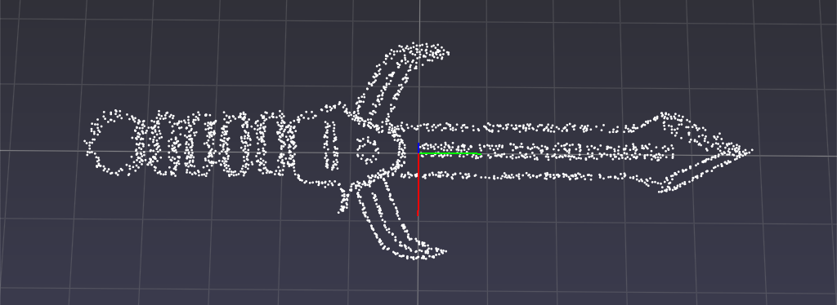
Our Dataset
Stanford ShapeNet: Reconstruction and Segmentation
17,000 models from 16 shape categories
Each category has 2 to 6 parts with 50 different parts annotated in total.
Point Cloud shapes generated from uniformly sampled 3D surfaces.
Shapes: Airplane, Bag, Cap, Chair, Earphone, Guitar, Knife, Lamp, Laptop, Motorbike, Mug, Pistol, Rocket, Skateboard, Table
Notes:
Shape Net: Chang et al., ShapeNet: An Information-Rich 3D Model Repository arXiv:1512.03012

Slide 15
Our Dataset: Lyft

Slide 16
Specifications from Blackboard
Introduction
Detailed Implementation
Results. Do they match expectations
Differences and improvements compared to previous works
Challenges met and solutions
Contributions of each team member

Slide 17
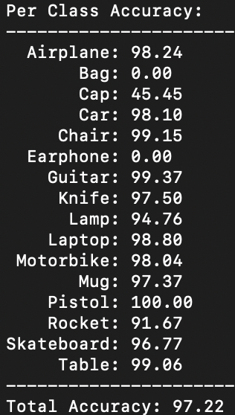
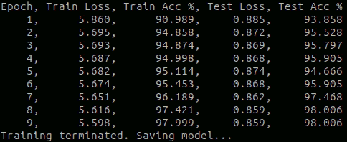
Results
Accuracy compared to baseline
Training times
Picture of results and tables

Slide 18
Specifications from Blackboard
Introduction
Detailed Implementation
Results. Do they match expectations
Differences and improvements compared to previous works
Challenges met and solutions
Contributions of each team member

Slide 19
Differences and Improvements
TBD

Slide 20
Agenda
Introduction
Detailed Implementation
Results. Do they match expectations
Differences and improvements compared to previous works
Challenges met and solutions
Contributions of each team member

Slide 21
Challenges
Data (ShapeNet):
Point clouds do not have equal number of points: Solved via sampling with replacement
Uneven data distribution (e.g. test set has 341 airplane pointclouds and 15 bag and earphone pointclouds): Solved via TODO

Slide 22
Agenda
Introduction
Detailed Implementation
Results. Do they match expectations
Differences and improvements compared to previous works
Challenges met and solutions
Contributions of each team member

Slide 23
Contributions
Model Building – Michael and Rishabh
Classification
Segmentation
Data Loading – Michael and Rishabh
Visualization – Michael
Training – Michael
Testing – Rishabh

Slide 24
Thanks!

Slide 25
References
Qi, C. R., Su, H., Mo, K., and Guibas, L. J. Pointnet: Deep learning on point sets for 3d classification and segmentation.CoRR, abs/1612.00593, 2016. URLhttp://arxiv.org/abs/1612.00593

Slide 26
Backup
If needed

