Slide 1
PointNet: 3D Classification and Segmentation
Michael Hodges, Rishabh Shukla
Notes:
Add drawing cartoon

Slide 2
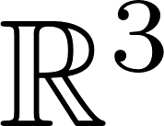
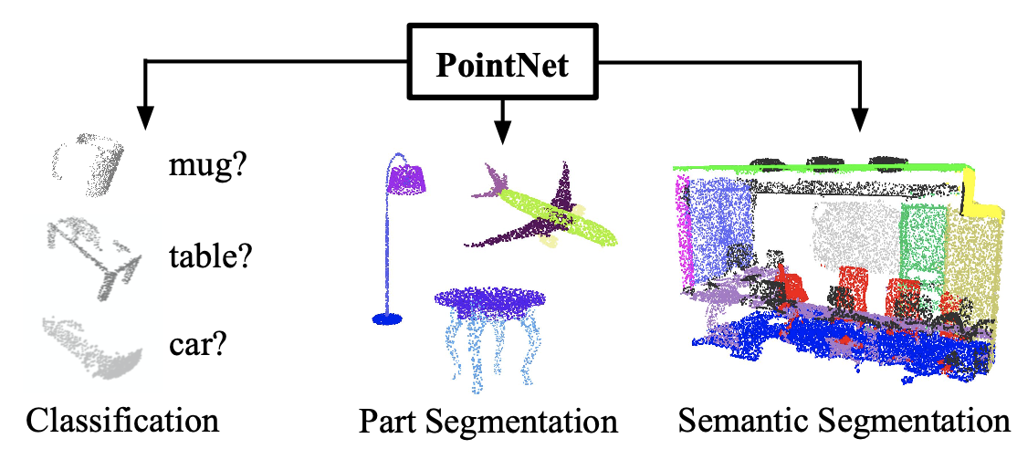
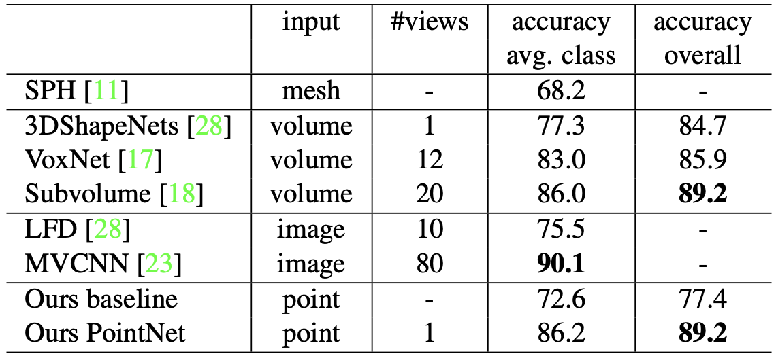
Introduction
Point clouds are an important way of representing geometric data by a collection of points in
Traditional methods transform these points into voxel grids or a collection of images that makes the data take up more volume.
PointNet avoids this transformation and can still perform at state of the art levels with classification, part segmentation, and Semantic Segmentation

Slide 3
Motivation
Point cloud are used in a variety of applications including robotics and self driving cars with the data generated from RGB-D(epth), stereo, and LiDAR
Developing lightweight deep learning implementations that consume point cloud data will be useful for autonomous systems in performing segmentation and classification.

Slide 4
New Contributions
Utilize Batch normalization to improve training times
Implement on Toyota HSR Lidar point cloud data. We will utilize the published rostopic data along the LaserScan topic to capture the point cloud data and run the trained model over this point cloud.
Try implementing the whole pipeline in C++ and evaluate the performance metrics.
Notes:
These are just ideas

Slide 5
Project Plan and Expected Results
Implement PointNet in PyTorch
Train Pytorch on Lyft Level 5 Dataset / nuScenes dataset
Benchmark testing results with the tensorflow implementation.
Benchmark results with our modifications over the original implementation
Implement the trained model on a different point cloud data like the one recorded from HSR and evaluate the predictions.

Slide 6
Thanks!

