Slide 1
PointNet: 3D CLASSIFICATION AND SEGMENTATION
Michael Hodges, Rishabh Shukla
Notes:
Add drawing cartoon

Slide 2
Agenda
Introduction
Detailed Implementation
Results
Differences and improvements compared to previous works
Challenges met and solutions
Contributions of each team member
Notes:
Slide for reference while developing only

Slide 3
Agenda
Introduction
Detailed Implementation
Results
Differences and improvements compared to previous works
Challenges met and solutions
Contributions of each team member

Slide 4

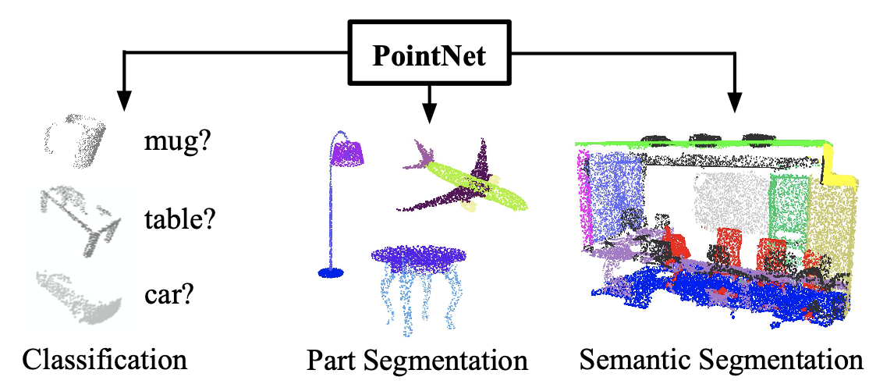
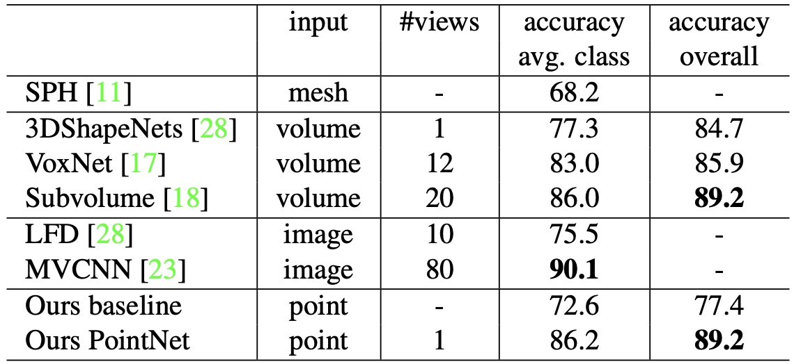
Introduction
Point clouds are an important way of representing geometric data by a collection of points in
Traditional methods transform these points into voxel grids or a collection of images that makes the data take up more volume.
PointNet avoids this transformation and can still perform at state of the art levels with classification, part segmentation, and Semantic Segmentation

Slide 5
Motivation
Why?
Point cloud are used in a variety of applications including robotics and self driving cars with the data generated from RGB-D(epth) or stereo cameras, and LiDAR
Developing lightweight deep learning implementations that consume point cloud data will be useful for autonomous systems in performing segmentation and classification.
Goals
Implement PointNet in PyTorch
Achieve similar accuracy as paper with ShapeNet Dataset

Slide 6

Properties of Point Sets
Given a collection of points in :
Unordered: Set of points without specific order. Given N points the network needs to be invariant to N! permutations
Interaction among points: points are not isolated and neighboring points form a meaningful subset.
Invariance under transformation: rotating and translating all points together should not modify the global point cloud category nor the segmentation of points.
Notes:
In R^n

Slide 7
Agenda
Introduction
Detailed Implementation
Results
Differences and improvements compared to previous works
Challenges met and solutions
Contributions of each team member

Slide 8
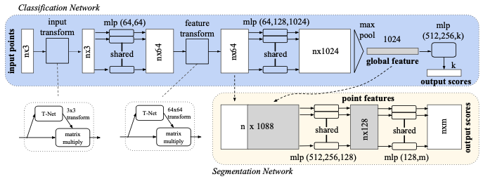
Implementation: Architecture Overview
Inputs: Point clouds in
Outputs: class labels for entire input or per point segment/part label for each point

Slide 9
Implementation: Transform’s
Mini-PointNets: Used for alignment/transformation for input points and features
Output Initialized as 3x3 and 64x64 identity matrix respectively
Why: to make input invariant to input permutation

Slide 10
Implementation: Detials
Shared MLP use Conv1D function in PyTorch
All layers use ReLU and Batch Normalization
Loss: Cross Entropy
Optimizer: Adam (Learning Rate: 0.001, No Weight Decay

Slide 11
Claims
Symmetry Functions used to make input invariant to permutations
Local and Global information is aggregated to improve point segmentation
Invariant to rigid transformations (translation, rotation)
Network learns to summarize an input point cloud by a sparse set of key points aka the skeleton of the object
Robust to small perturbation of input points as well as corruption to outliers and missing data
Notes:
Network learns set of optimization functions/criteria that select interesting or informative points of the point cloud and encode the reason for their selection
Fully connected layers of the network aggregate learnt optimal values into the global descriptor for entire shape (shape classification) or are used to predict per point labels (shape segmentation)
Easy to add transformations as each point transforms independently
Symmetry Function for Unordered Input:
For invariance to input permutation
Aggregate each input into a vector that is invariant to input order by using + and * operators.
Local and Global Information Aggregation:
Used for segmentation
Joint Alignment Network:
Used for segmentation

Slide 12
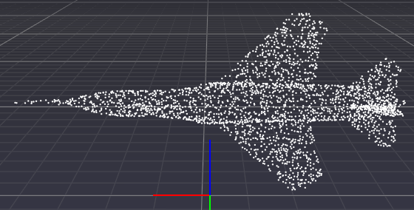
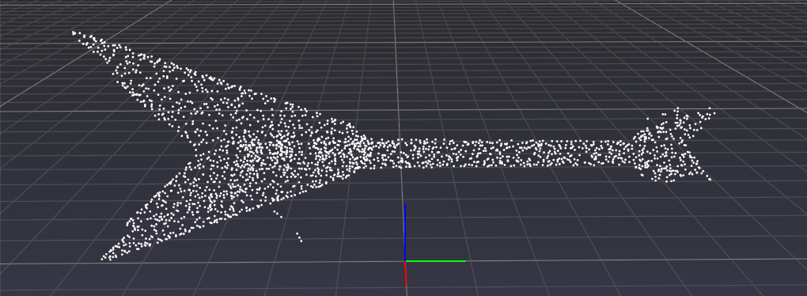
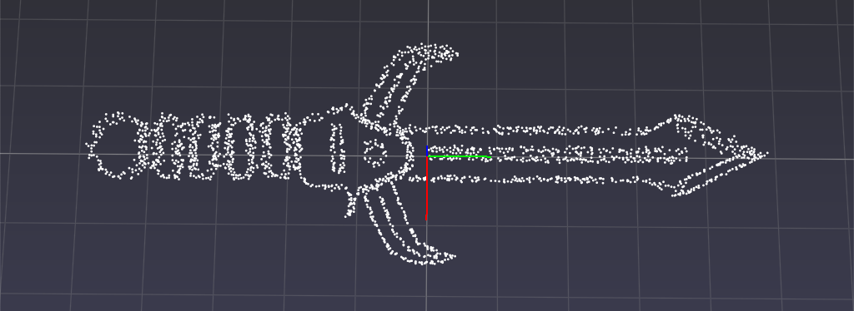
Our Dataset
Stanford ShapeNet: Reconstruction and Segmentation
17,000 models from 16 shape categories
Each category has 2 to 6 parts with 50 different parts annotated in total.
Point Cloud shapes generated from uniformly sampled 3D surfaces.
Shapes: Airplane, Bag, Cap, Chair, Earphone, Guitar, Knife, Lamp, Laptop, Motorbike, Mug, Pistol, Rocket, Skateboard, Table
Notes:
Shape Net: Chang et al., ShapeNet: An Information-Rich 3D Model Repository arXiv:1512.03012

Slide 13
Agenda
Introduction
Detailed Implementation
Results
Differences and improvements compared to previous works
Challenges met and solutions
Contributions of each team member

Slide 14
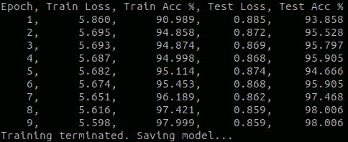
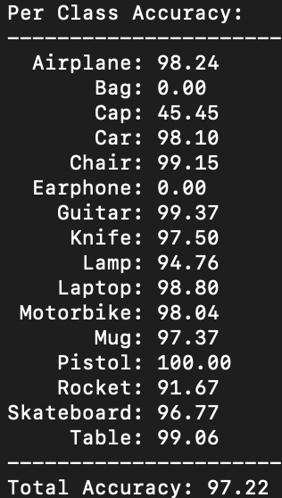
Results
Observations:
Fast Training times
Skewed data altering results

Slide 15
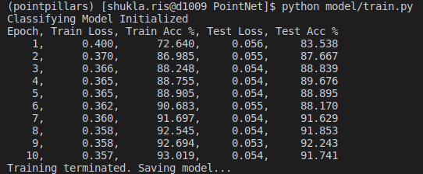
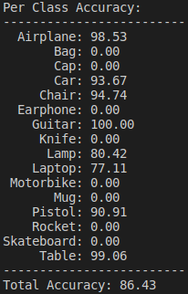
Results
Observations with Transforms:

Slide 16
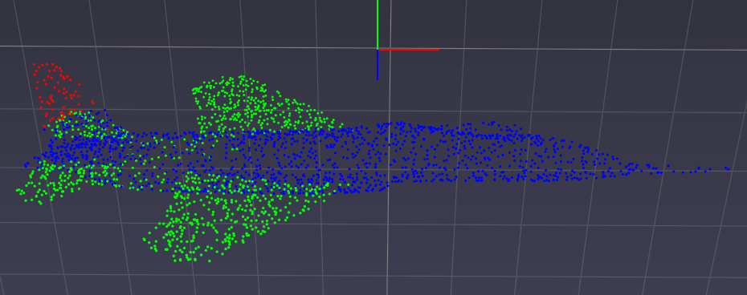
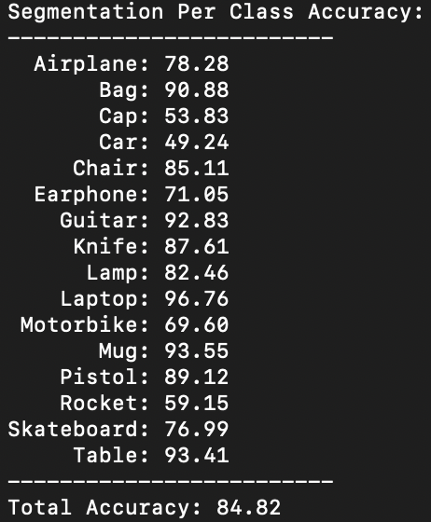
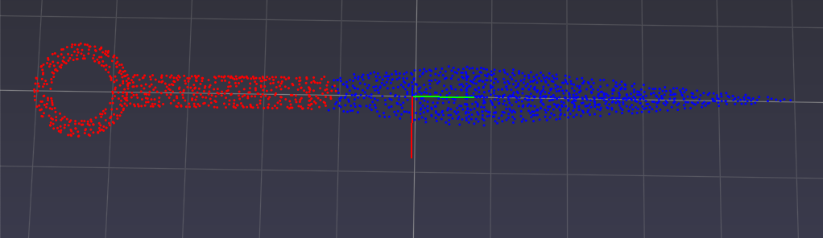
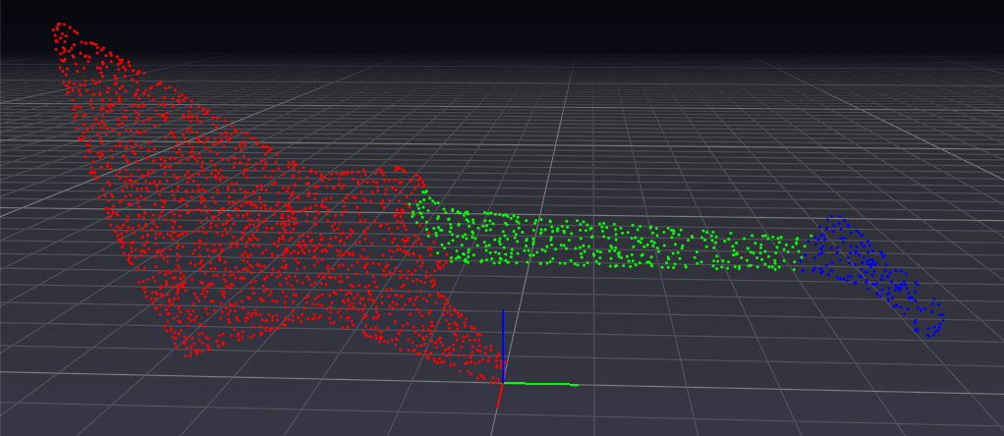
Results: Part Segmentation

Slide 17
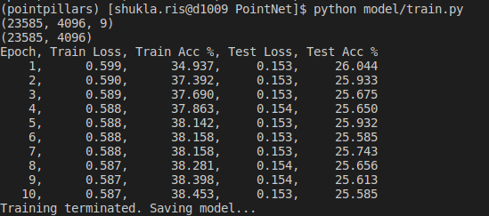
Results: Semantic Segmentation
Observations:

Slide 18
Agenda
Introduction
Detailed Implementation
Results
Differences and improvements compared to previous works
Challenges met and solutions
Contributions of each team member

Slide 19
Differences and Improvements
Single Network used for part segmentation compared to separate networks for each class in original implementation
Parts are segmented into 2-6 segments. Let network learn how to segment parts based on labeled data

Slide 20
Agenda
Introduction
Detailed Implementation
Results
Differences and improvements compared to previous works
Challenges met and solutions
Contributions of each team member

Slide 21
Challenges
Data (ShapeNet):
Point clouds do not have equal number of points: Solved via sampling with replacement
Uneven data distribution (e.g. test set has 341 airplane pointclouds and 15 bag and earphone pointclouds)
Framework Conversion(Tensorflow -> Pytorch): - Original Repository was built in Tensorflow 1.2 and we translated the implementation in Pytorch. - All details of the implementation were not covered in the paper so we referenced the outdated tensorflow code and accordingly translated the functionalities in Pytorch.
Improving the Semantic Segmentation

Slide 22
Agenda
Introduction
Detailed Implementation
Results
Differences and improvements compared to previous works
Challenges met and solutions
Contributions of each team member

Slide 23
Contributions
Model Building – Michael and Rishabh
Classification – Rishabh and Michael
Segmentation - Michael
Semantic Segmentation - Rishabh
Data Loading – Michael and Rishabh
Visualization – Michael
Training – Michael
Testing – Michael and Rishabh

Slide 24
Thanks!
https://github.com/Michael-Hodges/PointNet

Slide 25
References
Qi, C. R., Su, H., Mo, K., and Guibas, L. J. Pointnet: Deep learning on point sets for 3d classification and segmentation.CoRR, abs/1612.00593, 2016. URLhttp://arxiv.org/abs/1612.00593

Slide 26
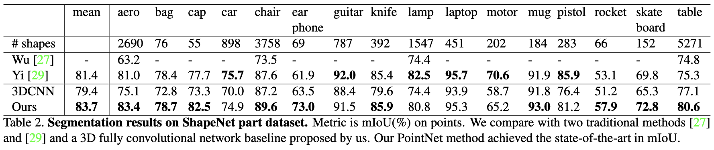
Backup

