Slide 1
Estimating GHG Emissions
Goal: to discuss and clarify the project approach

Slide 2
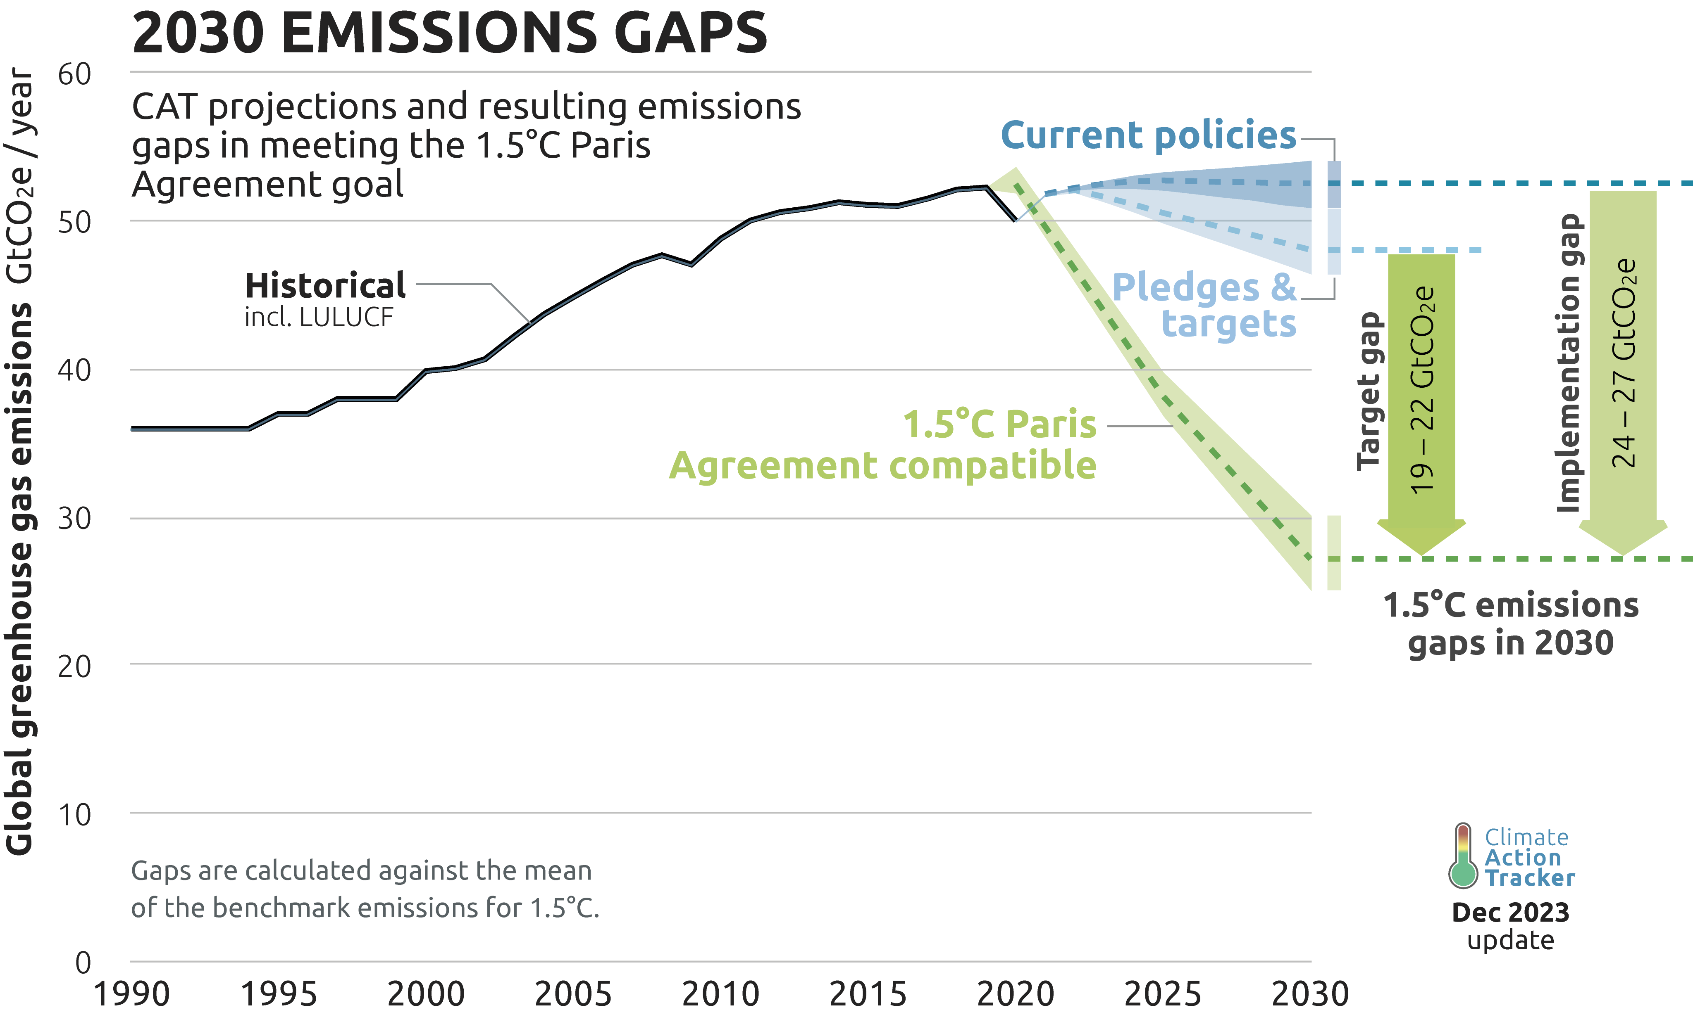
Notes:
Source: https://climateactiontracker.org/global/cat-emissions-gaps/

Slide 3
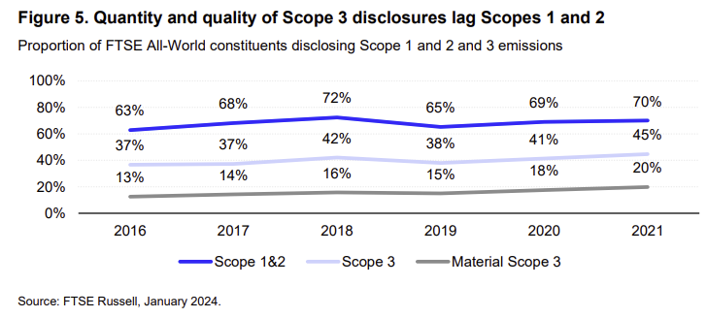
Notes:
Source: https://www.lseg.com/content/dam/ftse-russell/en_us/documents/research/solving-scope-3-conundrum.pdf
Note FTSE All-World Index represents over 4000 companies which are listed large/mid cap.

Slide 4


Can we improve on simple estimates?
Scope 1 (Direct)
Median < regression < XGBoost < Meta-learner
Total emissions better predicted than just S1
Scope 2 (Indirect, energy)
Same improvements as above
However, percentage errors remain high
Scope 3 (Indirect, all 15 categories)
Linear forest better than OLS or industry fill
Improvements only marginal, prediction accuracy low
Notes:
From Nguyen et al. (2021) :
Goldhammer et al. (2017) [GBB model] attempt to use multivariate regression to predict the total emissions (Scope 1 + Scope 2). They restrict their calculations to a small but consistent sample of the 93 largest EU firms in the chemical, construction, engineering, and industrial machinery sectors. Their set of predictors is extended above firm size to reflect the level of vertical integration, centrality of production, capital intensity, and the emission intensity of the national energy mix. They find that carbon emissions can be explained reasonably well with externally available data. The in-sample adjusted R² is 81.7% for log-transformed emissions and 80.7% for retransformed emissions on OLS regression.
In order to ascertain the degree to which investors price emissions, Griffin et al. (2017) [GLS model] employ a very similar strategy to GBB model to estimate emissions for non-disclosing S&P 500 firms. Their study accounts for the role of technology (asset ages, capital investments, and intangible assets) and business model (GICS sector membership and gross margin) and finds that revenue and sector membership are the two important predictors. The explanatory power (R²) for the total emissions of the GLS model exceeds 80% in the early years (2006–2007) most probably due to the small/consistent sample size but reduces to 70% for the entire period (2006–2012). The explanatory power, however, decreases when isolating the estimation of Scope 1 (60–70%) and Scope 2 (30–38%), highlighting that the model performs better in explaining direct emissions than indirect emissions. Further, the restriction of S&P 500 membership limits the generalizability of the model, as it is very likely to be biased towards firms with the larger scales, more advanced technologies, and potentially higher awareness of environmental issues.
On top of these econometric models, Nguyen et al. (2021) show that by using XGBoost as a base learner and then an elastic net meta-learner on top of that, improvements to MAE out of sample from the econometric models range between 25-30%. However, percentage error remains high: “However, the size of PE remains relatively high as a range even in the best calibrations where the averaged PE ranges from −39% to 66% although the median value is −0.9%. This supposed to be due to pure contribution from the publicly available predictors although they cover the widest possible range of firms. In this aspect, high-quality predictors such as energy consumption/production amounts might help to increase the prediction accuracy whilst with a narrow firm coverage. Moreover, poor data quality (e.g. unverified reported emissions), as well as sparse datasets in certain industries and regions also lead to low accuracy.”
Nguyen et al 2023 tried to use ML on Scope 3: “Scope 3 prediction accuracy is low, even with the most sophisticated machine learning algorithms and an extensive set of business and financial predictors. In general, it is easier to predict upstream emissions than downstream emissions. Critically, estimating total Scope 3 emissions from category level instead of aggregated level improves prediction accuracy (i.e., mean absolute error [MAE] of log-transformed emissions reduced by 25% in Linear Forest). This is most probably because the aggregated Scope 3 emissions are distorted by non-reported categories, suggesting that the modelling of Scope 3 emission should be conducted at category level. However, there are limited improvements in prediction performance of sophisticated machine learning models (i.e. Linear Forest) relative to baseline models (i.e. Industry Fill or Ordinal Least Square). More precisely, Linear Forest is slightly better at predicting total Scope 3 emissions at category level and aggregated level than baseline models (MAE is reduced by 2% to 6%), and yields more or less equivalent prediction accuracy to a Stepwise regression model across most individual categories. Further, predictor importance varies by category materially. Overall, our findings imply that researchers and investors should be wary of the potential prediction errors when using Scope 3 emissions obtained from third parties. The findings also call for more transparent disclosure from third-party data providers in terms of estimation methodologies and prediction performance.”

Slide 5
Goal: Apply DL to GHG estimation, esp S3
Simple baselines
Sector/region averages
OLS on size, sector, region
Statistical models
Multivariate GLM
ARIMA
Machine learning
XGBoost
Random Forest
Deep learning
LSTM
TFT
Notes:
Key question: which models? All of them might be overkill.
TFT = temporal fusion transformer. Good for explainability and flexibility of inputs.

Slide 6
Plan
Start with baselines and progress down the model list
Focus on S3, originality
Need data/data dictionary ASAP to begin EDA
For now, beginning analysis on dummy data

