Slide 1
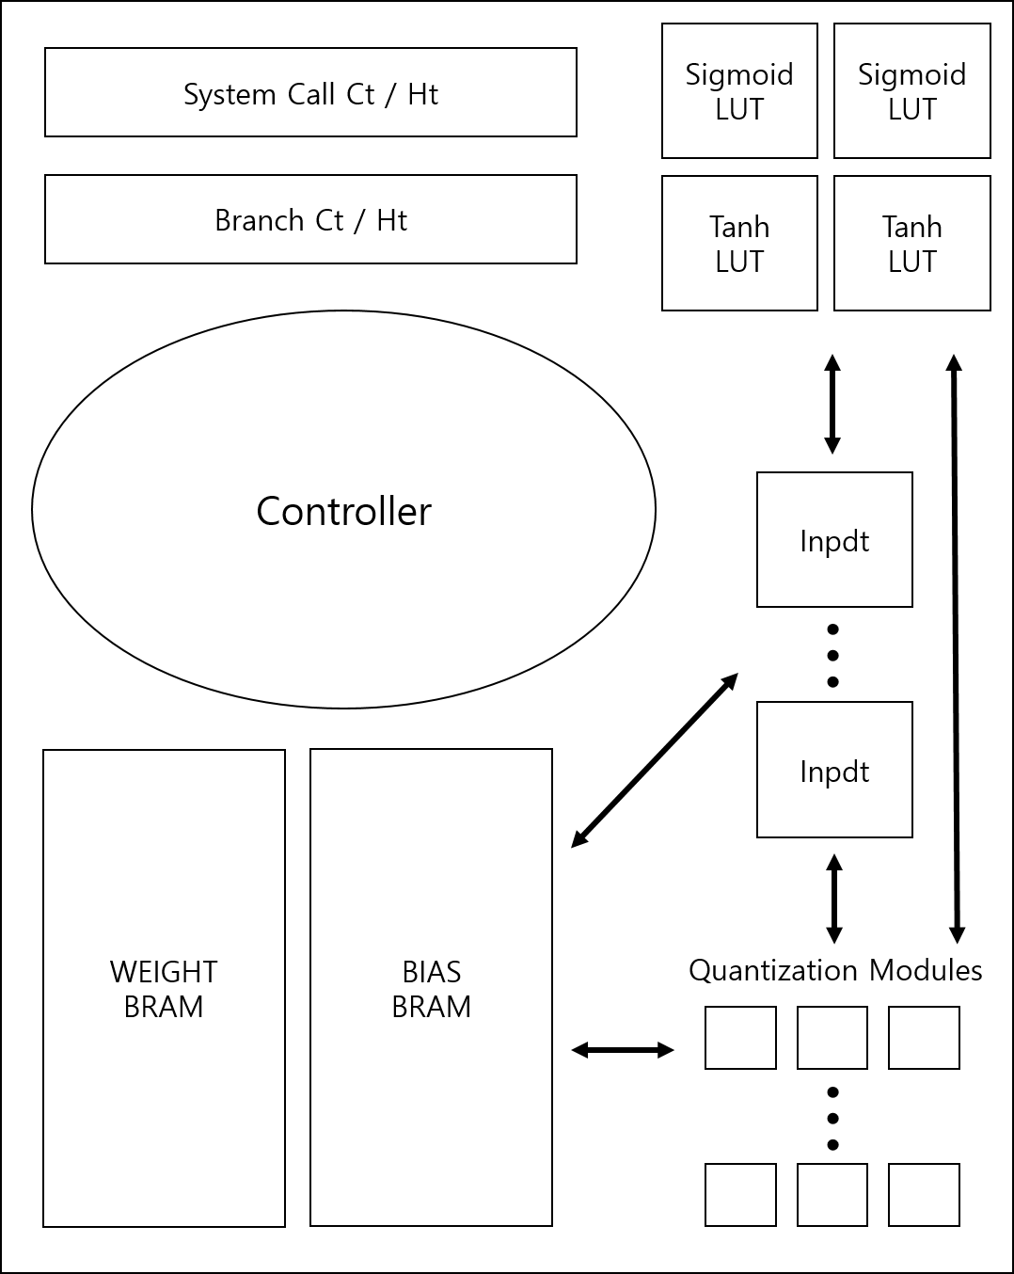
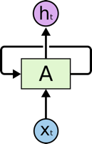
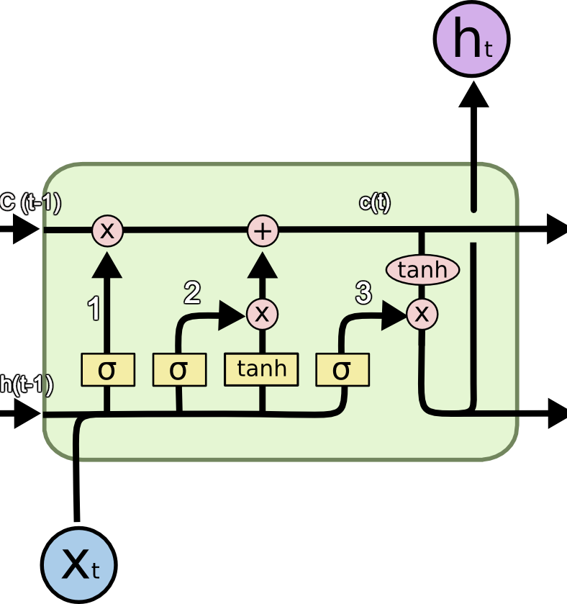
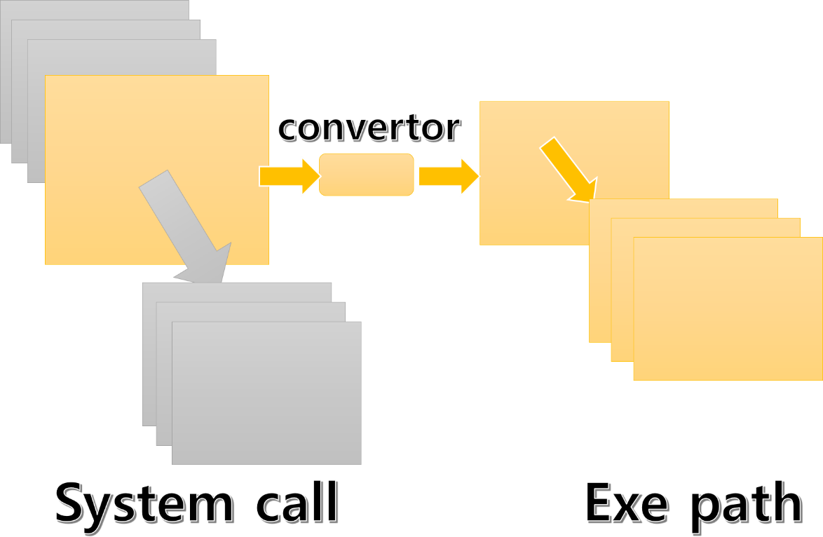
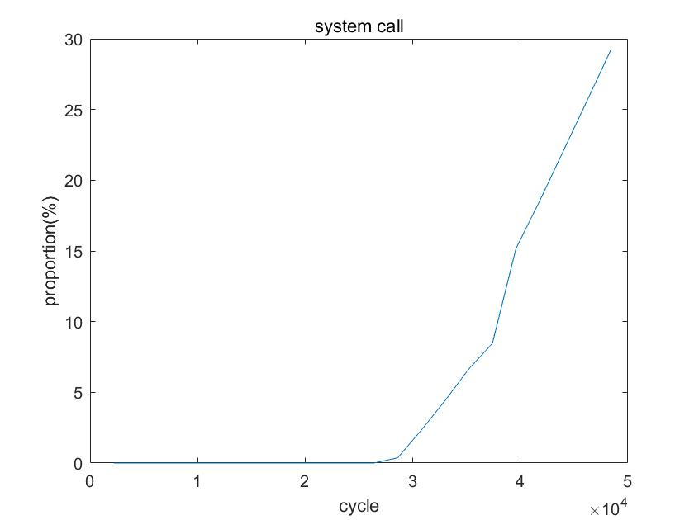
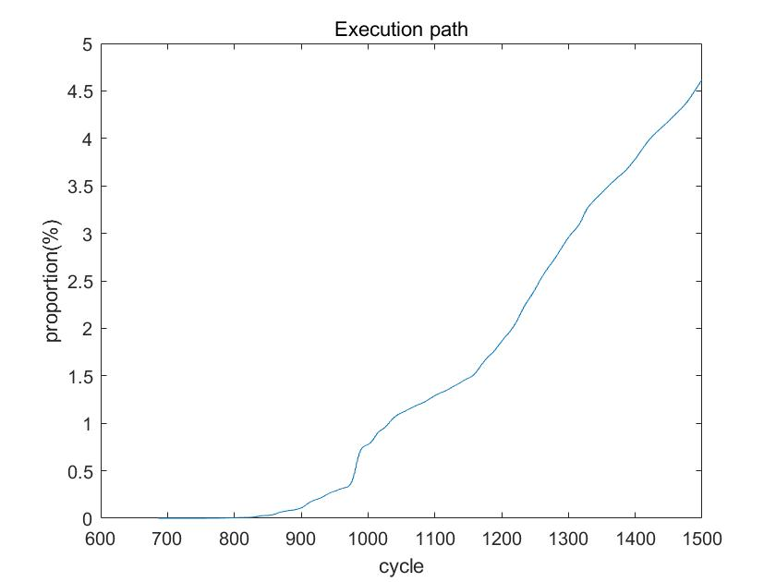
Title
Professor : Paek, Yunheung R.A. :
Researcher : 김재민, 이석현, 최호근, Ham, Yeongju
Introduction
Model
LSTM
Result & Discussion
Syscall / Execution path Statistic
 | sys | exe
Min | 19800 | 736
Avg | 30M | 7229
Future Work
Measuring accuracy of quantized model
Hardware Design
Reference

Slide 2
convertor
System call
Exe path
System Call Ct / Ht
Sigmoid LUT
Sigmoid LUT
Branch Ct / Ht
Tanh
LUT
Tanh
LUT
Controller
Inpdt
…
WEIGHT
BRAM
BIAS
BRAM
Inpdt
Quantization Modules
…

