Slide 1

GreenCoin – Decentralized Digital Currency
GreenCoin – Decentralized Digital Currency

Slide 2
Signature Generation
Signature Verification
Data / Message

Slide 3
Unique id
In order to avoid malicious duplicate messages.
Message / Data
The actual data which is sent.
Could be a plain-text message, or a digital currency transaction.
DSA Signature
Two pieces of data which can be used to verify the authenticity of the whole message.

Slide 4

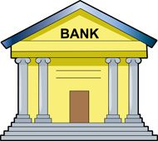
Alice
Bob
+2,500
-2,500
⋮ | ⋮
Bob | -2,500
Alice | 2,500
⋮ | ⋮

Slide 5

⋮
Bob sends Alice 2,500
⋮
⋮
Bob sends Alice 2,500
⋮
Alice
Bob
⋮
Bob sends Alice 2,500
⋮
Bob sends Alice 2,500
⋮
Bob sends Alice 2,500
⋮
⋮
Bob sends Alice 2,500
⋮

Slide 6


⋮
Steve sends Bob 100
⋮
⋮
Steve sends Bob 300
⋮
⋮
Steve sends Bob 100
⋮
⋮
Steve sends Bob 100
⋮
⋮
Steve sends Bob 100
⋮
⋮
Steve sends Bob 100
⋮
⋮
Steve sends Bob 300
⋮
⋮
Steve sends Bob 100
⋮

Slide 7
Byte Size | Type Name | Range | Name
1 | Byte / Char | -128 -> 127 | int8_t
 |  | 0 -> 255 | uint8_t
2 | Word | -32,768 -> 32,767 | int16_t
 |  | 0 -> 65,535 | uint16_t
4 | Double Word | -2,147,483,648 -> 2,147,483,647 | int32_t
 |  | 0 -> 4,294,967,295 | uint32_t
 |  | 3.4E +/- 38 (7 digits) | float
8 | Quad Word | -9,223,372,036,854,775,808 -> 9,223,372,036,854,775,807 | int64_t
 |  | 0 -> 18,446,744,073,709,551,615 | uint64_t
 |  | 1.7E +/- 308 (15 digits) | double

Slide 8
BN * a
0b1000 0000 0000 0000 0000 0000 0000 0000
BN_Mul_Int(a, a, 2);
BN * a
0b0000 0000 0000 0000 0000 0000 0000 0000
0b0000 0000 0000 0000 0000 0000 0000 0001

Slide 9
Previous Block Hash
Previous Block Hash
Previous Block Hash
Previous Block Hash
… Data …
… Data …
… Data …
… Data …
Nonce
Nonce
Nonce
Nonce

Slide 10
Hash: c8d9…
a12b…
… Nefarious
Data …
Nonce
Hash: a12b…
Hash: b78b…
Hash: 6e53…
Previous Block Hash
a12b…
b78b…
… Data …
… Data …
… Data …
Nonce
Nonce
Nonce

Slide 11
Byte Size | Data Name | Description
8 | Block Index | The index of the block the transaction is destined for.
4 | Time (UNIX) | The time the transaction was signed.
128 | Sender | Public key of the sender.
128 | Receiver | Public key of the receiver.
8 | Fee | The fee to be collected by the notary.
8 | Value | The value to be passed to the receiver. Note: Receiver += Value; Sender -= (Value + Fee);
40 | Signature | The DSA signature (r, s).

Slide 12
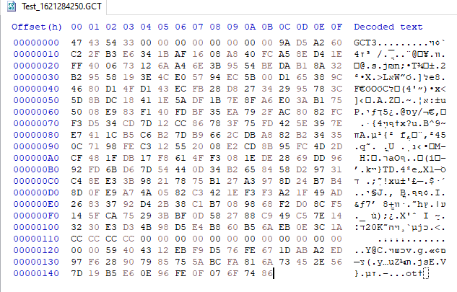
Block Index
UNIX Time
Transaction File Magic
Sender Public Key
Receiver Public Key
Transaction Fee
Transaction Value
Byte Alignment
Signature

Slide 13
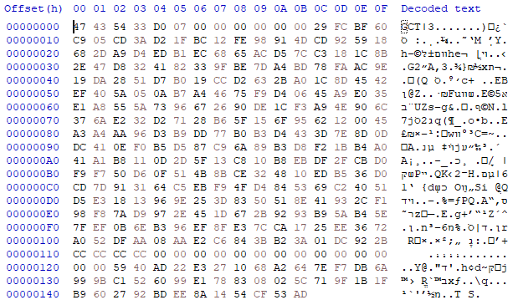
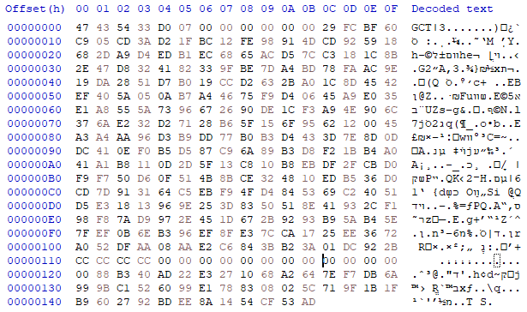
00 00 00 00 00 00 59 40 = 100
00 00 00 00 00 88 B3 40 = 5,000

Slide 14
Byte Size | Data Name | Description
8 | Block Index | The index of the block.
4 | Time (UNIX) | The time the block was created.
32 | Previous Block’s Hash | The SHA-256 hash of the previous block.
328 * 64 | Transactions | An array of 64 transactions.
128 | Notary Address | The address of the block’s verifier’s wallet.
32 | Nonce | A 256 bit value which is changed in order to produce the desired hash digest for the block.

Slide 15
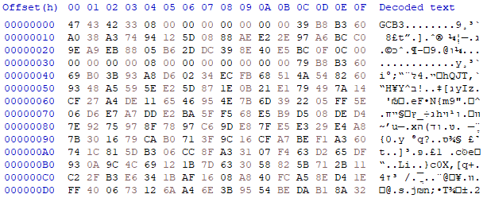
Block Index
UNIX Time
Previous Block’s Hash
Block File Magic
Byte Alignment
Transactions

Slide 16
Abby sends Steve 455GC
Alice sends Abby 130GC
Bob sends Alice 350GC
Satoshi sends Bob 2,008GC
Steve sends Bob 280GC
GreenCoin
Miner

Slide 17
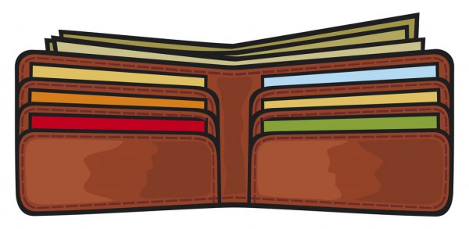
Private Key: +UKTs0dcf73nAGzrH0/AUlKYLmY=
Public Key: yQXNOtIfvBL+mJFNzZJZGGgtqdTtsexoZazVfMMYHIsuR9gyQYIzn759pL14+qyeGdooUdewGczSYyugHI1FQu9AWgUKt6RGdfnUBkWp4DXhqFVac5ZnJpDeHPOpTpBsN2riMtJxKLZfFW+VYhIARaOkqpbTud13sLPUQz1+jQ0=

Slide 18
Private Key
Public Key

Slide 19
Alice
Bob
TRANSACTION
Alice sends Bob 15,000GC
Network
Validator
Evil
Steve
Network
Validator
Network
Validator
Network
Validator

