Slide 1

GreenCoin – Decentralized Digital Currency
GreenCoin – Decentralized Digital Currency

Slide 2
Signature Generation
Signature Verification
Data / Message

Slide 3
Unique id
In order to avoid malicious duplicate messages.
Message / Data
The actual data which is sent.
Could be a plain-text message, or a digital currency transaction.
DSA Signature
Two pieces of data which can be used to verify the authenticity of the whole message.

Slide 4

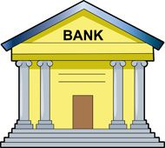
Alice
Bob
+2,500
-2,500
⋮ | ⋮
Bob | -2,500
Alice | 2,500
⋮ | ⋮

Slide 5

⋮
Bob sends Alice 2,500
⋮
⋮
Bob sends Alice 2,500
⋮
Alice
Bob
⋮
Bob sends Alice 2,500
⋮
Bob sends Alice 2,500
⋮
Bob sends Alice 2,500
⋮
⋮
Bob sends Alice 2,500
⋮

Slide 6
⋮
Bob sends Alice 2,500
⋮
⋮
Bob sends Alice 2,500
⋮
⋮
Bob sends Alice 2,500
⋮
⋮
Bob sends Alice 2,500
⋮
⋮
Bob sends Alice 2,500
⋮

Slide 7
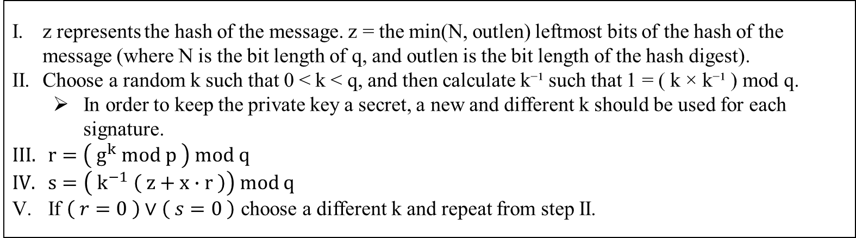
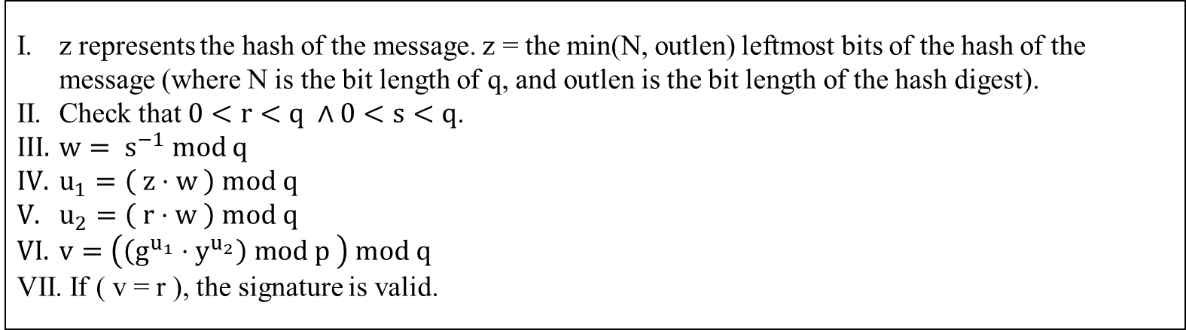
z represents the hash of the message. z = the min(N, outlen) leftmost bits of the hash of the message (where N is the bit length of q, and outlen is the bit length of the hash digest).
Choose a random k such that 0 < k < q, and then calculate k⁻¹ such that 1 = ( k × k⁻¹ ) mod q.
In order to keep the private key a secret, a new and different k should be used for each signature.
$r=\left( g^{k} mod p \right) mod q$
$s=\left( k^{−1} \left( z+x∙r \right)\right) mod q$
If $\left( r=0 \right)∨\left( s=0 \right)$ choose a different k and repeat from step II.
z represents the hash of the message. z = the min(N, outlen) leftmost bits of the hash of the message (where N is the bit length of q, and outlen is the bit length of the hash digest).
Check that $0<r<q ∧0<s<q$.
$w= s^{−1} mod q$
$u_{1}=\left( z⋅w \right) mod q$
$u_{2}=\left( r⋅w \right) mod q$
$v=\left(\left(g^{u_{1}}⋅y^{u_{2}}\right) mod p \right) mod q$
If ( v = r ), the signature is valid.

