Slide 1
FLEETLLM · DEMO
FleetLLM
Agent teams on hardware you own.
An agent harness and inference engine, working together.
Notes:
Project overview. FleetPi is the demo harness package built around the Pi SDK and Fleet inference engine. Hardware results are distinct experiments: Mac Metal website demo and Raspberry Pi CPU GPQA.

Slide 2

THE PREMISE
Make local memory do more useful work.
“it’s quite terrible to have everybody have a bunch of the world’s limited supply of DRAM sitting in their own computer.”
Sam Altman · Cheeky Pint · Oct 29, 2026
Context: utilization of scarce memory, locally versus in the cloud.
Notes:
Exact excerpt from the original transcript, with curly apostrophes normalized typographically. Source: https://cheekypint.transistor.fm/39/transcript . The remark discusses how frequently scarce DRAM is utilized, rather than advocating removing memory from users. Portrait: https://forum.openai.com/public/videos/event-replay-sam-altman-on-building-the-future-of-ai-2026-04-06 ; official asset https://d2xo500swnpgl1.cloudfront.net/uploads/openai/Sam-Headshot-2025-6d27c54e-da78-475b-be5f-17702f1ff5b1-1775058548097.png

Slide 3
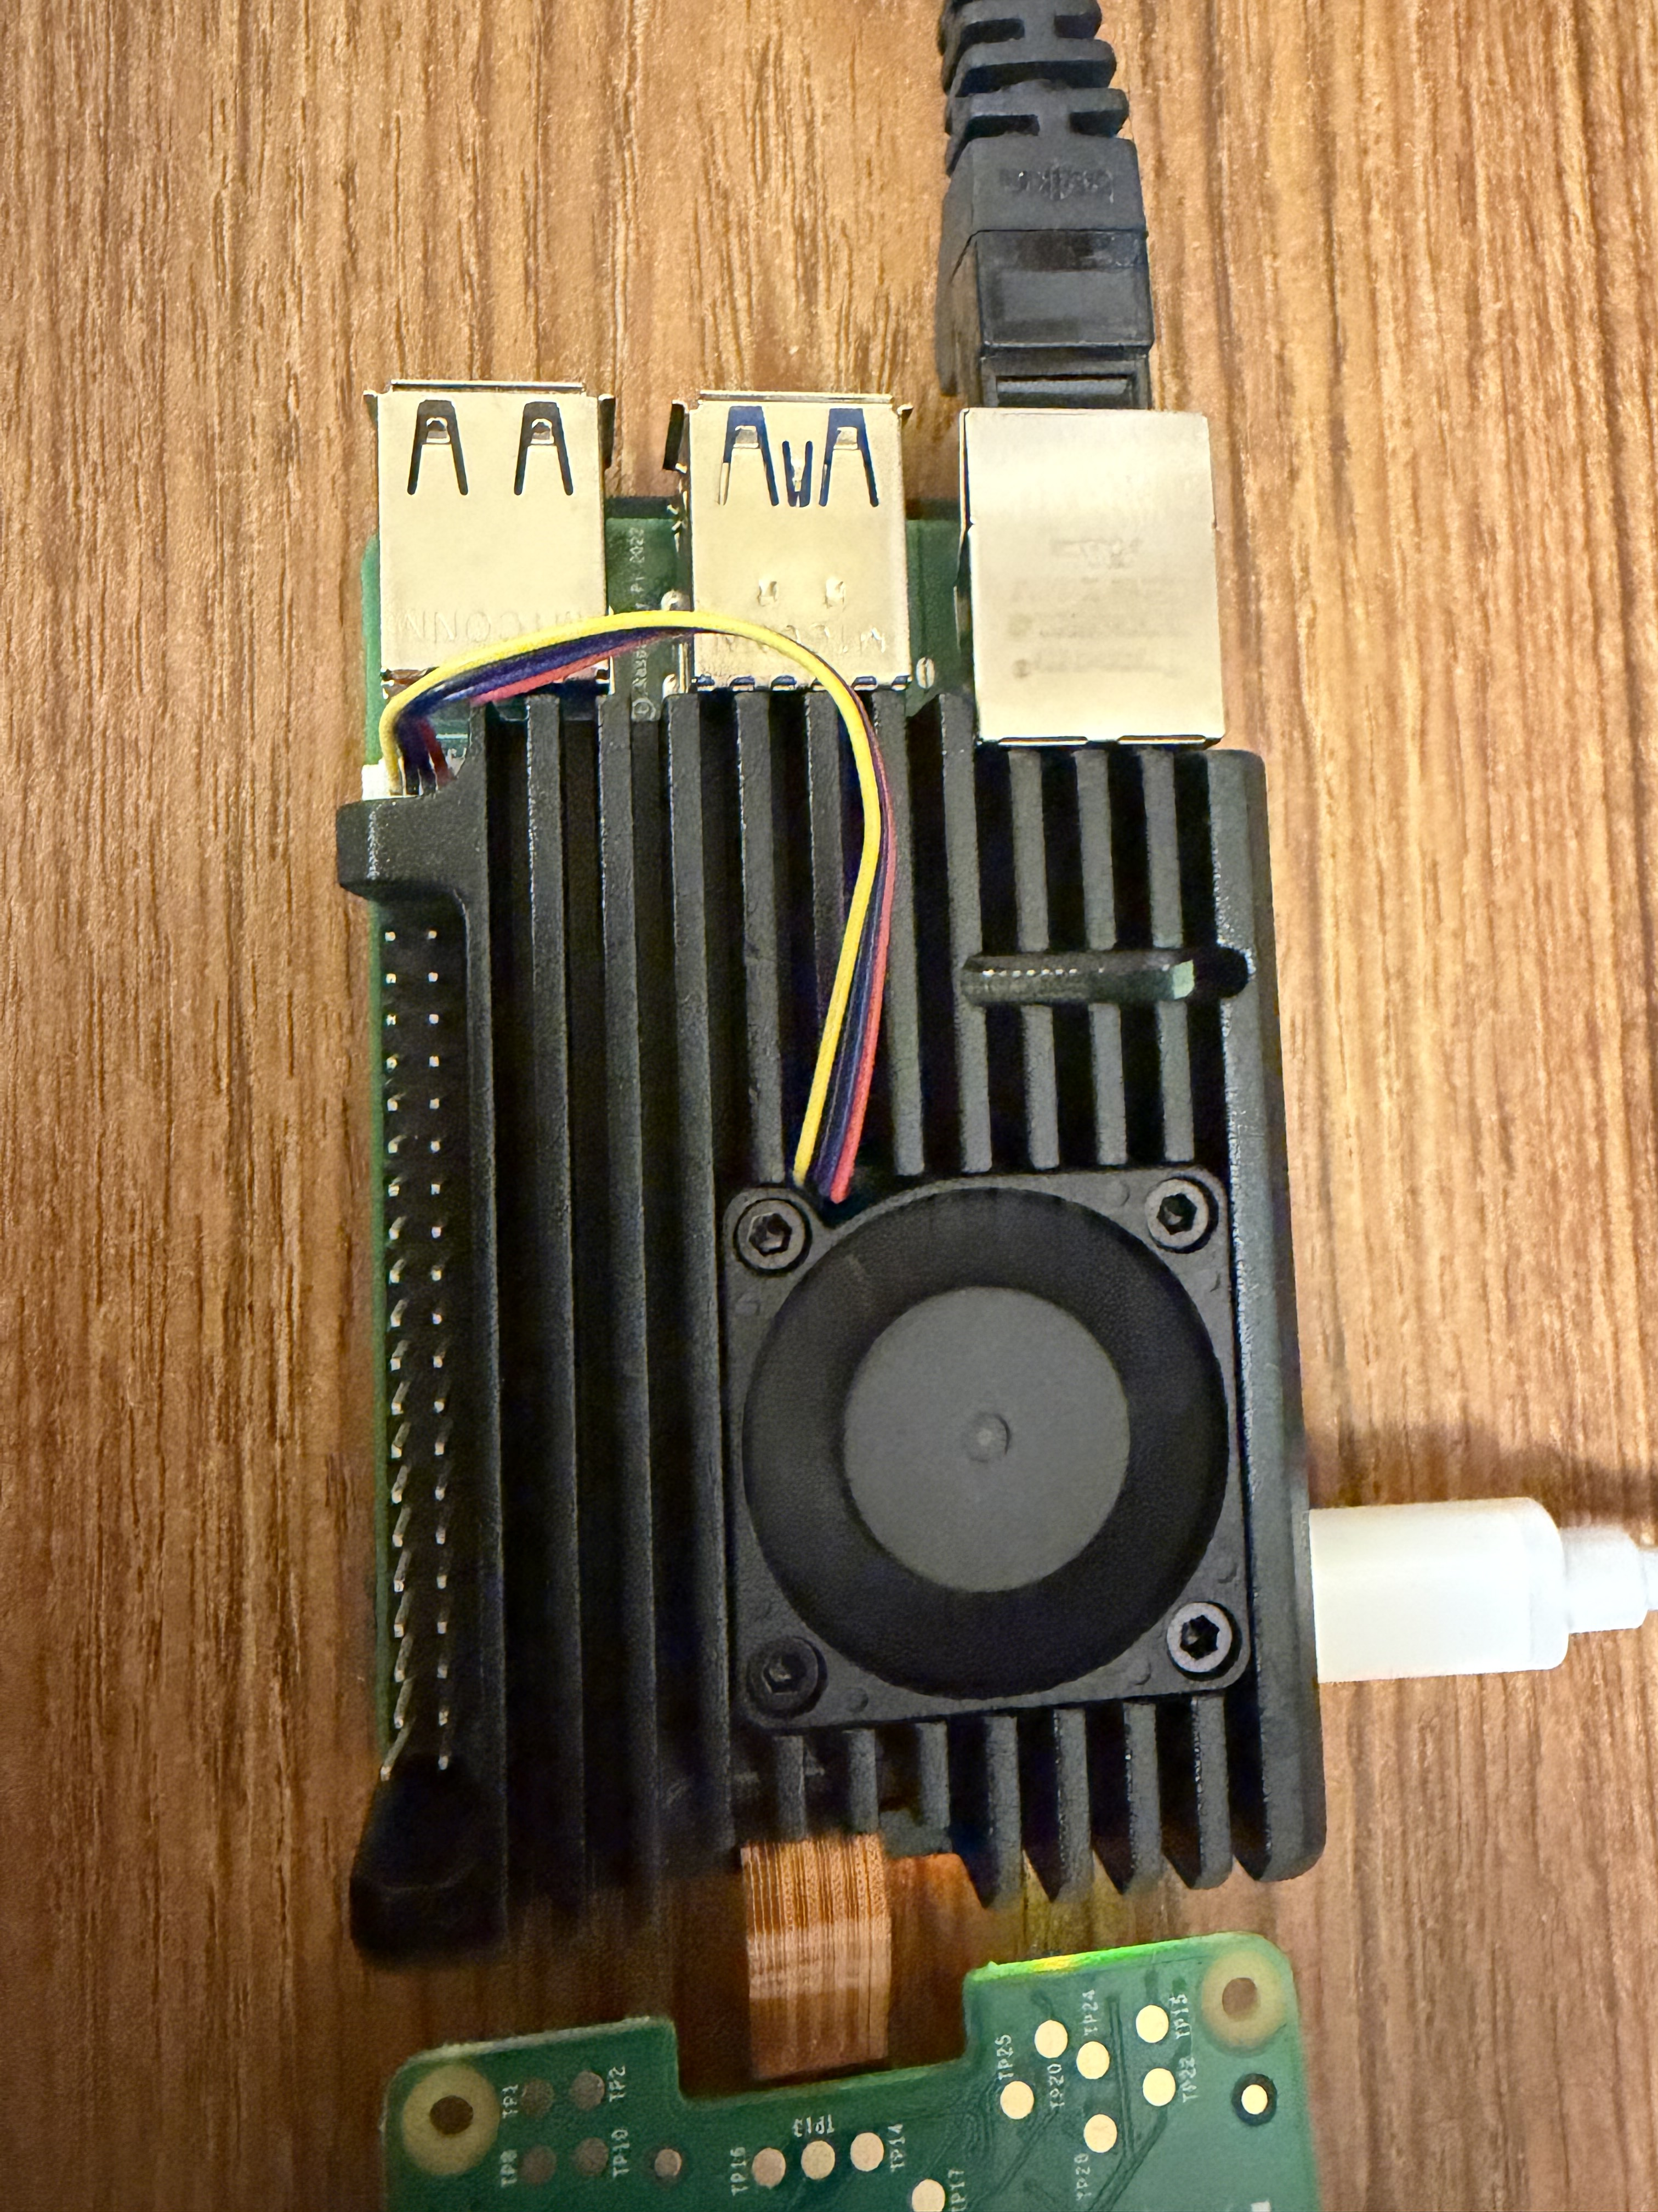
LOCAL BY DESIGN
Small machine.
Real workloads.
Raspberry Pi 5
16 GB RAM
Four CPU cores
A 30B model, running locally
Notes:
Photo supplied by Michael: /Users/michaelli/Desktop/IMG_5052.HEIC. Converted to JPEG for embedding, without changing its content. Model used in GPQA: Muse-Glimmer-30B Q2_K GGUF, CPU inference. Hardware/source: results/pi5/2026-11-03/gpqa-diamond-full/run_info.json and results/gpqa/2026-11-04-glimmer-q2k-phased/summary.json in constrained-inference.

Slide 4
THE SYSTEM
Bring the harness and engine together.
Typical setup
Agent harness
Inference server
Requests cross an API boundary.
FleetLLM
Agents + tools
Shared scheduler
Inference engine
Ready tasks · shared context · available memory
Notes:
Conceptual diagram of the combined system. FleetPi is an SDK-based harness extension, not a rewrite of Pi core. Fleet-aware admission considers KV pressure; shared system context enables prefix reuse; tool waits release harness admission permits; ready-agent validation avoids a harness group barrier. vLLM already supports continuous batching and prefix caching. The advantage shown is the measured complete configuration, not a claim that other engines cannot implement these features. Deeper persistent context-handle integration remains future work. Sources: constrained-inference-fleetpi/results/fleetpi/README.md and protocol.json.

Slide 5
HOW IT WORKS
What makes the system faster
Technique | What it does | How it helps
Engine-aware scheduling | Admits agents as capacity opens | Keeps compute busy
Shared context + KV reuse | Reuses common prompt work | Less repeated processing
Independent agent checks | Checks each agent when ready | Less waiting for the group
Verified speculation | Drafts tokens; model verifies | Fewer decoding steps
Hardware-tuned kernels | Runs optimized low-bit math | Faster work per token
Techniques combine; gains depend on the workload.
Notes:
Implementation summary for the Mac FleetPi demo. Engine-aware admission considers KV pressure and releases harness permits during tool execution; ready-agent checks remove a harness group barrier. Stable shared project prefix, simultaneous prefix coalescing and KV reuse/COW reduce repeated prompt work. Verified n-gram speculation uses k15/specrows128; accepted drafted tokens can reduce target decoding steps, but benefits depend on match rate. Packed-layout Metal/NAX four-bit kernels optimize inference math. Source: /Users/michaelli/code.tmp/GithubDevelopment/constrained-inference-fleetpi/results/fleetpi/README.md, protocol.json and summary.json. These are the techniques used by the complete configuration; the recorded3.03x result does not assign a separate speedup to each technique, and several techniques also exist in other engines.

Slide 6
MAC · MATCHED EIGHT-AGENT WEBSITE TASK
3.03× faster to the finished website.
 | FleetLLM + harness | vLLM-Metal
Task completion | 5m 39s | 17m 09s
Output tokens / second | 112.7 | 38.0
Engine peak memory | 18.19 GiB | 17.99 GiB
All three stages | Passed | Passed
Same Muse Glimmer 30B · MLX four-bit · M5 Pro · eight agents each
One recorded end-to-end comparison; complete system configurations.
Notes:
Source: /Users/michaelli/code.tmp/GithubDevelopment/constrained-inference-fleetpi/results/fleetpi/summary.json, README.md, protocol.json and protocol-amendment.json. Fleet: 339.428356625 seconds, 38251 output tokens, 112.6924 workflow output tokens/s, engine peak 18.1941 GiB. vLLM 8: 1029.26414175 seconds, 39078 output tokens, 37.9669 tokens/s, engine peak 17.9886 GiB. Ratio 3.0323. Both passed 187/187, 219/219 and 251/251 across three stakeholder rounds. vLLM defaults retained batching and caching; correctness/tool-stream fixes were applied consistently to vLLM modes. Same Muse Glimmer 30B affine four-bit group64 checkpoint. This result has no component ablation and does not isolate harness-only speedup.

Slide 7
GPQA DIAMOND · MUSE GLIMMER 30B Q2_K
Reasoning on constrained hardware.
65.7%
130 / 198 correct
Extended-budget result · Pi + Mac retries
Pi-only run: 58.1% · 115 / 198 · 16 GB Raspberry Pi 5
Notes:
Primary evidence: /Users/michaelli/code.tmp/GithubDevelopment/constrained-inference/results/gpqa/2026-11-04-glimmer-q2k-phased/summary.json and README.md. Aggregate uses 130 correct of 198: phase1 Pi CPU max2048, phase2 Pi CPU max8192, phase3 Mac Metal max32768. 170 retained answers came from Pi; 28 from Mac. Two aggregate questions remained capped. This is an extended-budget phased result, not a uniform Pi-only evaluation. Uniform Pi run:115 correct,48 wrong,35 capped at2048,0unfinished,16workers,int8KV. Official simple-evals GPQA harness pinned652c89d0. Reported primary wall time102681 seconds including interruptions;221168 completion tokens. Do not attribute the65.7% aggregate entirely to the Pi.

Slide 8
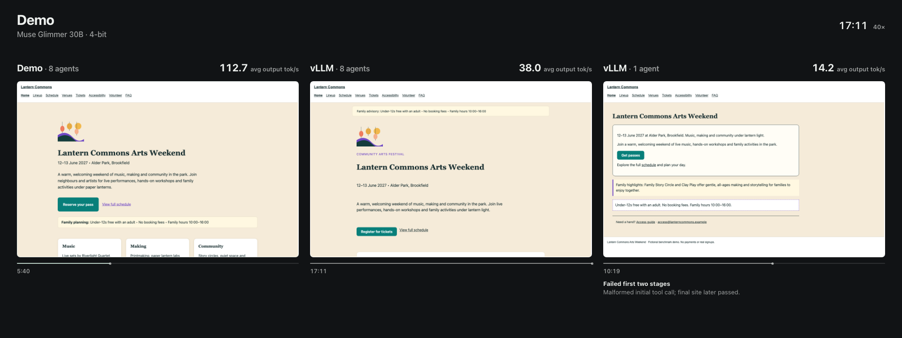
WATCH IT HAPPEN
One task. Three ways to run it.
Notes:
Recorded comparison video: /Users/michaelli/Desktop/Demo Comparison.mp4 . Poster from results/fleetpi/presentation/annotated-demo/poster.png. The single-agent vLLM run failed the first two stage checks, so its runtime is not a comparable successful staged task result. The main speedup compares only matched eight-agent successful workflows.

Slide 9
FLEETLLM
More useful work per local machine.
Coordinate the agents.
Reuse the context.
Keep the engine busy.
One terminal experience—from task to verified result.
Notes:
Implemented elements include engine-aware admission, stable shared-prefix placement, simultaneous shared-prefix coalescing, KV reuse/COW, verified n-gram speculation, Metal/NAX four-bit kernels and ready-agent checks. No learned DFlash drafter, T-MAC, approximate layer skipping or TEAL used in this result. These are configuration-level gains on this workload, not a universal engine speedup.

Slide 10

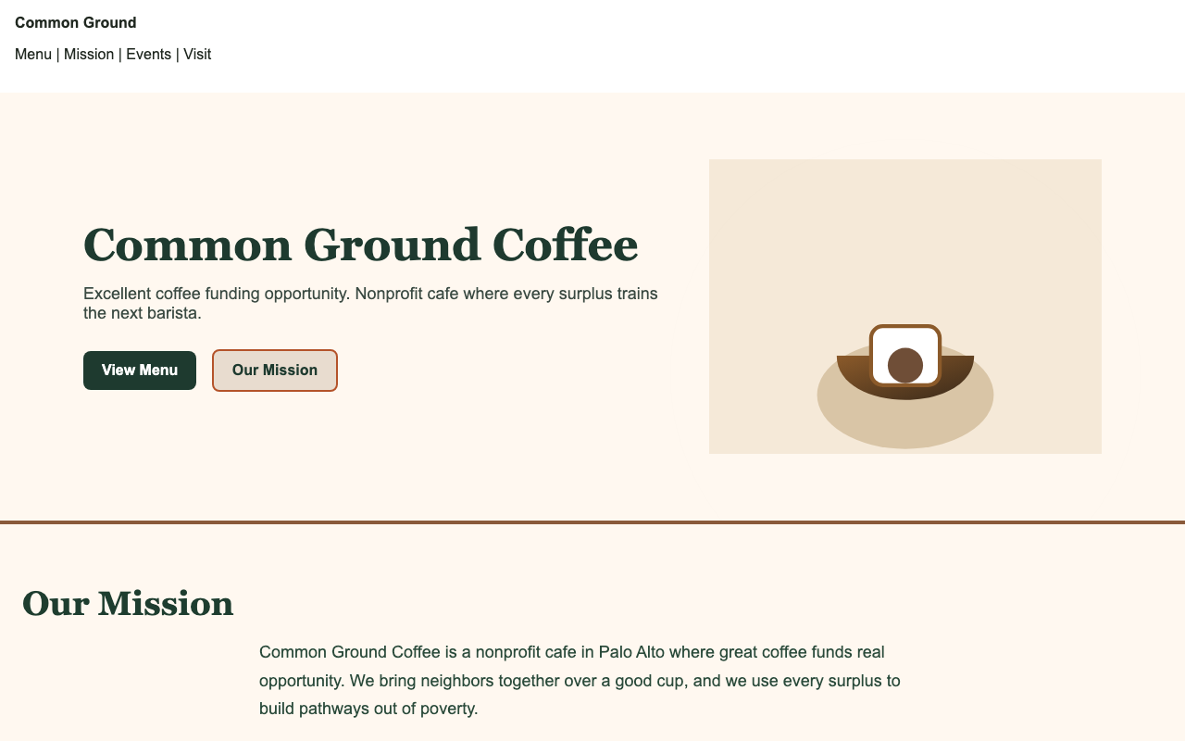
RASPBERRY PI · WEBSITE DEMO
A website built by agents on the Pi
Before
After · latest generated view
Muse Glimmer 30B Q2_K · FleetLLM CPU · eight agents
Notes:
Actual screenshots from the Raspberry Pi website run, not from the Mac comparison. Initial capture frame-000000.png and latest sampled frame-001673.png, both from /Users/michaelli/code.tmp/GithubDevelopment/constrained-inference/results/pi5/2026-11-04/coffee-site-v2-fleet8/capture/frames/. The second screenshot is a work-in-progress snapshot, not a claim of completed benchmark checks. Pi runs Glimmer30B Q2_K CPU with8agents; harness runs on the Mac. Local Claude project transcript a9280fa7-d291-433a-92ed-1f895603f8b4.jsonl documents the run and a separate Claude menu-edit copy; that separate copy is excluded here. Header/menu agents were still working in the recorded run. Capture metadata: /Users/michaelli/code.tmp/GithubDevelopment/constrained-inference/results/pi5/2026-11-04/coffee-site-v2-fleet8/capture/capture.json .

