Slide 1
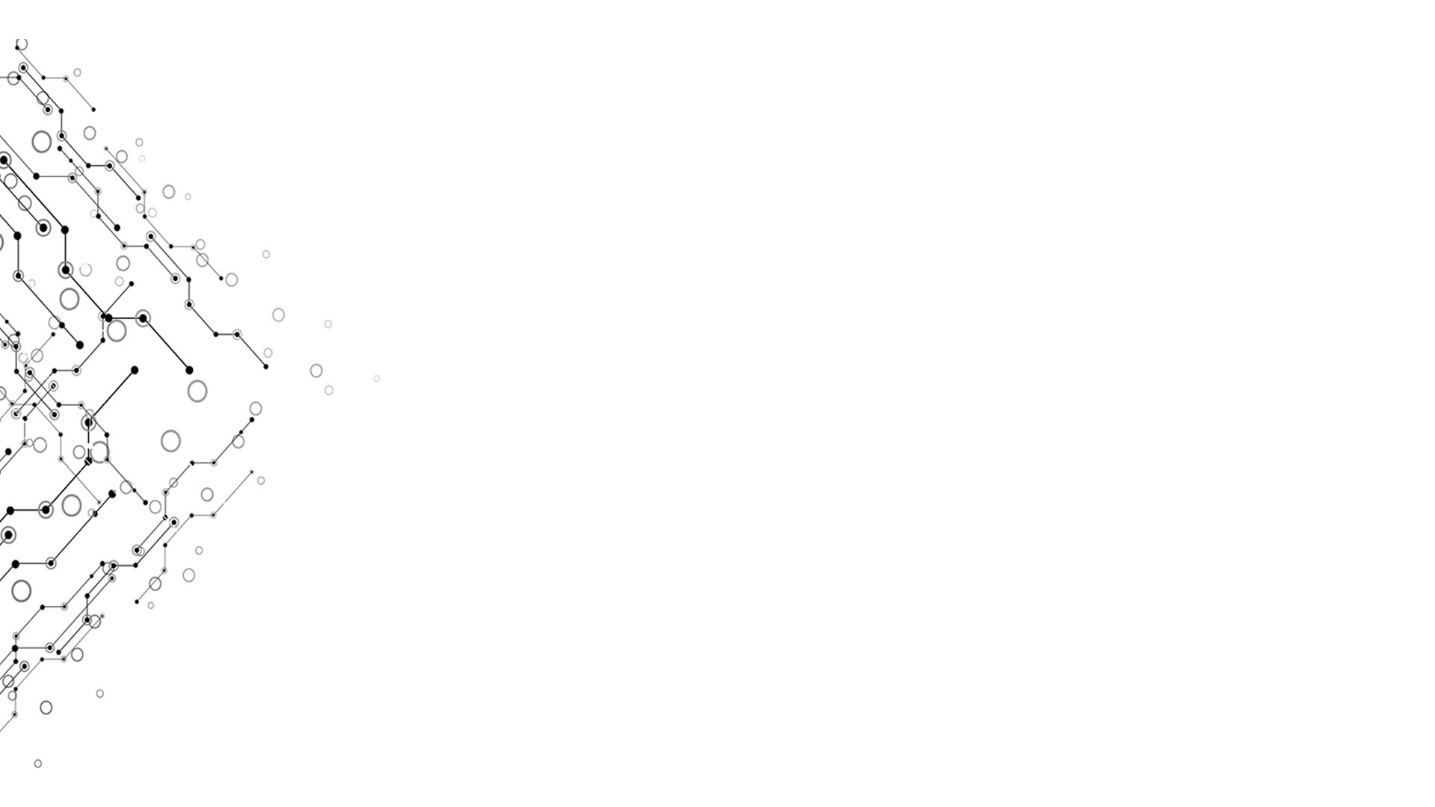

Weekly Report 12
Computational Thinking and System Design
金帆
李浩源
Week 12

Slide 2
逻辑模型
输出：
包含 HttpWebApi 模块的 JackCompiler，并在云端部署
过程：
阅读教材，大部分内容没有结合实例
用样例程序编译 PongGame 例程
直接对比 jack 和 vm 文件
效果：
程序代码写完，并通过样例程序测试
Beyond Compare 文本比较工具
外部因素：
组员们之间的交流沟通较少。
李闫涛同学退课
希望与第1组合写编译器出版物
背景：
第9、10、11章代码全部写完
准备开始写出版物
目标：
写出版物
输入：
课本（7、8、11章）
样例程序（vital）
Nand2X资源库
其他课程的同学在维基的内容

Slide 3

Summary of Projects 9 & 10
Week 12
Game 2048 in Jack
Add an AI based on Minmax tree and alpha-beta pruning?
Tokenizer in Java
Analyzer in Java
Recursive-descent LL(0) parser
RESTful Web API
Computational Thinking and System Design

Slide 4
Rules of 2048 game
The game has a 4-by-4 grid and some blocks with value on it
Press arrow keys to move
During a move operation
all blocks are moved to that direction
Two blocks with the same value which are adjacent and are added together, forming a new block with the added value
A block with value 2 or 4 is placed on a random place
When a block with value 2048 comes up, the player wins
When there is no valid operation, the game is over

Slide 5
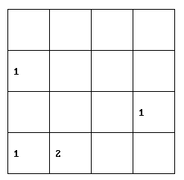
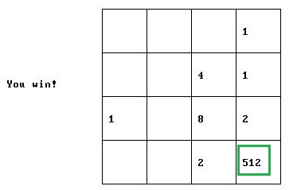
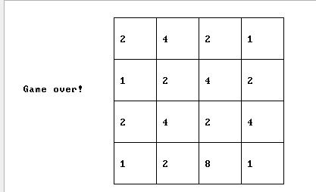
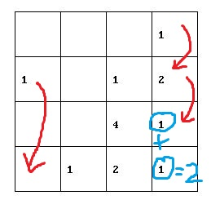
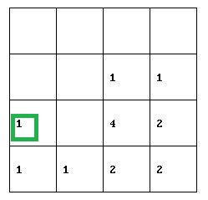
2048游戏规则
游戏界面有4x4的方格，其中一些格子上有数字
用方向键移动，若此方向上可移动，每次移动
所有方格都移到该方向的尽头
同方向上无分隔的两个具有相同数字的方格合为一个，数字相加
在随机一个空格上放一个2或4
若出现2048则判定为胜
若四个方向均不可移动则游戏结束
按下“↓”键

Slide 6
Project 11: Jack Code Generator
Still recursive-descent on an XML document
procClass(): generate a hashmap for all fields and for static members
Records locations in memory relative to registers “this” and “static”
procSubroutineDec():
Constructor: Allocate memory for all fields; set pointers to “this”; call Method
Method: generate a hashmap for “arguments”; do each statement
Function: generate a hashmap for “arguments”; do each statement
procVarDec(): generate a hashmap for local variables; set “local”
procStatement(): recursive-descent on Expressions and Terms

Slide 7
Project 11: Jack Code Generator
procSubroutineCall(): calculate & push arguments; call; pop return
procExpression(): calc terms using procTerm(); post-order operators
procTerm():
Integer: push constant
String: push characters one after another
VarName: look it up in hashmaps; push the value in that address
VarName[]: look it up in hashmaps; push the value in that address plus offset
UnaryOp: push the succeeding term using procTerm(); unary operator
https://github.com/kingium/JackCompiler (installation guide in README.md)

Slide 8
Obstacles
Handling Multiclass files:
C++: Compile each source file separately before linking
Declaration and implementation in different files
Source files (implementation) need to include header files (declaration)
Java: Compile all source files as a whole, in various namespaces
Both declaration and implementation in one file
No need to include other class files
compiler looks them up automatically
Jack: Concatenate source files into one jack file before compiling it *
Treat each class separately, like in C++
No need to look up definitions of other classes in need
Because Jack is neither strong type nor compiler-time safe
* Thank you, 王抒阳!

Slide 9
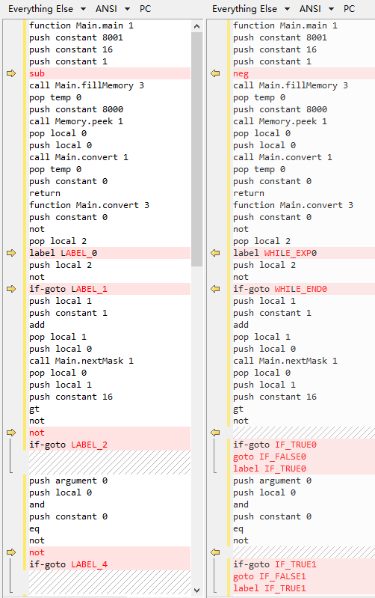
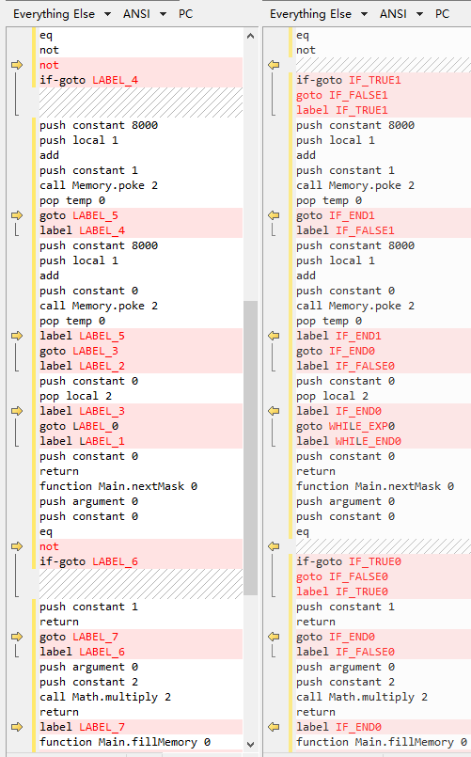
验证： 仅标签名称有所出入

Slide 10
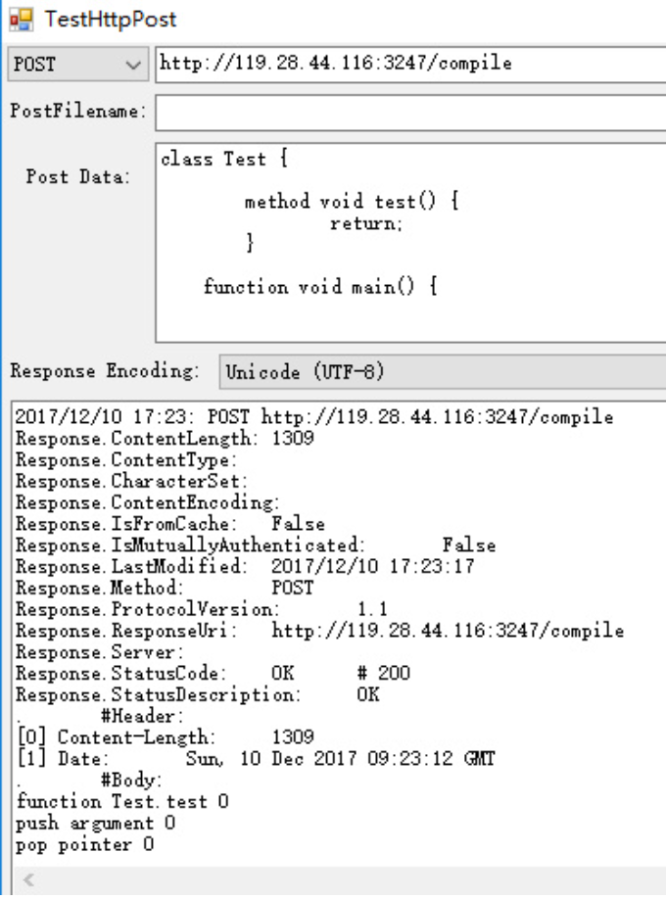
Http Web API
GUI Test tool
./TestHttpPost/TestHttpPost.exe
written in C#
http://119.28.44.116:3247/compile
http://119.28.44.116:3247/analyze

Slide 11
Time for Demo!

Slide 12

学习笔记
每个类对应一个单独的 vm 文件
每一个 constructor、method 或者 function 对应一个 function
命名规则是“类名.函数名”。不同类的函数名称可以相互区分。

Slide 13
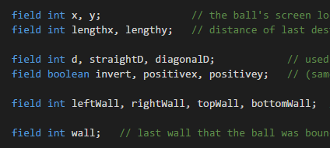

学习笔记
在每个类的 constructor 中，首先分配内存，分配的内存长度等于该类的 field 个数之和（相当于给该实例的每个 field 分配内存）。

Slide 14


学习笔记
在每个函数中分配内存后，就是处理变量声明了。
变量声明并不显式对应代码，但是编译器需要记下各个局部变量的名称及其在栈上的位置。
（例如 push local x 中的数字 x 是多少）

Slide 15

学习笔记
变量声明后就是各种语句。
语句遵循后缀表达式，同样采用递归式生成。
所有变量名称需要查询 symbol table（由编译器维护），转换为相应的 argument 或者 local 内存位置。

Slide 16


学习笔记
类的 static 成员使用专门的 static 内存区。
具体用法参见 PongGame.vm 的 newInstance 函数。

Slide 17
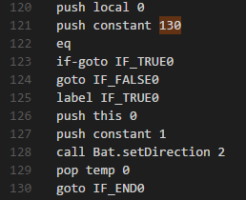
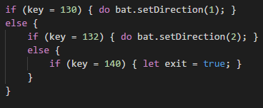
学习笔记
赋值语句使用成对的 push 和 pop 实现。
函数调用，先将参数压入栈，然后调用栈，再弹出返回值。
if、while 语句需要使用 if-goto 指令，配合不同的 label。

Slide 18
文档大纲
3. Code generation
Stack-based VM
Memory allocation
Parsing expressions
Subroutine calls
Obstacles
Comments
4. Game 2048: an app
5. Documentation
Java docs
Readme file
References
0. Introduction
How compilers work
Logical model
Introduction to Jack Language
1. Tokenization
Finite state machines
Design Tokenizer module by contract
2. Syntax tree
Tree and its traverse
Stack and recursion
Design Analyzer module by contract
Disambiguation
Obstacles
Comments
Dockerization
任务分工：金帆 李浩源

Slide 19
Invitation to Group 1
Group 1: implements parser from functional programming perspective
LEX, RegEx
Group 2: implements parser using recursive-descent
Java, Java, Java
We would like to invite group 1 to collaborate with us in writing the textbook-like publication, providing various approaches on the same problem.
It will surely enrich the diversity of our work if you join us!

