Slide 1
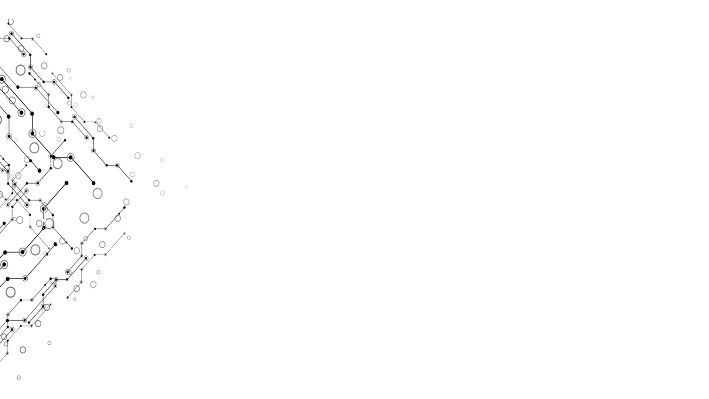

Thread
Computational Thinking and System Design
Group 1
Week 12

Slide 2
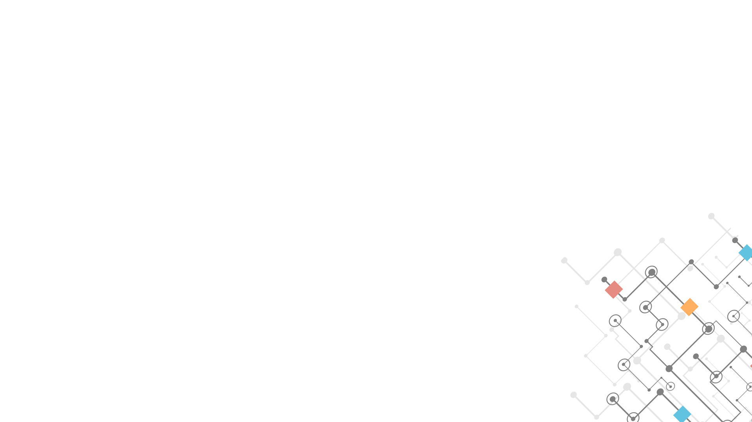

Logical Model
Week 12
Input
The Elements of Computing System Book
Nand2tetris Book
Output
Reports
The part of Project 12 and Project 10 in our publication.
Progress
学习八叉树四叉树
整理以前进行展示的内容以及编写的代码.
Effect
学习BFS，八叉树四叉树的加速原理
对ANTLR Lex的优劣有了更详细的认识
Computational Thinking and System Design

Slide 3
Thread
Week 12
A thread of execution is the smallest sequence of programmed instructions.
managed independently by a scheduler
typically a part of the operating system.
(could not be regarded as a character of high-level language.)
Computational Thinking and System Design

Slide 4
Create thread
Week 12
Windows vs. Unix
Creating thread —— Windows
Creating Process —— Unix
Factor —— time cost
Computational Thinking and System Design

Slide 5
Why choosing multithreading?
Week 12
Decreasing the time cost of computing (parallel computing)
Better performance of multi-core CPU
Computational Thinking and System Design

Slide 6

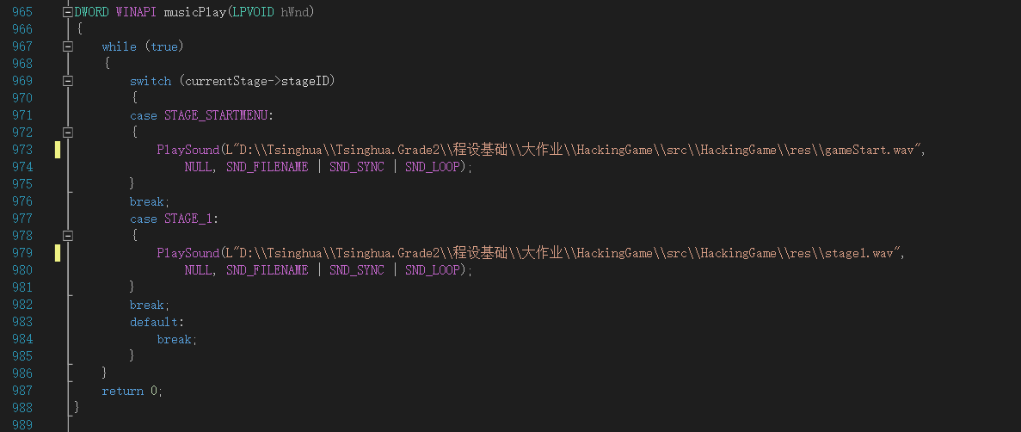
Example
Week 12
Computational Thinking and System Design

Slide 7
Multithreading in tensorflow
Week 12
Accelerate the computing and the building of graph.
Promote the performance of GPU (even TPU)
Computational Thinking and System Design

Slide 8
Week 12
Thank you for your time!
Computational Thinking and System Design

