Slide 1


Computer Architecture
Computational Thinking and System Design
Group 4
Week 10

Slide 2

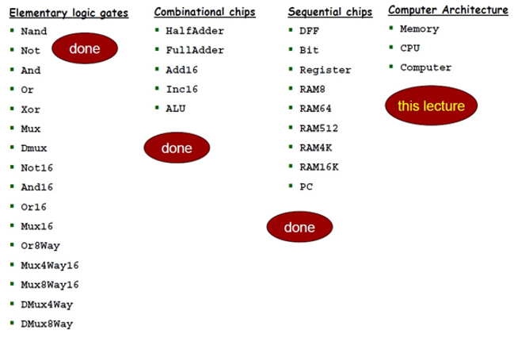

Logical Model
Week 10
Background
Aim
Computational Thinking and System Design

Slide 3
Logical Model
Week 10
Result Output Process Input
Build a Hack Computer, imply computation and data storage functions
Memory
CPU
Computer
To be presented…
Register
ALU
PC
Computational Thinking and System Design

Slide 4
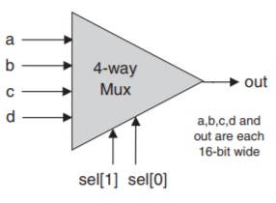
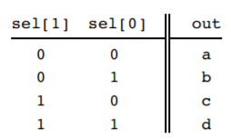
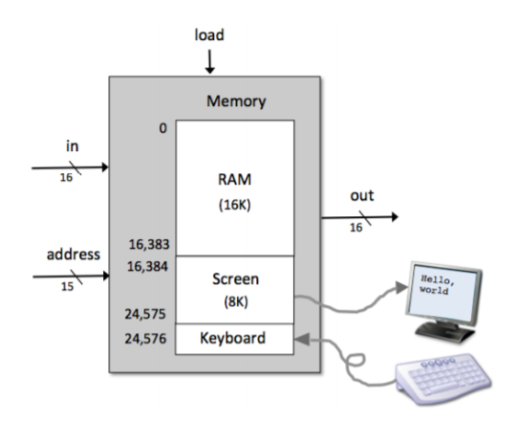
Computer Architecture
Week 10
Memory
16384=100,000,000,000,000
24576=110,000,000,000,000
Address[14]
Address[13]
Computational Thinking and System Design

Slide 5
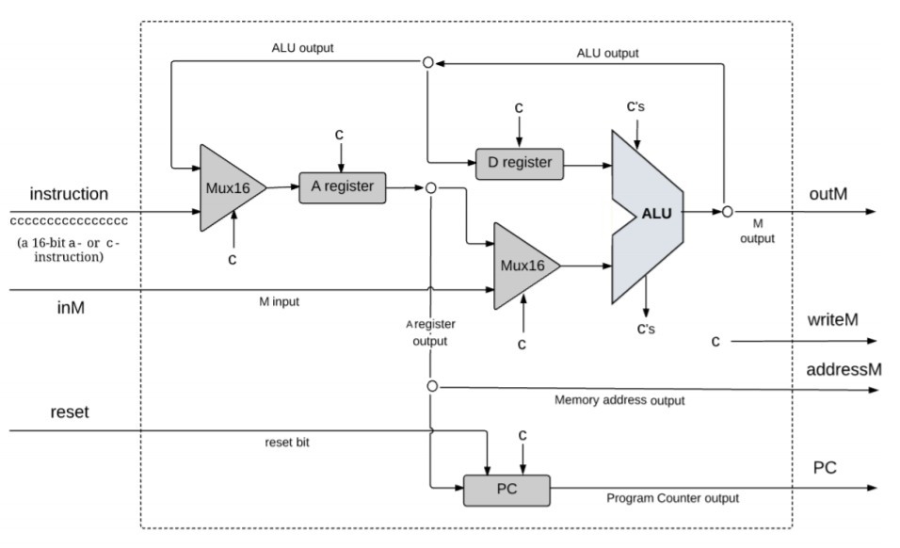
Computer Architecture
Week 10
CPU
Computational Thinking and System Design

Slide 6
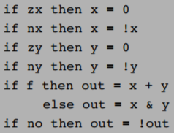

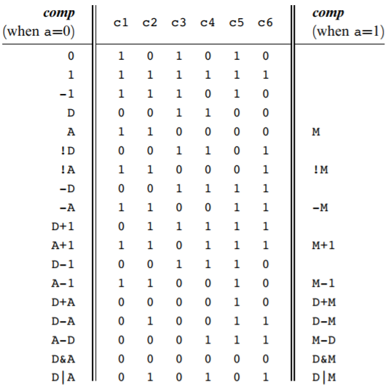
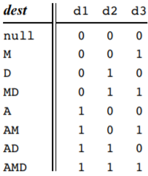
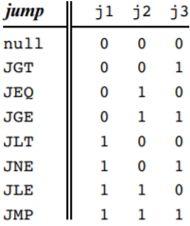
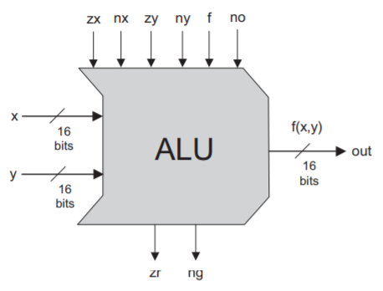
Computer Architecture
Week 10
CPU
D
A/M
Computational Thinking and System Design

Slide 7

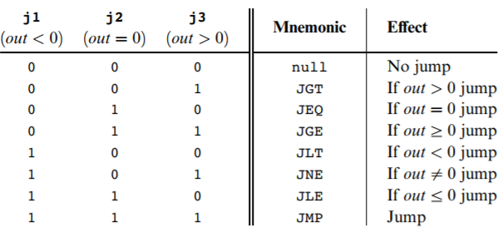
Computer Architecture
Week 10
CPU
Computational Thinking and System Design

Slide 8
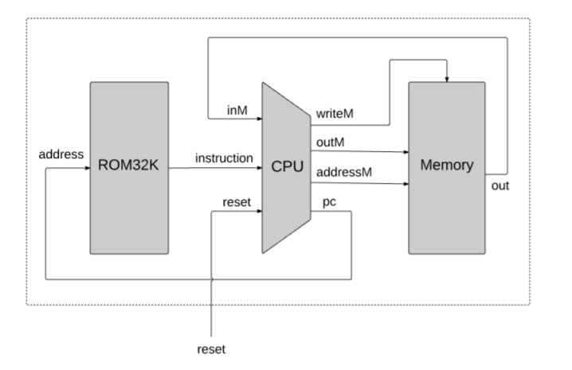
Computer Architecture
Week 10
Computer
Computational Thinking and System Design

