Slide 1
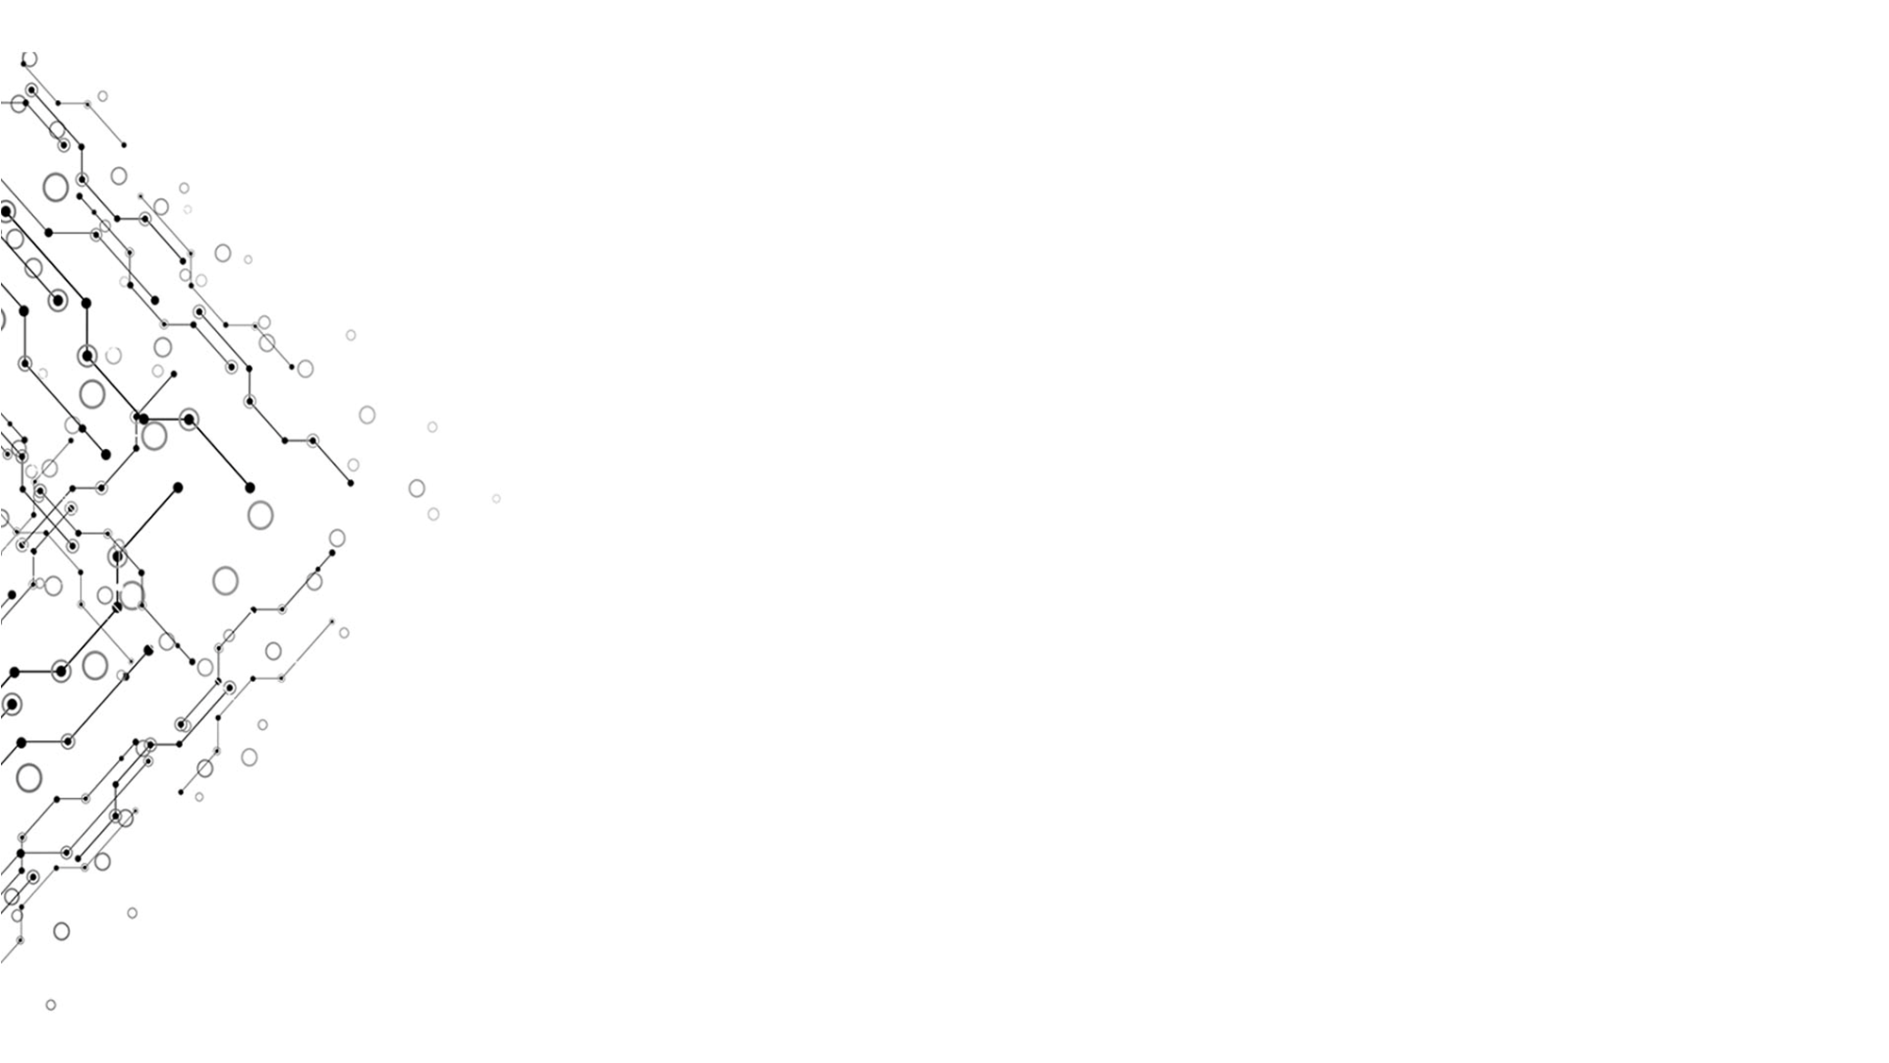
Elements of Computing Systems
Chapter 5
Computer Architecture

Slide 2

Background
Learn about all the chips built in Chapter 1-3 and machine language. Complete Chapter 1-4.
Learn about boolean logic and sequential logic.
Learn about the syntax of machine language.
Basically know about assembly and its translation to machine language.

Slide 3
Goal
Complete a computer which is able to run programs in machine language with chips in chapter 1-3.
Understand the connection between hardware and software.
Understand how a modern computer works at the hardware level.
Learn about von Neumann architecture.
Know memory allocation.
Be familiar with machine language and assembly.
Provide a hardware platform for following chapters.

Slide 4
Output
CPU, memory, computer in HDL
Effect
Complete a computer which is able to run programs in machine language with chips in chapter 1-3 in HDL and pass all of the test scripts.

Slide 5
Input
Elements of Computing Systems p.79-101 chapter 5
Hardware stimulator
von Neumann architecture
Chips built in chapter 1-3
Machine language (binary code)

Slide 6
Process
Base on the syntax and structure of machine language instructions, determine which chip can realize the functions of each part of an instruction.
Analyst the data flow and connect the chips.
Connect CPU and I/O devices to memory base on von Neumann architecture.

