Slide 1
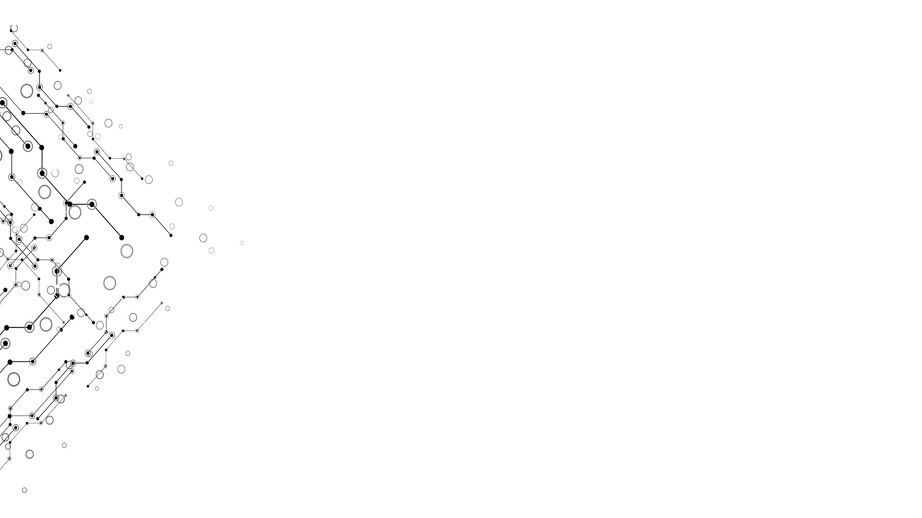

Assembler
Computational Thinking and System Design
Group 4
Week x

Slide 2


Logical Model
Week 10
Result Output Process Input
Realize an assembler translating assembly language into machine language
Assembler
To be presented…
nand2tetris
Computational Thinking and System Design

Slide 3
Assembler
Week 10
Parser Module more command? Command type extract each part
Code Module translate comp\dest\jump into binary code
SymbolTable Module match between a symbol and its address
(xxx) @xxx R1 this
Computational Thinking and System Design

Slide 4

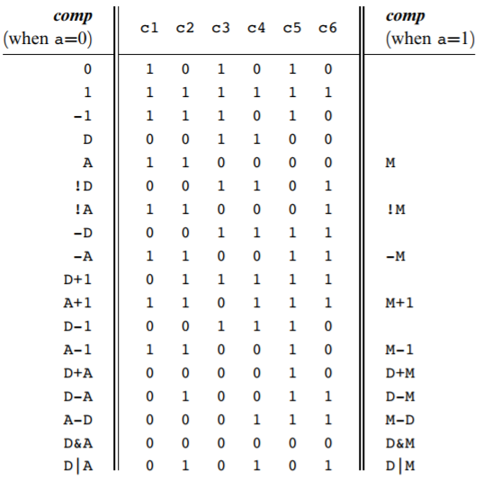
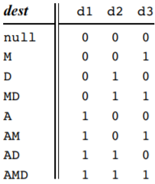
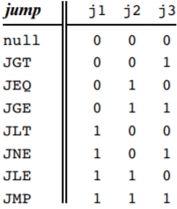
Assembler
Week 10
Computational Thinking and System Design

Slide 5
Week 10
File pointer
Empty space
SymbolTable
Computational Thinking and System Design

Slide 6
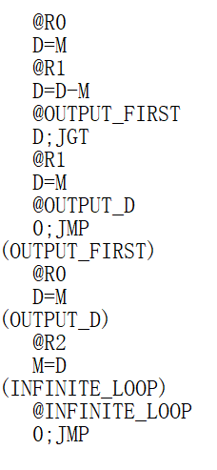
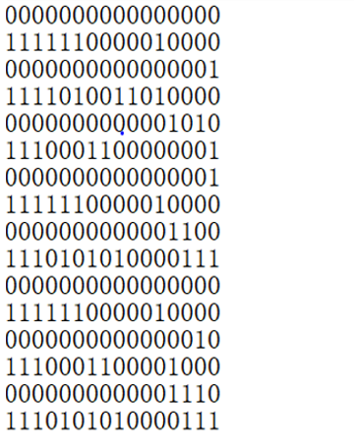
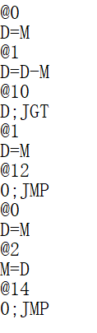
Week 10
Computational Thinking and System Design

