Slide 1
第2小组第8周工作汇报
计算思维与系统设计
金帆、李浩源、李闫涛

Slide 2
逻辑模型
===背景===
学习计算思维
学习不同抽象层之间的关联
学习汇编语言及编译器的写法
===目标===
使零碎的知识形成体系
实现一个 Jack 语言编译器
===输入===
课堂教学PPT
Wiki, Git, Endnote
图书馆借阅《编译器设计之路》
Nand2Tetris教材第10章、第11章
StackOverflow、Oracle等在线文档
===过程===
上课教学
组员互相学习、请教问题
将之前的工作封装成 Web API
学习第11章教材，补学 Hack 汇编语言
===输出===
个人学习报告
自编教材初稿的大纲
Nand2Tetris推进到第7章
===效果===
所写的 Web API 通过 TestHttpPost 工具的测试
所写的章节作业通过各自的测试脚本

Slide 3
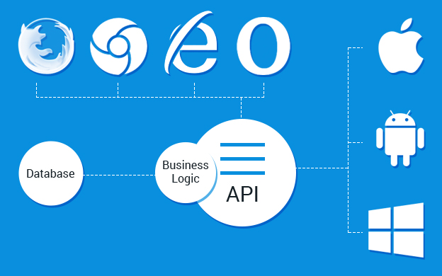
Why Web API
对通信的抽象
Request -> Response
前后端分离
Cloud computing
手机 app 页面基于 HTML5
RESTful API
https://www.b3net.com/wp-content/uploads/2015/10/web-API.jpg

Slide 4
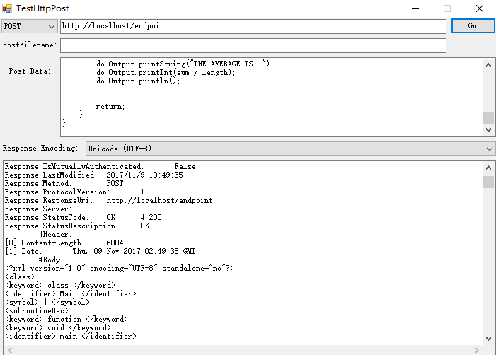
小组工作
RESTful Web API
GET (浏览网页)
POST (登录账号)
PUT (更新资料)
DELETE
Client
浏览器
移动 app
Server

Slide 5
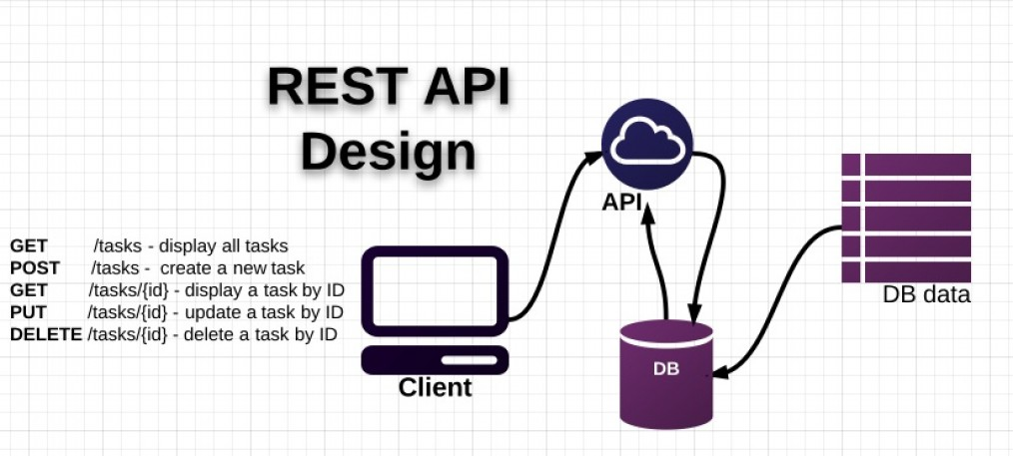
Web API 与 计算思维
Easy to deploy on Docker
Abstraction
Modularization
RESTful means standardization
https://maxoffsky.com/word/wp-content/uploads/2012/11/RESTful-API-design-1014x457.jpg

Slide 6
文档大纲
3. Code generation
Stack-based VM
Memory allocation
Handling Lifecycle
Parsing expressions
Subroutine calls
Obstacles
Comments
4. Documentation
Java docs
Readme file
References
0. Introduction
How compilers work
Logical model
1. Tokenization
Finite state machines
Design Tokenizer module by contract
2. Syntax tree
Tree and its traverse
Stack and recursion
Design Analyzer module by contract
Disambiguation
Obstacles
Comments
Dockerization
任务分工：金帆 李浩源 李闫涛

Slide 7


Tree and its traversal
+
Inorder
Human readable
Postorder
Machine readable
Abstract operand
Arithmetic operand: + - * /
Subroutine call: func(args)
Statements: if(expr) {statements}
$$a×b×(c−d)+e$$
*
e
$$ab×cd−×e+$$
*
-
a
b
c
d

Slide 8

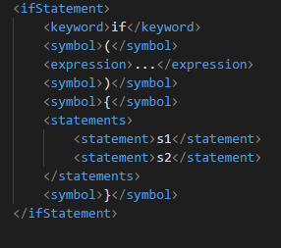
Abstract operands
if
Equivalent to:
>
{}
*
-
s1
s2
a
b
c
d

Slide 9
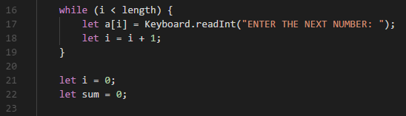
Design Analyzer Module by Contrast
What is design by contract?
Top-down Recursive Analyzer
Assume that each handler starts right after the beginning token
Each handler returns right after the token following the ending token
The tokenizer is assumed here when a “whileStatement” handler starts.
The tokenizer is assumed here when a “whileStatement” handler returns.

Slide 10
Disambiguation
Instead of starting before the beginning token and returning after the ending token, our handlers have one-token offset.
This helps disambiguate between “if” and “if-else”, as our handlers are able to read one token ahead to check if a “else” follows.
This does not contradict the LL(0) rule, since tokenizer stores its last token until it advances to the next token.

Slide 11
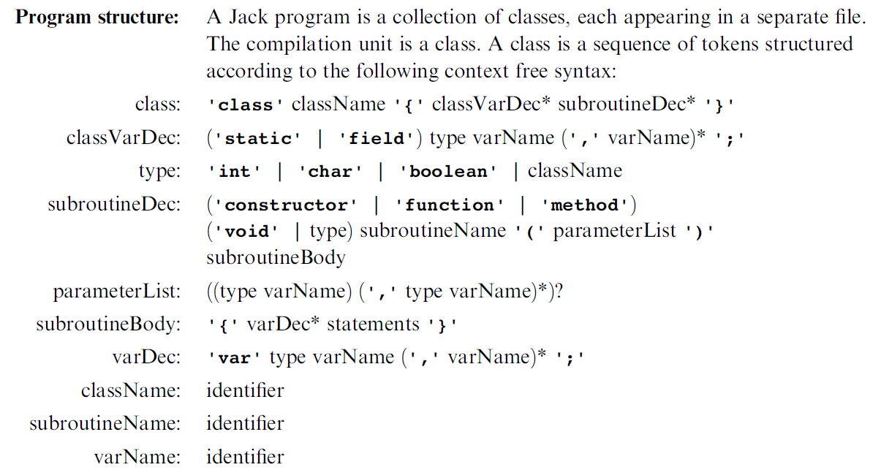
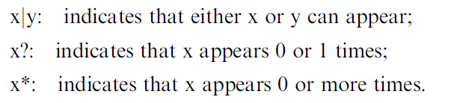
Case Study: subroutineDec

Slide 12
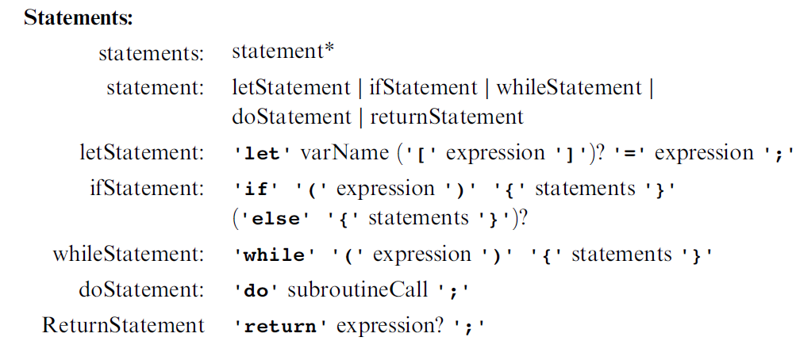
Case Study: ifStatement

Slide 13
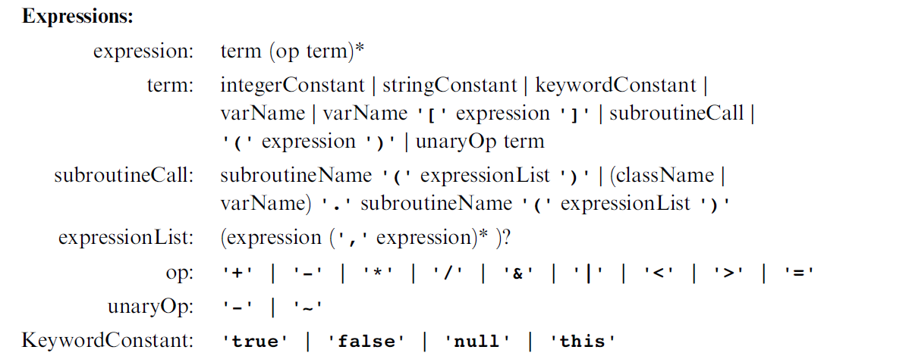
Case Study: term

Slide 14
Comments
Another group use RegEx-based tools, such as Lex
Functional programming
We use process oriented programming plus a bit of OOP
Power of Top-down recursion
One problem, various approaches

