Slide 1
计算思维与系统设计基础
Weekly report
Week 2
第四组
田卓钰 孔德嘉 南佳凡

Slide 2
Chapter 3 Sequential Logic
时序逻辑
工物40 孔德嘉
2017年10月

Slide 3
Combinational Logic
Sequential Logic

Slide 4
Combinational Logic
Sequential Logic
Maintain state

Slide 5
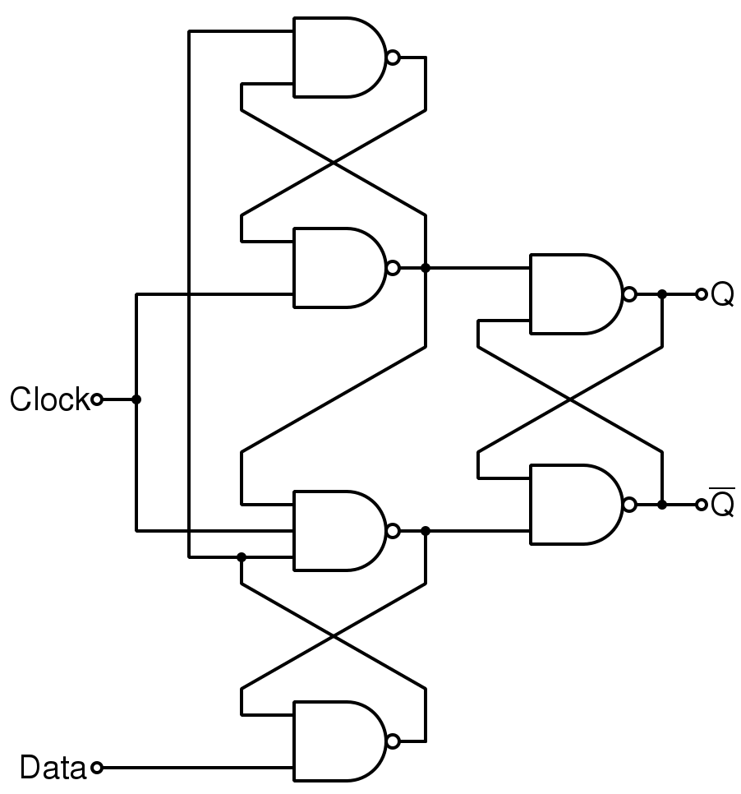
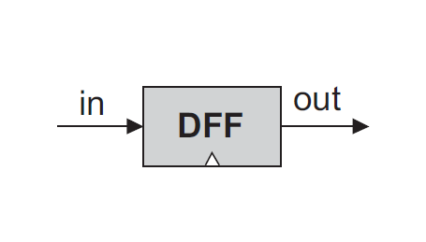
Combinational Logic
Sequential Logic
Maintain state
data flip-flop
D触发器
out(t)=in(t-1)

Slide 6
DFF(built in)
Register
Memory
Counter
1-Bit Register (Bit)
w-Bit Register
8-Register Memory (RAM8)
RAM64
RAM512
RAM4K
RAM16K

Slide 7
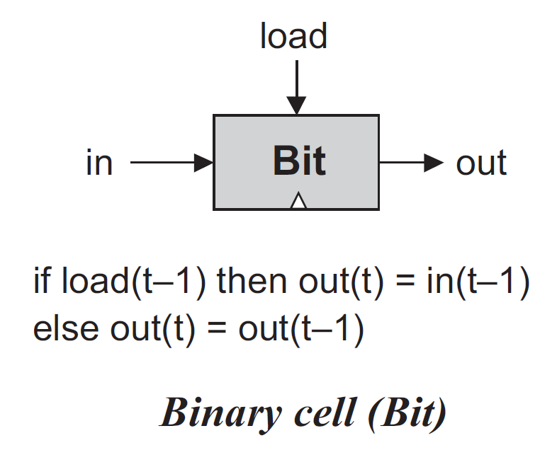
1-Bit Register (Bit)

Slide 8
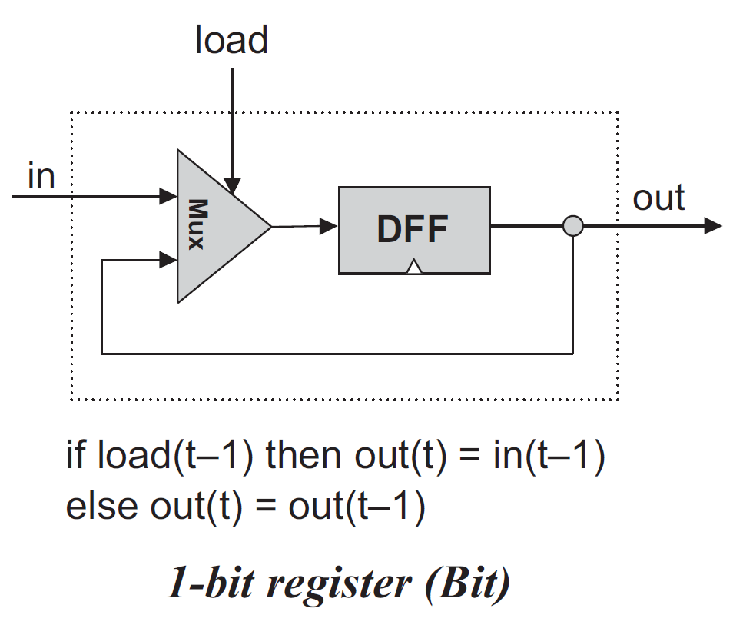
1-Bit Register (Bit)

Slide 9

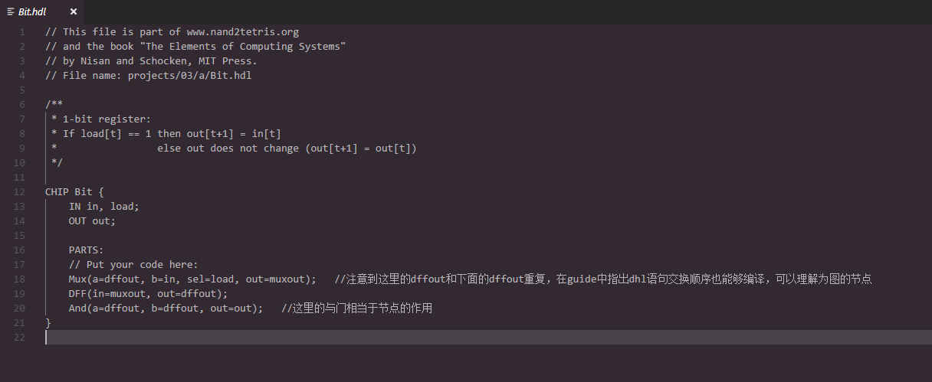
1-Bit Register (Bit)

Slide 10
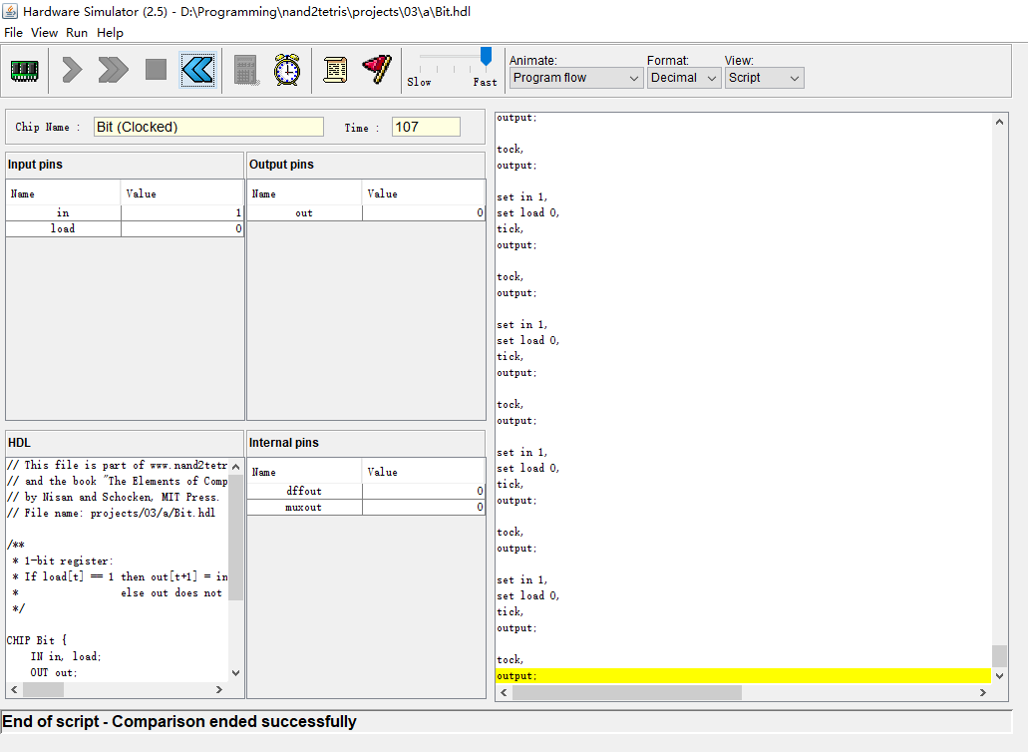

Slide 11
谢谢！

Slide 12
Project 4
Machine Language Programming
南佳凡 自64

Slide 13
知识内容
Assembly Language
Assembler
CPUEmulator

Slide 14
题目
1.mult
Multiplies R0 and R1 and stores the result in R2.
(R0, R1, R2 refer to RAM[0], RAM[1], and RAM[3], respectively.)

Slide 15
MULT
输入：R0 , R1
过程 : 循环，R1个R0相加
输出 : R2
效果 : R2=R0*R1

Slide 16
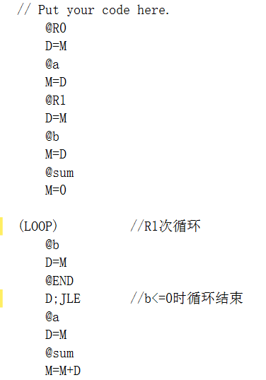
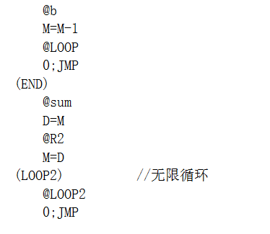

Slide 17
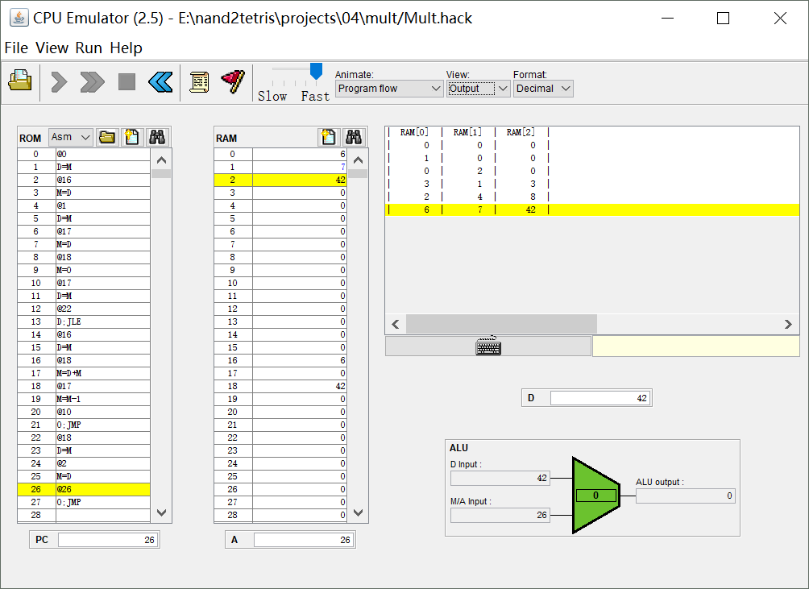

Slide 18
谢谢！

Slide 19
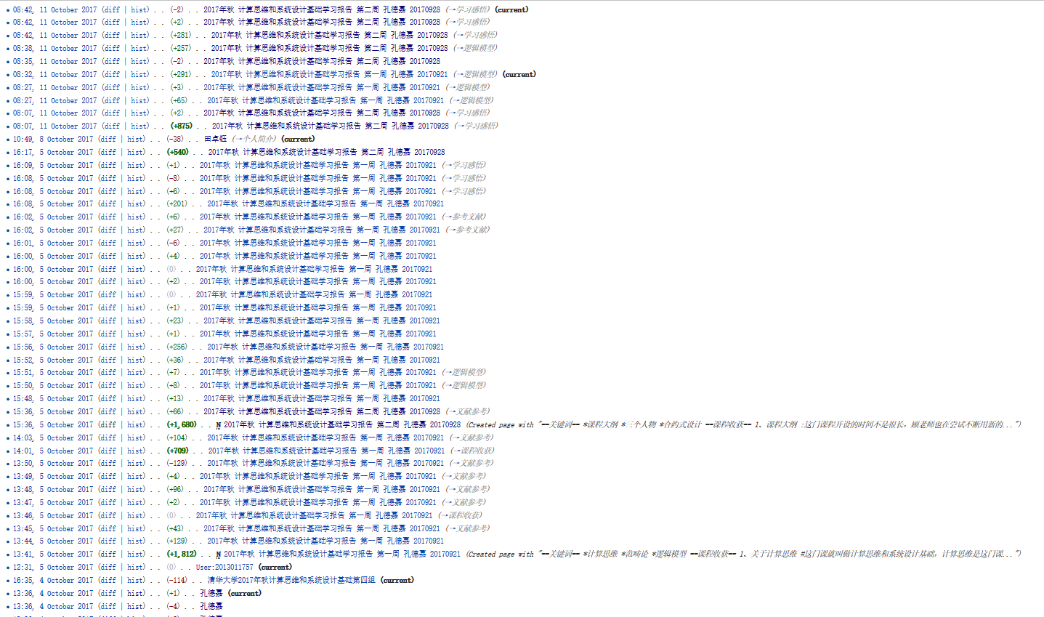
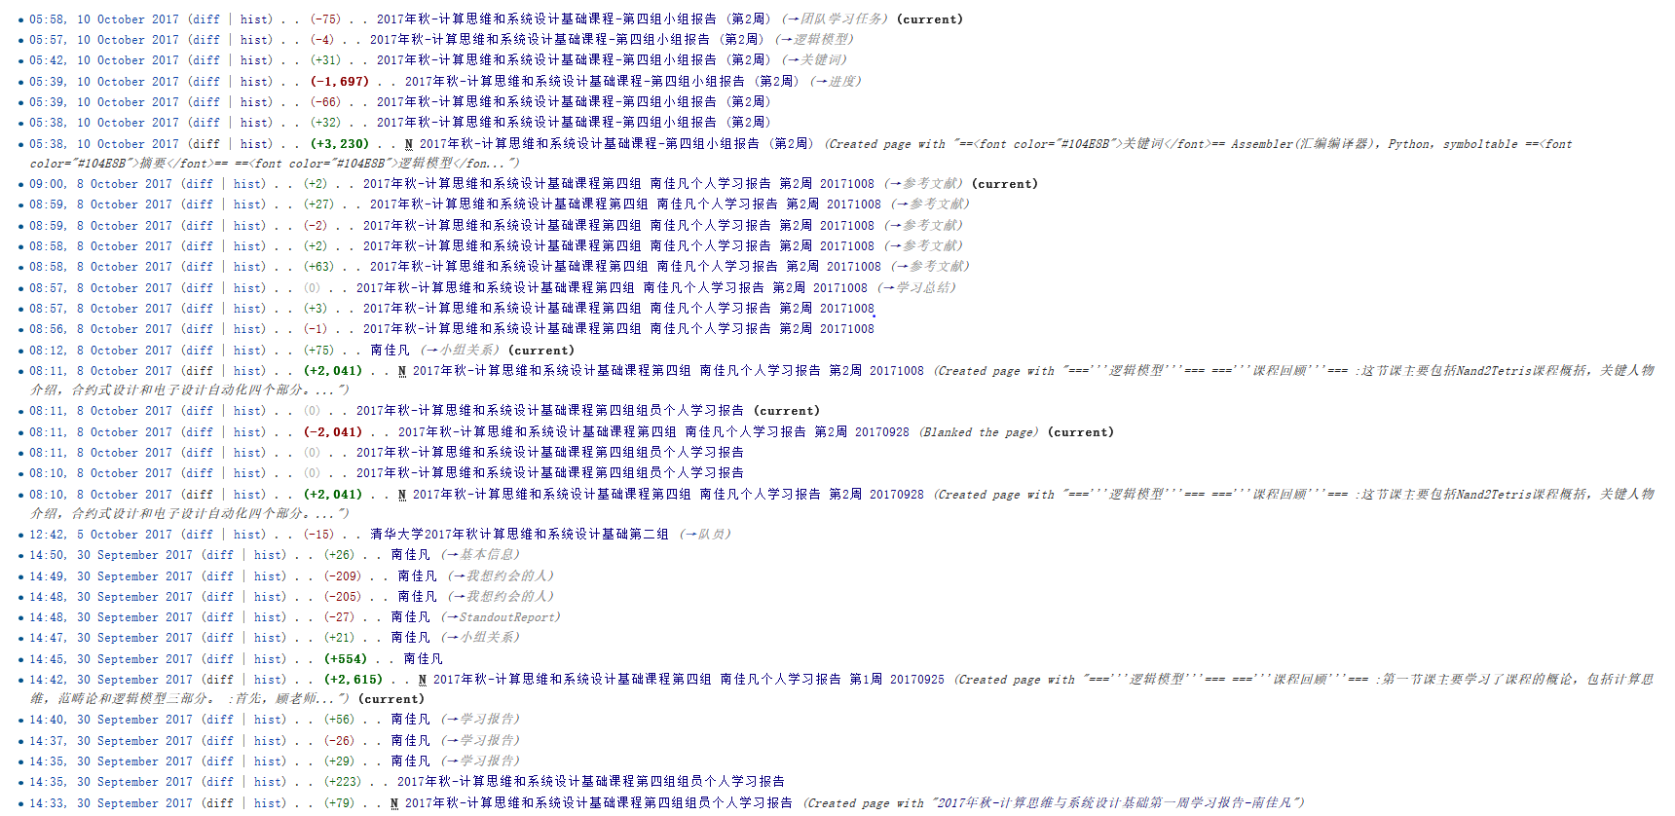
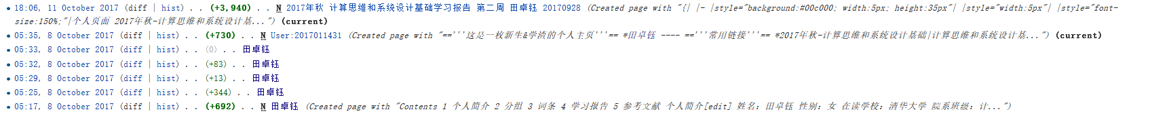
Wiki活跃度

Slide 20
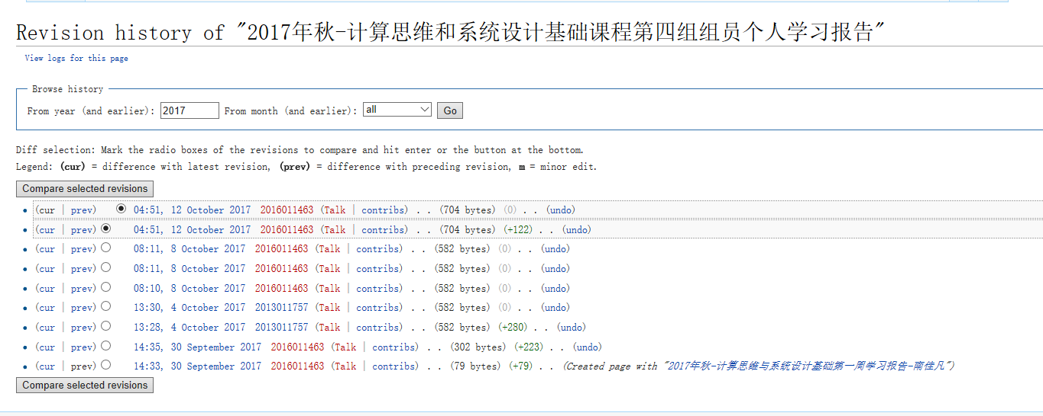
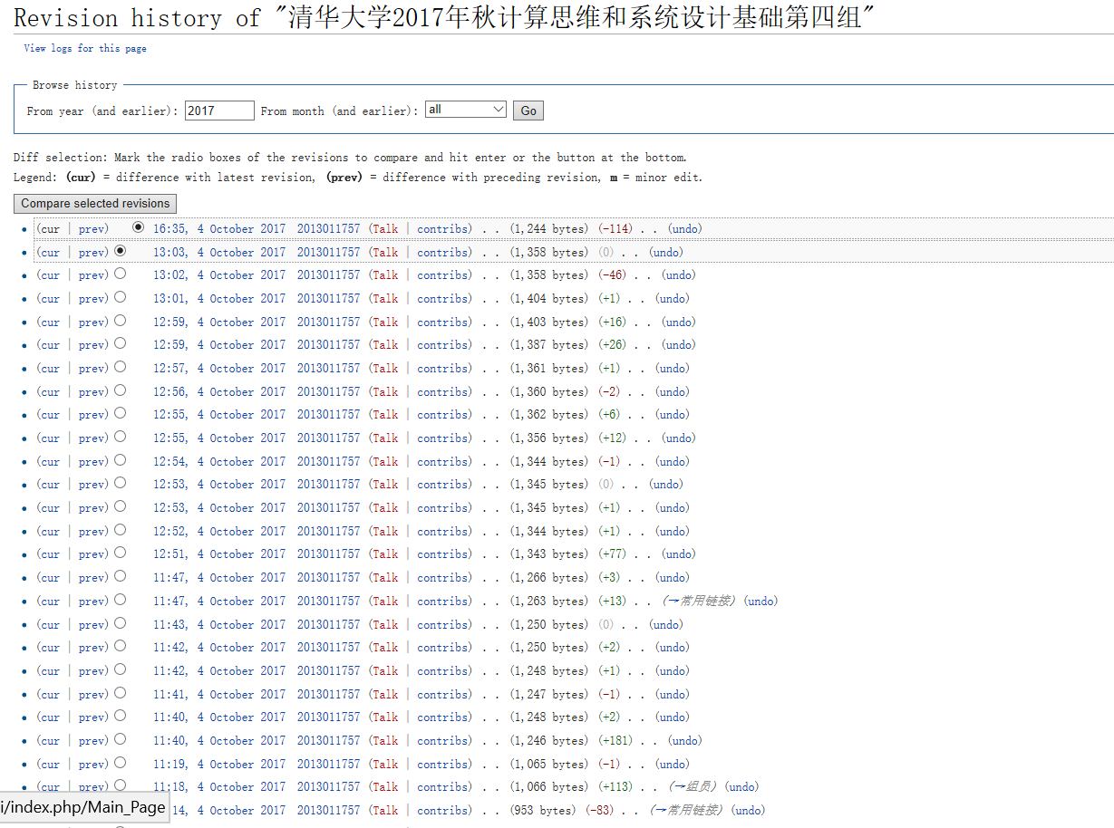
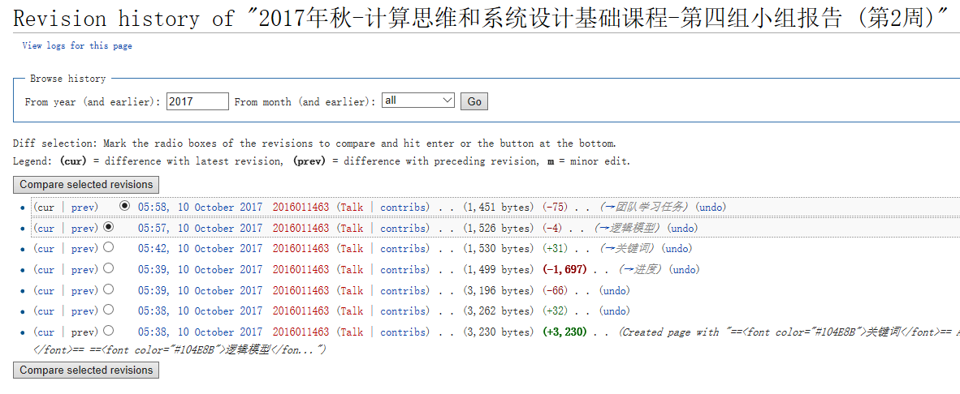
Wiki活跃度

Slide 21
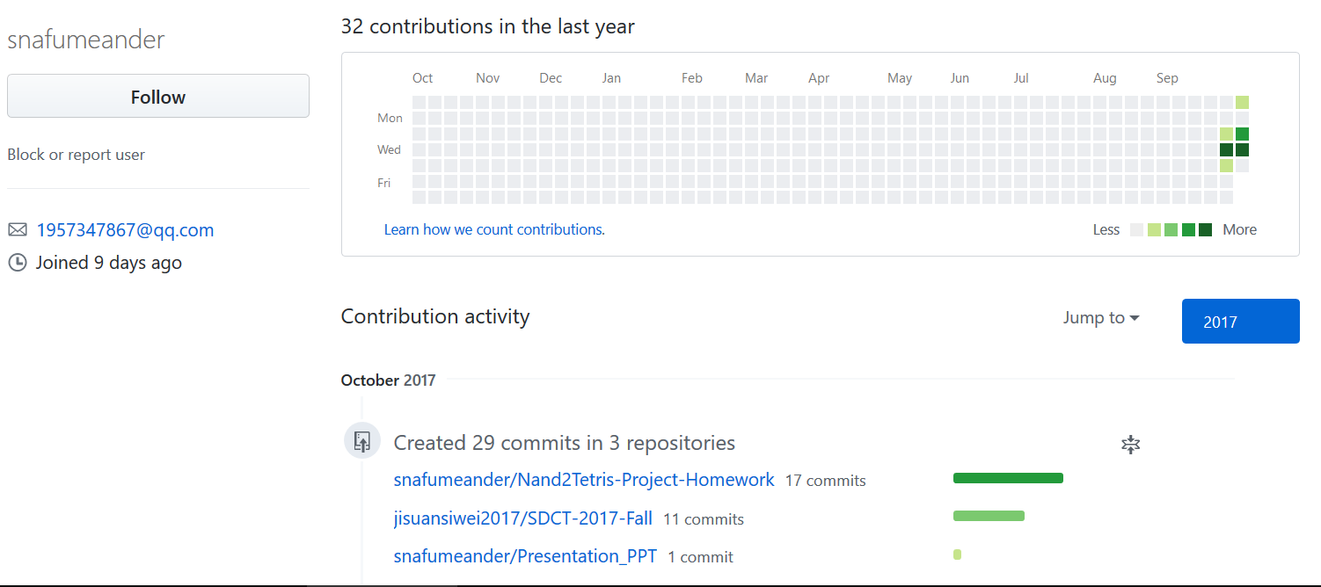
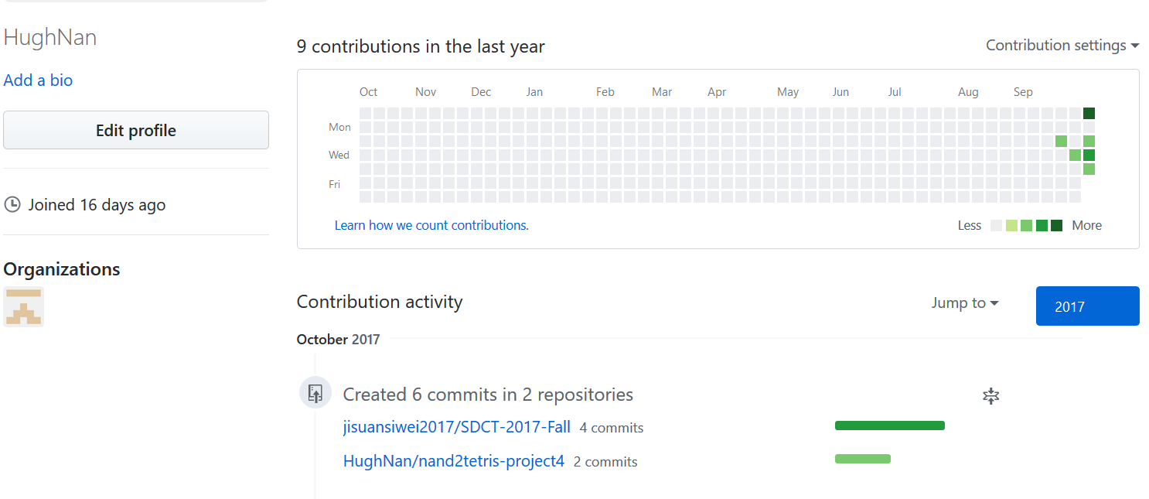
GitHub活跃度

