Slide 1
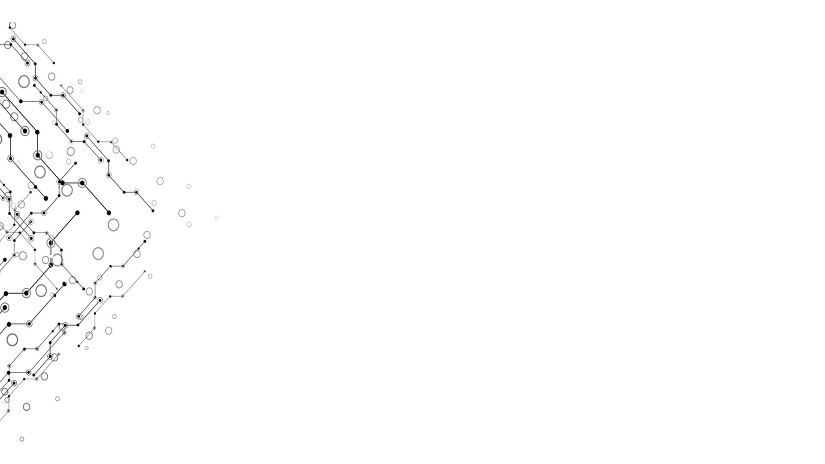

About Hash Table & Docker
Computational Thinking and System Design
Group 1
Week 11

Slide 2
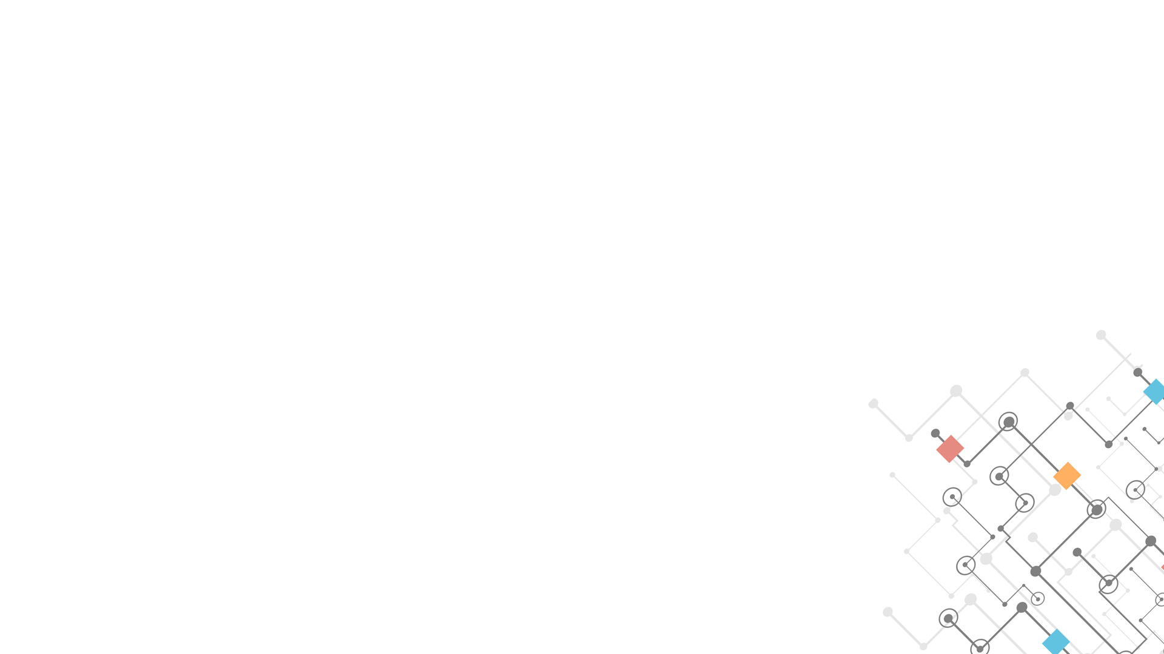

Logical Model
Week 10
Input
Nand2tetris
Introduction to Algorithms
The Elements of Computing System
Output
Reports
Progress
学习八叉树四叉树
阅读其他章节获得灵感
尝试实现哈希表等
Effect
Know some other things that may relate to this course
Computational Thinking and System Design

Slide 3
Hash Table (Symbol Table)
Week 11
The Combination of Arrays and Linked Lists
Hash Functions
Very practical
Computational Thinking and System Design

Slide 4
Array vs. Linked List
Week 11
O(logN) for search
O(N) for insert, delete
O(1) for insert
O(N) for search, delete
Computational Thinking and System Design

Slide 5
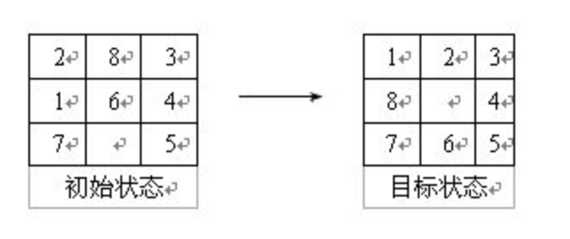
Example
Week 11
BFS for search
Hash Table for judging states
Computational Thinking and System Design

Slide 6
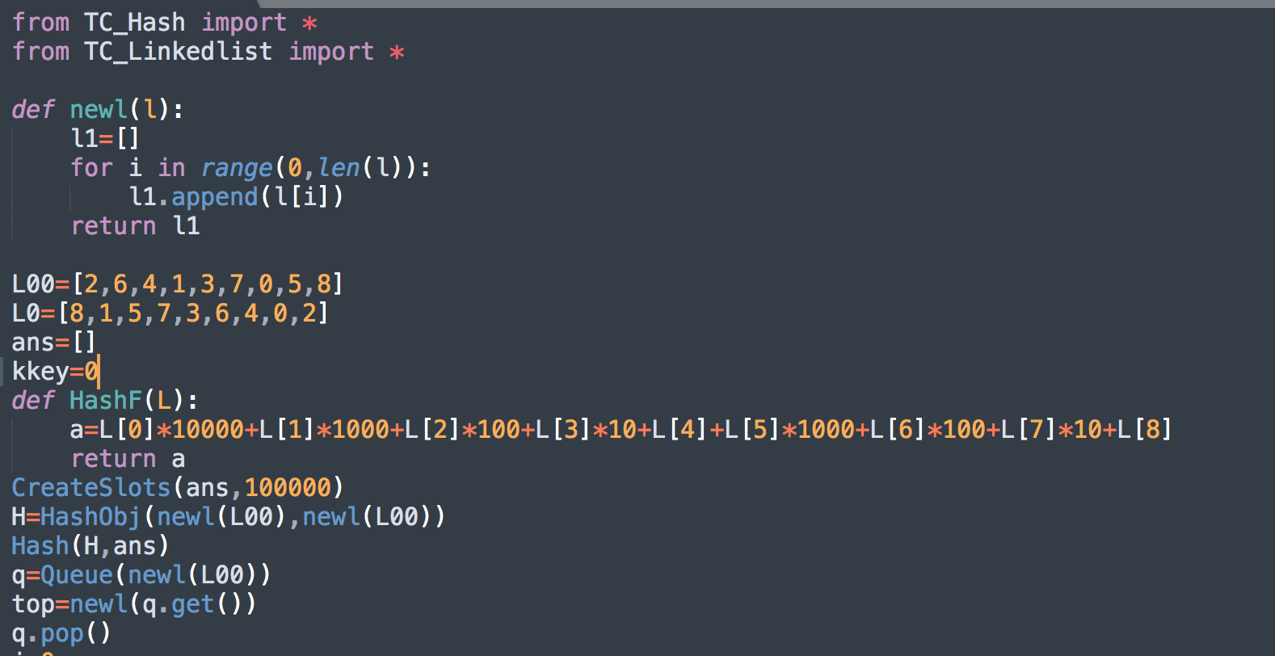
Example
Week 11
Computational Thinking and System Design

Slide 7
Week 10
Thank you for your time!
Computational Thinking and System Design

