Slide 1
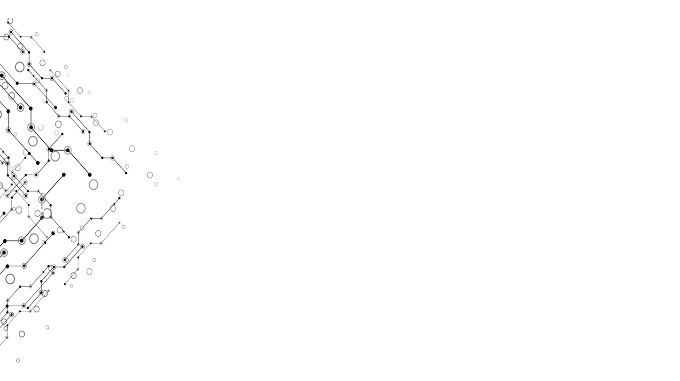

Weekly Report 12
Group 4
南佳凡
孔德嘉
田卓钰
Week 12

Slide 2

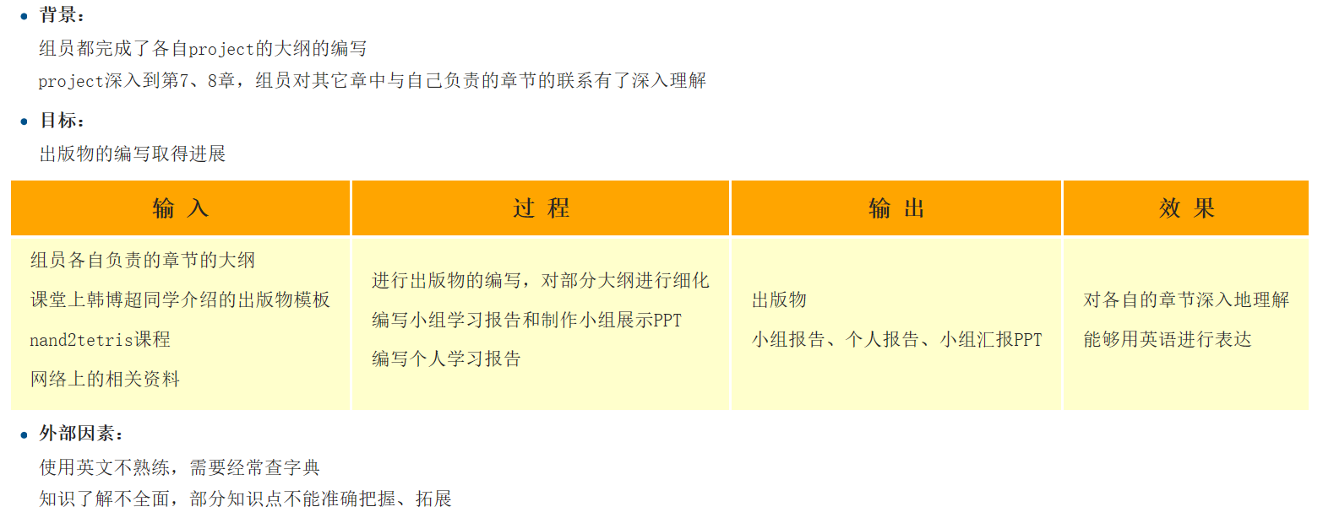

逻辑模型
Week 12
Computational Thinking and System Design

Slide 3
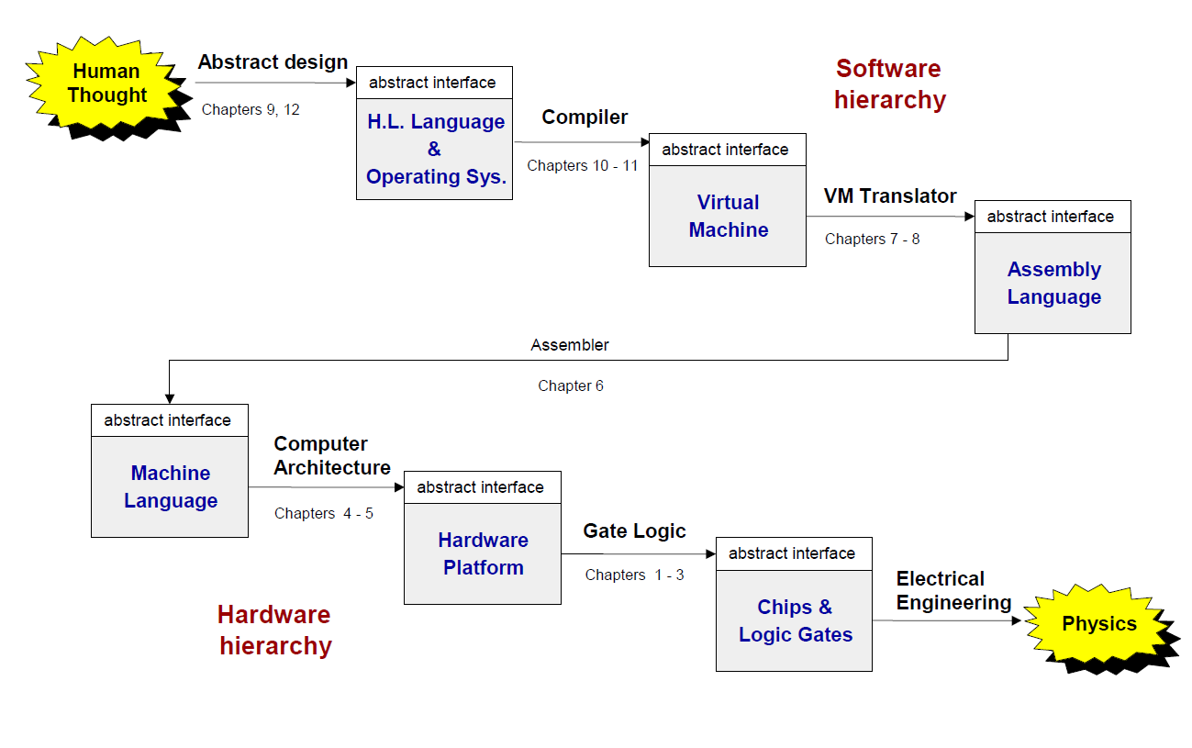
学习虚拟机
Week 12
Computational Thinking and System Design

Slide 4
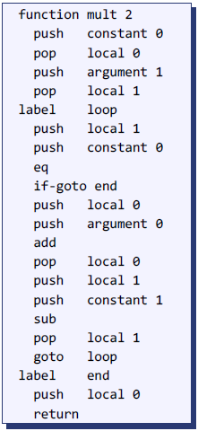
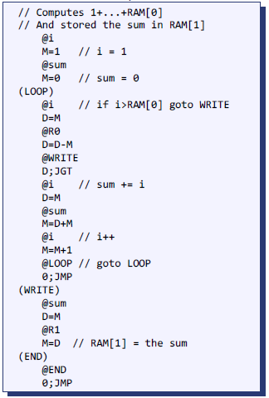
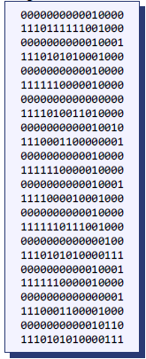
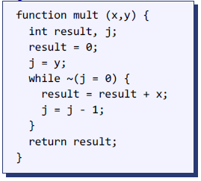
Code Translation
Week 12
Compiler
Virtual Machine
Assembler
Computational Thinking and System Design

Slide 5
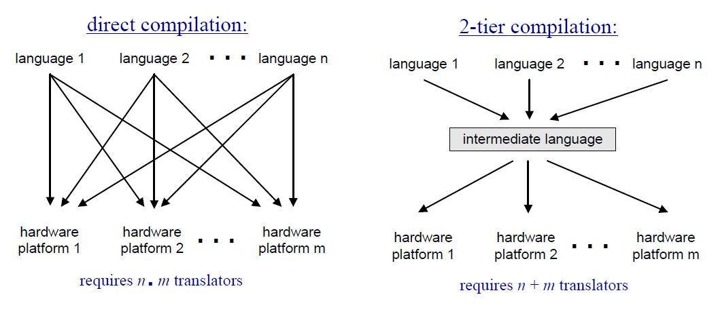
学习虚拟机
Week 12
Computational Thinking and System Design

Slide 6
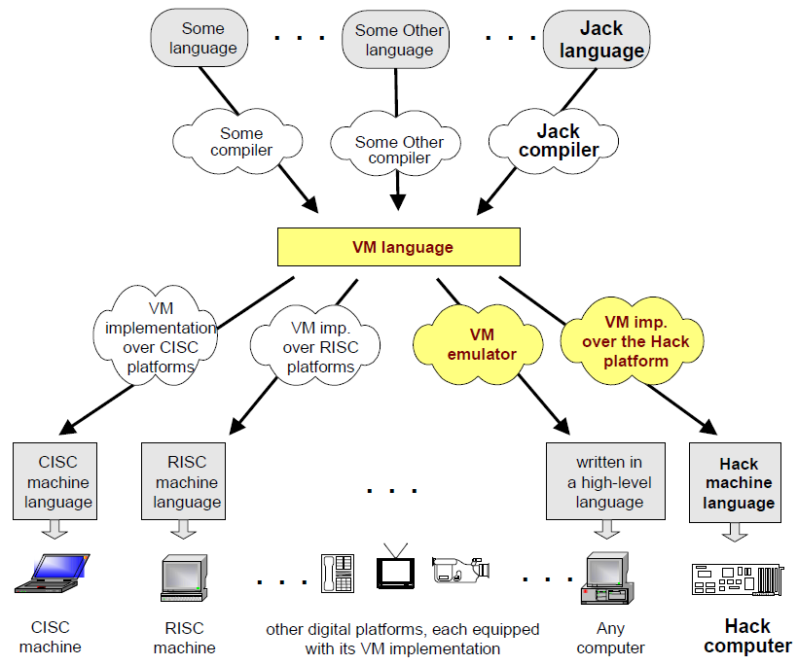
Week 12
Computational Thinking and System Design

Slide 7
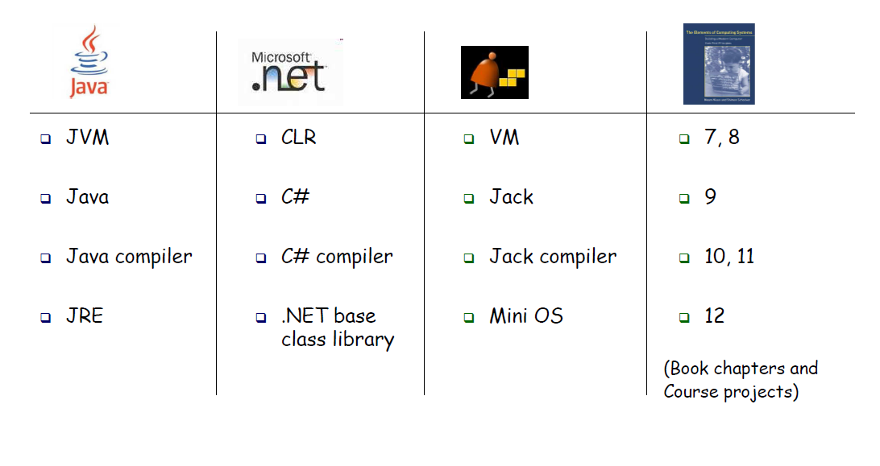
学习虚拟机
Week 12
Computational Thinking and System Design

Slide 8
数字出版物
Week 12
Computational Thinking and System Design

Slide 9
数字出版物
Week 12
Chapter 2-5
Computational Thinking and System Design

Slide 10

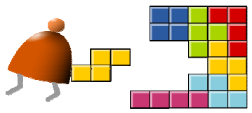

主要参考资源
Week 12
Chapter 2 Boolean Arithmetic
Chapter 3 Sequential Logic
Chapter 4 Machine Language
Chapter 5 Computer Architecture
toy
house
Computational Thinking and System Design

Slide 11
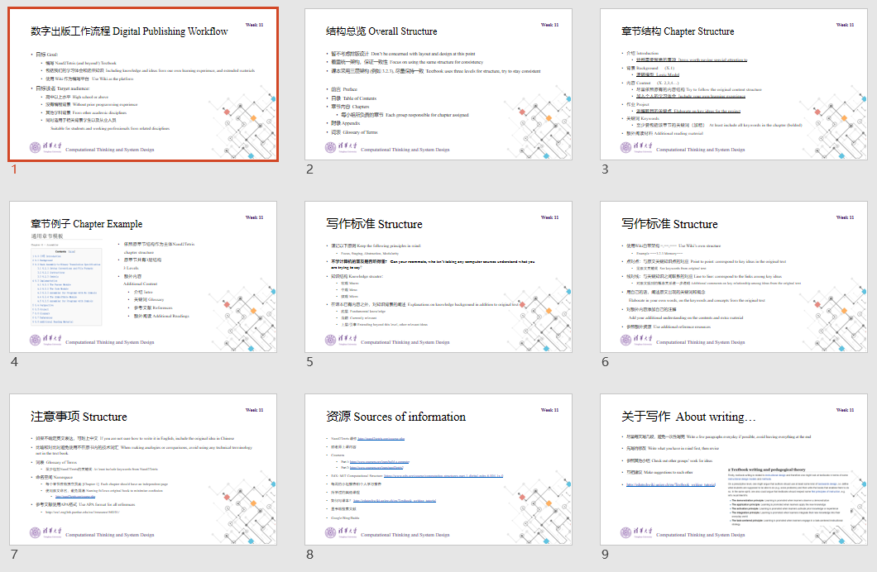
设计和约
Week 12
Computational Thinking and System Design

Slide 12
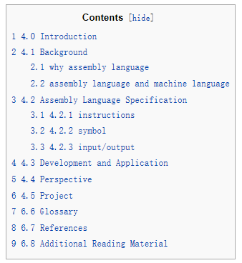
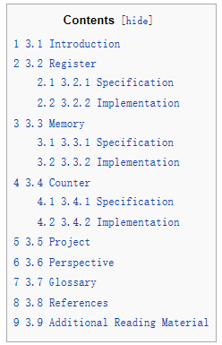
Week 12
Ch4
Ch3
Computational Thinking and System Design

Slide 13
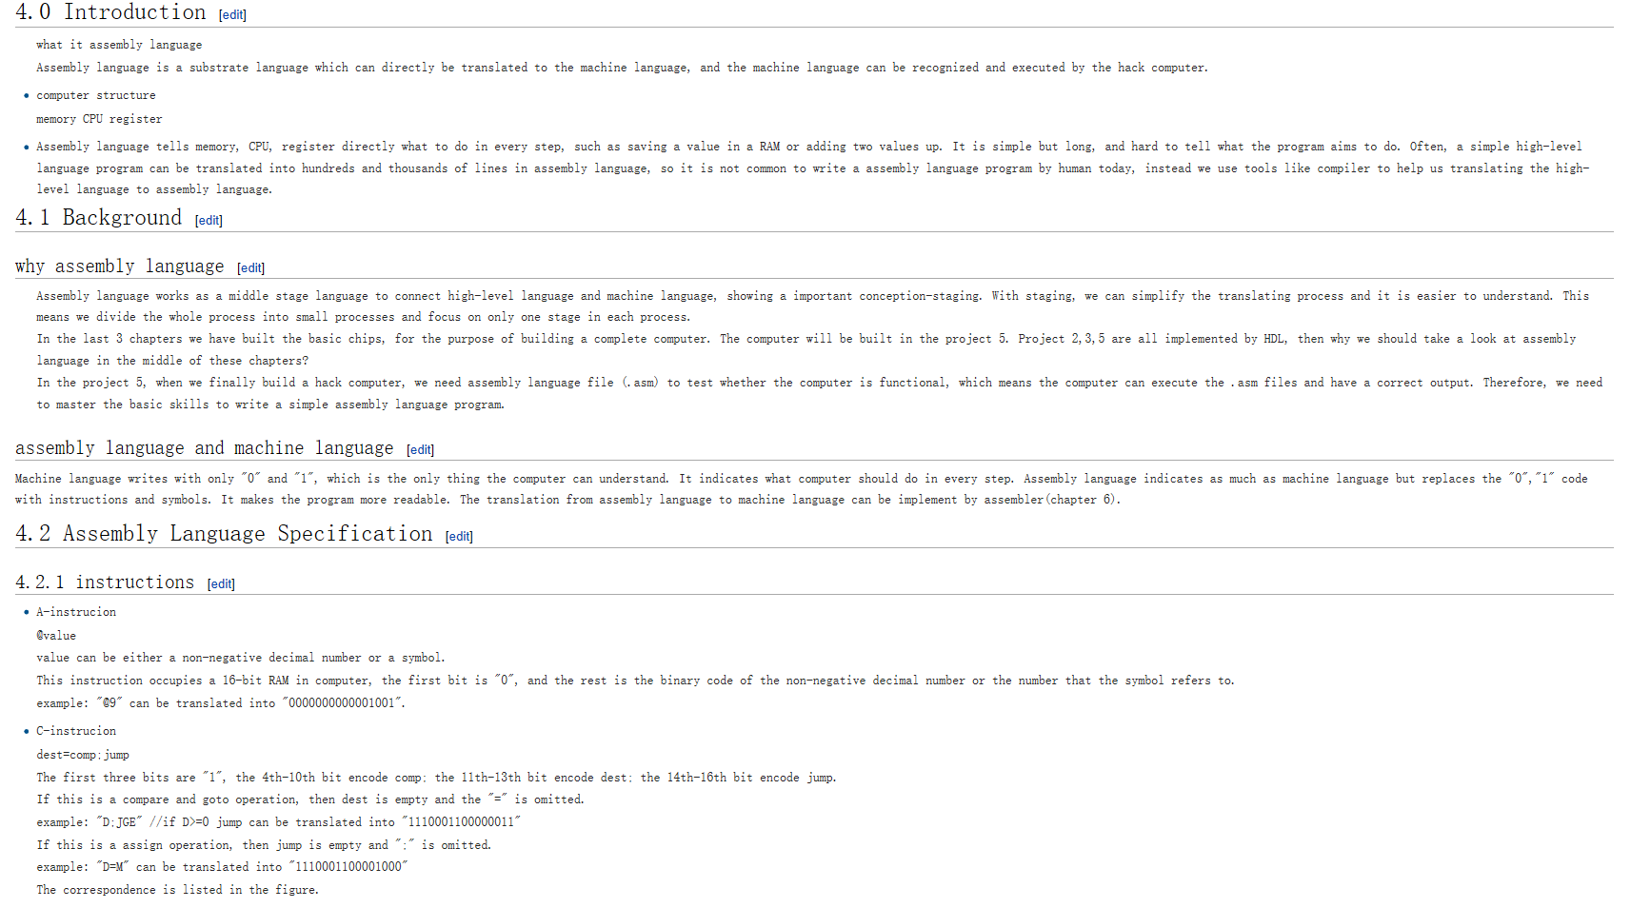
Week 12
Computational Thinking and System Design

Slide 14
Week 12
谢谢!
Computational Thinking and System Design

