Slide 1
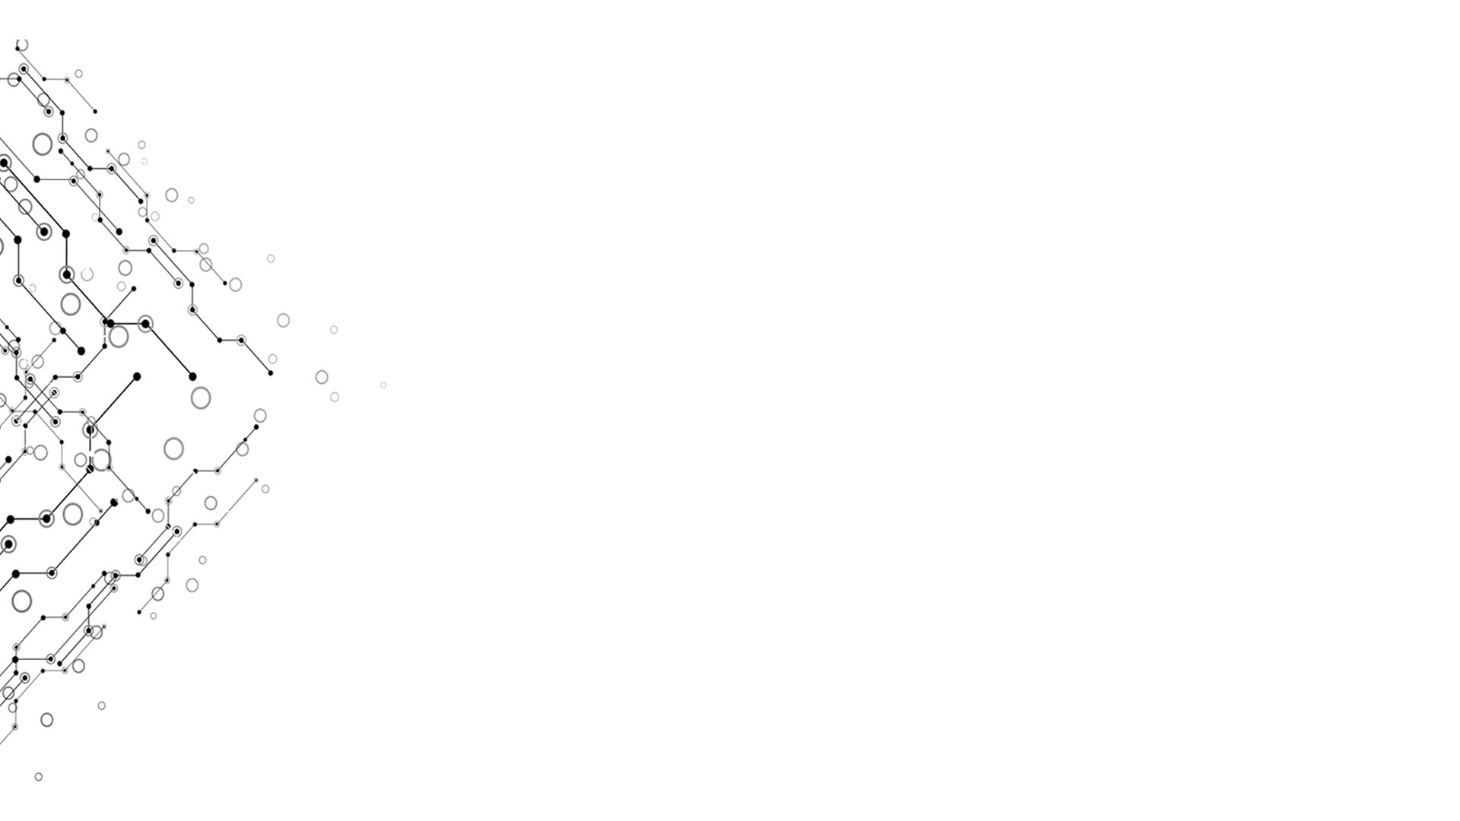

A possible approach to shorten assembly code
Chapter 7 & 8
Group 5
Week 12

Slide 2
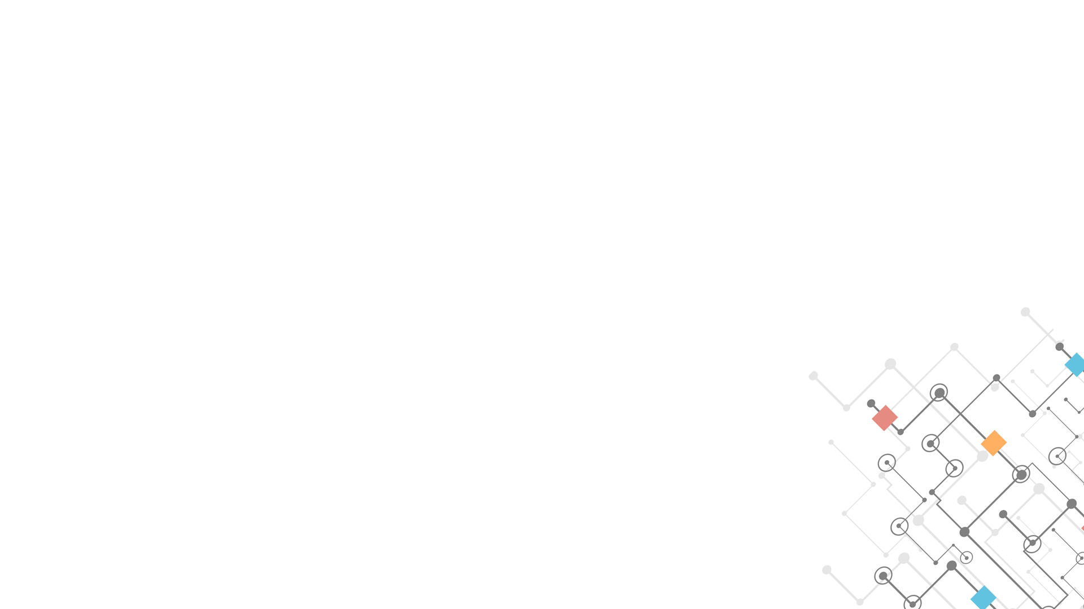
The Bigger Picture
Week 12
Step 1: Using a short VM or assembly code block, search for the shortest version directly.
Step 2：Using step1‘s tool to generate massive data. Use those data to train an artificial neural network
Step 3: Using the trained artificial neural network to write some long codes, use those data to train another network, which should be more effective in writing long code.
Computational Thinking and System Design

Slide 3
Step1 What we have done
Week 12
A CPU emulator to test the computer-written code.
Main Problems:
Is the computer-written data do the exactly same thing as original code did? How can we determine?
In many situations, it’s hard to track and determine variables with different input.
Computational Thinking and System Design

Slide 4
Our solutions
Week 12
Try more data (easy to be done but risky for exception)
Track every memory and variables. (hard to be done but steady)
Problem: may have different situation
In step 2, program control are not included;
Computational Thinking and System Design

Slide 5
Goal: Machine write machine language
Week 12
Use machine to write close to perfect code!
Use a smart bot as a Virtual Machine translator!
Computational Thinking and System Design

Slide 6
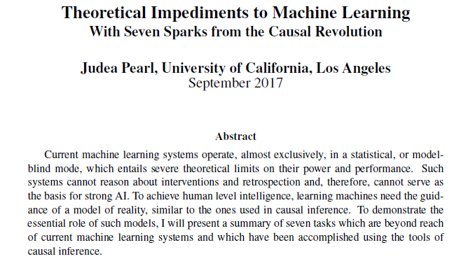
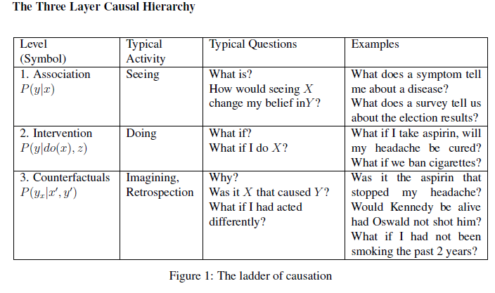
Neural Network, Neuroscience and Psychology
Week 12
Levels of cognition
Sensorimotor
Neural Reflex (knee jerk response)
Basic Circuit
Mental Representation
Object size and distance
Use of mental resources
Reasoning
2 > 1
Good > Evil
Affect
???
Computational Thinking and System Design

Slide 7
Digital Publishing
Computational Thinking and System Design
Group 5
Week 12

Slide 8
数字出版工作流程 Digital Publishing Workflow
Week 12
目标 Goal:
编写 Nand2Tetris (and beyond!) Textbook
包括我们的学习体会和延伸知识 Including knowledge and ideas from our own learning experience, and extended materials
使用 Wiki 作为编写平台 Use Wiki as the platform
目标读者 Target audience:
高中以上水平 High school or above
没有编程背景 Without prior programming experience
其他学科背景 From other academic disciplines
同时适用于相关背景学生以及从业人员
Suitable for students and working professionals from related disciplines
Computational Thinking and System Design

Slide 9
结构总览 Overall Structure
Week 12
暂不考虑排版设计 Don’t be concerned with layout and design at this point
着重统一架构，保证一致性 Focus on using the same structure for consistency
课本采用三层架构 (例如 3.2.3), 尽量保持一致 Textbook uses three levels for structure, try to stay consistent
前言 Preface
目录 Table of Contents
章节内容 Chapters
每小组所负责的章节 Each group responsible for chapter assigned
附录 Appendix
词表 Glossary of Terms
Computational Thinking and System Design

Slide 10
章节结构 Chapter Structure
Week 12
介绍 Introduction
特别需要留意的事项 Items worth paying special attention to
背景 Background (X.1)
逻辑模型 Logic Model
内容 Content (X. 2,3,4…)
尽量依照原有的内容结构 Try to follow the original content structure
加入个人的学习体会 Include your own learning experience
作业 Project
讲解题目的关键点 Elaborate on key ideas for the project
关键词 Keywords
至少要包括该章节的关键词（加粗） At least include all keywords in the chapter (bolded)
额外阅读材料 Additional reading material
Computational Thinking and System Design

Slide 11
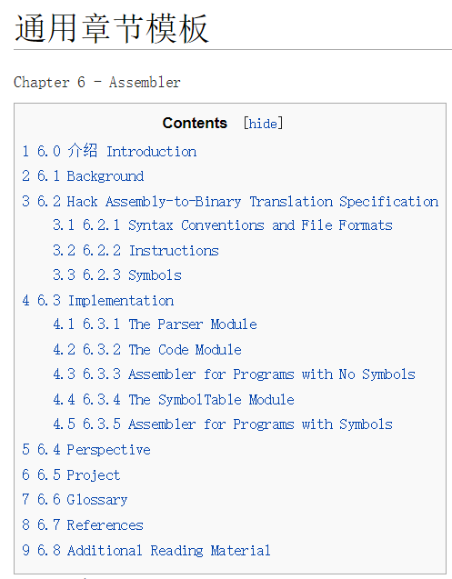
章节例子 Chapter Example
Week 12
依照原章节结构作为主体Nand2Tetris chapter structure
原章节共有3层结构
3 Levels
额外内容
Additional Content
介绍 Intro
关键词 Glossary
参考文献 References
额外阅读 Additional Readings
Computational Thinking and System Design

Slide 12
写作标准 Structure
Week 12
谨记以下原则 Keep the following principles in mind:
Focus, Staging, Abstraction, Modularity
不学计算机的室友是否听得懂? Can your roommate, who isn’t taking any computer courses understand what you are trying to say?
知识结构 Knowledge strcutre：
宏观 Macro
中观 Meso
微观 Micro
在课本已有内容之外，对知识背景的阐述 Explanations on knowledge background in addition to original text
底层 Fundamental knowledge
当前 Currently relevant
上层/引申 Extending beyond this level, other relevant ideas
Computational Thinking and System Design

Slide 13
写作标准 Structure
Week 12
使用Wiki自带架构 =,==,=== Use Wiki’s own structure
Example ===3.2.3 Memory===
点对点：与原文关键知识点的对应 Point to point: correspond to key ideas in the original text
见原文关键词 See keywords from original text
线对线：与关键知识之间联系的对应 Line to line: correspond to the links among key ideas
对原文提到的概念关系进一步说明 Additional comments on key relationship among ideas from the original text
用自己的话，阐述原文出现的关键词和概念
Elaborate in your own words, on the keywords and concepts from the original text
对额外内容添加自己的注解
Add your additional understanding on the contents and extra material
参照额外资源 Use additional reference resources
Computational Thinking and System Design

Slide 14
注意事项 Structure
Week 12
如果不确定英文表达，可附上中文 If you are not sure how to write it in English, include the original idea in Chinese
比喻和对比时避免使用不在原书内的技术词汇 When making analogies or comparisons, avoid using any technical terminology not in the text book.
词表 Glossary of Terms
至少包括Nand2Tetris的关键词 At least include keywords from Nand2Tetris
命名空间 Namespace
每个章节应有独立页面 [Chapter 1] Each chapter should have an independent page
使用原文命名，避免混淆 Naming follows original book to minimize confusion
http://nand2tetris.org/course.php
参考文献使用APA格式 Use APA format for all references
http://owl.english.purdue.edu/owl/resource/560/01/
Computational Thinking and System Design

Slide 15
资源 Sources of information
Week 12
Nand2Tetris 课件 http://nand2tetris.org/course.php
顾老师上课内容
Coursera
Part 1: https://www.coursera.org/learn/build-a-computer
Part 2: https://www.coursera.org/learn/nand2tetris2
EdX: MIT Computational Structure https://www.edx.org/course/computation-structures-part-1-digital-mitx-6-004-1x-0
每周的小组报告和个人学习报告
所学过的其他课程
如何写课本？ http://edutechwiki.unige.ch/en/Textbook_writing_tutorial
图书馆搜索文献
Google/Bing/Baidu
Computational Thinking and System Design

Slide 16
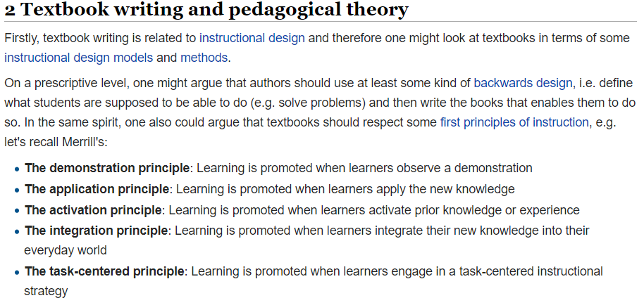
关于写作 About writing…
Week 12
尽量每天写几段，避免一次性写完 Write a few paragraphs everyday if possible, avoid leaving everything at the end
先写再修改 Write what you have in mind first, then revise
参照其他小组 Check out other groups’ work for ideas
互相建议 Make suggestions to each other
http://edutechwiki.unige.ch/en/Textbook_writing_tutorial
Computational Thinking and System Design

