Slide 1
Presentation of GOBOARD 2
TgopKnight

Slide 2
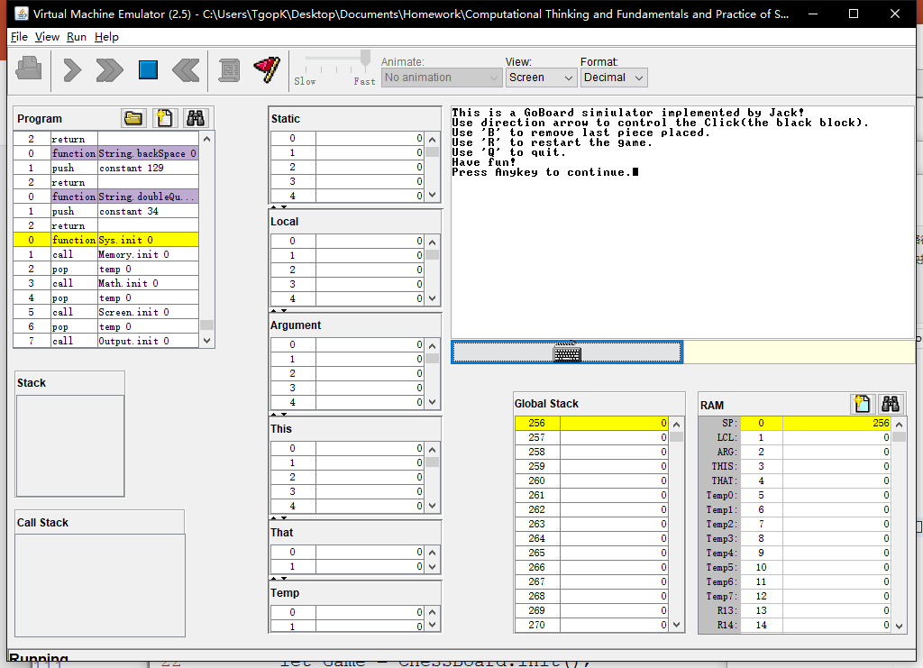
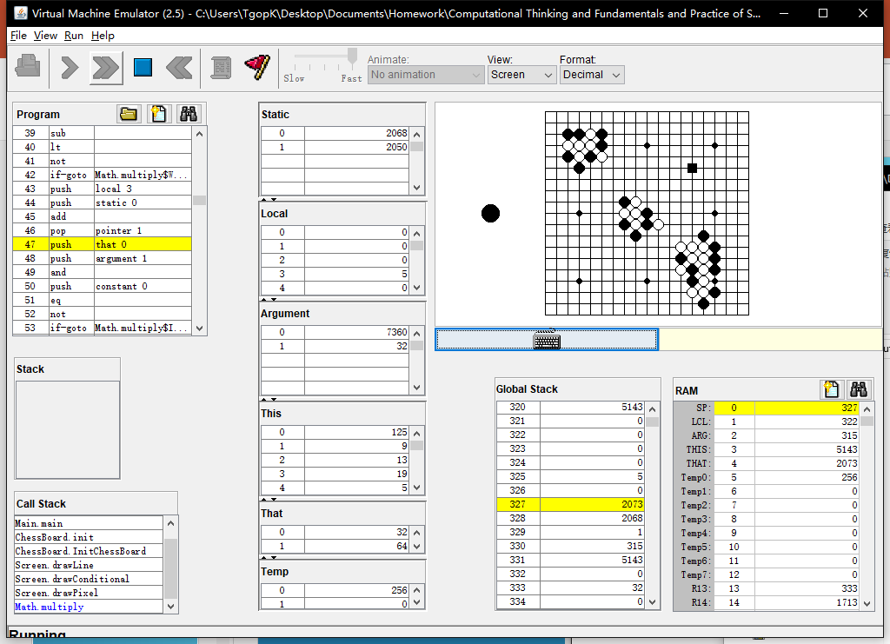
EFFECTION
Simulated on
VMEmulator!

Slide 3
Logic model
Inputs:
Jack OS API.pdf + Lecture 09 High-level language.pdf
Recourse code from Project 9
Activities:
Editor(Vim) + Programming
Partly adapted from the SquareGame provided in Project 9
Outputs:
A board supports basic placing pieces operation
Outcomes/Impacts:
As a basic of GO game(using Jack language!)

Slide 4
What DO WE ACHIEVE
Simulator of a Goboard
Able to place Black and White Go piece
Able to judge placed point, but unable to reflact
Able to ‘Withdraw’
Able to ‘Clear’ the ‘Board’

Slide 5
HOW DO WE achieve
Jack language
Vim

Slide 6
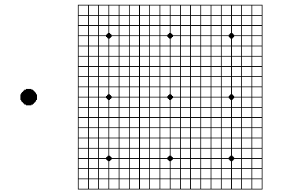
Build a board without chess pieces
Line 19 * 19
Top left corner: (125, 9)
Interval between lines: 12
9 Black circles
Radius = 3
1 Hint Go piece
Which color next
Radius = 10

Slide 7
PLACE A Chess piece
Jack
Array: Grid[19 * 19]
-1: empty 0: black 1: white
Int: NextPiece = 0/1 (decide which Go piece next)

Slide 8
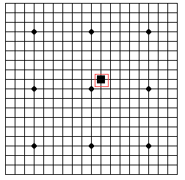
PLACE A Chess piece
However, Jack language can not provide mouse click.
I didn’t find it from Jack OS API.pdf
A Black Block to substitute mouse!
Int: ClickX, ClickY
Length of Block side: 11
Press “Enter” to place a Go piece
Using direction arrows to move the Block
This idea is adapted from the SquareGame

Slide 9
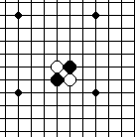
PLACE A Chess piece
With Array Grid, we can simply finish judging if a location was already place with a Go piece.
However we can’t provide an alert window…
For Go piece
Black: radius = 6
White: A Black one + radius = 5

Slide 10
Withdraw
Jack
Data Structure: Stack
Needn’t record placed color
Keyboard.keyPressed() = ‘B’

Slide 11
CLEAR
Jack
InitChessBoard()
Keyboard.keyPressed() = ‘R’

Slide 12
QUIT
Jack
Return ;
Keyboard.keyPressed() = ‘Q’

Slide 13
HINT
The Screen is very small (256 * 512)
System: ERROR 8
Reason: output beyond the Screen
Better not using vim as the editor
Its syntax coded with the format of xml (*.xml)
Vim use its own format (*.vim)
Jack expression does not follow the usual priority
A + B * C = (A + B) * C

Slide 14
HINT
VMEmulator: Animate: No animation
Sorry for blaming Jack as a very slow language
Screen.drawCircle(int x, int y, int r)
Its radius is exactly r + 1

Slide 15

OuR PRoblems
In fact, the Click was static initially.
But that was too inconspicuous(ugly)…
Sol: Make it blink!

Slide 16
OuR PRoblems
Code:
method void Display() {
let cnt = cnt + 1;
if (cnt > 599) {
if (cnt = 600) { do DisplayPiece(ClickX * Size + ClickY); }
if (cnt > 19999) { let cnt = 0; }
}
else { do DisplayClick(); }
return ;
}

Slide 17
HOWEVER
When the click displayed on a black Go piece, it is still not very conspicuous……
Primary reason: the Screen is a little bit small…

Slide 18
OUR PROBLEMS
When display the Block, sometimes the part it locate will refresh to white
This problem become evident when the Block displayed on a Black Go piece
Sol:?

Slide 19
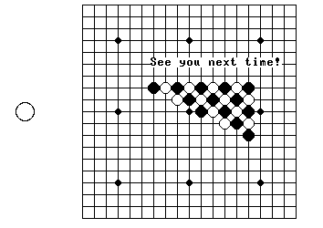

Slide 20
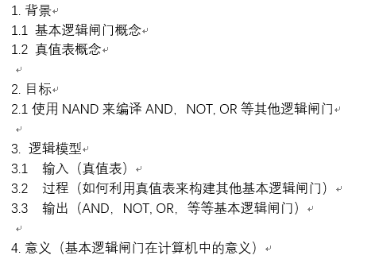
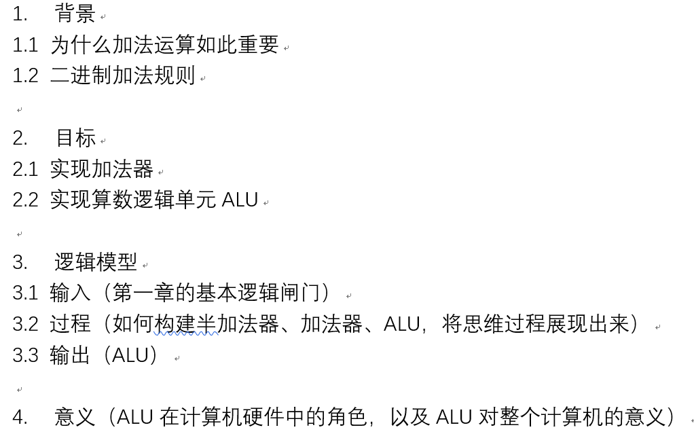
大纲，以第一、二章为例
Thanks for listening!

