Slide 1
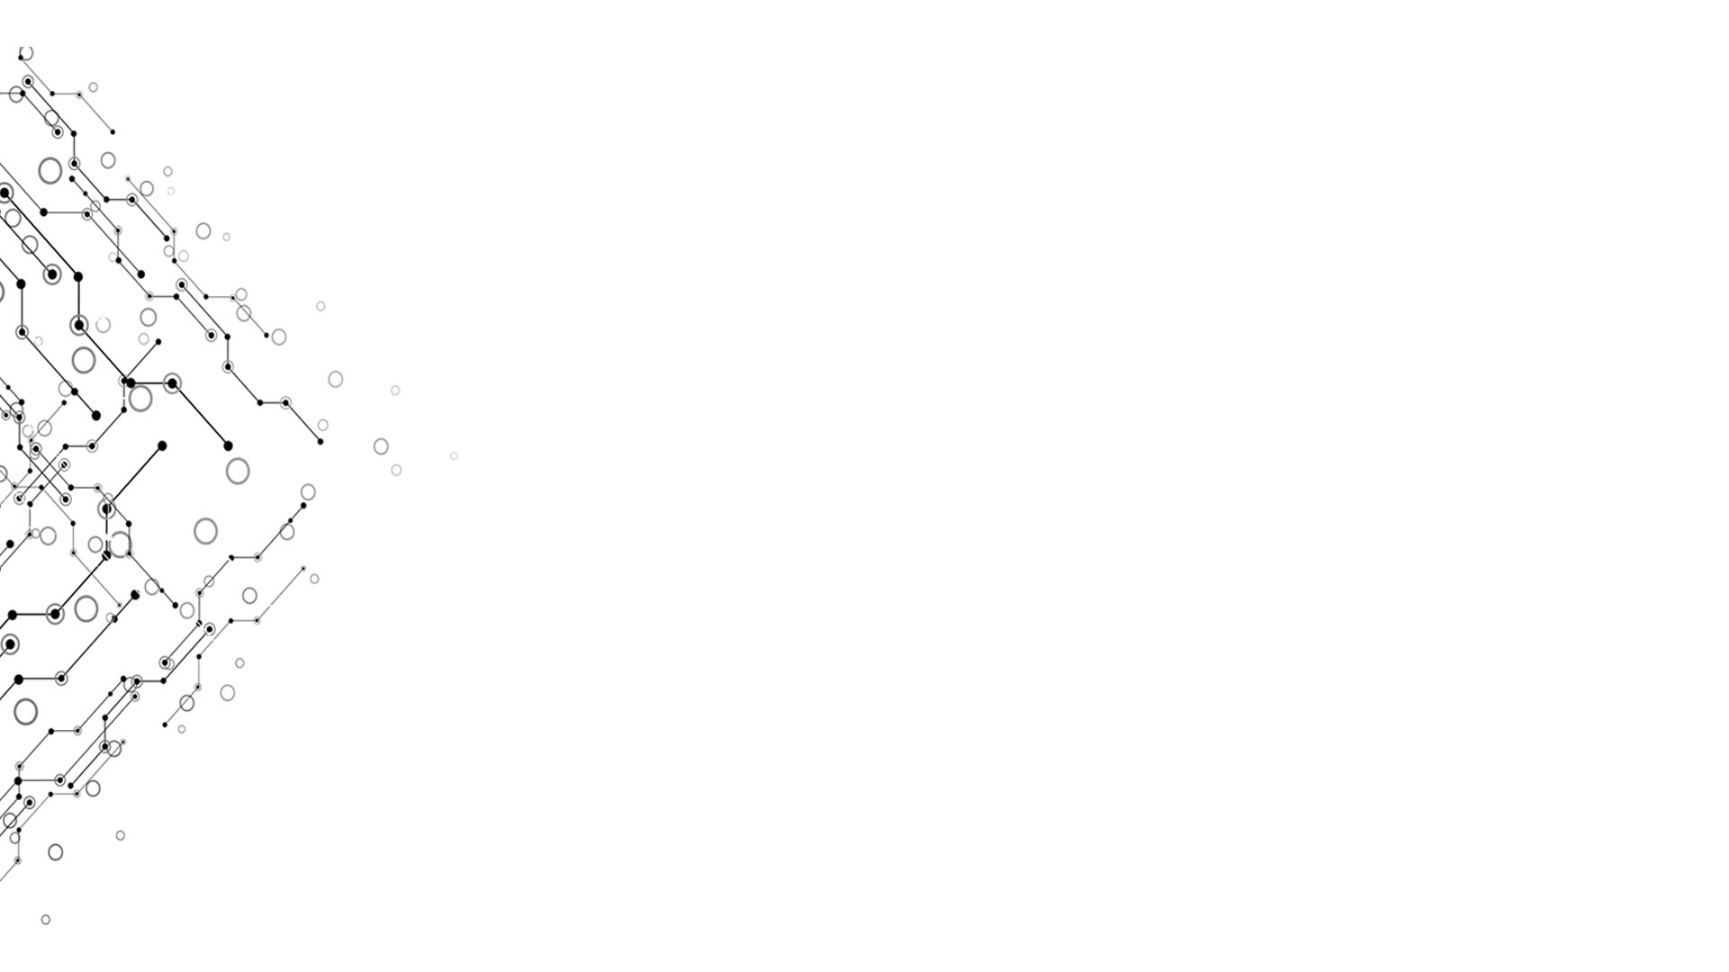

sss
Computational Thinking and System Design
ss
Week 10

Slide 2
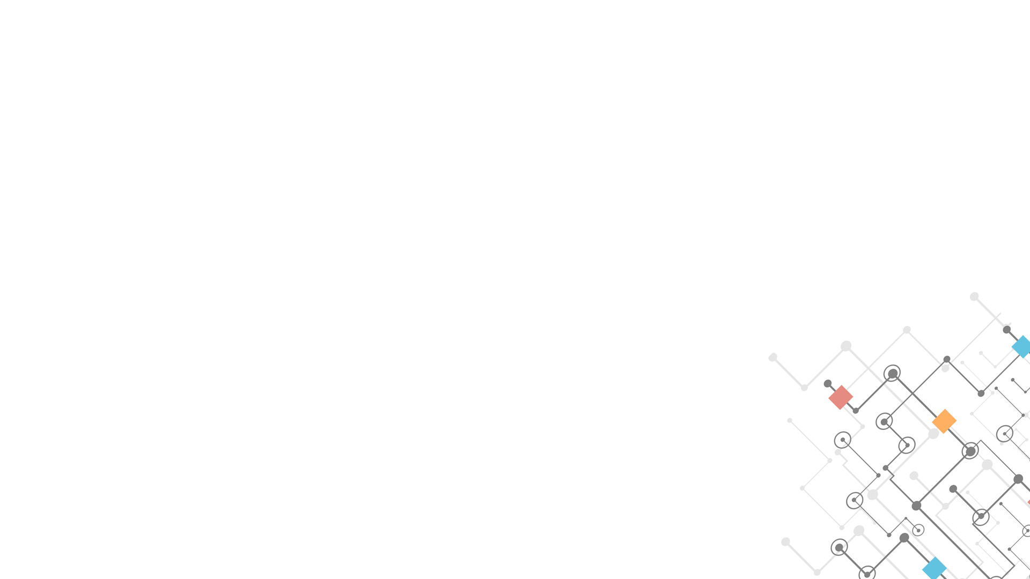
sss
Week 10
Ss ssss
Computational Thinking and System Design

