Slide 1
Group 1 Week 9 report
About ANTLR

Slide 2
Logic Model
Input
Coursera Machine Learning
ANTLR
Mathematica
Output
An example in ANTLR
Reports
Progress
Try to use Mathematica
Implement an arithmetic parser
Effect
Find two ways to parse
Learn Mathematica
Better understanding of category theory

Slide 3
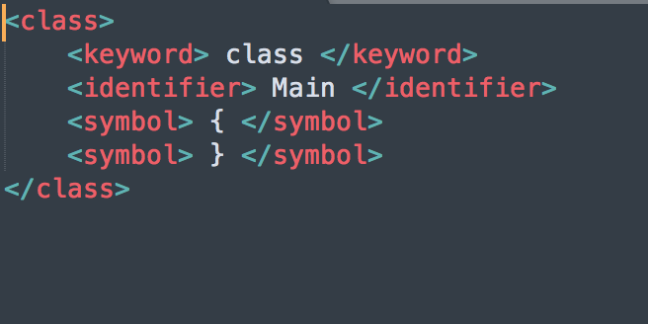
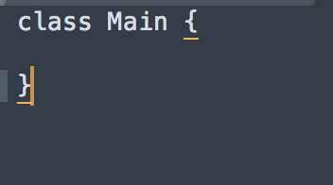
A quick summary of what we have done
Lex
C
Regular Expression
All the functions in head file
Additional space for information (Stack)

Slide 4
Pros vs. cons
Needs huge patience
May need some programming experience (hard to debug)
Only works for code written in strict format.
Almost impossible to change if the contract changes.
Fast
Straightforward

Slide 5
ANTLR
Another Tool for Language Recognition
Implemented in JAVA
Match tokens
Match patterns for tokens
tree-structure output

Slide 6
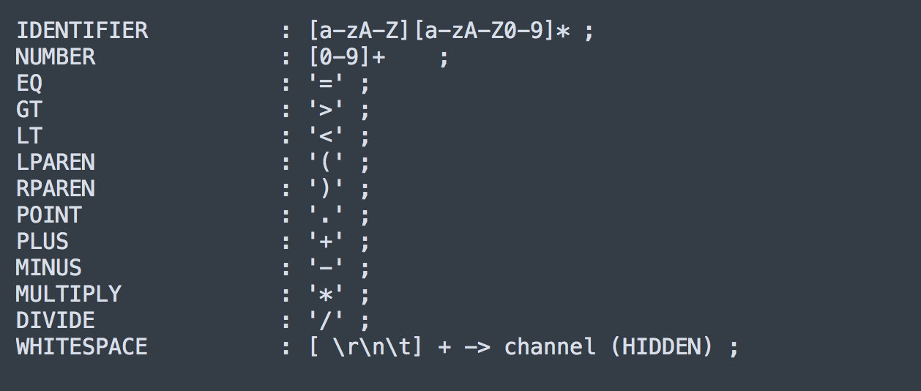
AN arithmetic example
This part is just tokenizing

Slide 7
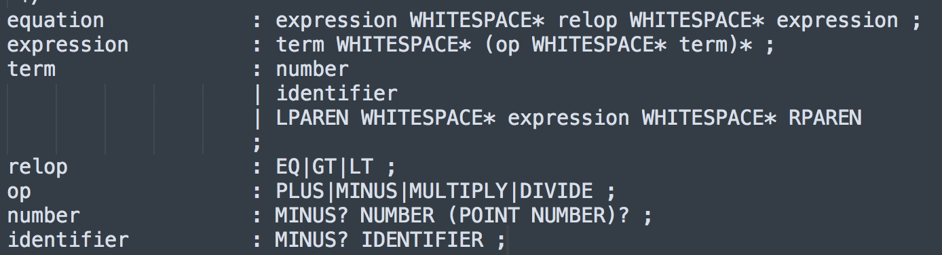
AN arithmetic example
That’s how it parses
A huge “Regular Expression”
Depth-First Search

Slide 8
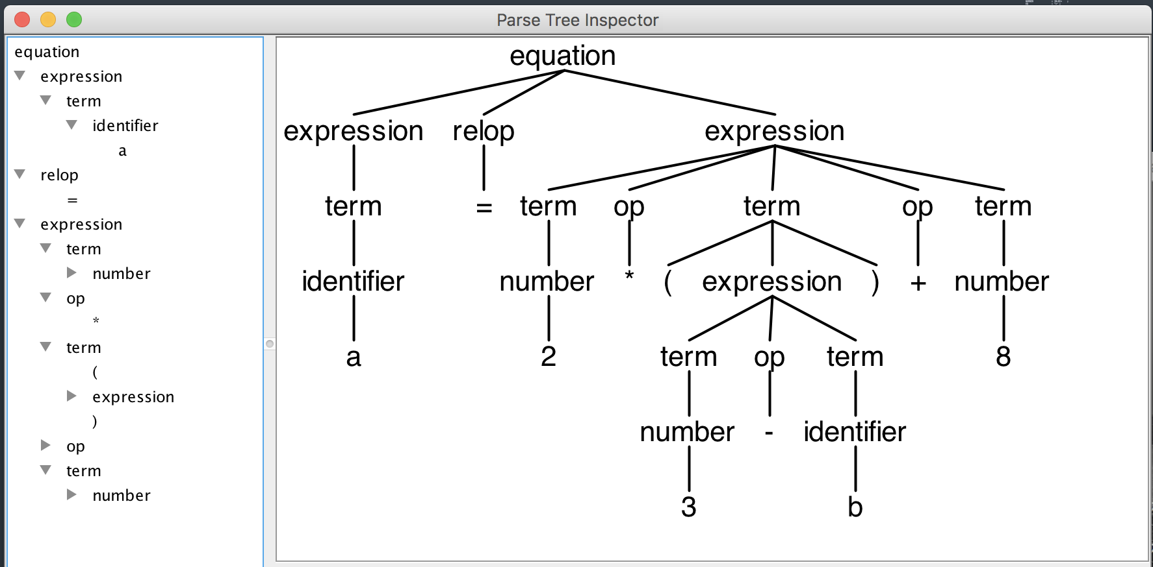
Input & output

Slide 9
Thank you for youR time!

