Slide 1
计算思维与系统设计基础
Weekly report
Week 4
第四组
田卓钰 孔德嘉 南佳凡

Slide 2
Project 4
Machine Language Programming
南佳凡 自64

Slide 3
知识内容
Assembly Language
Assembler
CPUEmulator

Slide 4
题目
1.mult
Multiplies R0 and R1 and stores the result in R2.
(R0, R1, R2 refer to RAM[0], RAM[1], and RAM[3], respectively.)

Slide 5
MULT
输入：R0 , R1
过程 : 循环，R1个R0相加
输出 : R2
效果 : R2=R0*R1

Slide 6
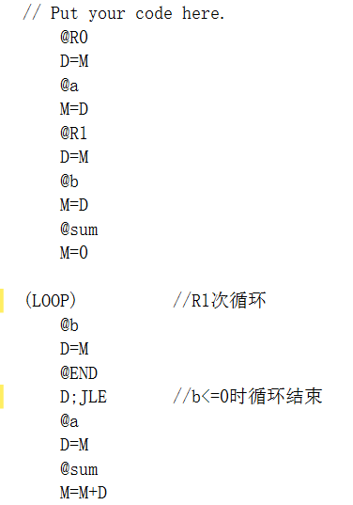
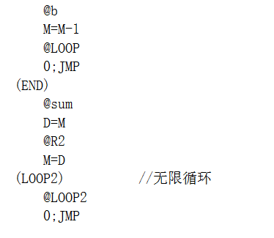

Slide 7
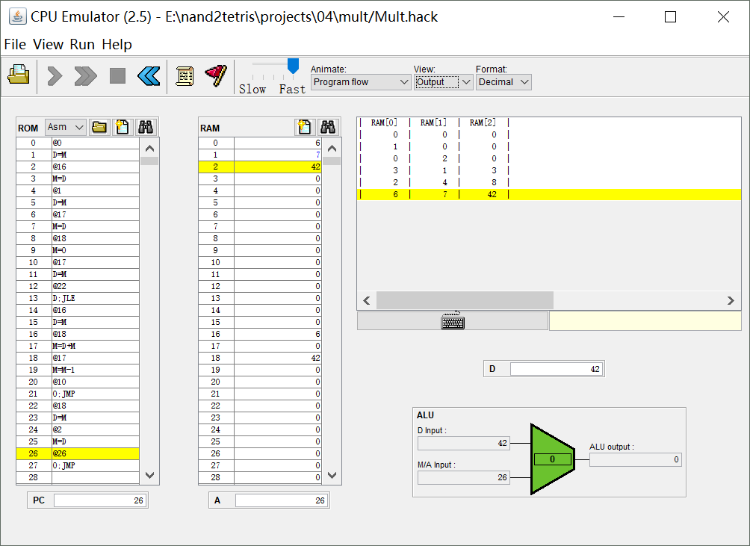

Slide 8
题目
2.fill
Runs an infinite loop that listens to the keyboard input.
When a key is pressed (any key), the program blackens the screen, i.e. writes "black" in every pixel; the screen should remain fully black as long as the key is pressed.
When no key is pressed, the program clears the screen, i.e. writes "white" in every pixel; the screen should remain fully clear as long as no key is pressed.

Slide 9
Screen 16384 512×256
Keyboard 24576 ASCⅡ

Slide 10
谢谢！

Slide 11
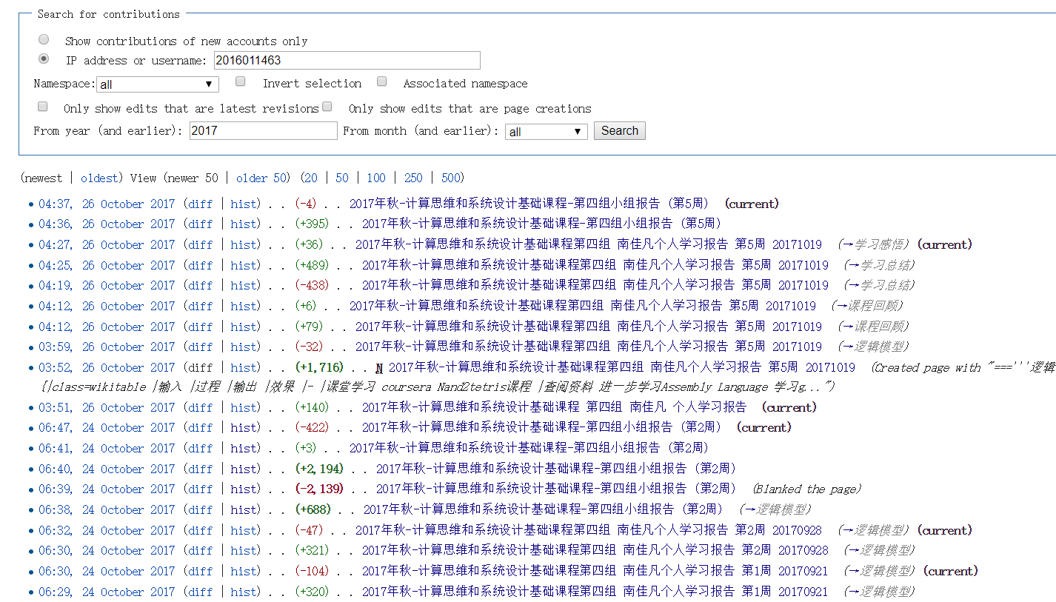
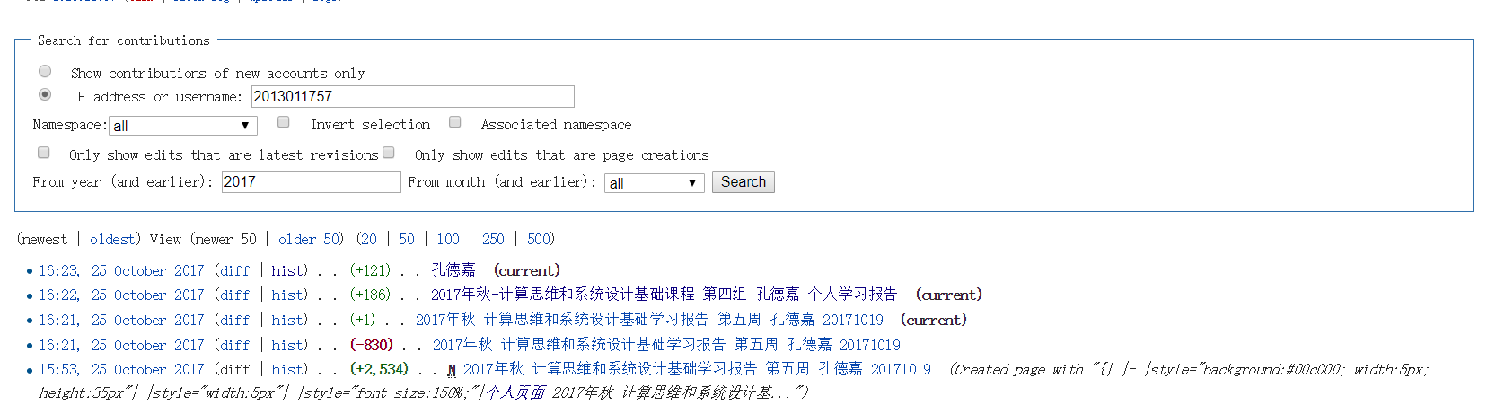
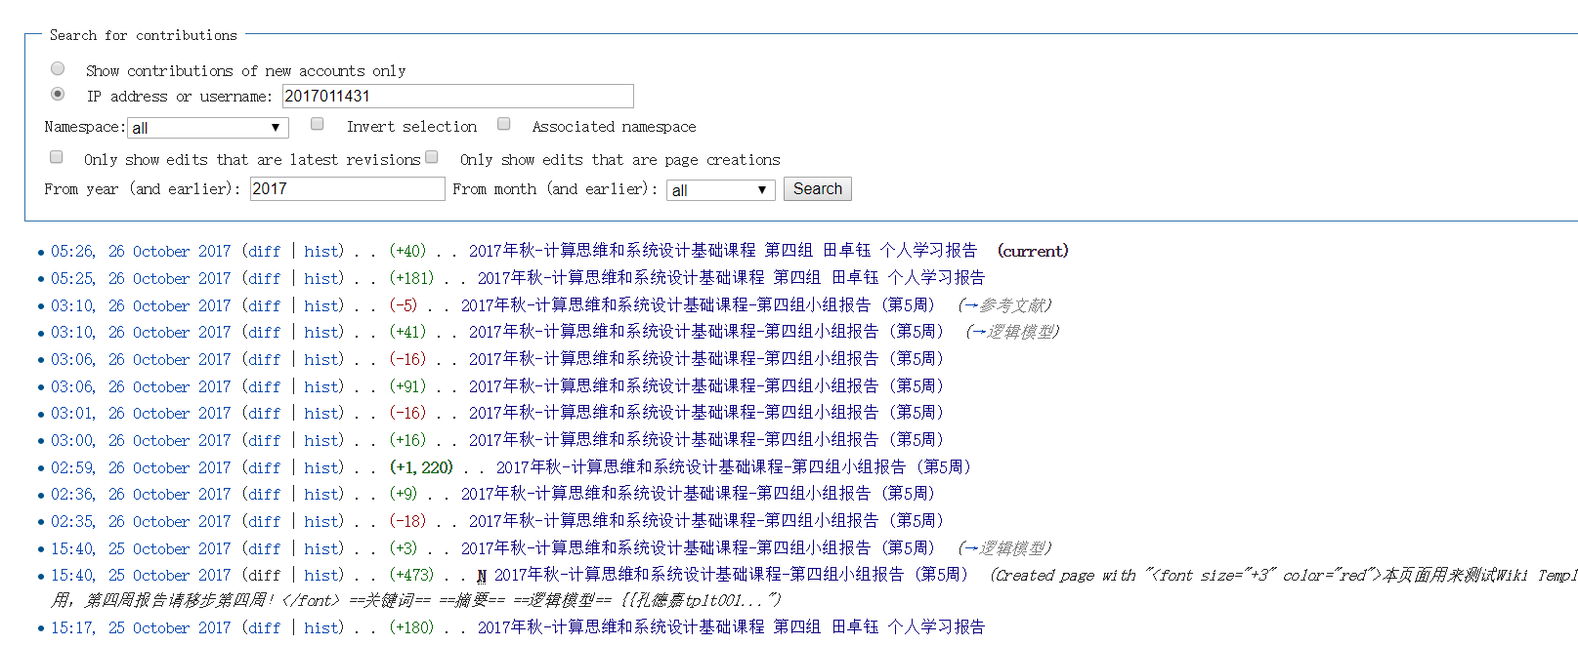
Wiki活跃度

Slide 12
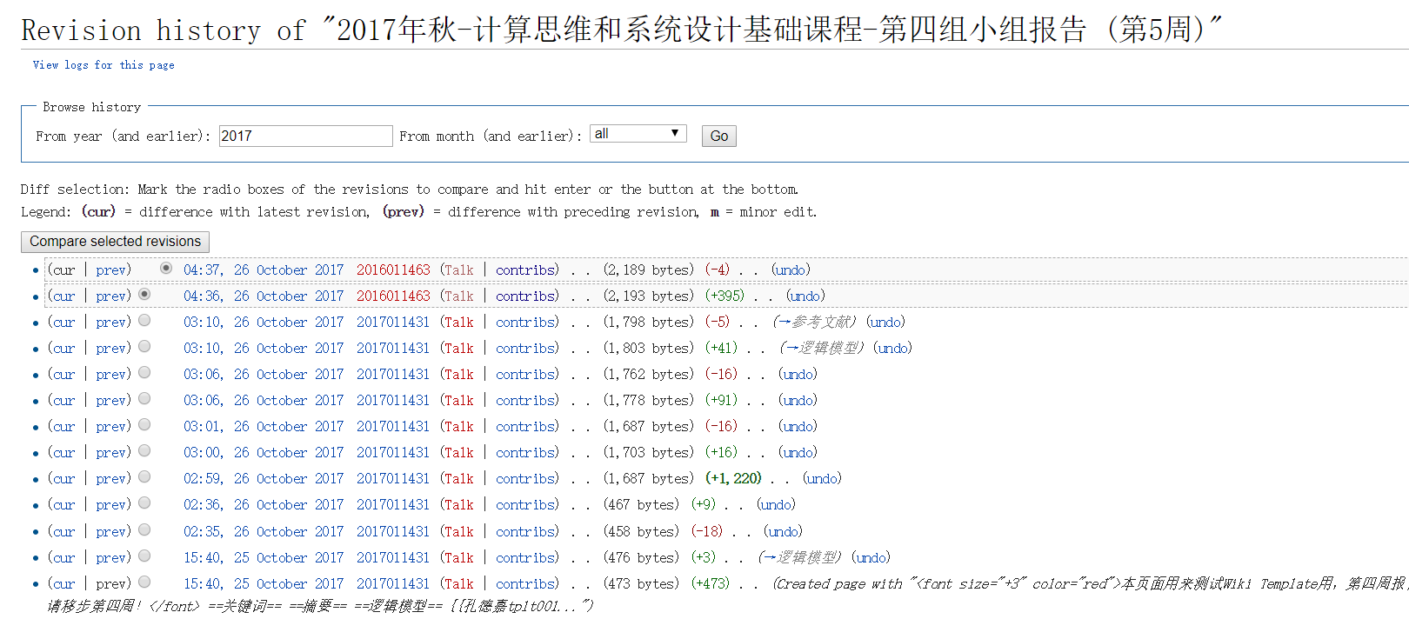
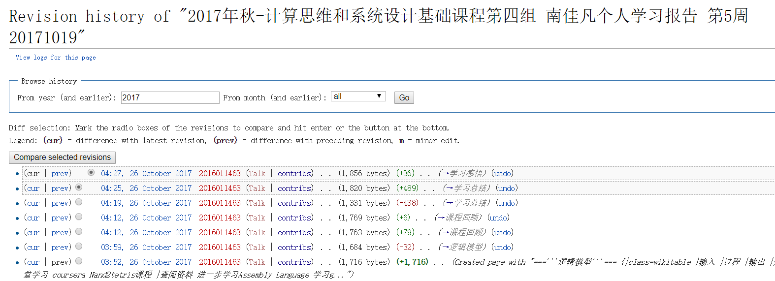
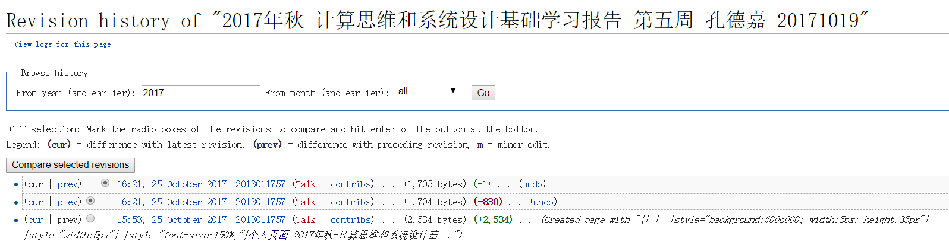
Wiki活跃度

Slide 13
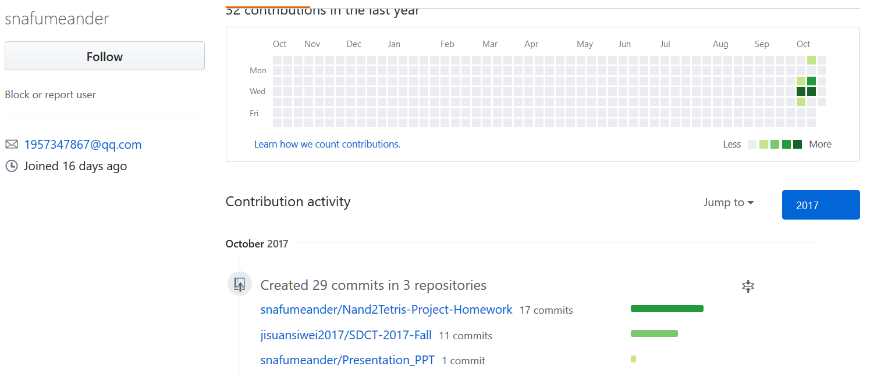
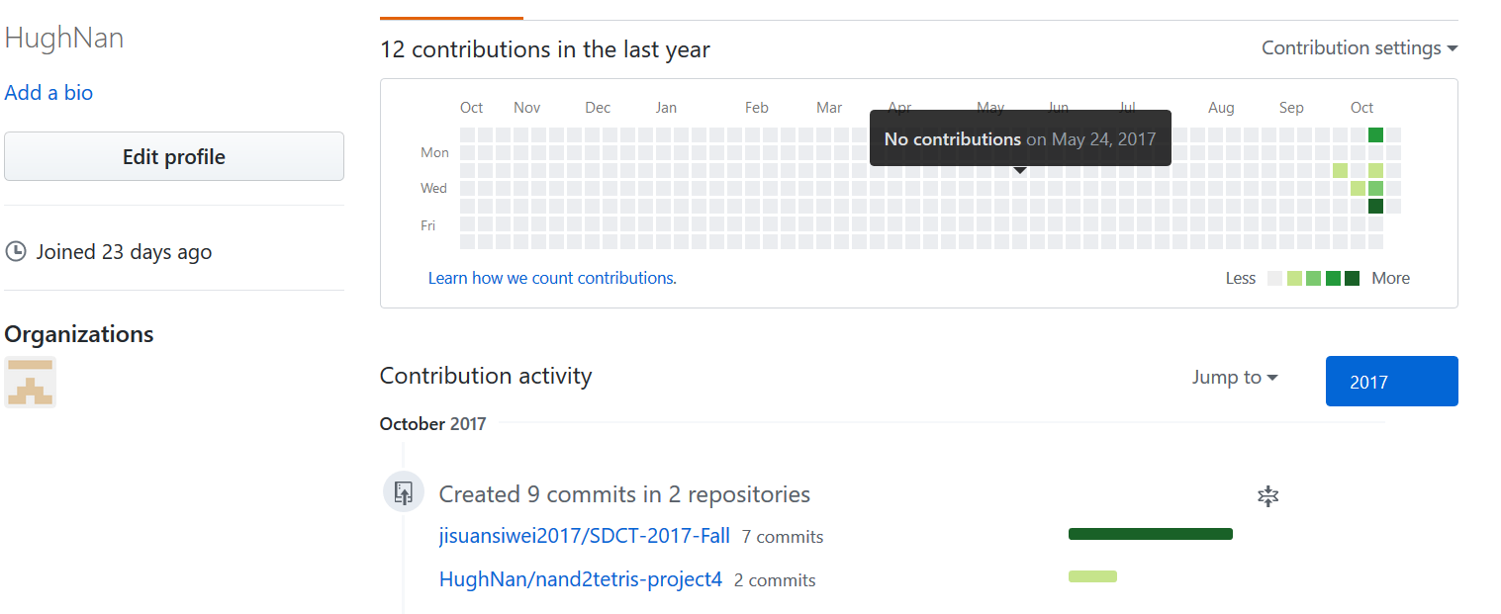
GitHub活跃度

