Slide 1
计算思维与系统设计基础
Weekly report
Week 6
第四组
田卓钰 孔德嘉 南佳凡

Slide 2
背景
Project 2，3，5
已实现的Not, And, Or, Mux 等基本的逻辑门
目标
实现更加复杂的逻辑门，用其构造CPU , RAM , computer

Slide 3
效果
输出
过程
输入
构建出的computer能够执行.hack文件，完成操作。
Computer，包含RAM和CPU。
使用Project1中基本的逻辑门构造Project2、3中的逻辑门，再由其构造出RAM和CPU，进而构造一个computer
Project1中的逻辑门，nand2tetris课程。

Slide 4
Project 4
Machine Language Programming
南佳凡

Slide 5
背景
实现了复杂的逻辑门，准备构建computer
目标
了解底层语言，为下一章使用.hack文件测试computer铺垫

Slide 6
知识内容
Machine Language
Assembly Language
Assembler
CPUEmulator

Slide 7
题目
1.mult
Multiplies R0 and R1 and stores the result in R2.
(R0, R1, R2 refer to RAM[0], RAM[1], and RAM[2], respectively.)

Slide 8
MULT
效果 : R2=R0*R1
输出 : R2
过程 : 循环，R1个R0相加
输入：R0 , R1

Slide 9
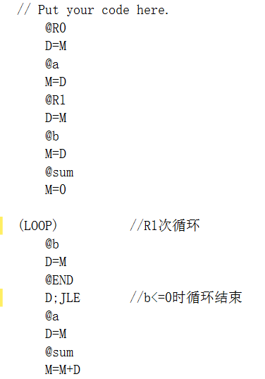
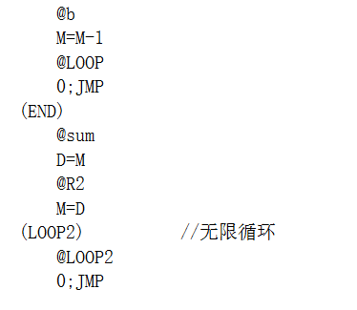
程序

Slide 10
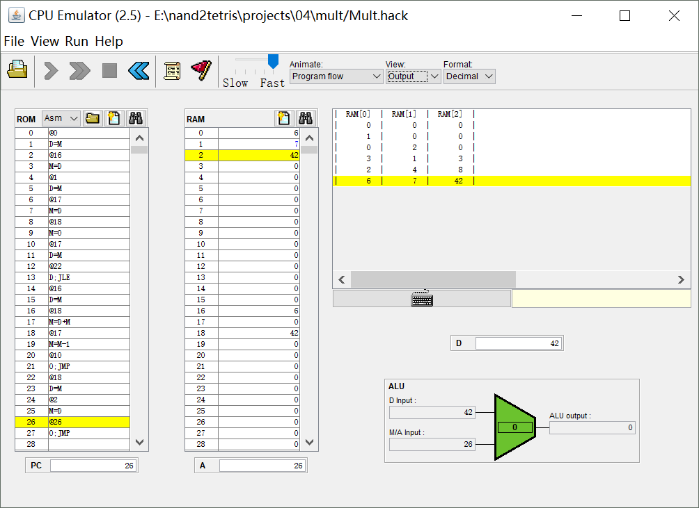

Slide 11
题目
2.fill
Runs an infinite loop that listens to the keyboard input.
When a key is pressed (any key), the program blackens the screen, i.e. writes "black" in every pixel; the screen should remain fully black as long as the key is pressed.
When no key is pressed, the program clears the screen, i.e. writes "white" in every pixel; the screen should remain fully clear as long as no key is pressed.

Slide 12
Screen 16384 512×256
Keyboard 24576 ASCⅡ

Slide 13
谢谢！

Slide 14
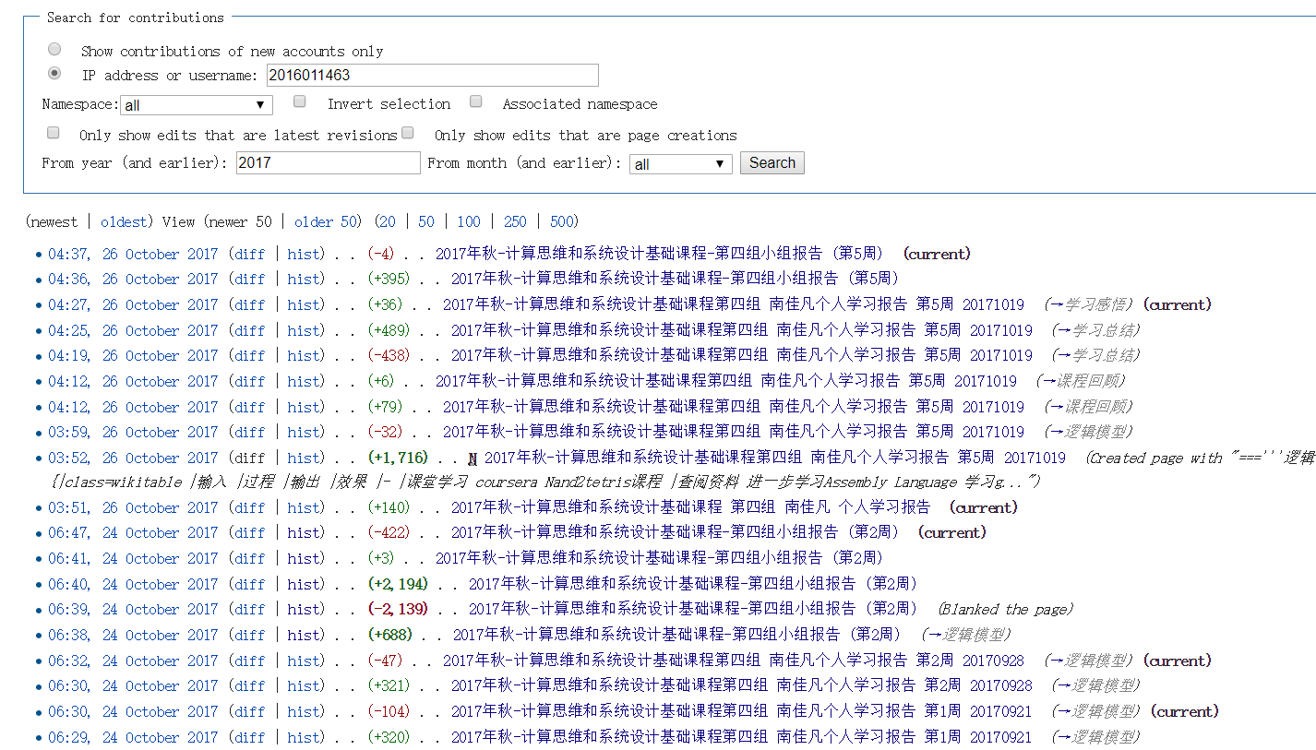
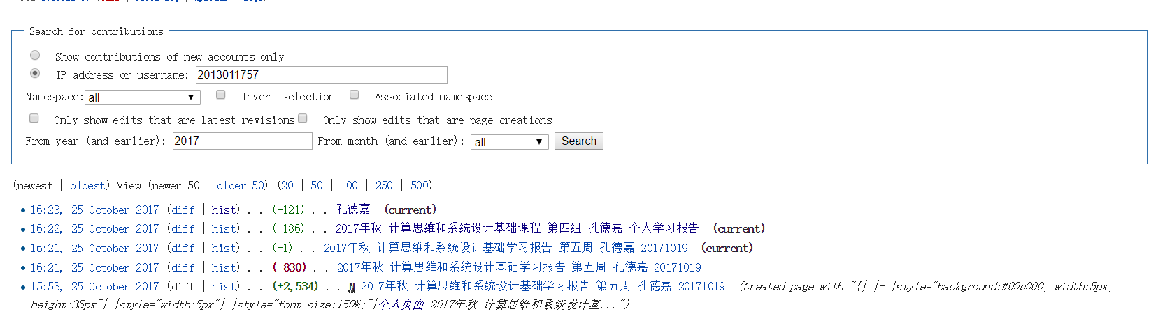
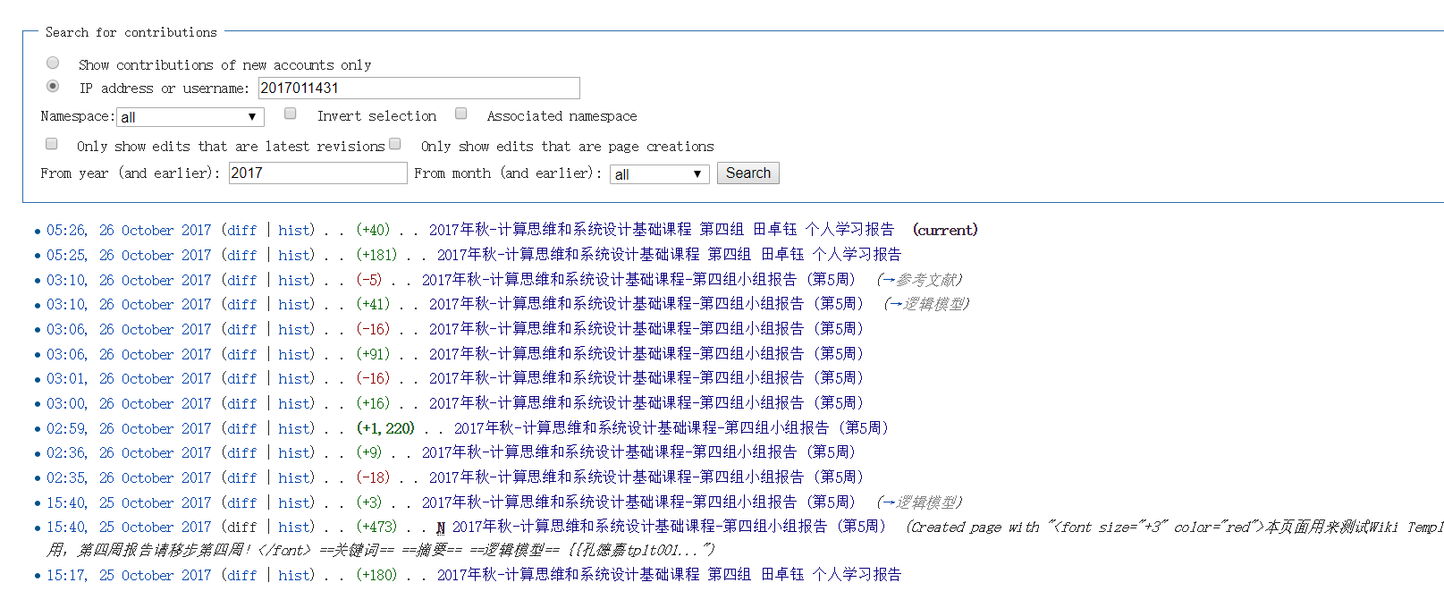
Wiki活跃度

Slide 15
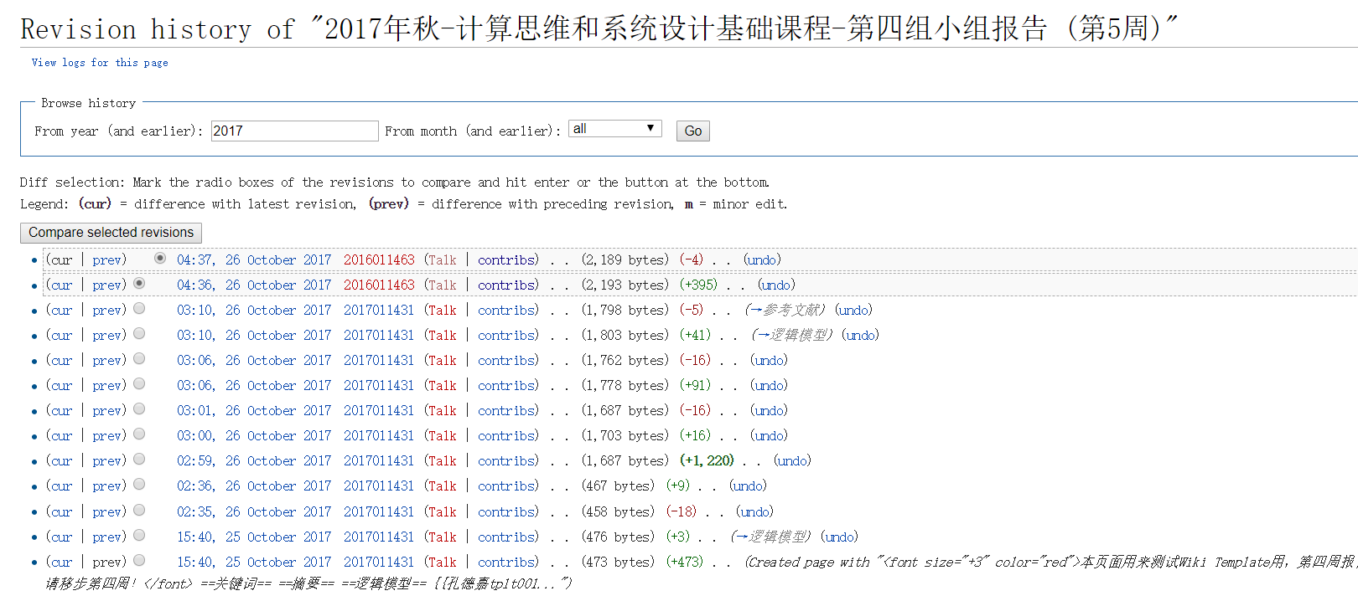
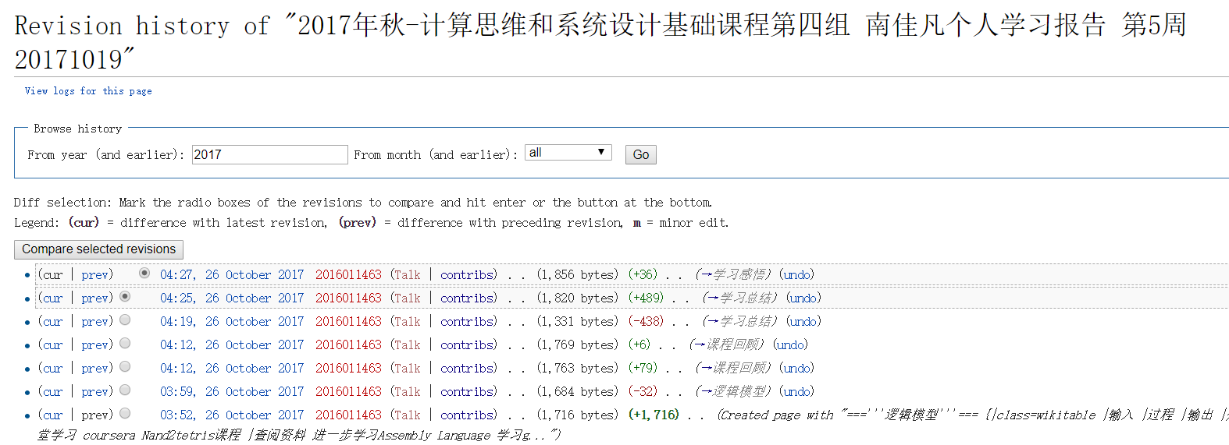
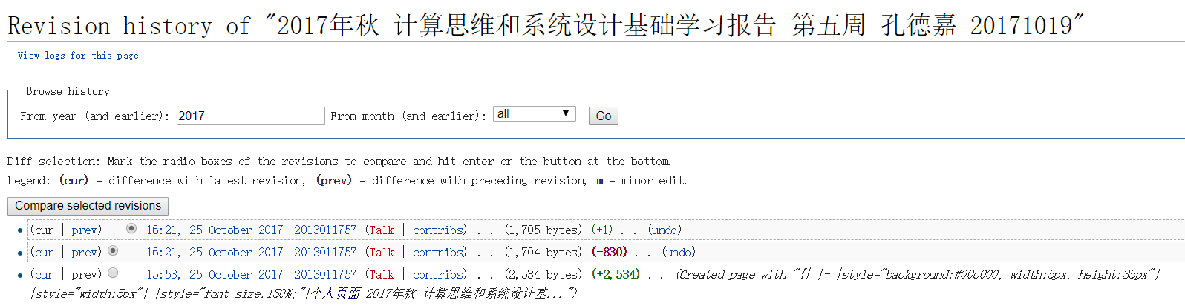
Wiki活跃度

Slide 16
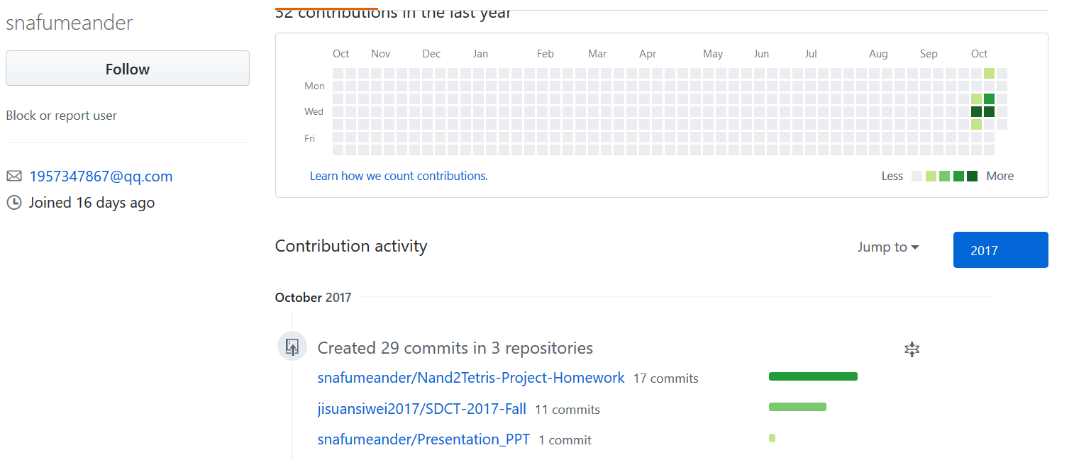
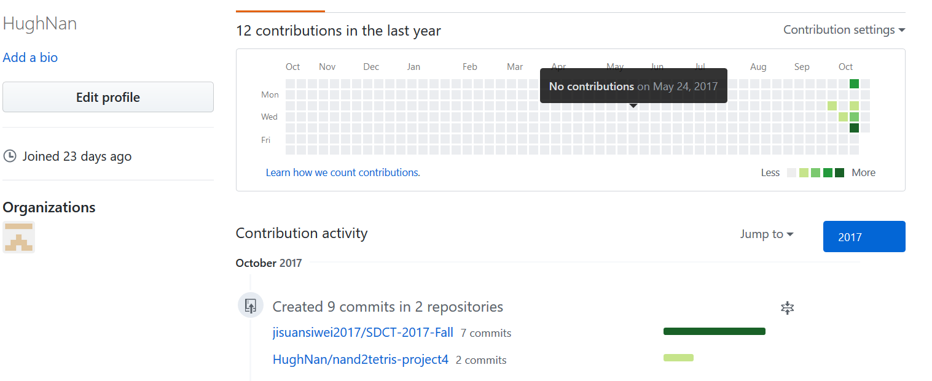
GitHub活跃度

