Slide 1


About Lex and ANTLR
Computational Thinking and System Design
Group 1
Week 10

Slide 2


Logical Model
Week 10
Input
Coursera Machine Learning
ANTLR
Mathematica
Output
An example in ANTLR
Reports
Progress
Try to use Mathematica
Implement an arithmetic parser
Effect
Find two ways to parse
Learn Mathematica
Better understanding of category theory
Computational Thinking and System Design

Slide 3
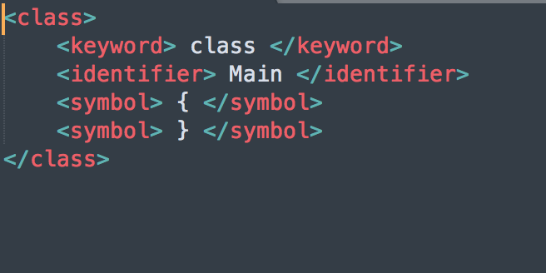
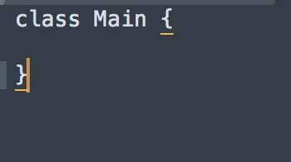
A quick summary of what we have done
Week 10
Lex
C
Regular Expression
All the functions in head file
Additional space for information (Stack)
Computational Thinking and System Design

Slide 4
Pros vs. cons
Week 10
Needs huge patience
May need some programming experience (hard to debug)
Only works for code written in strict format.
Almost impossible to change if the contract changes.
Fast
Straightforward
Computational Thinking and System Design

Slide 5
ANTLR
Week 10
Another Tool for Language Recognition
Implemented in JAVA
Match tokens
Match patterns for tokens
tree-structure output
Computational Thinking and System Design

Slide 6
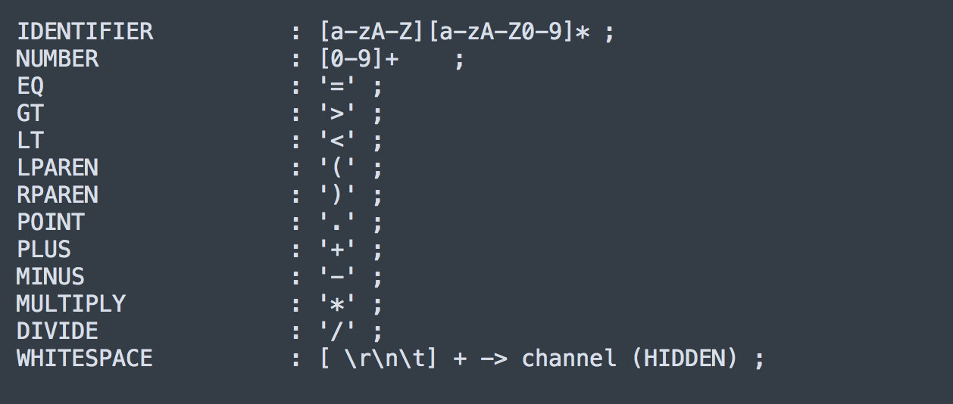
AN arithmetic example
Week 10
This part is just tokenizing
Computational Thinking and System Design

Slide 7
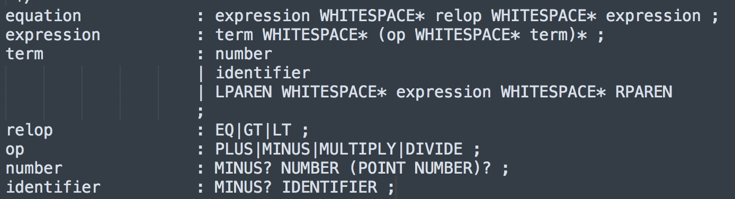
AN arithmetic example
Week 10
A huge “Regular Expression”
Depth-First Search
Computational Thinking and System Design

Slide 8
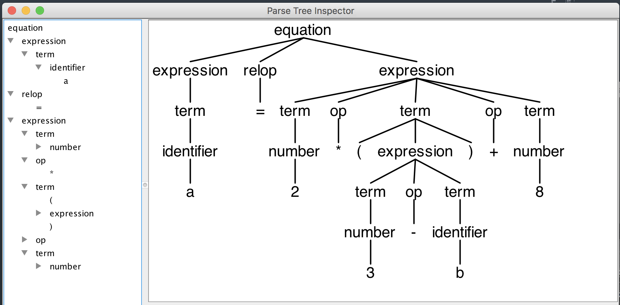
Input & output
Week 10
Computational Thinking and System Design

Slide 9
Week 10
Thank you for your time!
Computational Thinking and System Design

