Slide 1

Distributed Video Encoding
Adam Espinosa, Michael Metz

Slide 2
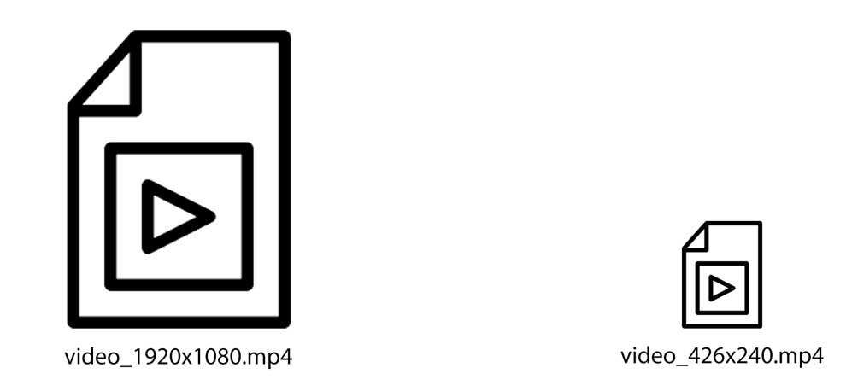
What is Video Encoding

Slide 3
Motivation
Netflix
Youtube

Slide 4
But Why?
Low powered devices
1
Low bandwidth Connections
2

Slide 5

Implementation
TCP SERVER
Raw videos
Transcoded Videos
job
job
job
job
job
job
…
Encoding
Encoding
WORKER CLIENTS

Slide 6
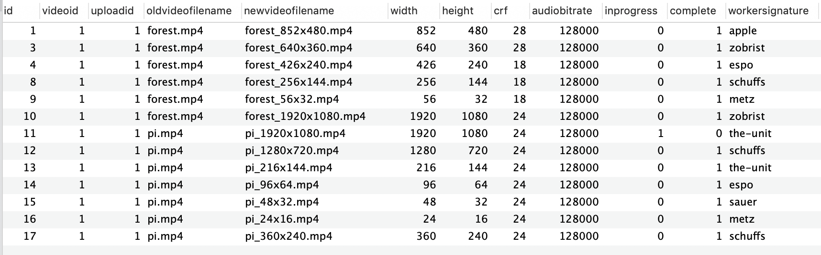
MYSQL JOB TABLE

Slide 7
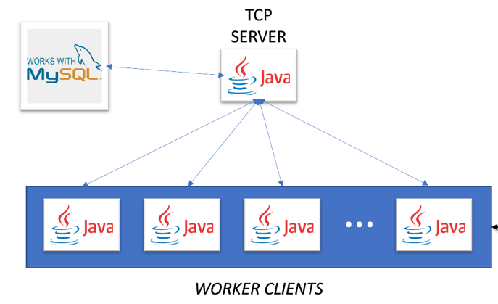
MUTUAL EXCLUSION
Single Threaded TCP server VS RMI

Slide 8
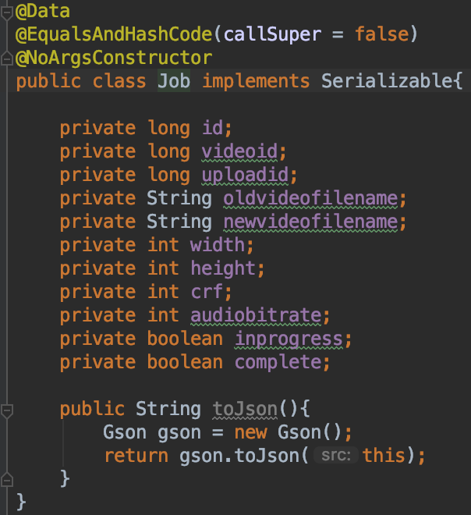
Use JSON with TCP

Slide 9
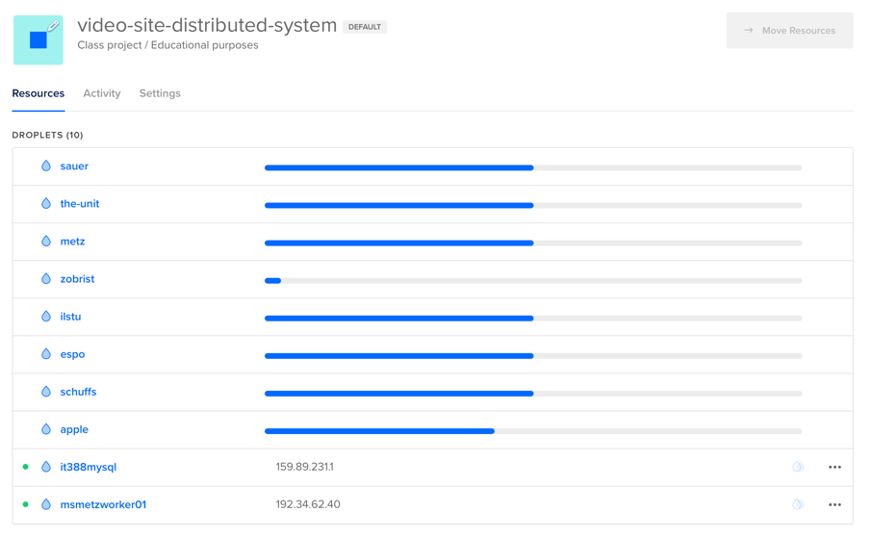
Digital ocean

Slide 10
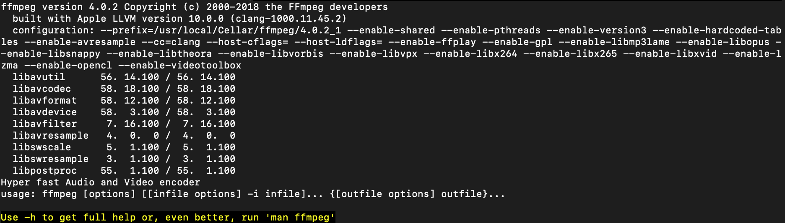
Encoding
FFMPEG Wrapper

Slide 11

Things to consider for production environment
S3 options
MPEG-DASH
Encoding api?

