Slide 1

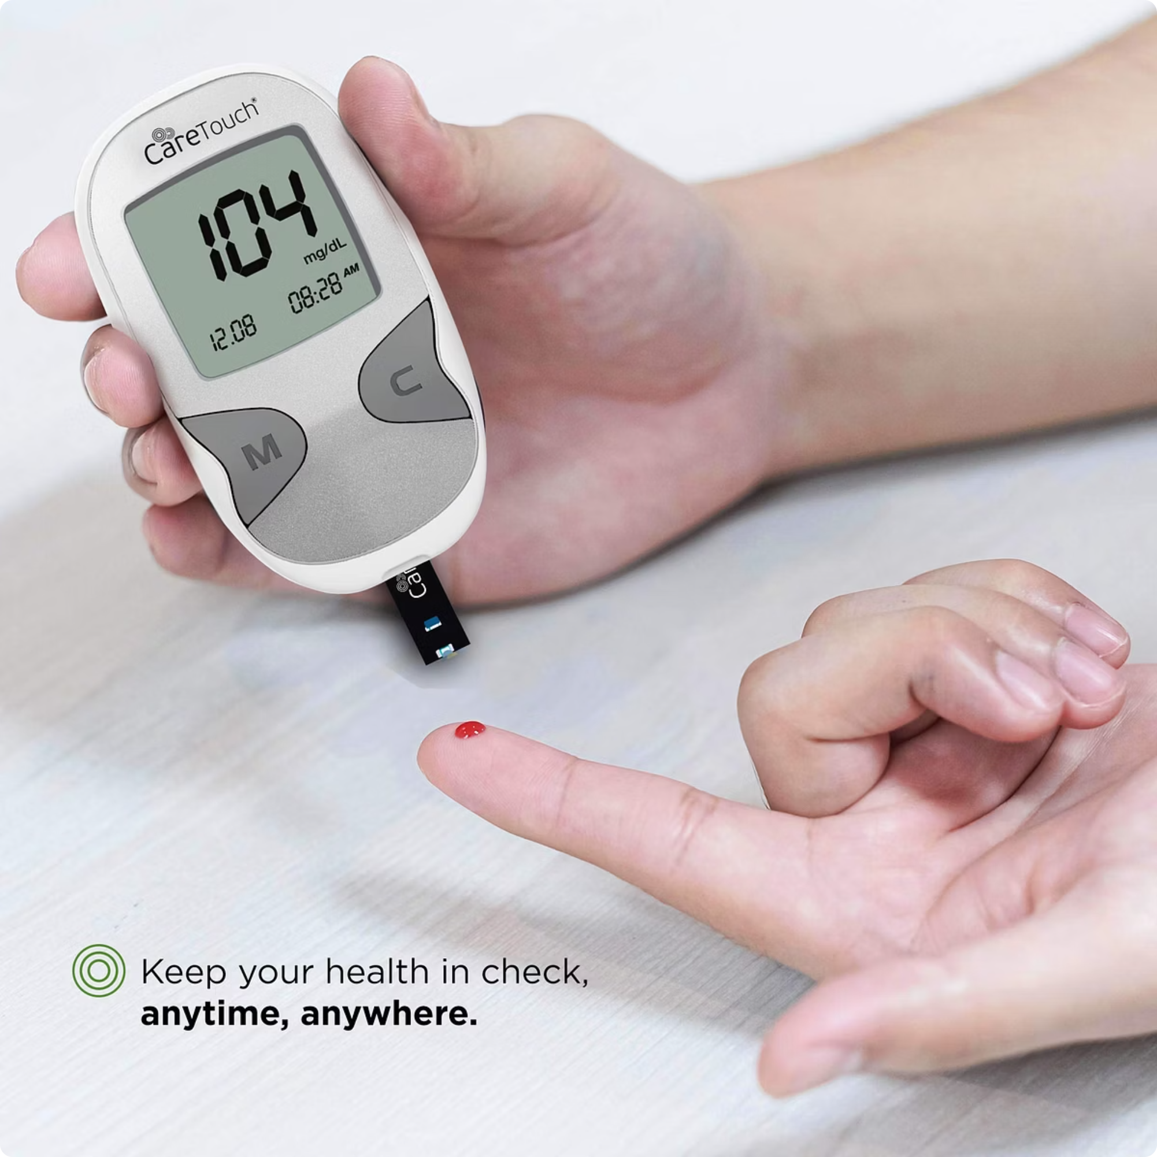
Predictive Analytics for Diabetes Risk using Logistic Regression
Michael Nyawade

Slide 2



Motivation & Public Health Relevance
Global Health Burden
Prevention Power
Data-Driven Decisions
Diabetes represents a major public health challenge, particularly in resource-limited settings
Early detection enables targeted interventions, reducing long-term complications
Machine learning tools can enhance screening programs and clinical decision-making
Goal: To build a predictive classification model to identify individuals at risk using medical and demographic features

Slide 3

Dataset Overview
Pima Indians Diabetes Dataset
Sample size: 768 observations
Features: 9 clinical and demographic variables
Target Variable: Binary outcome (1 = Diabetes, 0 = No Diabetes)
Key Variables
Glucose concentration
Body Mass Index (BMI)
Age & pregnancy history
Insulin levels
Blood pressure
Skin thickness
Diabetes pedigree function

Slide 4




Analytical Approach
Data Preprocessing
Zero-value clinical fields treated as missing data and imputed using median values, as the features were skewed.
Exploratory Analysis
Comprehensive examination of feature distributions, correlations, and risk factor patterns.
Logistic Regression
Interpretable probabilistic model for binary classification.
Performance Evaluation
Assessed using accuracy metrics, confusion matrix, and ROC-AUC curve analysis.

Slide 5
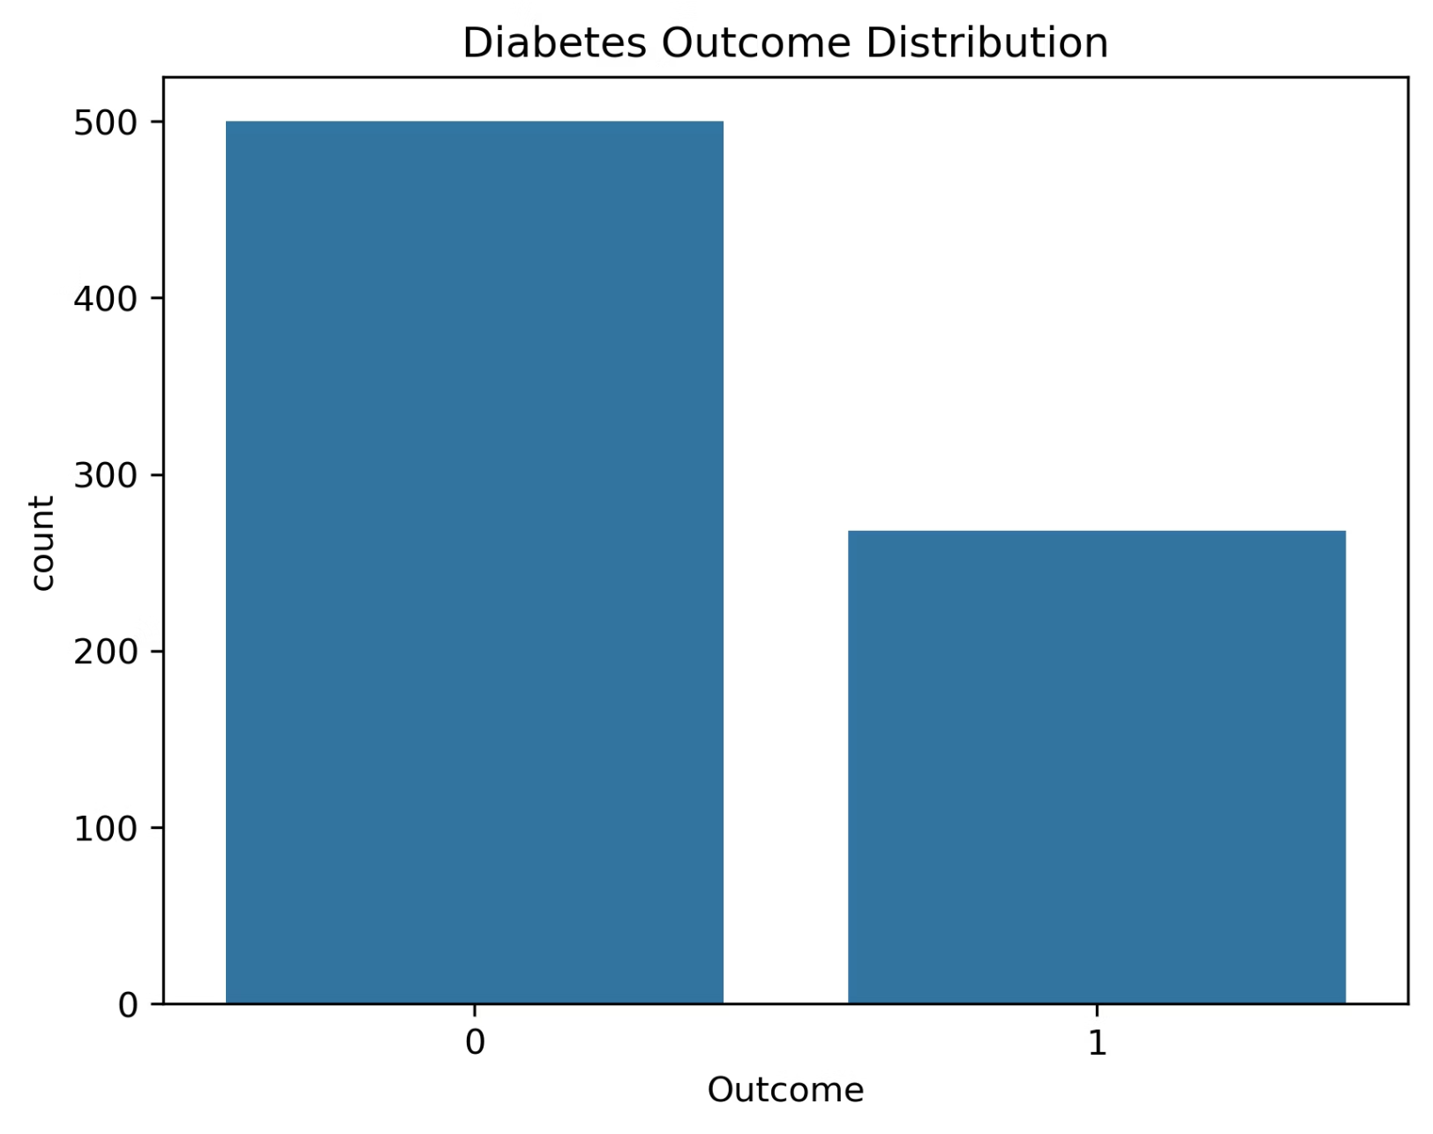

Outcome Class Distribution
Dataset Balance Analysis
Understanding the prevalence of diabetes in our sample is critical for model interpretation and performance assessment.
The dataset shows a moderate class imbalance, with approximately 65% non-diabetic and 35% diabetic cases.
This distribution reflects real-world prevalence patterns but may influence model sensitivity

Slide 6

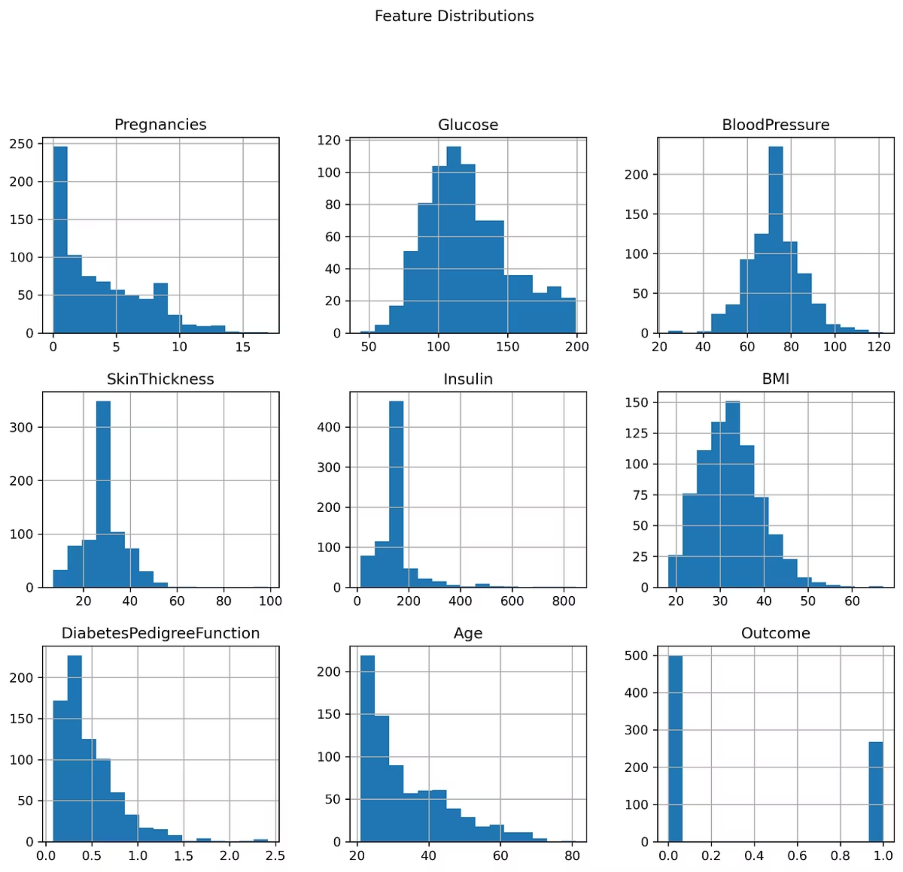
Feature Distributions
Distribution Patterns
Most clinical features show right-skewed distributions.
Outlier Presence
Several variables (esp. insulin) contain extreme values requiring careful consideration during model training.

Slide 7
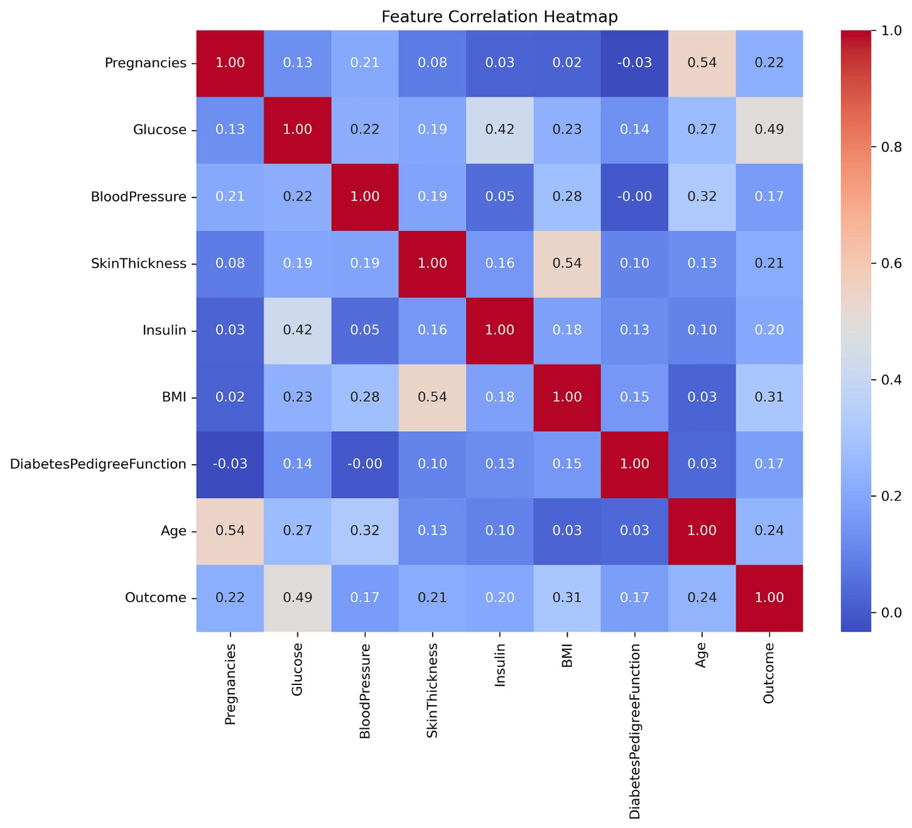
Correlation Analysis
Key Associations with Diabetes Risk
Glucose
Strongest predictor (r ≈ 0.49)—elevated levels strongly indicate diabetes risk
BMI
Moderate correlation—obesity is a known risk factor for Type 2 diabetes
Age
Positive association—risk increases with age
Pregnancies
Moderate link.

Slide 8
Class-Separated Statistics
Comparing Clinical Features: Non-Diabetic vs. Diabetic Patients
Feature
Mean (No Diabetes)
Mean (Diabetes)
Median (No Diabetes)
Median (Diabetes)
Pregnancies
3.30
4.87
2
4
Glucose
110.68
142.13
107.5
140
Blood Pressure
70.92
75.12
72
74
Skin Thickness
27.73
31.69
29
29
Insulin
127.79
164.70
125
125
BMI
30.89
35.38
30.40
34.25
Pedigree Function
0.43
0.55
0.34
0.45
Age
31.19
37.07
27
36
Diabetic patients show consistently higher values across key metabolic indicators

Slide 9

Model Performance & Interpretation
Classification Results
Feature Importance: Odds Ratios
71%
0.81
76%
Glucose
Overall Accuracy
ROC-AUC Score
3.26× increased odds per unit
Correct classification rate on test data
50%
Key Insight: Model demonstrates better performance identifying non-diabetic cases (higher specificity than sensitivity)
BMI
1.99× increased odds
32%
Pregnancies
1.46× increased odds

Slide 10
Recommendations
Promote routine glucose screening
Weight management interventions
Target at-risk individuals using predictive scoring

Slide 11
Limitations & Next Steps
Current Limitations
Future Directions
01
Sample Size
Dataset Expansion
Limited to 768 observations with constrained feature scope—may not generalize broadly
Incorporate larger, more diverse populations with additional clinical markers
Class Imbalance
02
Fewer diabetic cases reduce model sensitivity and recall performance
Resampling Techniques
Apply other methods to address class imbalance
Imputation Bias
03
Median replacement for missing values may introduce systematic error
Advanced Models
Explore ensemble methods and deep learning approaches

