Slide 1
PROJECT PROPOSAL

Slide 2
STUDENT INFORMATION
NAME: MICHAEL OTIENO KASUKU
REGISTRATION NUMBER: COM/B/01-00162/2021
COURSE CODE: BCS 326
COURSE TITLE: COMPUTER SCIENCE PROJECT I
PHONE NUMBER: 0742644460
EMAIL: michaelotienokasuku@gmail.com
SUPERVISOR: DR. DOROTHY APONDI RAMBIM

Slide 3
PROJECT TITLE
Bursary Mashinani – Proposed Bursary Application Portal for Kisumu West Constituency

Slide 4
ABSTRACT
This document outlines the "Bursary Mashinani" initiative, aimed at revolutionizing educational access in Kisumu West Constituency, Kenya. The project addresses the challenges of the current manual bursary application system by proposing an innovative Bursary Application Portal.
The document presents a detailed methodology, incorporating an Iterative and Incremental Development Model, with key milestones, system requirements, and a schedule.
The document concludes with a commitment to transparency in budget considerations, covering development costs, testing, deployment, user training, ongoing maintenance, and scalability.

Slide 5
1. INTRODUCTION
1.1 Background of the Study
In the dynamic landscape of the 21st century, education stands as a fundamental pillar for individual empowerment and societal progress.
The Kisumu West Constituency, like many other regions, grapples with the challenge of ensuring that every child, regardless of their socio-economic background, has the opportunity to acquire quality education.
The NG-CDF program emerges as a beacon of hope, providing a solution to the financial constraints that often impede students from pursuing education beyond primary levels.
The innovative "Bursary Mashinani" initiative, proposed for the Kisumu West Constituency, aligns seamlessly with the government's commitment to democratize educational access.

Slide 6
2. PROBLEM DEFINITION
2.1 Current System Workflow
The existing process for students to apply for a bursary in Kisumu West Constituency is cumbersome. Initiated by a public address announcement, applicants, whether students, parents, or guardians, must physically travel to the constituency headquarters office to obtain and subsequently return a paper application form.
This manual process involves the collection of extensive personal information, including student registration numbers and school details. Once the form is filled, it is submitted back to the constituency headquarters, marking the commencement of a 14-day application period. Following this, a vetting process is undertaken by the constituency bursary application committee, leading to the shortlisting of successful candidates, followed by allocation and disbursement.

Slide 7
2. PROBLEM DEFINITION
2.2 Weaknesses of the Current System
Time-Consuming and Fatiguing: The process demands significant time and effort from applicants due to long queues and the necessity for multiple visits to the constituency headquarters, sometimes incurring travel expenses.
Inefficiency and Misallocation: The manual approach allows for the misappropriation of funds, as both local and non-local students may benefit. This results in a lack of financial accountability and potential misappropriation of public funds.

Slide 8
2. PROBLEM DEFINITION
2.3 The Proposed Idea: Bursary Mashinani
To address these challenges, I propose "Bursary Mashinani," an innovative Bursary Application Portal designed to automate and streamline the bursary application process for Kisumu West Constituency. This digital solution offers:
Real-Time Application Status: Users can check the bursary application status online, eliminating the need for physical visits.
Efficient Application Process: A simplified process involves selecting the desired institution, providing necessary details like National ID and Student Registration Numbers, and utilizing drop down menus for Institution Name and Account Number, reducing errors and enhancing efficiency.
Secure and User-Friendly Interface: The web app ensures security, validation of all required fields, and user-friendly functionalities such as submitting, canceling, and clearing application data.
Track Progress Functionality: Applicants receive a system-generated serial number upon successful submission, allowing them to track their application progress. A comprehensive report, including student details, disbursed amounts, and dates, can be generated for future reference.
Technology Integration: Developed using HTML, CSS, Javascript, Python, and Django Web Framework, the system guarantees security, manages concurrent users effectively, and sets the foundation for further enhancements.

Slide 9
3. OBJECTIVES
3.1 General Objective
To design and implement the proposed bursary application portal for Kisumu West Constituency.

Slide 10
3. OBJECTIVES
3.2 Specific Objectives
To conduct a comprehensive analysis of the requirements gathered from stakeholders at the conceptual design phase.
To develop a detailed system design based on the conceptual design, outlining the architecture, components, and data structures.
To implement the functionalities and features outlined in the conceptual design.
To conduct thorough testing at each iteration to ensure that individual components and features meet specified requirements.
To deploy the portal to a live environment, making it accessible to users for real-world application and testing.

Slide 11
4. PROBLEM JUSTIFICATION
4.1 Rationale of Automating the Current System
Time Efficiency: The current manual system demands significant time and effort from applicants, involving physical travel, long queues, and a prolonged application process. Automating the system through "Bursary Mashinani" will significantly reduce the time required for both applicants and administrative processes.
Enhancing Accessibility: The manual nature of the current system creates barriers for potential applicants, especially those with limited means for travel. By introducing an online portal, "Bursary Mashinani" ensures accessibility for a broader range of students, parents, and guardians, promoting inclusivity.
Transparent Application Tracking: The lack of real-time tracking in the current system often leaves applicants in the dark about the status of their applications. With the proposed system, applicants can easily track the progress of their bursary applications, fostering transparency and reducing unnecessary inquiries.

Slide 12
5. LITERATURE
5.1 The Current System
The current system for bursary application in Kisumu West Constituency operates within a traditional, manual framework. Literature on this system highlights its reliance on public announcements, physical travel to the constituency headquarters, and paper-based forms for application.
This literature emphasizes the labor-intensive nature of the process, where personal details, including student registration numbers and school information, are captured manually. The sequential steps involve a two-week application period, followed by vetting conducted by the constituency bursary application committee, and subsequent allocation and disbursement of funds.

Slide 13
5. LITERATURE
5.2 Challenges and Limitations of the Current System
Time-Consuming Process: The manual nature of the current system results in a lengthy and time-consuming application process due to physical visits, paper documentation, and sequential steps.
Financial Inefficiencies: Challenges arise with the misallocation and misappropriation of funds, allowing non-residents to benefit from the program while deserving local students may miss out.
Accessibility Barriers: The need for physical presence at the constituency headquarters creates barriers for potential applicants, particularly those with limited resources or living in remote areas.
Lack of Real-Time Tracking: The absence of a real-time tracking mechanism leaves applicants uninformed about the progress of their applications, leading to uncertainty and unnecessary inquiries.

Slide 14
5. LITERATURE
5.3 Conceptual Design
5.3.1 Features
5.3.1.1 Real-Time Application Status Updates: Applicants will have the ability to track the progress of their bursary applications instantly, providing transparency and reducing the need for inquiries.

Slide 15
5. LITERATURE
5.3.1.2 One-Time Application Restrictions: To enhance accuracy and reduce redundancy, the design restricts the National ID and Student Registration Numbers to a one-time application per financial year. This feature aims to prevent errors and ensure that each applicant has a fair and equal opportunity for bursary consideration.
5.3.1.3 Comprehensive Reporting System: The conceptual design incorporates a reporting system that generates comprehensive reports for successful applicants. These reports include essential details such as student name, registration number, institution details, disbursed amounts, and dates. This feature adds an extra layer of transparency and accountability to the disbursement process.

Slide 16
5. LITERATURE
5.3.1.4 Secure Database: To ensure the integrity and security of applicant information, the conceptual design includes the implementation of a robust database system. Sensitive data, such as National ID numbers and student registration details, will be stored securely, minimizing the risk of unauthorized access or data breaches.

Slide 17
5. LITERATURE
5.3.1.5 User-Friendly Interface: The conceptual design prioritizes the development of an intuitive and user-friendly interface. Applicants, including students, parents, and guardians, will find the portal easy to navigate, reducing the learning curve and ensuring accessibility for users with varying technological proficiencies.

Slide 18
5. LITERATURE
5.3.2 Technological Infrastructure: Utilizing a robust technological infrastructure, the design specifies the use of HTML, CSS, Javascript, Python, and the Django Web Framework. This technology stack not only ensures the security of the portal but also provides a scalable foundation for future enhancements and increased user load.

Slide 19
6. METHODOLOGY
6.1 Model
Iterative and Incremental Development Model: The methodology will be implemented in the following stages:
Requirements Analysis: Conduct a comprehensive analysis of the requirements gathered from stakeholders and the conceptual design phase.
System Design: Develop a detailed system design based on the conceptual design, outlining the architecture, components, and data structures. Identify the necessary technologies and tools for the implementation phase.
Implementation (Coding): Begin the coding phase, implementing the functionalities and features outlined in the conceptual design. Utilize the chosen technology stack, including HTML, CSS, Javascript, Python, and the Django Web Framework, to build the web application.
Testing: Conduct thorough testing at each iteration to ensure that individual components and features meet specified requirements. Address any issues or bugs identified during testing promptly.
Deployment: Deploy the system to a live environment, making it accessible to users for real-world application and testing.

Slide 20
6. METHODOLOGY
6.2 System Requirements
6.2.1 Functional Requirements
REQ -1: The portal shall ensure that the applicant can only apply once in every financial year.
REQ-2: The portal shall ensure that the national id number provided by the applicant belongs to that particular applicant based on the applicant’s registration number.
REQ-3: The portal shall ensure that the registration number provided by the applicant is actually a valid registration number based on the provided student register of the chosen institution.
REQ-4: The portal shall ensure that the applicant is indeed a resident of the chosen ward.
REQ-5: The portal shall ensure that the provided account number is indeed a valid account number of the chosen institution.
REQ-6: The portal shall ensure that the bursary application can be submitted only if the financial year status is open.
REQ-7: The portal shall ensure that the provided serial number is a valid serial number for the bursary application report to be generated.

Slide 21
6. METHODOLOGY
6.2.2 Non-Functional Requirements
6.2.2.1 Performance Requirements
Response Time:The portal shall provide a response time of not more than 5 seconds for any user-initiated action.
Scalability:The portal must be able to handle concurrent user loads of at least 500 users without significant degradation in performance.
Throughput: The portal should be capable of processing at least 500 bursary applications per minute.
Data Retrieval Speed: Data retrieval operations (e.g, generating reports) should take not longer than 2 seconds, even when the database contains millions of records.

Slide 22
6. METHODOLOGY
6.2.2 Non-Functional Requirements
6.2.2.2 Safety Requirements
Data Security: The portal must adhere to strict data security standards.
Disaster recovery: The portal must have a robust disaster recovery plan in place to ensure business continuity.

Slide 23
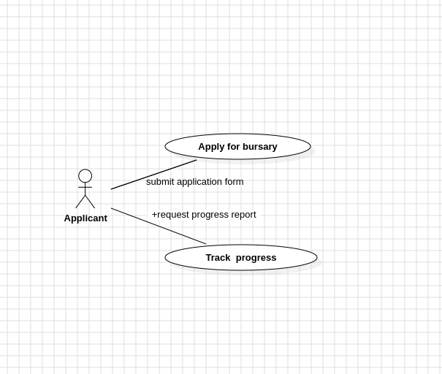
7. SYSTEM DESIGN: Use Case Diagram

Slide 24
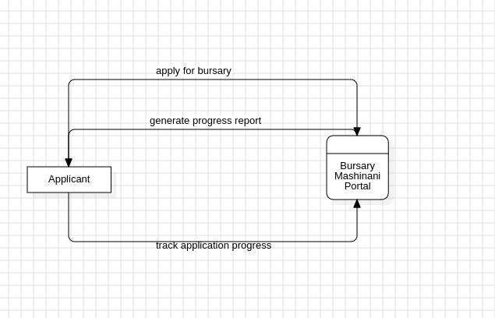
8. SYSTEM DESIGN: Context diagram

Slide 25
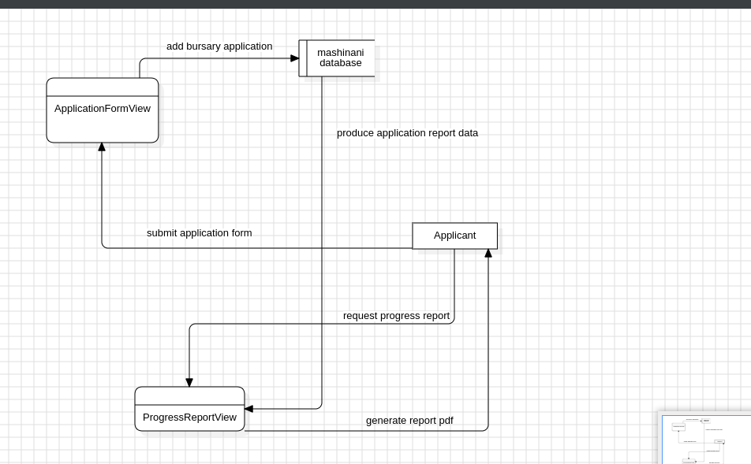
8. SYSTEM DESIGN: Level 1 DFD

Slide 26
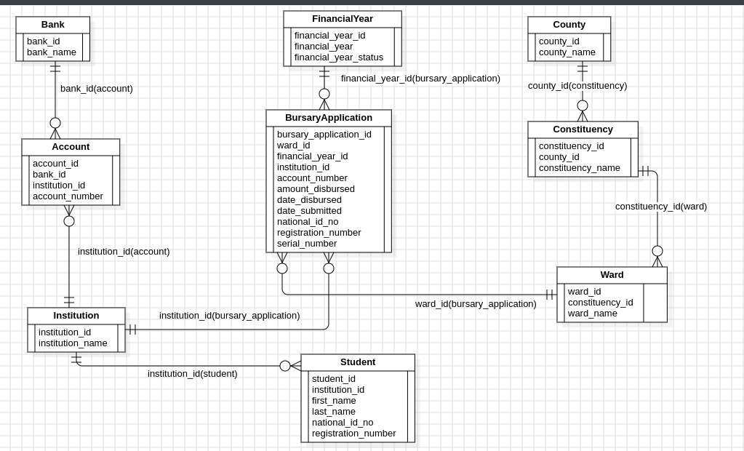
8.SYSTEM DESIGN: Database Design

Slide 27
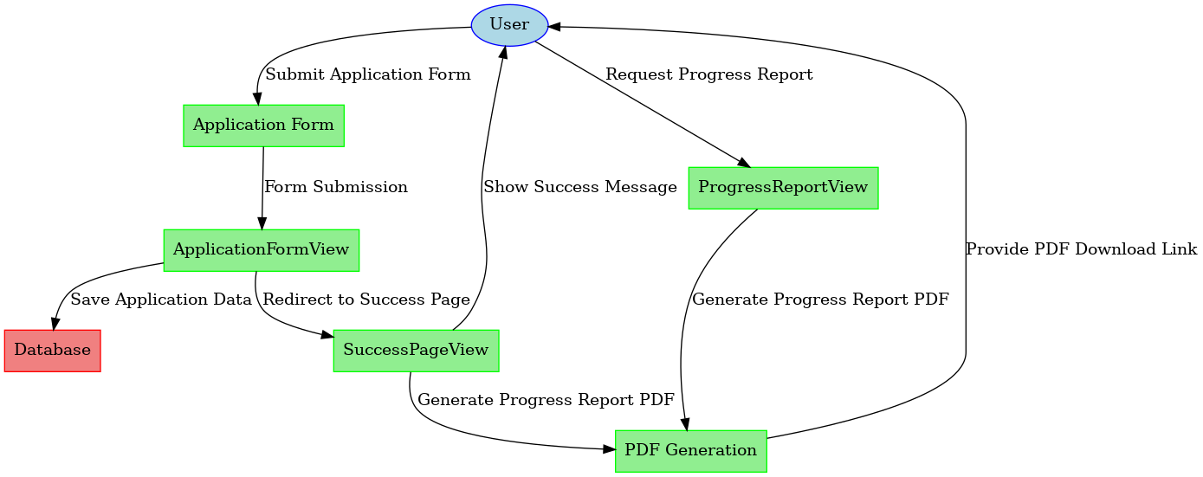
8.SYSTEM DESIGN: Flow chart

Slide 28
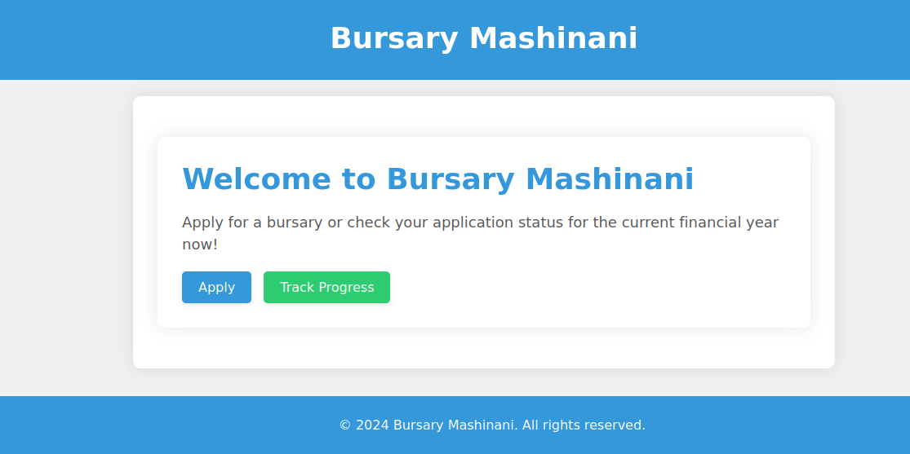
8. SYSTEM DESIGN:Landing Page

Slide 29
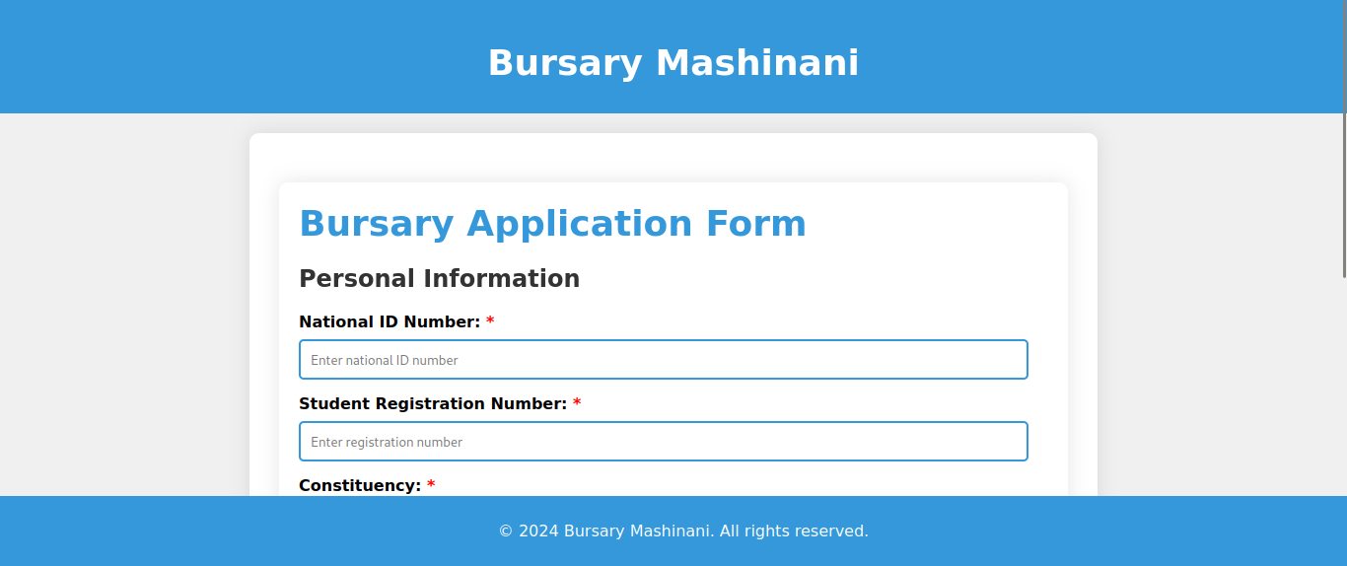
8. SYSTEM DESIGN: Application form page

Slide 30
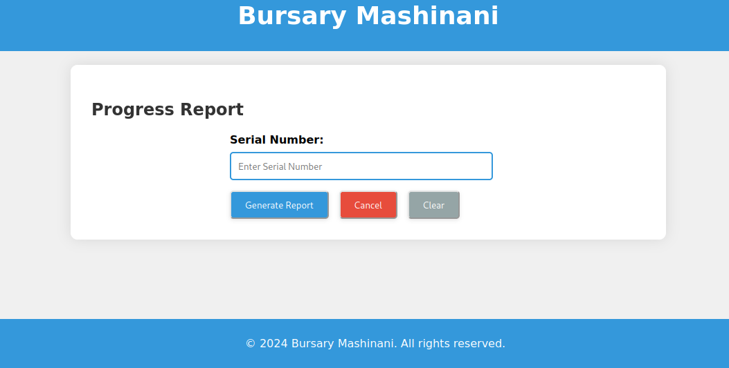
8. SYSTEM DESIGN: Track Progress Page

Slide 31
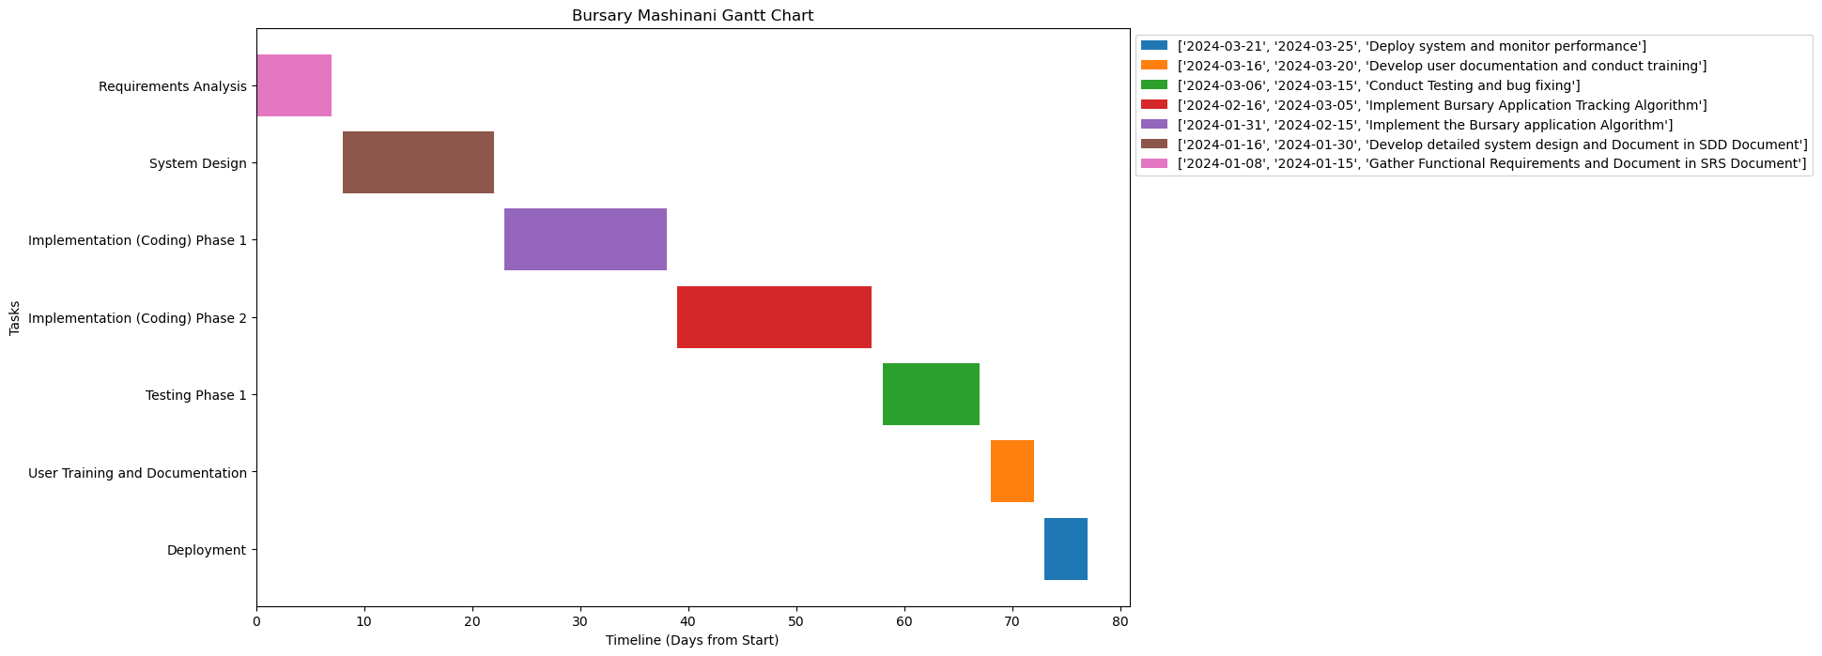
9. SCHEDULE

Slide 32
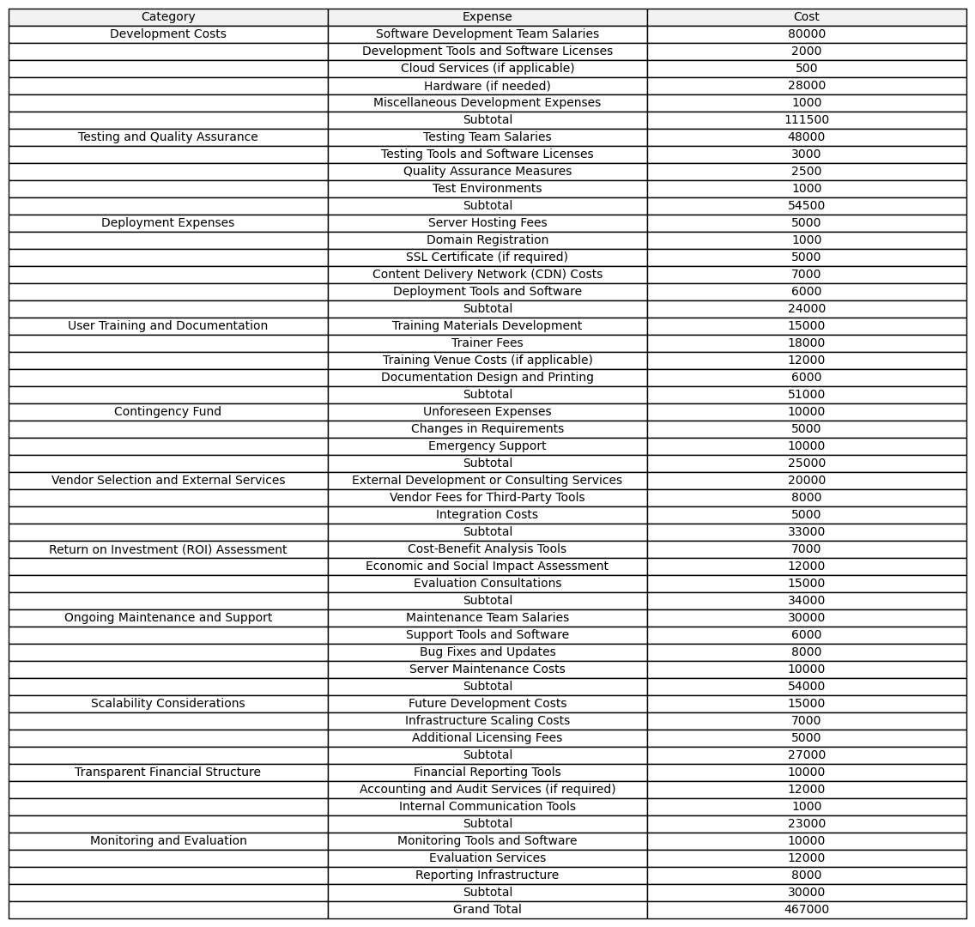
10. BUDGET

