Slide 1
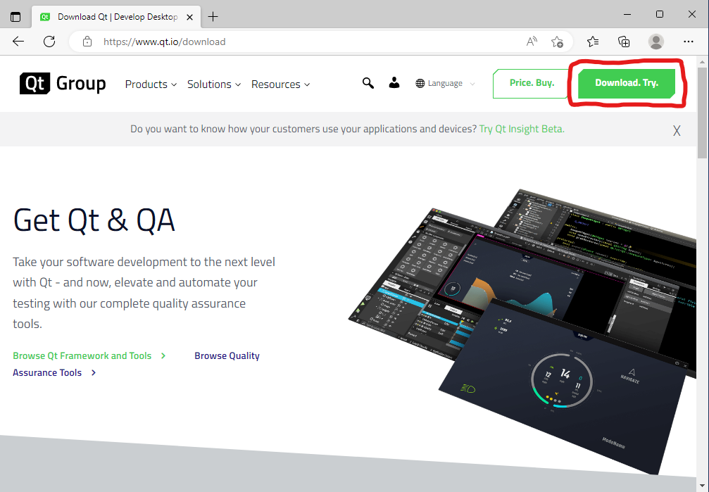
Steps:
1.) Go to website: https://www.qt.io/download

Slide 2
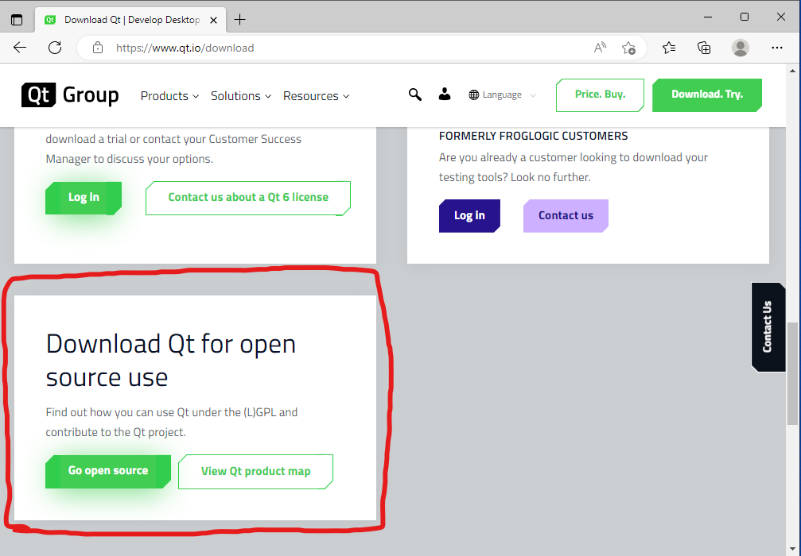
Steps:
1.) Scroll down the page and select the following highlighted link: Go open source.

Slide 3
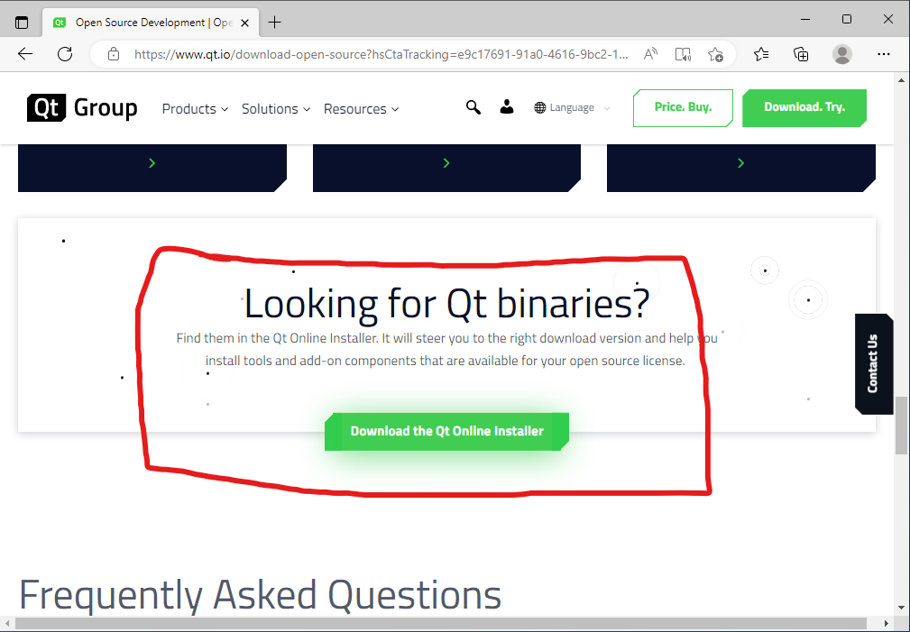
Steps:
1.) Scroll down and select the following link to download the installer: Download the Qt Online Installer.
2.) Once downloaded, open the installer.

Slide 4
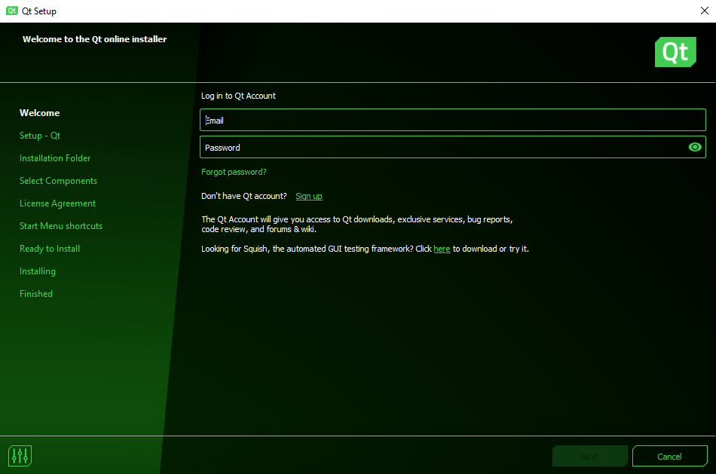
Steps:
1.) Login. Create an account if needed.

Slide 5
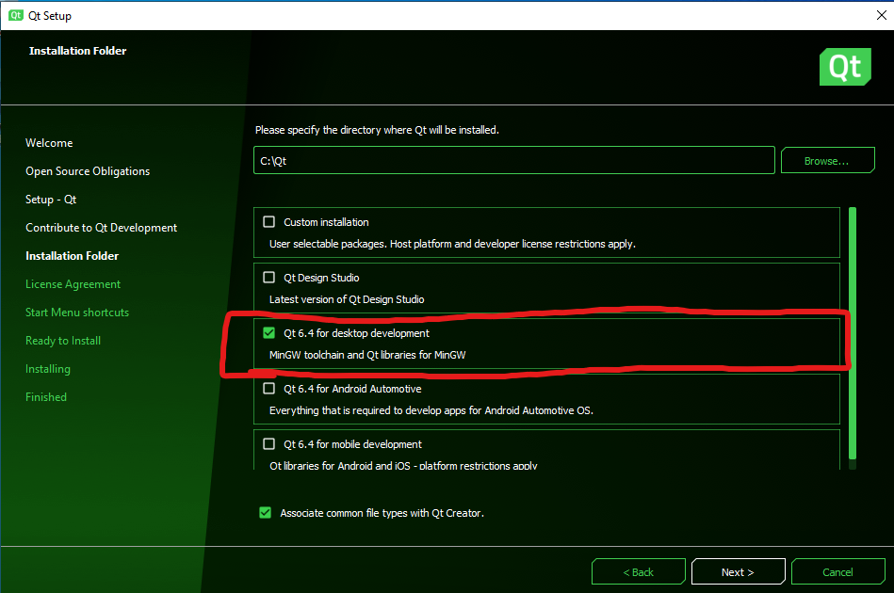
Steps:
1.) Select an installation folder.
2.) Select the checkbox highlighted in the screenshot: Qt 6.4 for desktop development.

Slide 6
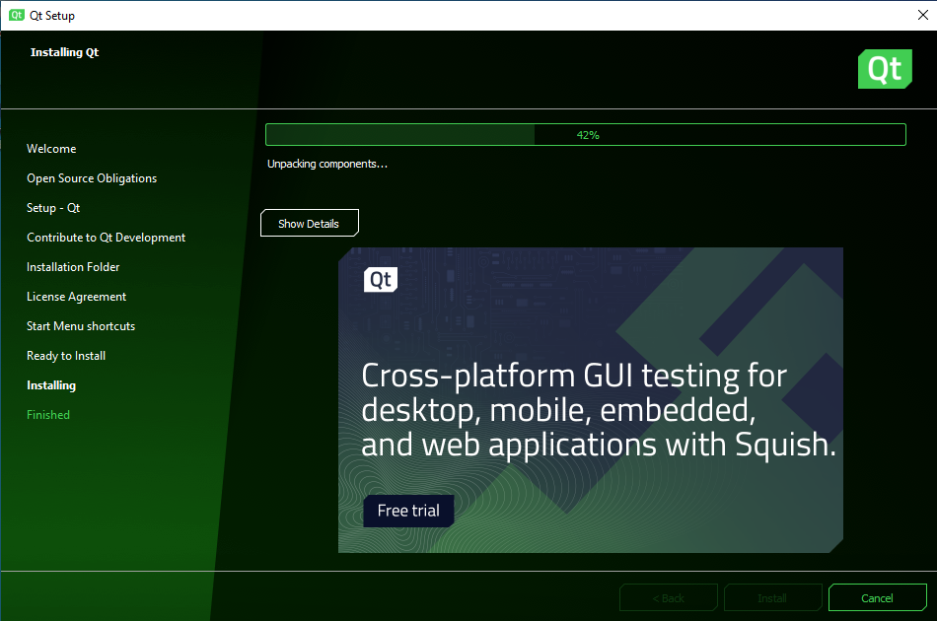
Steps:
1.) Wait for install to finish.
2.) Once finished, open Qt Creator. Might have to use your search bar to find it, if no desktop shortcut was added.

Slide 7
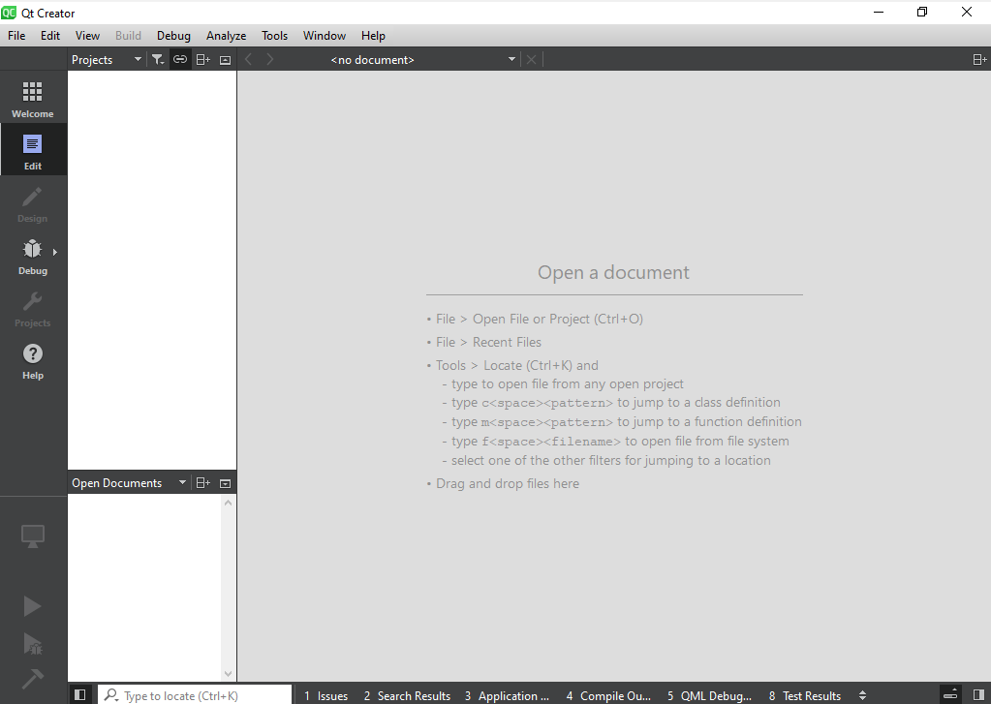
Steps:
1.) With Qt Creator opened you should see something similar to the screenshot.
2.) Select File->New Project
3.) Give the project a meaningful name, such as, “Qt_CSE240_Part_01”

Slide 8
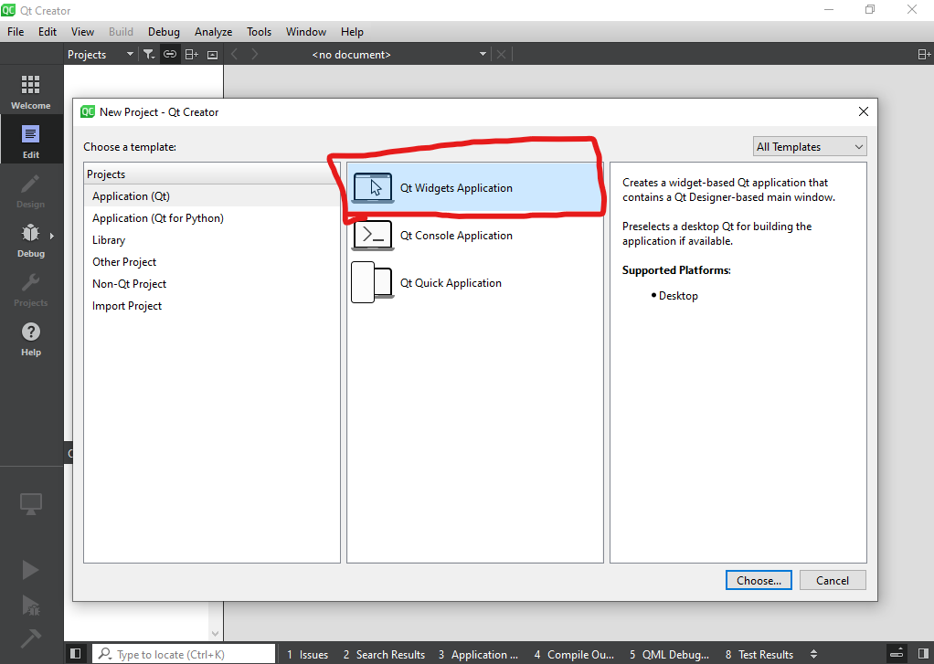
Steps:
1.) Select Application (Qt) under the Projects window.
2.) Select Qt Widgets Application.

Slide 9
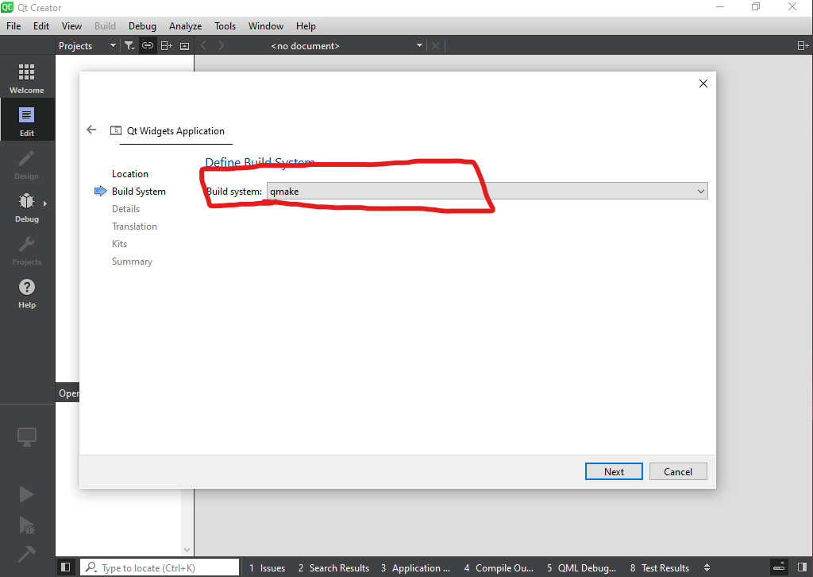
Steps:
1.) Select qmake for our build system.

Slide 10
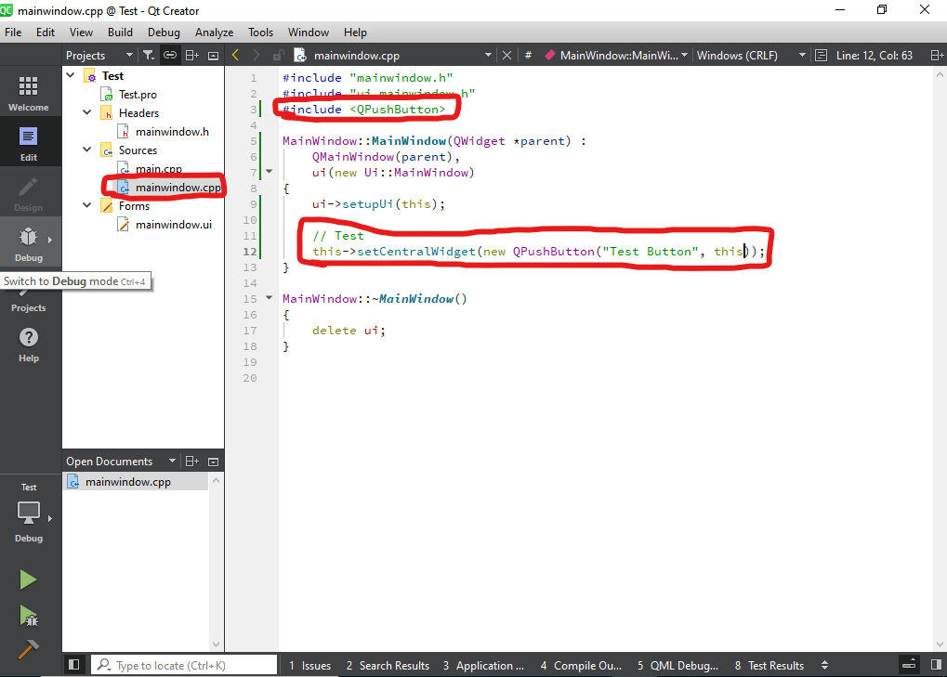
Steps:
1.) Open the mainwindow.cpp file.
2.) Include the <QPushButton> header.
3.) Add the following test code inside the MainWindow constructor: this->setCentralWidget(new QPushButton(“Test Button”, this));
4.) Select the green run button in the bottom left or use Ctrl+R hotkey.

Slide 11
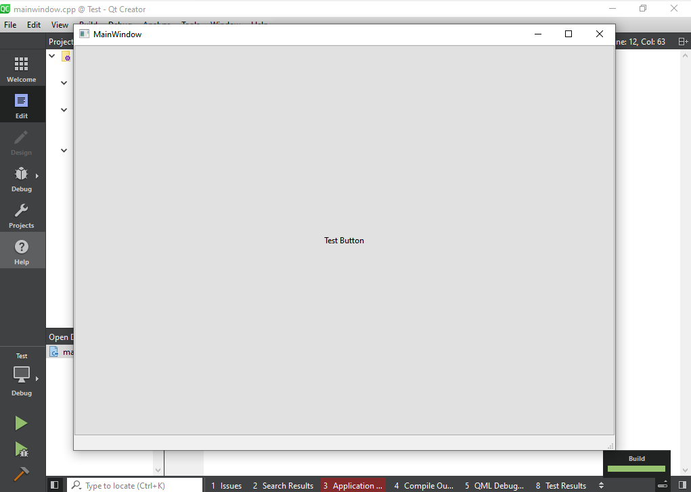
Steps:
1.) You should now have a similar window as to the one in the screenshot.
2.) Qt should now be setup and ready to start our tutorial series.
3.) Remove the previous test code.

