Slide 1



FIT DCS SERVER’S GUI
FIT Collaboration meeting
M. Sukhanov, NRNU MEPHI
7.08.2019

Slide 2
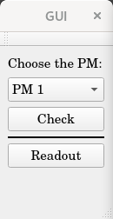
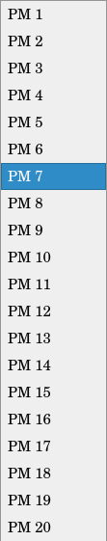
Main Window
The idea is to make a Server to control the transfer of parameters from DCS to TCM & PM and back
The whole project will be written with QT tools
Main Window
PM list
Graphical User Interface (ver. 1):
Main window —
choose the PM from PM list
PM configuration window —
view and set PM parameters
Readout window —
view and set readout parameters
Open PM configuration
window for current PM
7.08.2019
Open Readout window for current PM

Slide 3
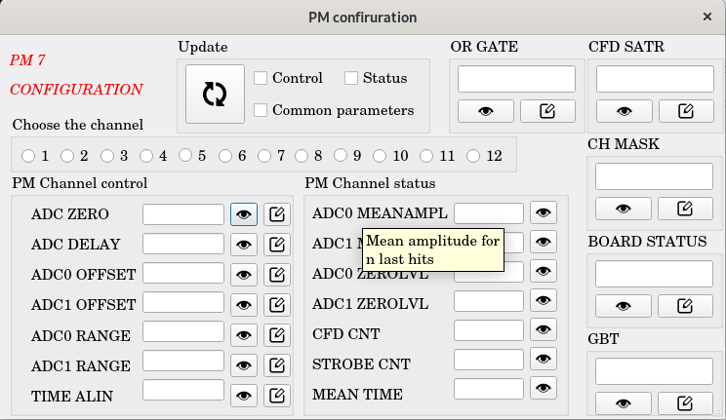

PM Configuration Window
Update all parameters ( button)
Common parameters
for each channel
*Hints are used to see the description of
parameter or button
— READ & WRITE buttons
Channel selection
List of PM’s current channel status parameters
List of PM’s current channel control parameters
7.08.2019

Slide 4
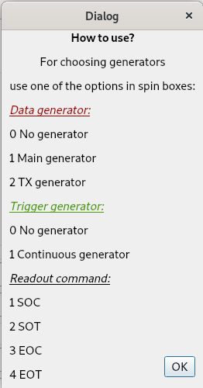
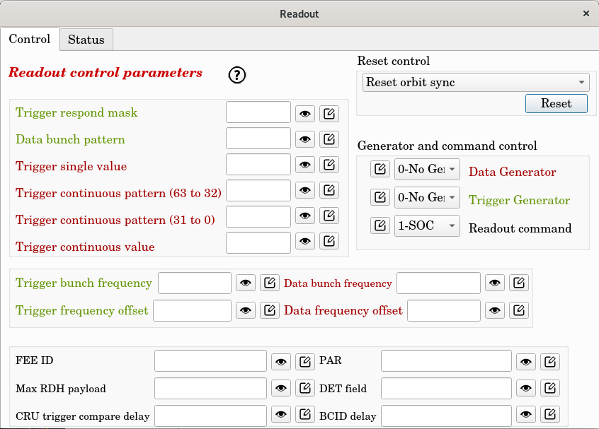
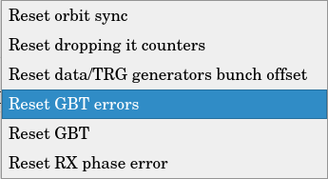
Readout Control Window
Control/status switcher
?
— button for information about
generator and command control
Reset control list
7.08.2019

Slide 5
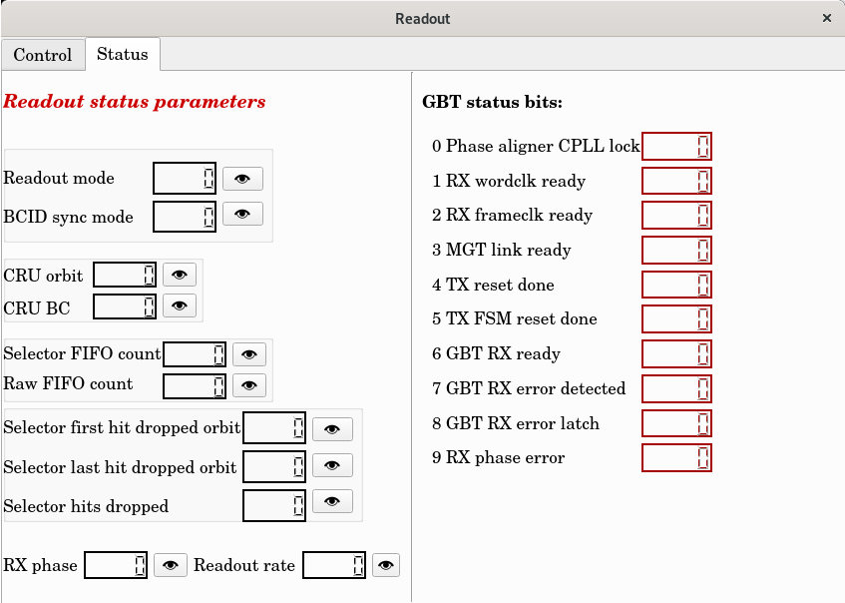
Readout Status Window
0
— false
1
— true
Add the information
about:
Readout mode
BCID sync mode
7.08.2019

Slide 6
Further Development
Here some items, which we’ve thought about:
Standardize the application for cross-platform support (to avoid overlay of elements)
Make one common window to reduce the number of clicks, while operating
Make some parameters more unique as them need it (for example Trigger Single Value is not just about setting a parameter but sending a command)
Single window option
PM
Readout control
parameters
PM
Readout status
parameters
PM
Configuration
1080
PM and channel selection
1600
Any suggestions?
7.08.2019

