Slide 1
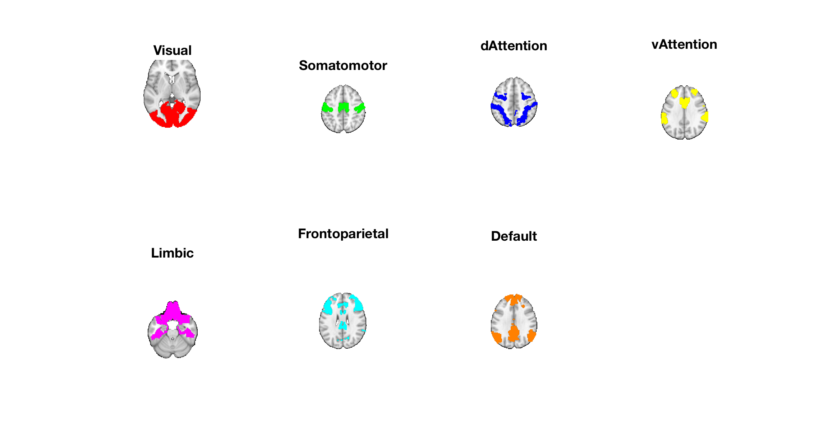
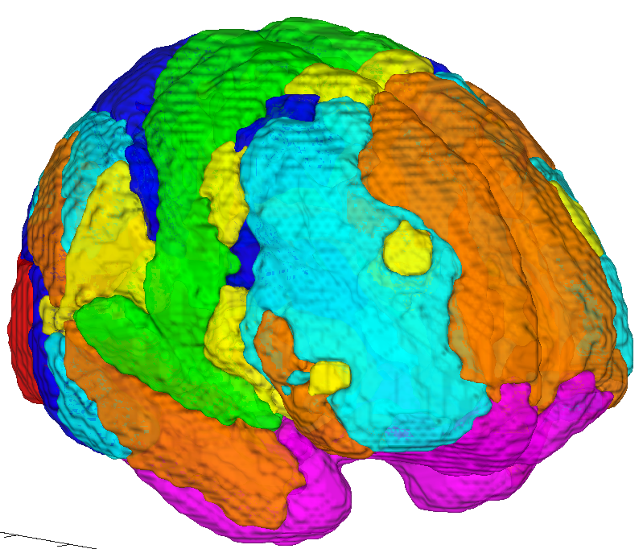
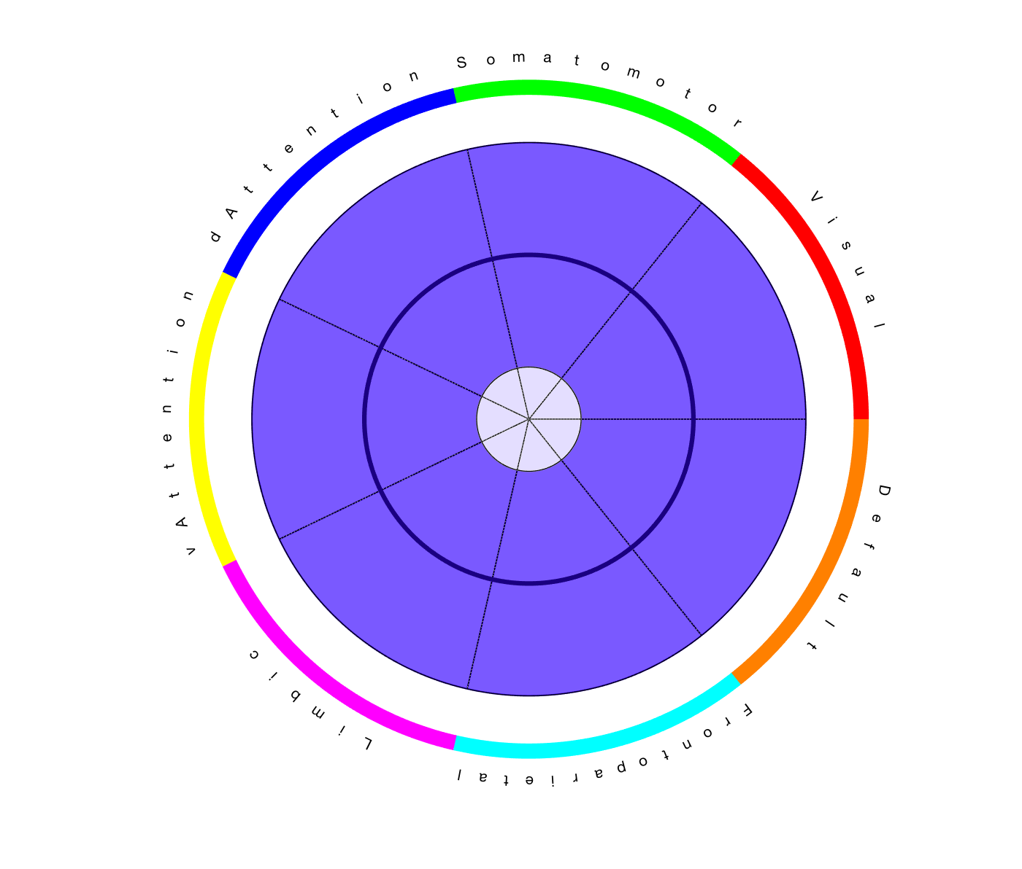
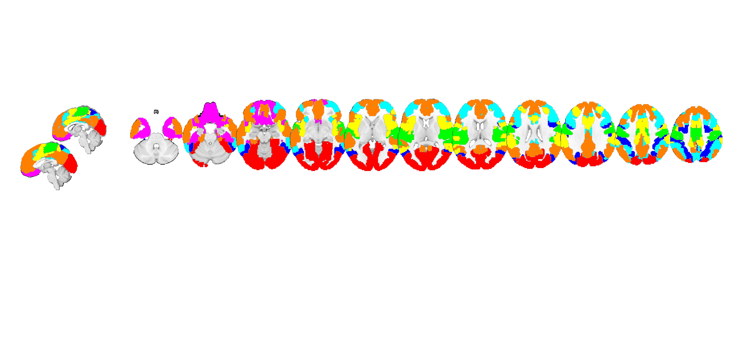
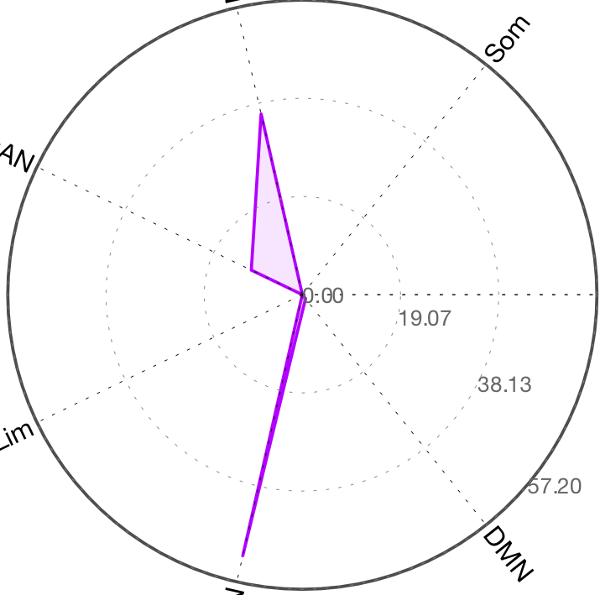
dAttn
SomMot
SomMot
dAttn
Vis
Vis
vAttn
vAttn
Cortical Networks
Wedge plot version
DMN
DMN
Limbic
Limbic
FPN
FPN
dAttn
SomMot
vAttn
Polar plot version
Vis
Limbic
DMN
FPN

Slide 2
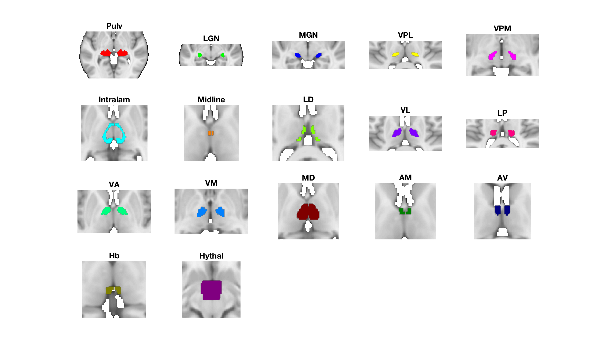
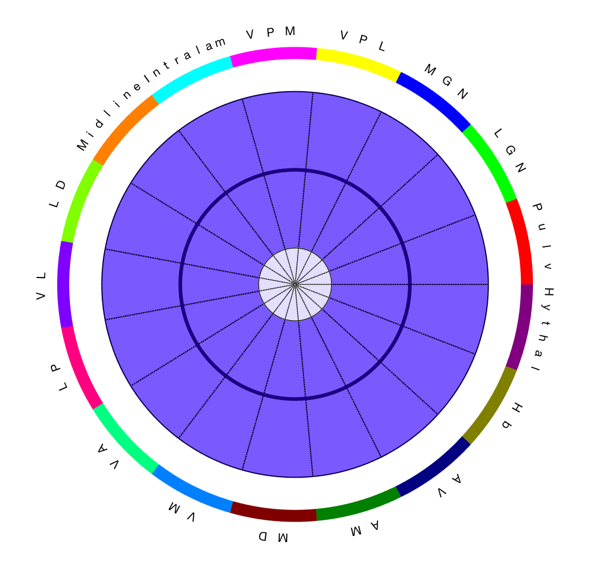
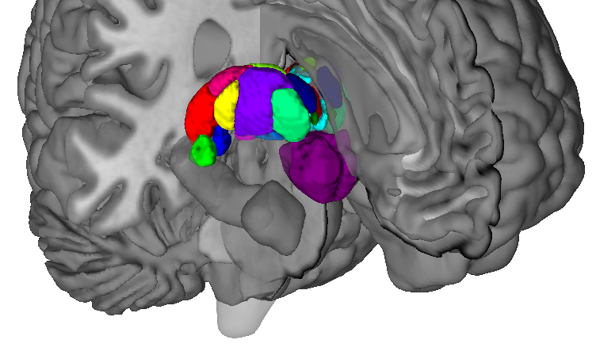
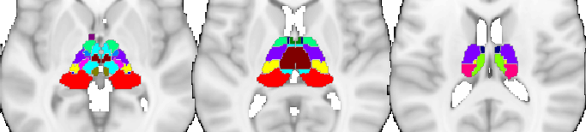
Thalamic regions

Slide 3
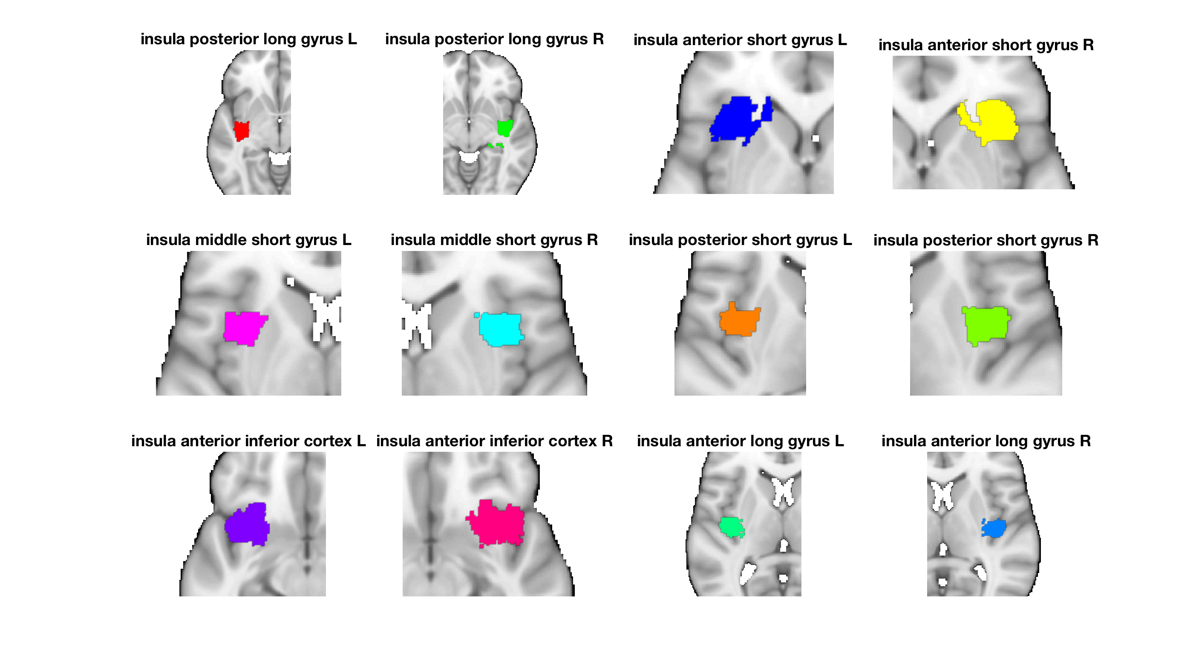
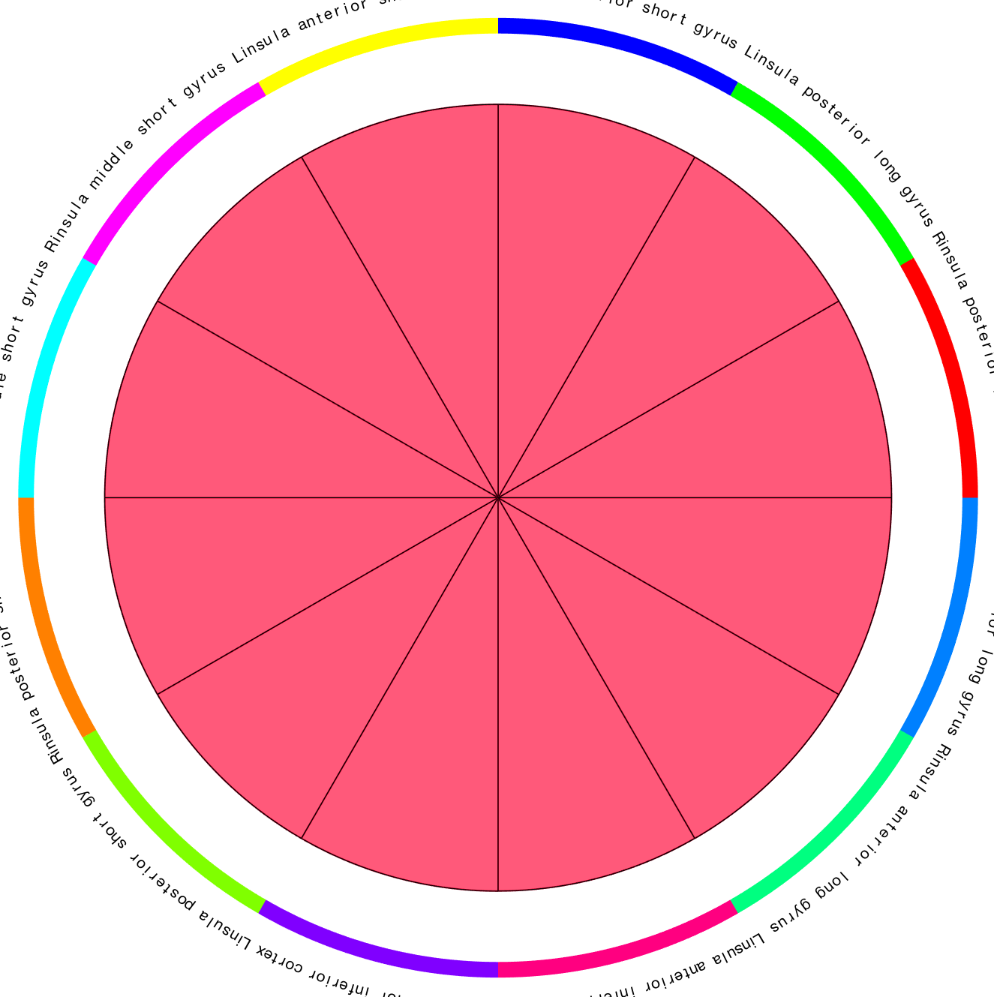
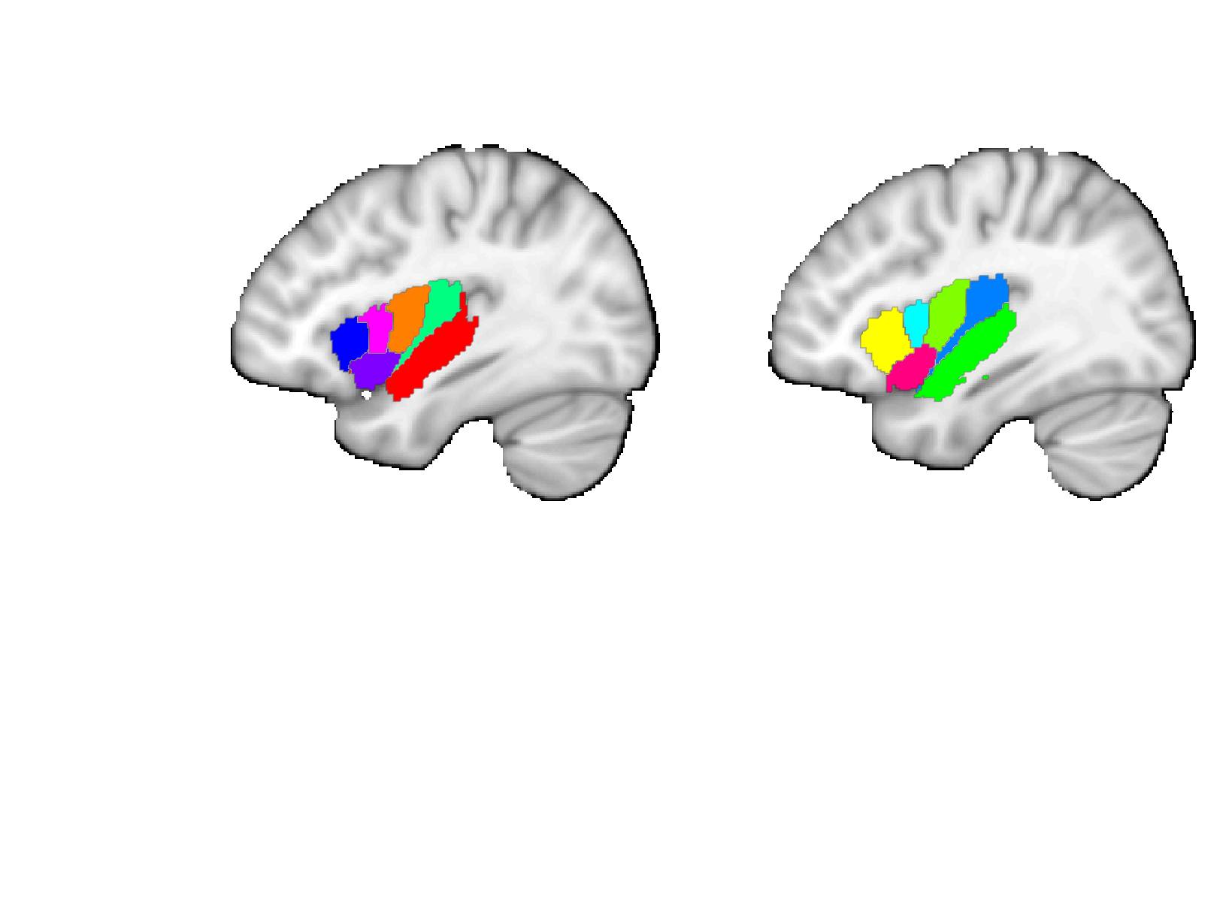
Faillenot insula
Post. short
Ant. long
Short
Long
Post.
Ant.
Middle short
Post. long
Mid.
Post.
Ant. short
Ant.
Ant. inf.
L
Ant. inferior
R
L
R

Slide 4
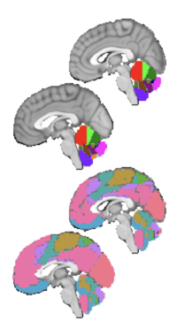
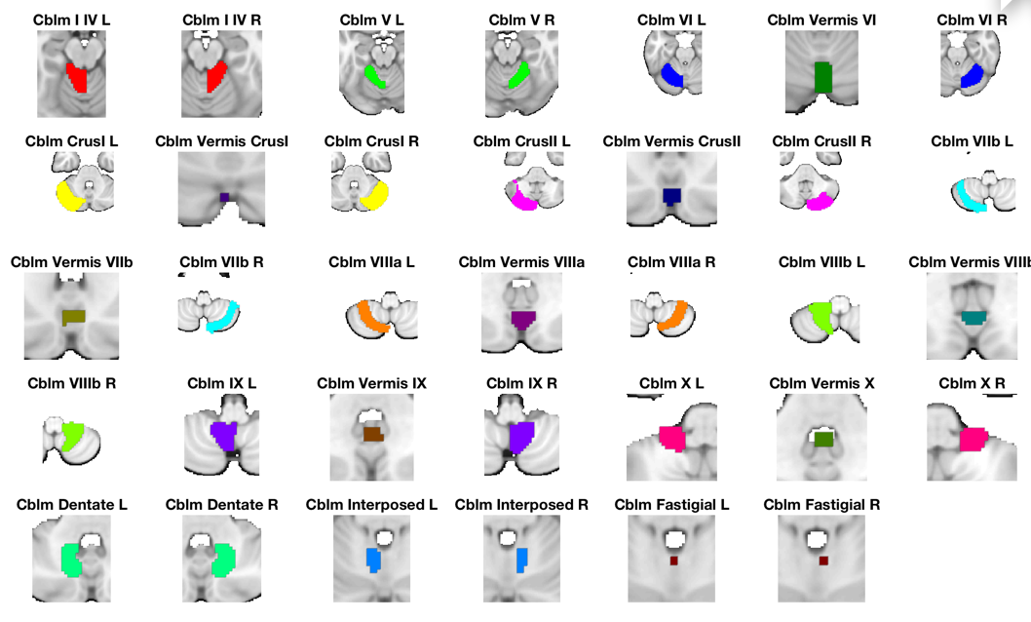
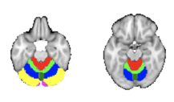
Diedrichsen Cerebellum
Diedrichsen, Jörn, Joshua H. Balsters, Jonathan Flavell, Emma Cussans, and Narender Ramnani. 2009. A Probabilistic MR Atlas of the Human Cerebellum. NeuroImage 46 (1): 39?46.’
Choi, Eun Young, B. T. Thomas Yeo, and Randy L. Buckner. 2012. “The Organization of the Human Striatum Estimated by Intrinsic Functional Connectivity.” Journal of Neurophysiology 108 (8): 2242–63.
Buckner, Randy L. 2013. “The Cerebellum and Cognitive Function: 25 Years of Insight from Anatomy and Neuroimaging.” Neuron 80 (3): 807–15.

Slide 5
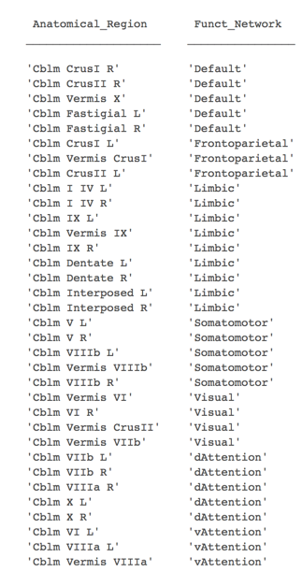
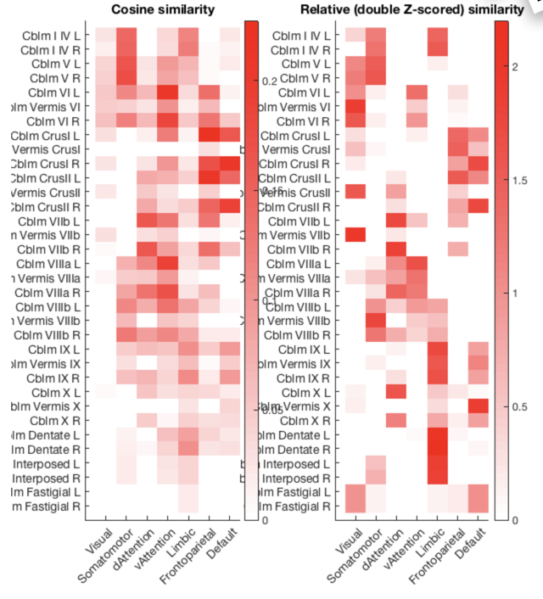
Cerebellum
Buckner/Yeo

