Slide 1
Common Dysfunction of Large-Scale Neurocognitive Networks Across Psychiatric Disorders
Zhiqiang Sha^{1,2,3}; Tor D. Wager^{4,5}; Andrea Mechelli⁶; Yong He^{1,2,3}
¹ National Key Laboratory of Cognitive Neuroscience and Learning, Beijing Normal University, Beijing, China ² Beijing Key Laboratory of Brain Imaging and Connectomics, Beijing Normal University, Beijing, China ³ IDG/McGovern Institute for Brain Research, Beijing Normal University, Beijing, China ⁴ Department of Psychology and Neuroscience, Muezinger D244, 345 UCB, Boulder, Colorado, USA ⁵ Institute of Cognitive Science, University of Colorado, 344 UCB, Boulder, Colorado, USA ⁶ Department of Psychosis Studies, Institute of Psychiatry, Psychology & Neuroscience, King’s College London, London, UK

Slide 2
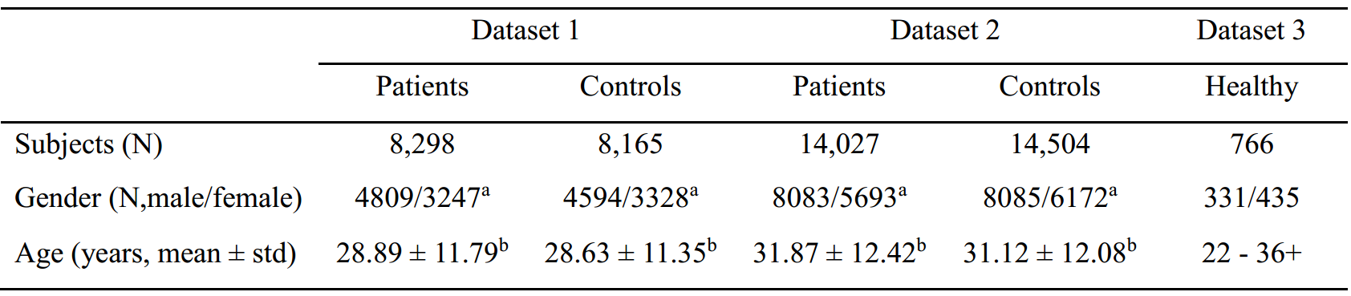
Datasets and Demographics Included in This Study
ª Gender information was extracted from available 237 and 352 studies by summing up the exact numbers in each study of Datasets 1 and 2, respectively.
^{b} Age information was extracted by averaging the mean and standard deviation values across 235 and 355 studies in Datasets 1 and 2, respectively.

Slide 3
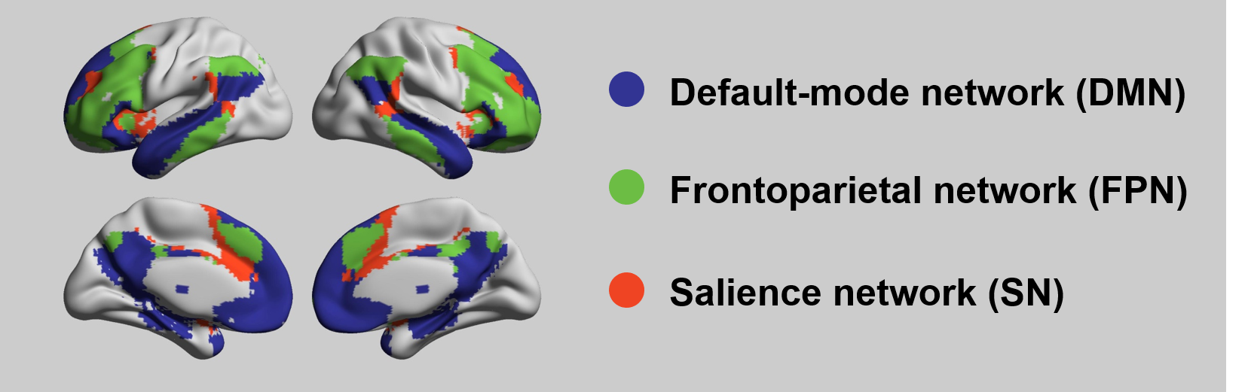
Spatial distribution of three neurocognitive networks

Slide 4
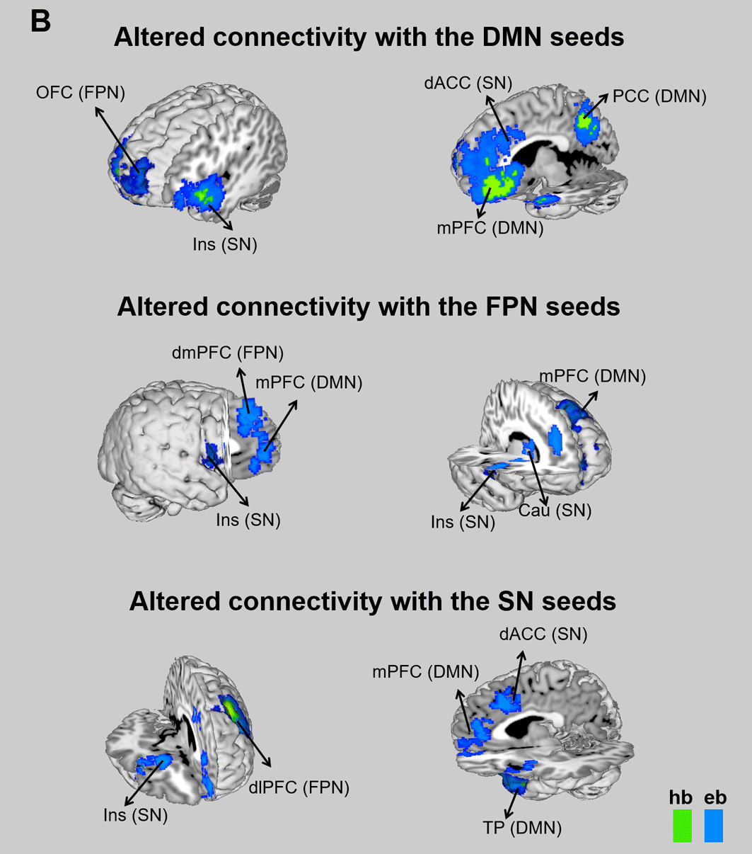
Functional Connectivity Differences between Psychiatric Disorders and Healthy Controls
Common alterations in functional connectivity within and between three neurocognitive networks

Slide 5
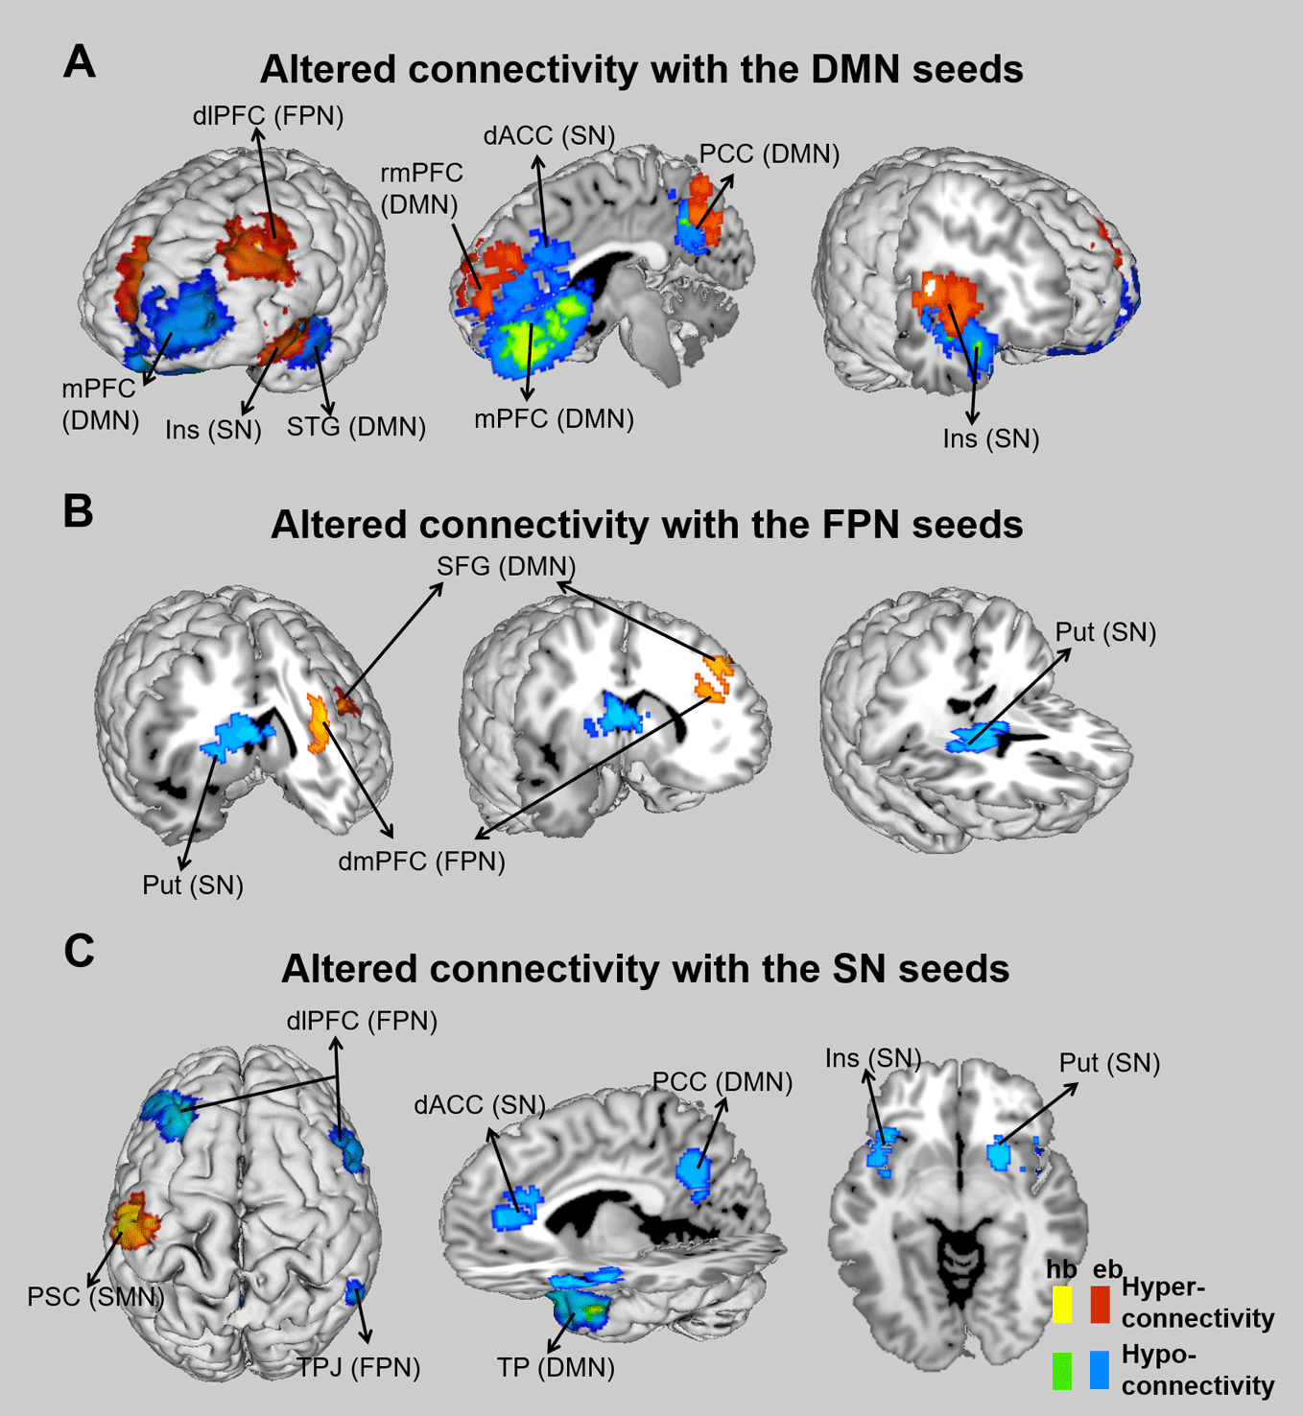
Hypo- and Hyperconnectivity across Psychiatric Disorders
Hypoconnectivity was expressed between the DMN and ventral SN and between the SN and FPN.
Hyperconnectivity was evident between the DMN and FPN and between the DMN and dorsal SN.

Slide 6
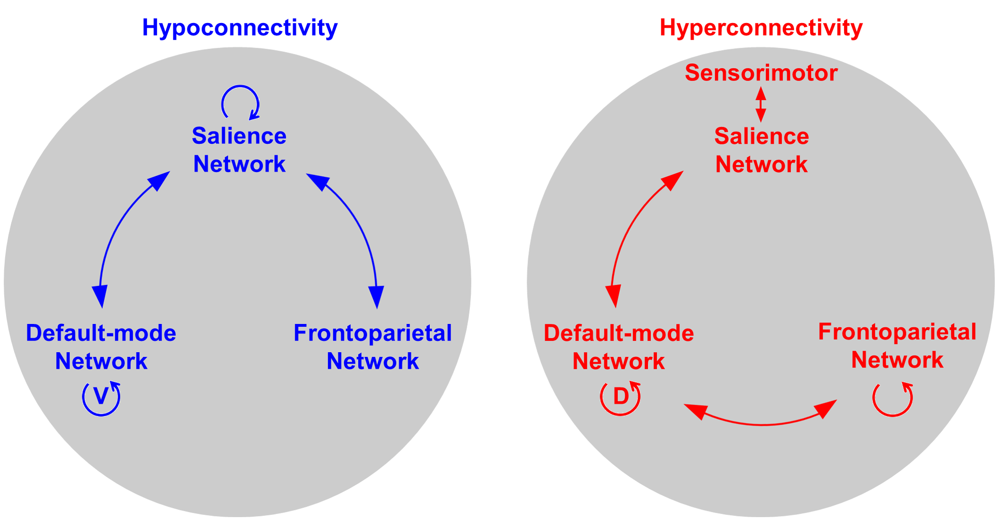
Disrupted Functional Architecture of Neurocognitive Networks across Psychiatric Disorders

Slide 7
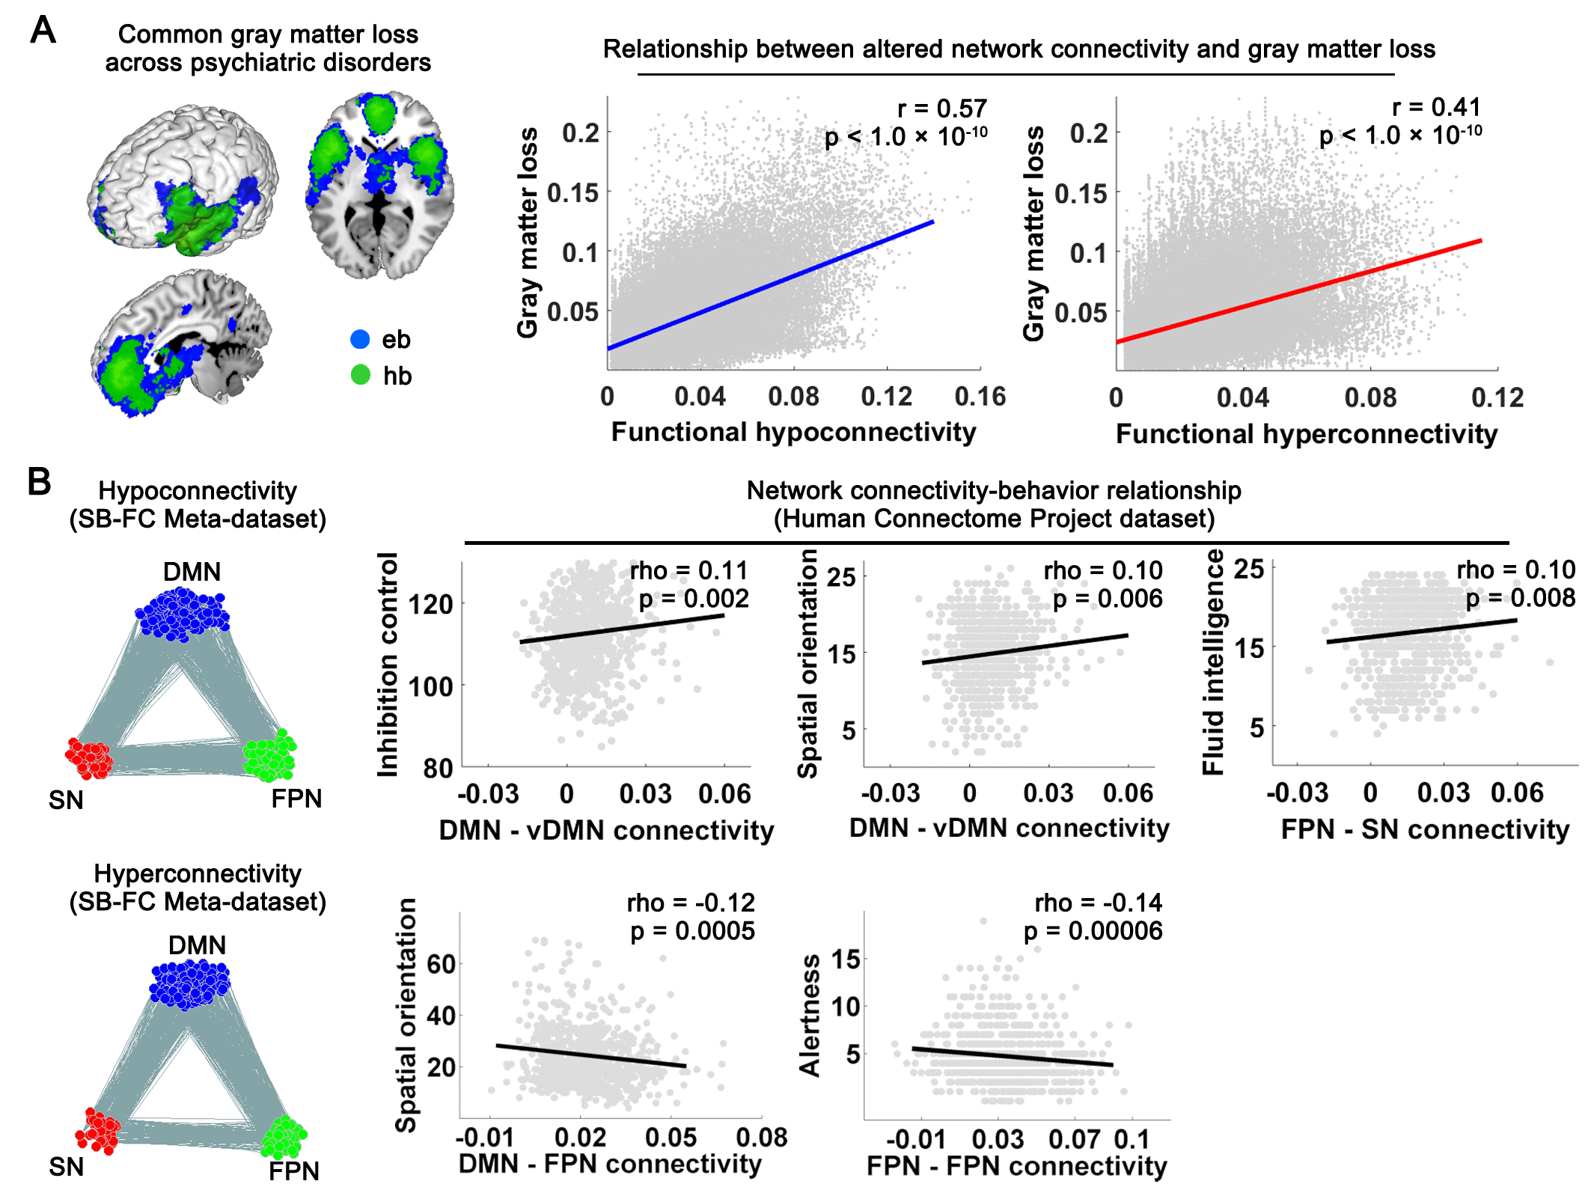
Structural Substrates of Functional Connectivity Alterations
Positive correlation between the regions showing functional alterations and structural perturbations.

Slide 8
Relationship between Functional Connectivity Alterations and Cognitive Performance

Slide 9
Thank you!

