Slide 1
Personalized Movie Recommendation using Probabilistic Matrix Factorization and Bayesian Reasoning

Slide 2
Introduction
The Challenge:
With countless options, finding the right movie can be overwhelming and time-consuming.
Project Goal:
Create personalized movie recommendations using probabilistic machine learning.

Slide 3
Overview
Start by analyzing a set of user movie ratings and learn user preferences and movie feature from training data.
New user input is used to learn user preference
User preference and movie features will be used to predict user ratings for movies not yet rated.
Movies are ranked by the predicted rating providing recommendations with the highest likelihood of satisfaction.

Slide 4
Data processing
Load Raw Data: Import movie ratings and metadata from CSV files into dataframes.
Filter Data: Retain only active users and frequently rated movies based on a user-defined threshold.
Create Rating Matrix: Transform filtered ratings data into a matrix, with users as rows and movies as columns.
Split Data: Divide the rating matrix into training (80%) and testing (20%) sets for model evaluation.

Slide 5
Probabilistic Matrix Factorization
(PMF)

Slide 6
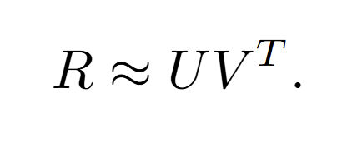
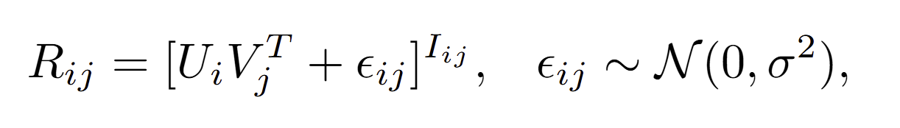
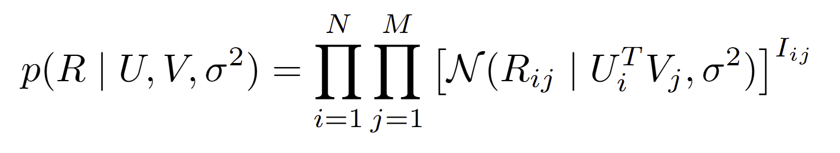
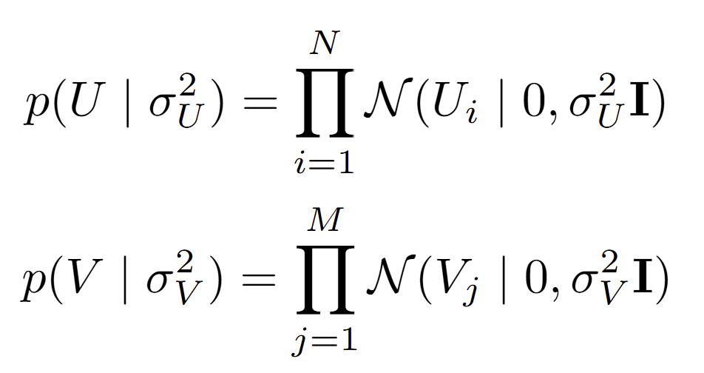
Probabilistic Matrix Factorization
Notes:
Normally and i.i.d. random noise (epsilon)
prob of R is the produc of the prob of each rating in the dataset
Each user and movie latent feature is normally distributed

Slide 7
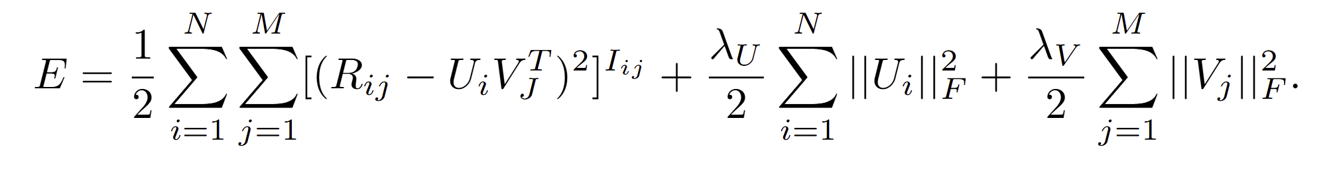
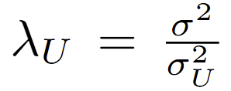
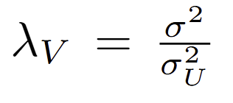
Probabilistic Matrix Factorization
:
Notes:
We want to maximize the “likelihood” of U and V (slightly different though).
Reduce num of hyperparameters

Slide 8
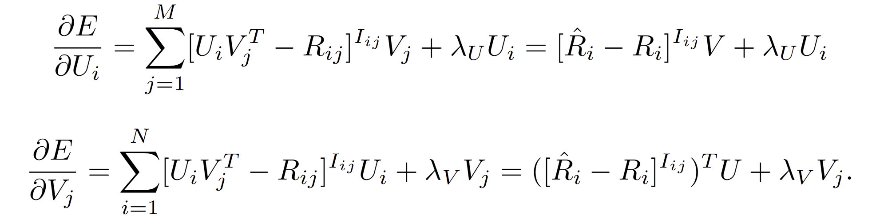
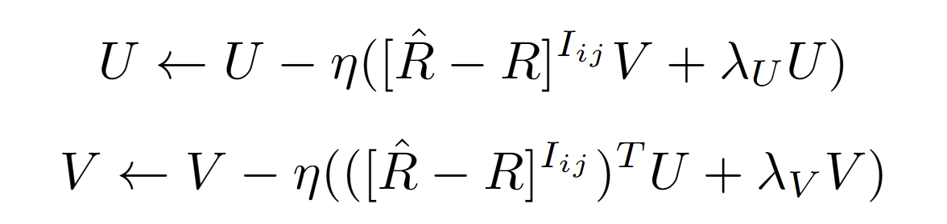
Probabilistic Matrix Factorization
Loss derivatives:
Gradient descent:

Slide 9
Experiment Settings
Test data: MovieLens 100K
Evaluation Metrics:
Precision (P): Proportion of relevant recommendations out of all recommendations
Recall (R)：Proportion of relevant recommendations out of all relevant movies
F1-Score (F1): Harmonic mean of P and R.
Mean Absolute Error (MAE): Average absolute difference between predicted and actual ratings

Slide 10
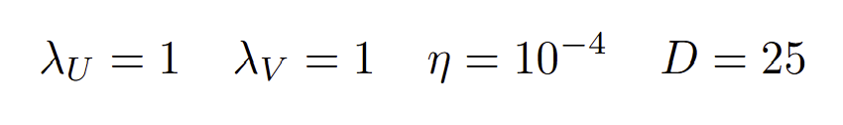
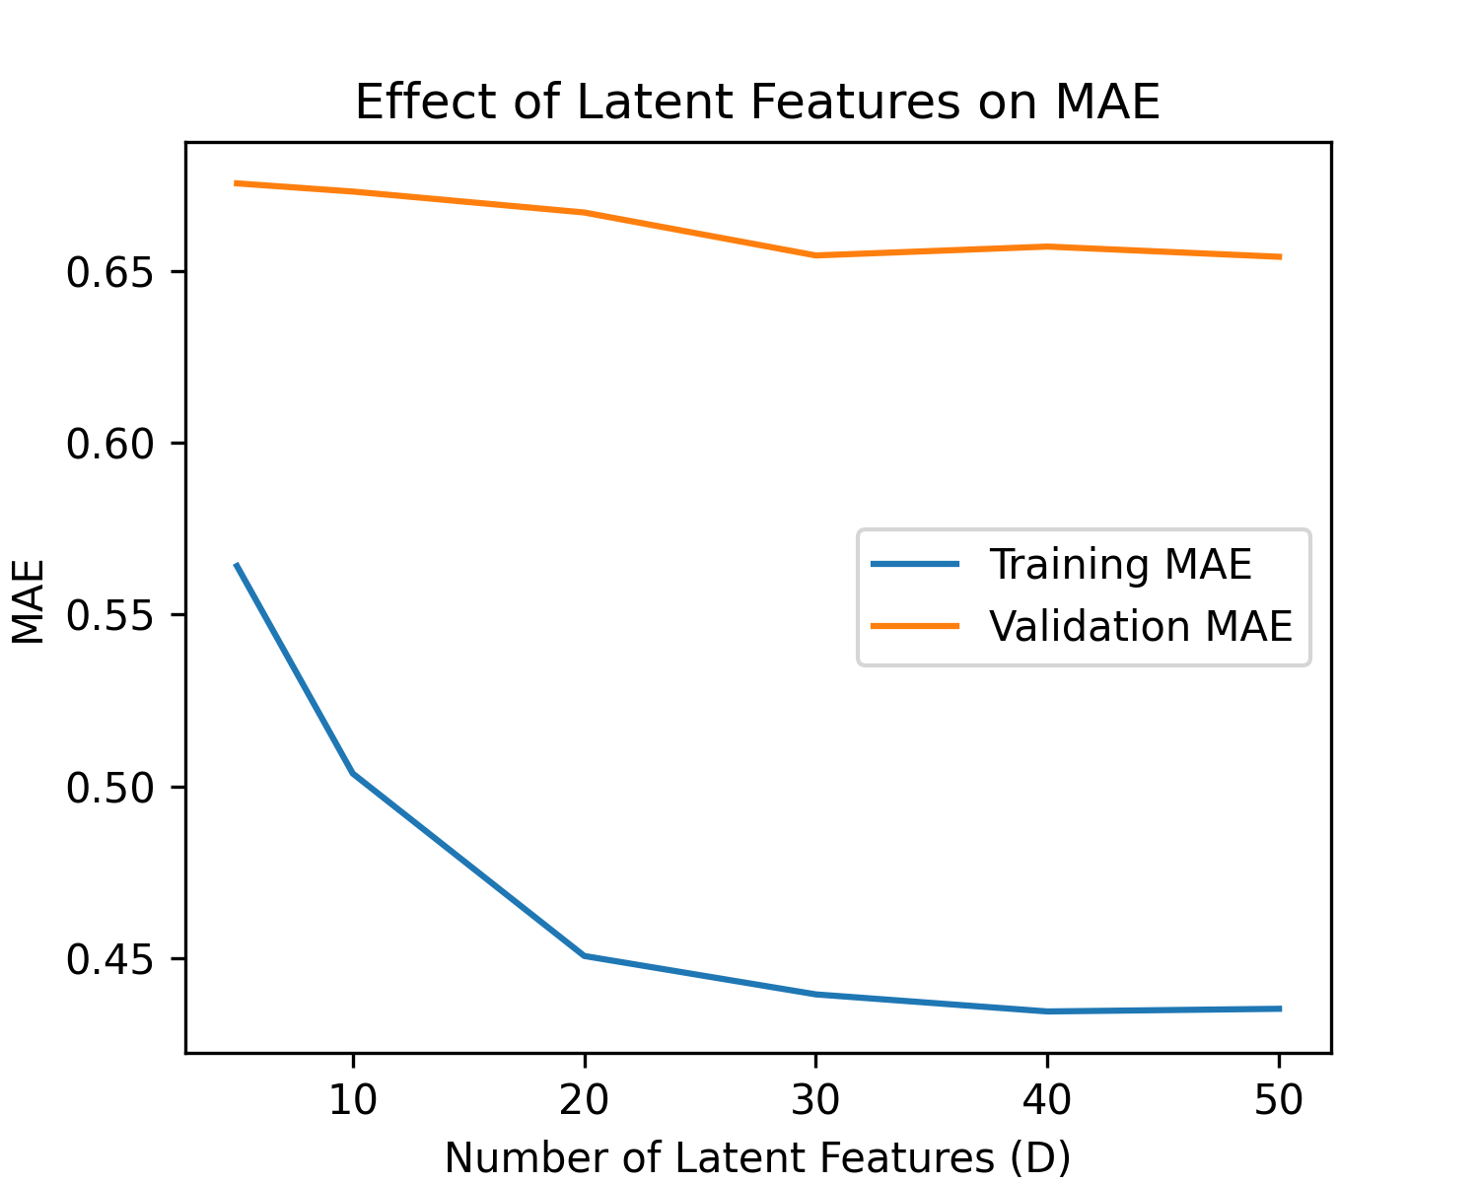
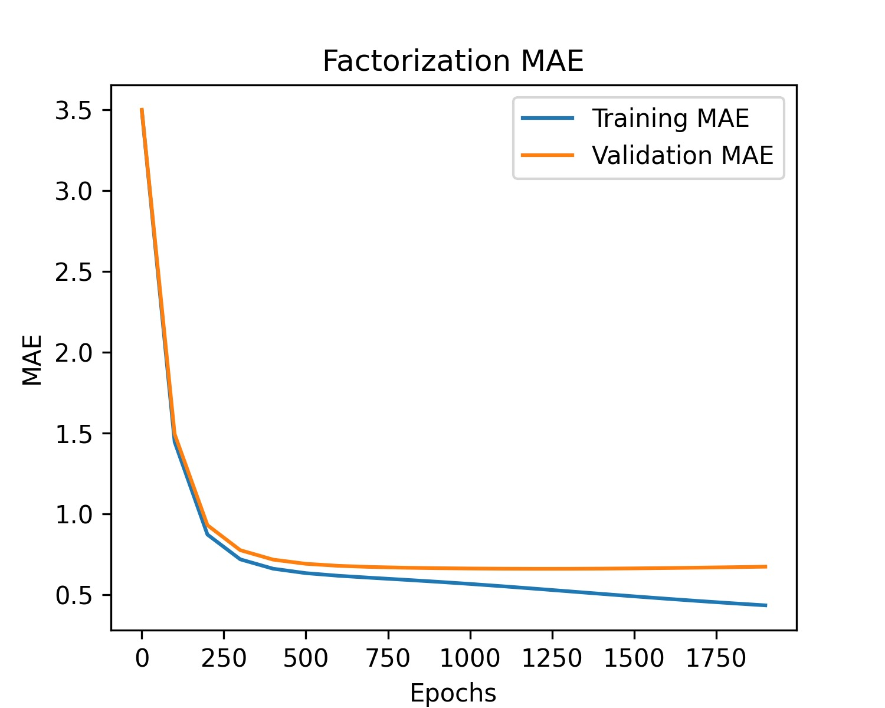
Model training
Notes:
We used D=25 to make the deviation of predicted ratings smaller. (Model is more certain about the prediction)

Slide 11
Inference Using Fitted Model

Slide 12
General Recommendation Process
Fitted U and V matrix & covariance matrices
Predictor
Predicted ratings for other movies
Classify, filter & sort by predicted ratings
Recommendations
New user provided ratings
Desired rating range

Slide 13
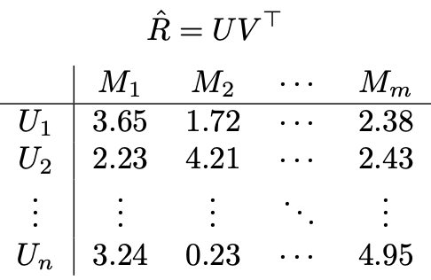

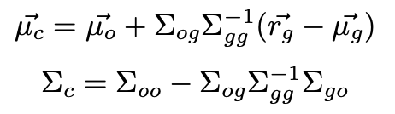
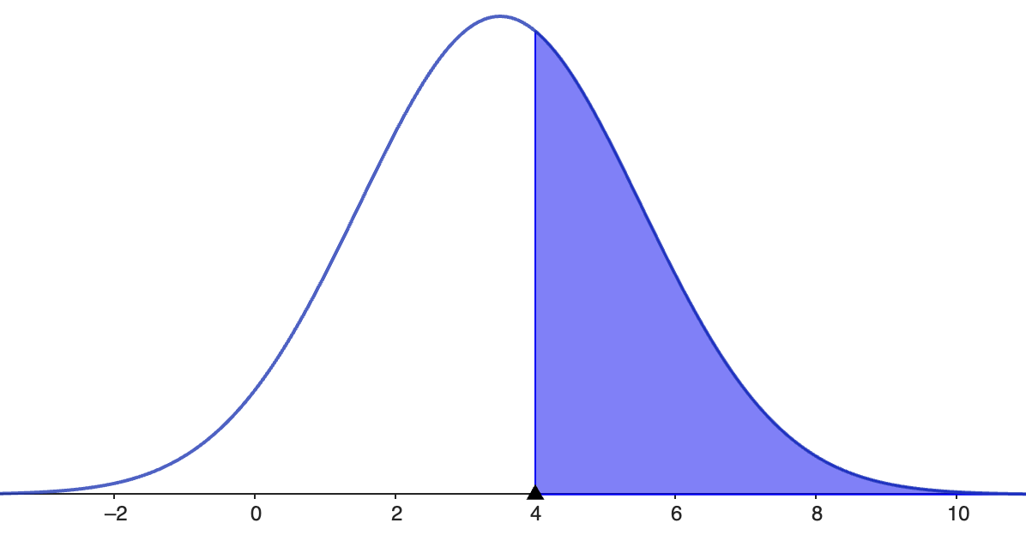
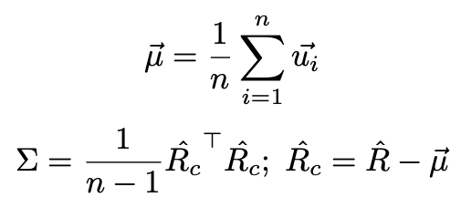
Multivariate Gaussian Does not Work Well
For each unrated movie
Learning Joint
Recommendation Score

Slide 14
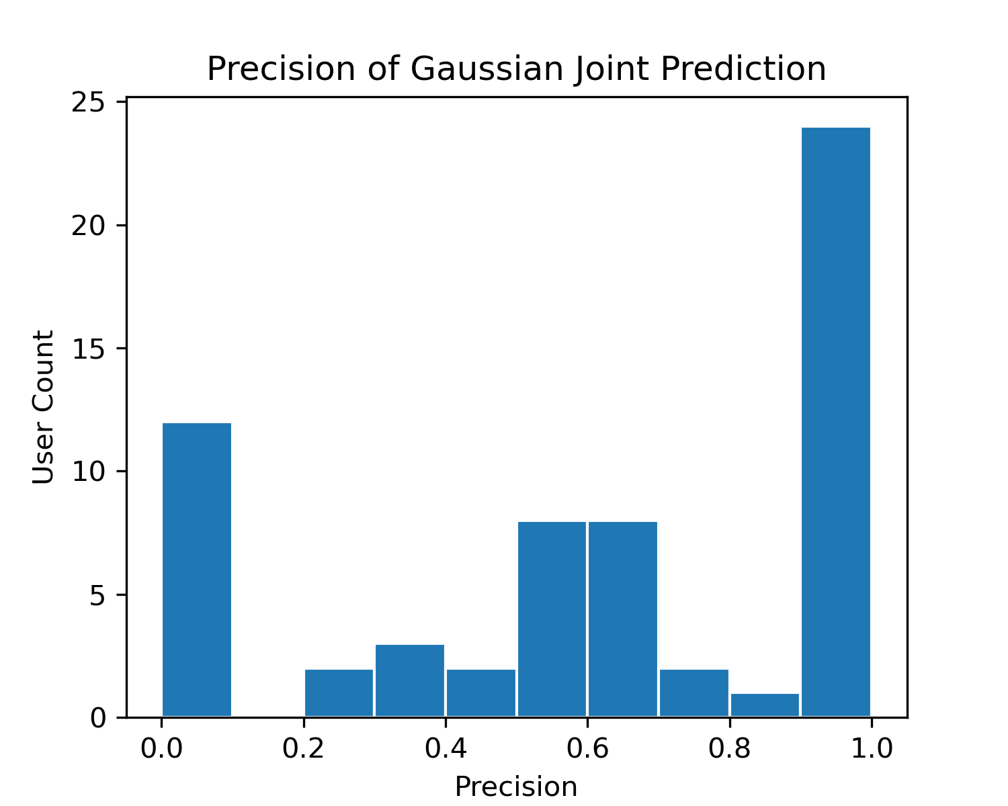
Multivariate Gaussian Does not Work Well
Overall Precision: 0.64

Slide 15
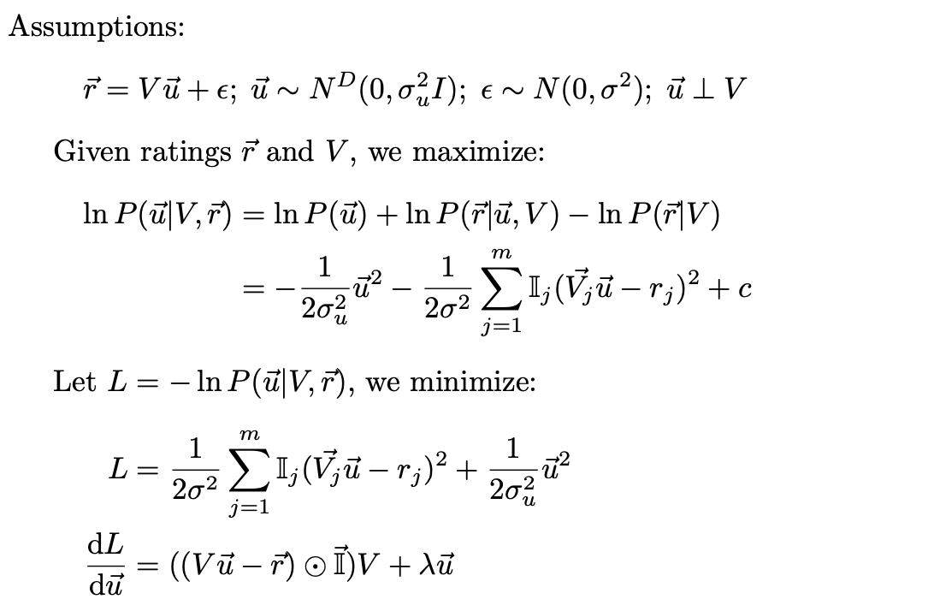
Using Partial PMF to Learn the “Taste” of New User

Slide 16
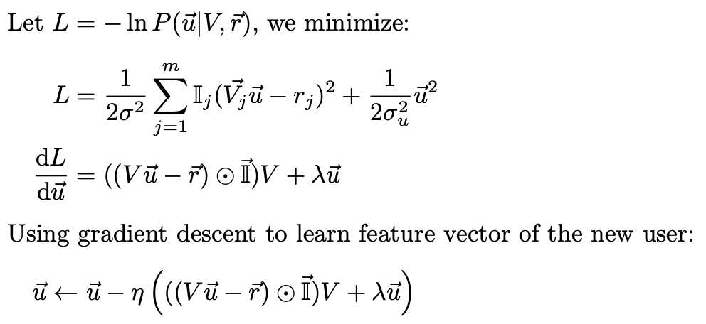
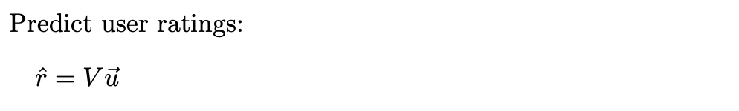
Using Partial PMF to Learn the “Taste” of New User

Slide 17
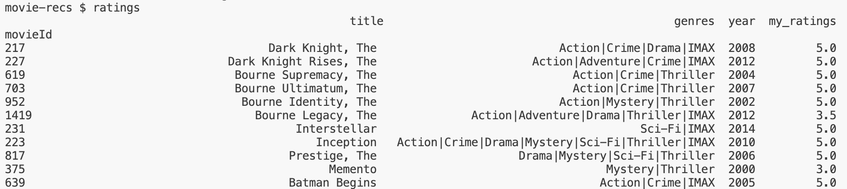
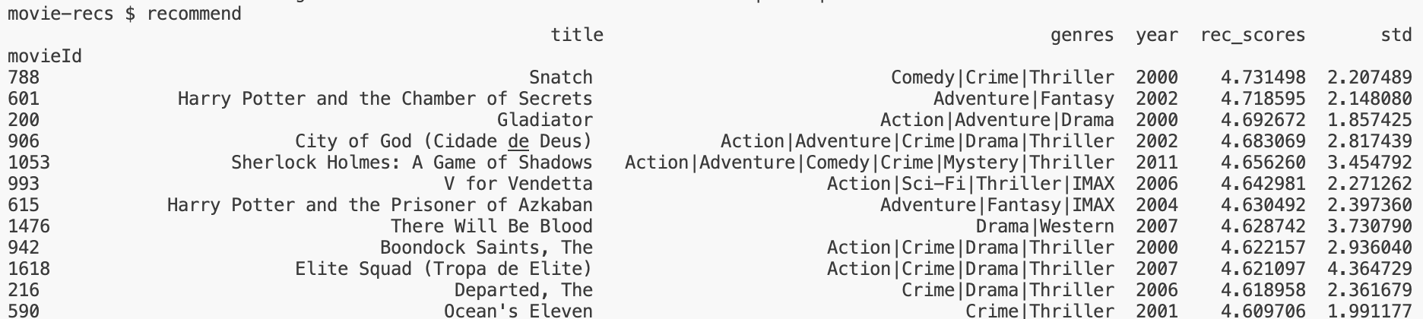
Recommendation by Predicting User’s Ratings

Slide 18
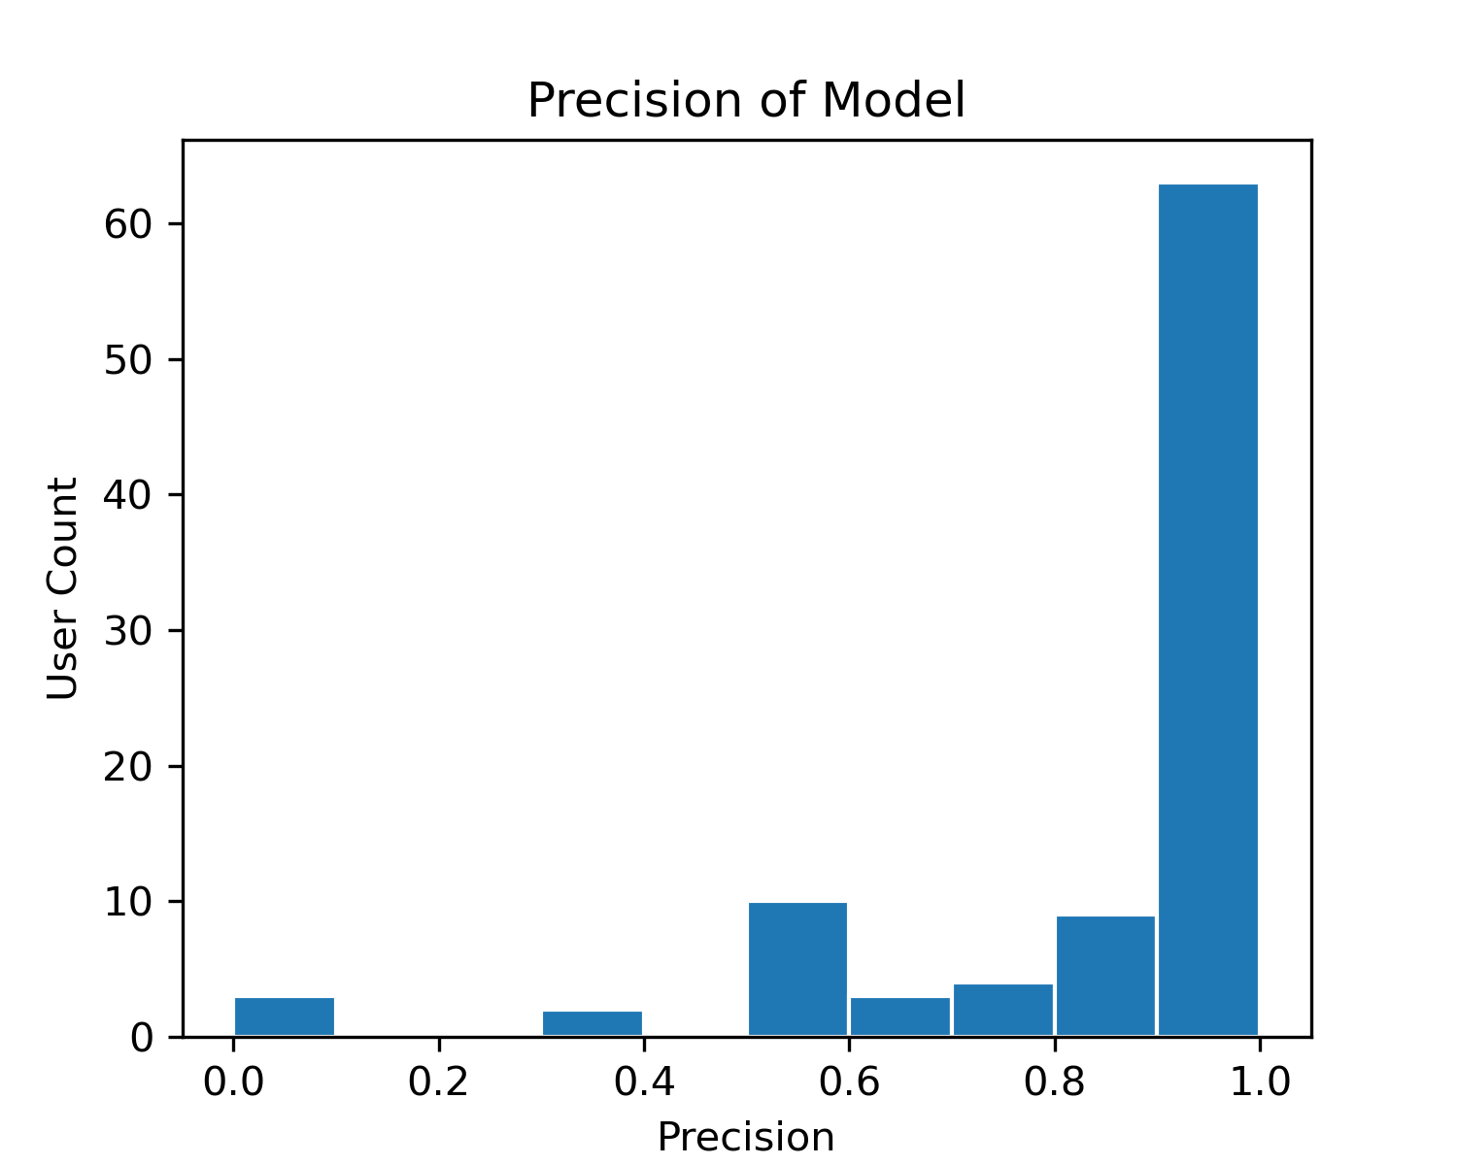
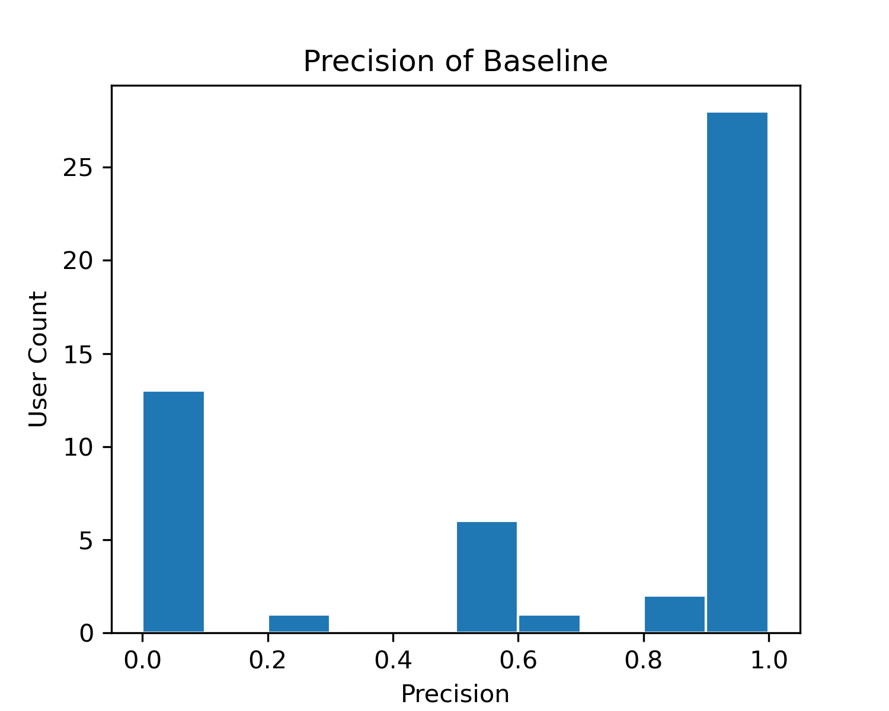
Partial PMF Yields High Precision and Recall
Overall Precision: 0.87
Overall Precision: 0.62

Slide 19
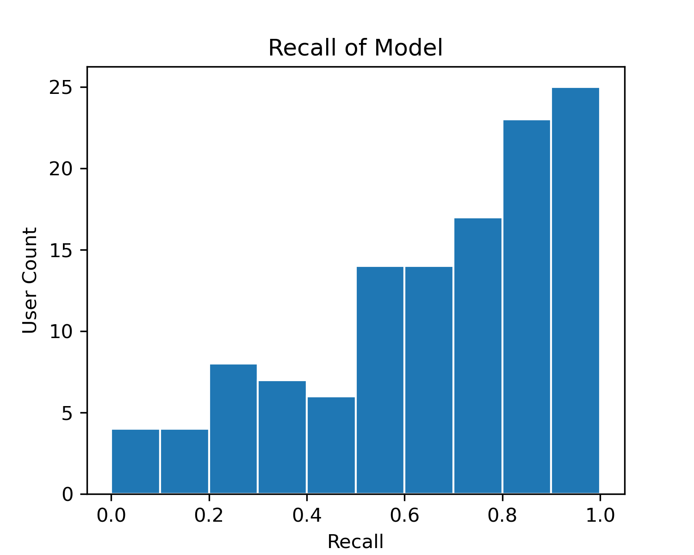
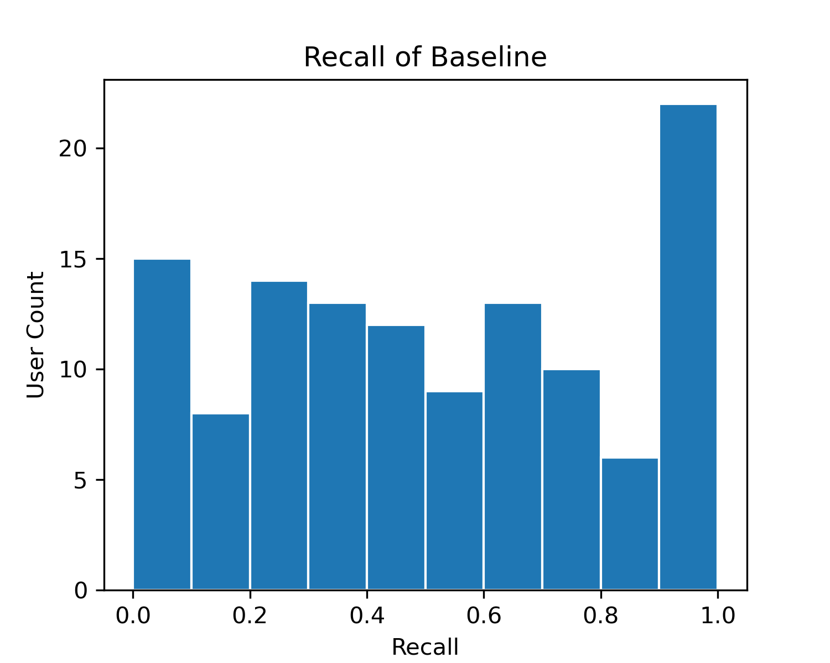
Partial PMF Yields High Precision and Recall
Overall Recall: 0.73
Overall Recall: 0.50

Slide 20
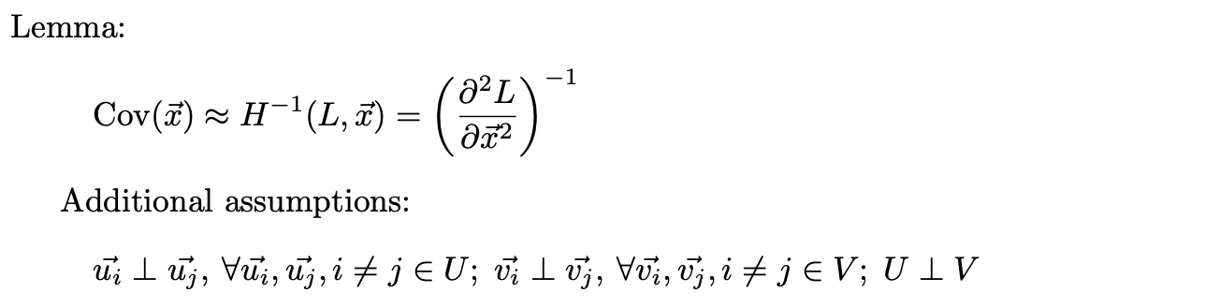
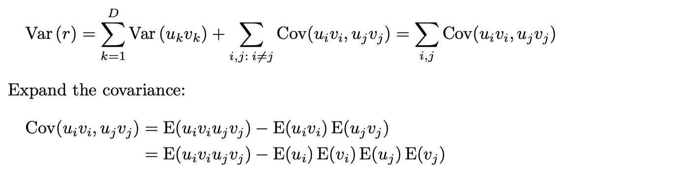
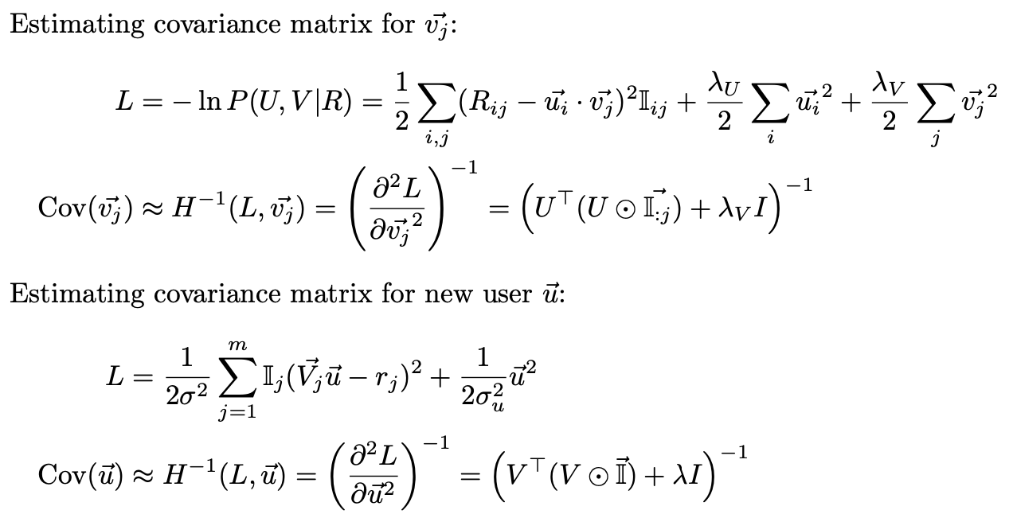
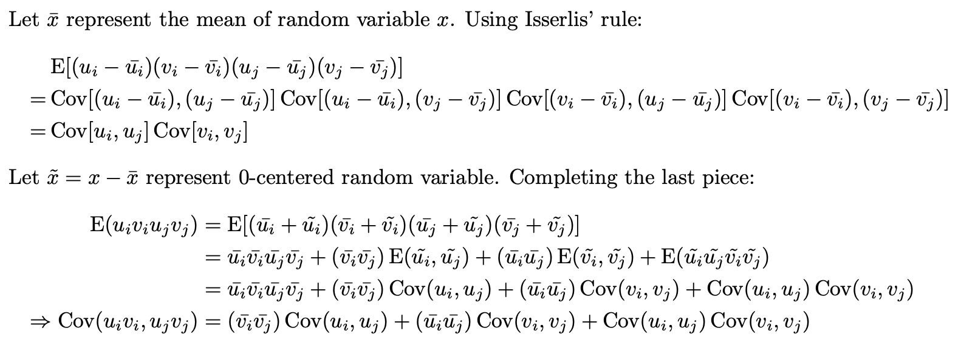
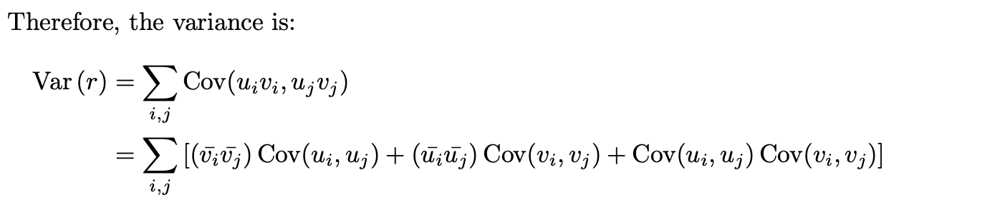
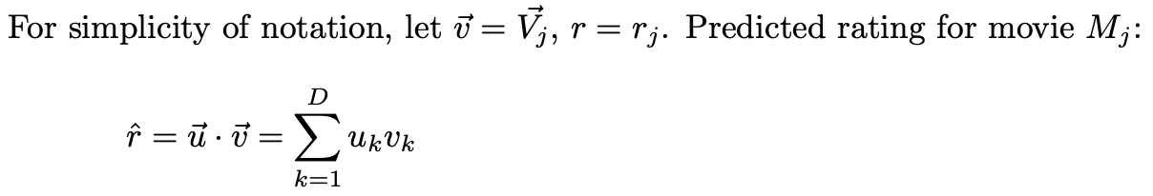
Estimating Variance of Predicted Ratings

Slide 21
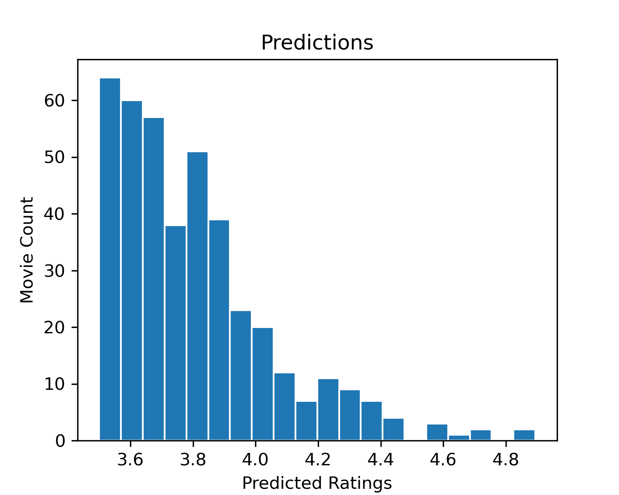
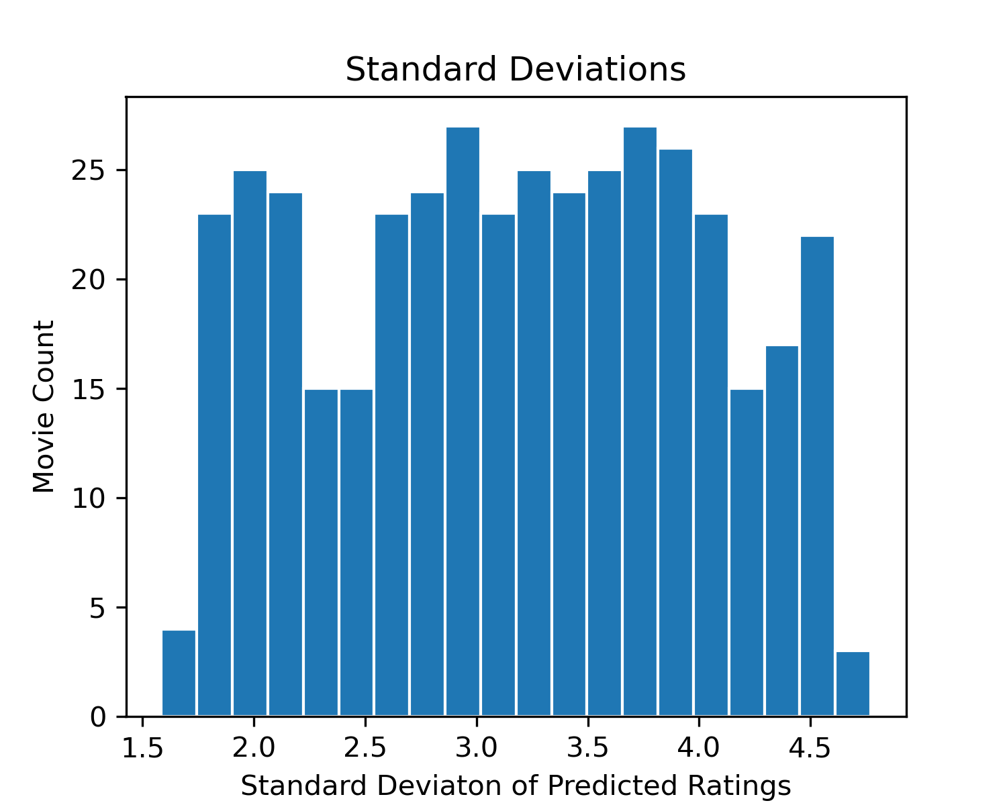
Predictions and Standard Deviations

Slide 22
Experiments and Analysis

Slide 23
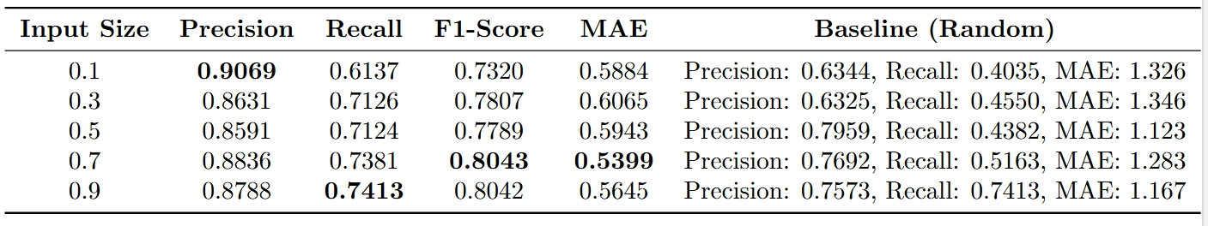
Results
Input Size: Proportion of observed ratings used as input

Slide 24
Future Work
Algorithmic improvements: Develop an algorithm that uses both U and V during prediction to improve accuracy and robustness.
Scalability: Test the model on larger datasets to evaluate scalability and generalization.
Hyperparameter optimization: Use advanced techniques like grid search or Bayesian optimization to fine-tune model parameters for better performance.
Additional features: Incorporate for example user demographics, movie genres, and metadata to enrich recommendations.
Evaluation Metrics: Introduce metrics like AUC to provide a more comprehensive assessment of recommendation quality.
Online learning: Enable the model to update U and V in real time when users rate new movies.

