Slide 1

Workshop

Slide 2
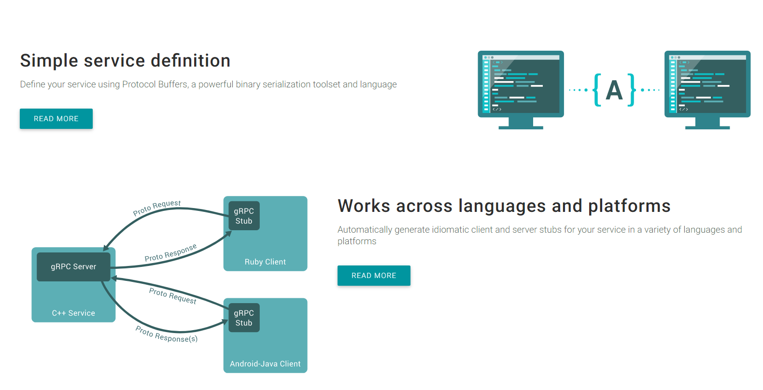

Slide 3
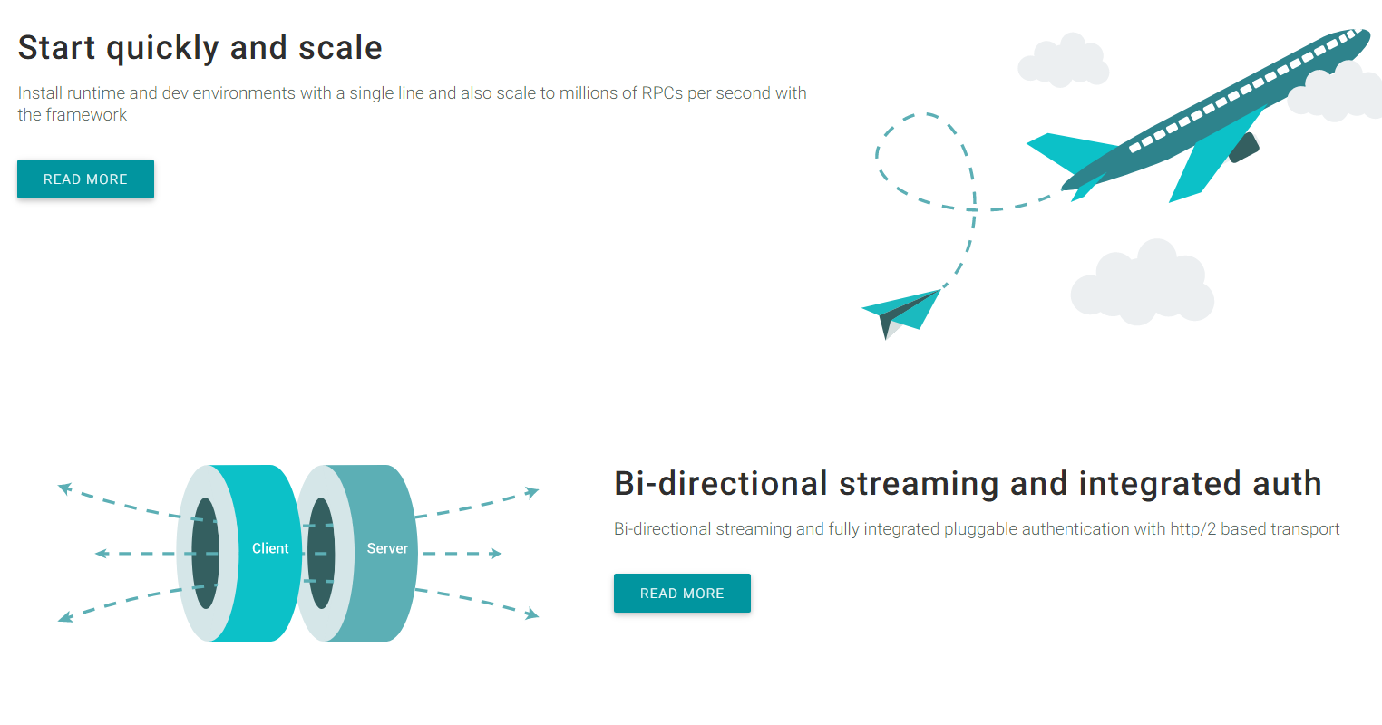

Slide 4
Why Grpc
Heeft de voordelen van SoapUI : - contract - security (verschillende modellen) - code generatie
En heeft de voordelen Json/Rest - speed - eenvoud

Slide 5
Protobuf
Contract wordt vastgelegd in een .proto file, en van daaruit wordt code gegenereerd. Syntax: service ServiceNaam { rpc MethodeAbc (msg) returns (msg) {} rpc MethodeYYY(stream msg) returns (stream msg) {} }
message AbcMsg { string Naam = 1; int64 GeboorteDatum = 2;
bytes RuweData = 3; repeated Adres = 4;
GeslachtMsg geslacht = 5; }

Slide 6
Protobuf vervolg …
// ‘inheritance’ is supported with:
message GenericMsg {
oneof value {
Specific01Msg specific01 = 1;
Specific02Msg specific02 = 2; } ..
}
//enumerations:
enum GeslachtMsg { MAN = 0; VROUW = 1; NEUTRAAL = 2; }
// other proto file(s) can be used.
import “andere.proto”;

Slide 7
Protobuf vervolg …
Compileren kan met protoc, mvn en/of gradle :
mvn protobuf:compile mvn protobuf:compile-custom
Deze genereerd code in ./target/generated-source/protobuf/java : XxxMsg.java + XxxMsgOrBuilder.java resp: ./target/generated-source/protobuf/java-grpc :
ServiceNaamGrpc.java , deze bevat: newStub(channel)
newBlockingStub(channel)
ServiceNaamGrpc.ServiceNaamImplBase

Slide 8
Implement grpc code ..1
Starten van de server (zonder security)
server = ServerBuilder.forPort(int).addService(service-impl).build();
server.start(); Starten van de client (zonder security): channel = ManagedChannelBuilder.forAddress(host, port).usePlaintext(true));
//todo secure

Slide 9
grpc code .. 2, sync request server & client
Server, implement services:
Maak een class die: ServiceNaamGrpc.ServiceNaamImplBase extends, en implementeer de bijbehorende methodes.
Voorbeeld: rpc GetFeature(Point) returns (Feature) {}
//server
@Override
public void getFeature(Point request, StreamObserver<Feature> responseObserver) {
responseObserver.onNext(Feature);
responseObserver.onCompleted();
}
--- //client
feature = blockingStub.getFeature(request);

Slide 10
grpc code .. 2b, async request client
Server is identiek.
//client
asyncStub.getFeature(request, responseObserver);
..
private StreamObserver<Feature> getObserver(CountDownLatch cdl) {
return new StreamObserver<TranslateStringMsg>() {
@Override
public void onNext(TranslateStringMsg msg) {...}
@Override
public void onError(Throwable t) {cdl.countDown();}
@Override
public void onCompleted() {
...
cdl.countDown();
}
};
}

Slide 11
grpc code .. 3a streaming api, server
Server, implement services:
Voorbeeld: rpc RecordRoute(stream Point) returns (RouteSummary) {}
public StreamObserver<Point>
recordRoute(StreamObserver<RouteSummary> responseObserver) {
return new StreamObserver<Point>() {
@Override
public void onNext(Point point) {
...
}
@Override
public void onError(Throwable t) {
...
}
@Override
public void onCompleted() {
responseObserver.onNext(RouteSummary.newBuilder()..build();
responseObserver.onCompleted();
}
};

Slide 12
grpc code .. 3b streaming api, client
voorb: rpc RecordRoute(stream Point) returns (RouteSummary) {}
StreamObserver<Point> reqObserver = asyncStub.recordRoute(respObserver);
StreamObserver<RouteSummary> responseObserver = new StreamObserver<RouteSummary>() {
@Override
public void onNext(RouteSummary summary) {
//doe iets met summary
}
@Override
public void onError(Throwable t) {
}
@Override
public void onCompleted() {
info("Finished RecordRoute");
finishLatch.countDown();
}
};

Slide 13
grpc code .. 4 bi-directional
Server, implement services:
Voorbeeld: rpc RouteChat(stream RouteNote) returns (stream RouteNote) {}
public StreamObserver<RouteNote> routeChat(StreamObserver<RouteNote>
responseObserver)
{
return new StreamObserver<RouteNote>() {
@Override
public void onNext(RouteNote note) {
...
responseObserver.onNext(RouteNote..build());
}
@Override
public void onError(Throwable t) {
}
@Override
public void onCompleted() {
responseObserver.onCompleted();
}
};

Slide 14
Hands-on
Volg de aanwijzing in :
doc\workshop-hanson.pdf
Met hints in doc\hints.txt (en deze presentatie)
(en werkende code in: \doc\working-code )
Zie verder : http://www.grpc.io/

