Slide 1

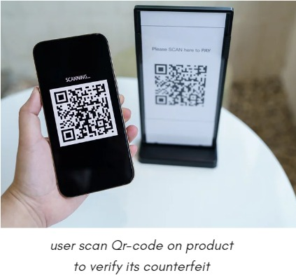
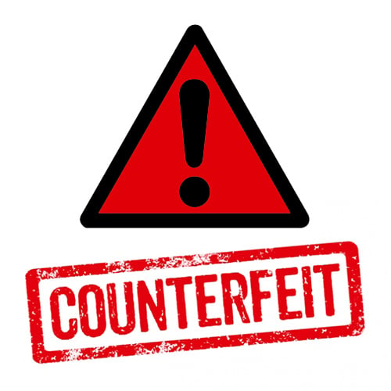
Identify fake Products using blockchain
(TrueTrace)
Michael Medhat Mounir, Michael Farid Fouad, Mario Mamdouh Reda,
Kermina Ashraf Mikhail, Philip Wagih George
Supervisors : Dr. Elshaimaa Abo-Alian , TA. Esraa Karam
Information Systems Department Faculty of computer and Information Sciences Ain Shames University
Abstract
4- Use a Smartphone App to Verify the Product's Authenticity
Consumers can use a smartphone app to scan the product's digital identity and verify its authenticity. This provides consumers with an easy and reliable way to check the authenticity of a product before making a purchase.
5- Trace the Origin of Fake Products using the Blockchain Record
If a fake product is identified, the blockchain record can be used to trace its origin and identify the parties responsible for its distribution. This helps to prevent the distribution of fake products and protect consumers from harm.
Since the invention of Blockchain technology in 2008, it has been used in many domains to ensure high security and reliability of data, like from the use of Bitcoin to BaaS (Blockchain as a Service) which is a new blockchain trend and a sort of cloud-based network for organizations in the business of building blockchain-based applications.
This paper implements the combined approach of the decentralized Blockchain technology and the Supply Chain to establish that the end-users in a supply chain does not completely rely on the trader to establish that the product is counterfeited or not and this can be done by authenticating the product at every stage in the Supply Chain who will be responsible for assuring the quality of products.
Furthermore, using this combined technical approach can considerably lower the cost of product quality assurance and this proposed system will track the authenticity of the product from its origin from the manufacturer to the end-user as well.
Introduction
A blockchain is a decentralized, distributed, and frequently public digital ledger made up of entries called blocks.
These Blocks are used for logging transactions across numerous computers so that any associated block cannot be changed retrospectively without changing all succeeding blocks.
Blockchain technology provides security as the transaction is stored on the network and a hash code is generated for that product.
Results
Designing a product identification system that utilizes Blockchain technology in order to:
Design a system that prevents the purchase of counterfeit products
Secure product details via a QR code.
Helping companies in identifying the products that are being duplicated or faked
Methodology
Counterfeiting is a major issue that affects a wide range of industries, including luxury goods, pharmaceuticals, and electronics. Counterfeit products not only undermine brand reputation but also pose a significant danger to consumers. To combat this problem, blockchain technology can be used to ensure that only genuine products are sold to consumers. Here are five steps that can be taken to identify fake products using blockchain methodology:
1- Assign a Unique Digital Identity to Each Product
Each product should have a unique digital identity that is stored on a blockchain ledger. This digital identity should contain information that is linked to the physical characteristics of the product, such as its serial number, manufacturing date, and location. This makes it difficult for counterfeiters to create fake products that mimic the original.
2- Link the Digital Identity to the Physical Characteristics of the Product
The digital identity should be linked to the physical characteristics of the product in order to create a tamper-proof record of the product's history. This ensures that the product's authenticity can be verified at every stage of the supply chain.
3- Upload Information about the Product's Journey to the Blockchain
Manufacturers and other authorized parties can upload information about the product's journey through the supply chain to the blockchain. This creates a transparent and immutable record of the product's history, making it easy to track the movement of products from the point of manufacture to the point of sale.
Conclusion
The paper proposes a blockchain-based supply chain, Block-Supply, that can detect and prevent attacks such as modification, cloning, and tag reapplication. The system tracks products without a centralized managing server. The paper presents a new decentralized consensus protocol that utilizes anonymous dynamic mapping and randomness to protect against attacks by powerful adversaries. The protocol randomly employs a different set of validators on every block proposal, making it scalable for large networks while maintaining a satisfactory level of security. Simulations show the effectiveness of the protocol with a relatively small number of validators.
Reference
1- D. Khazanchi, A. Kumar Vyas, K. Kant Hiran, S. Padmanaban, “Blockchain 3.0 for Sustainable Development 1st Edition”, 2021 ISBN 978-3-11-070245-3
2- B. Adsul and S. Kosbatwar. A novel approach for traceability & detection of counterfeit medicines through blockchain. Technical Report 2539, EasyChair, February 2020.
3- G. Blossey, J. Eisenhardt, and G. Hahn. Blockchain technology in supply chain management: an application perspective. In Proc. of the 52nd Hawaii International Conference on System Sciences (HICSS’19), Hawaii, USA, January 2019.

