Slide 1
Pedestrians & Cyclists Safety
Michael Gruver, Juan Gomez Sandoval
Daniel Choi, Maria Viteri

Slide 2
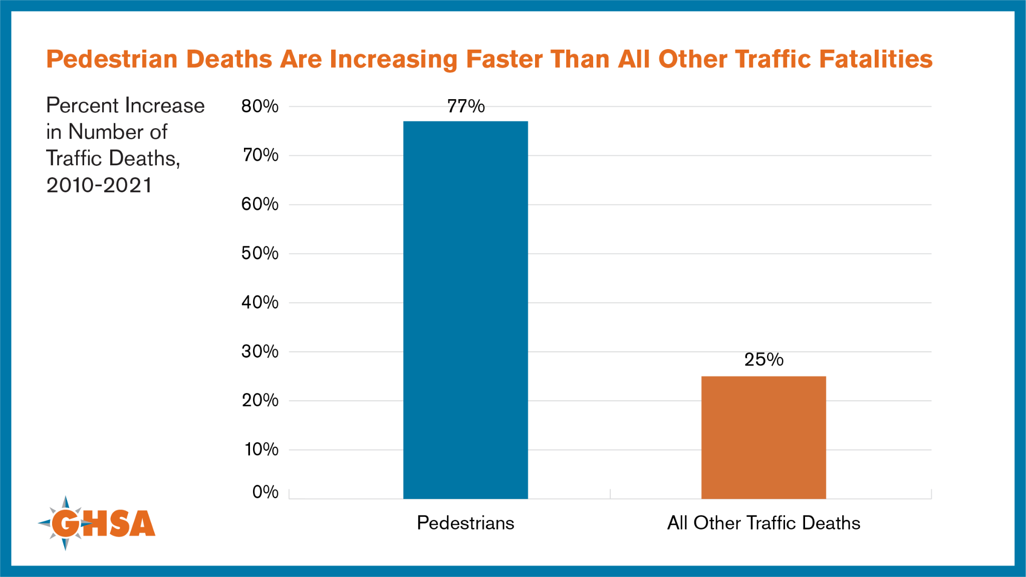
Pedestrian Crash Fatalities
Pedestrian Crash Fatalities Increased by 30% In Texas From 2018 to 2022:
5,766 Crashes
830 Deaths
1,526 Seriously Injured
In the U.S. (2021):
7,388 killed
Pedestrian killed every 71 minutes.
77% crashes occurred in the dark
In 2010, economic cost amounted to $11.5 billion. $65 billion comprehensive cost

Slide 3
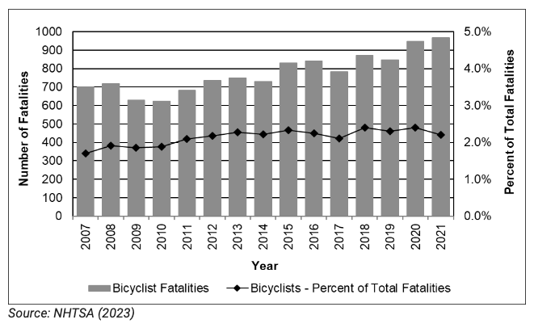
Cyclist Crash Fatalities
From 2010 to 2021, bicyclist fatalities ranged from 623 to a high of 966 with a yearly average of 800 (NCSA, 2022; Stewart, 2023)
Time/Light Conditions:
- Over half (56%) of bicyclist fatalities occur in dawn, dusk, or night-time conditions.
- The highest proportion (21%) of fatal crashes on weekdays occur from 6 p.m. to 8:59 p.m.
- The highest proportion (23%) of fatal crashes on the weekend also occur from 6 p.m. to 8:59 p.m.

Slide 4
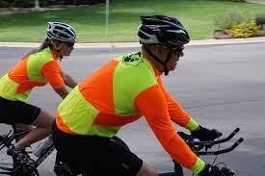
Effectiveness of Bright Clothing
Major Factors for Crashes Include:
Driver inattention
Failing to yield right-of-way
Speeding
~ 40%
Notes:
The lower the AR the better

Slide 5
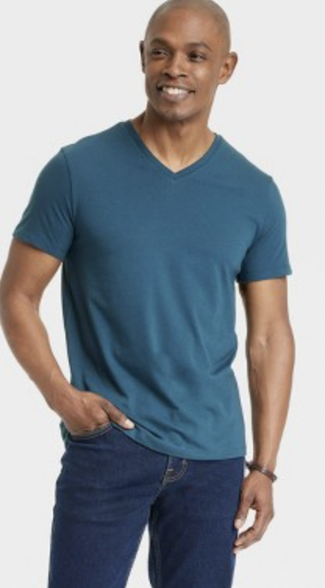
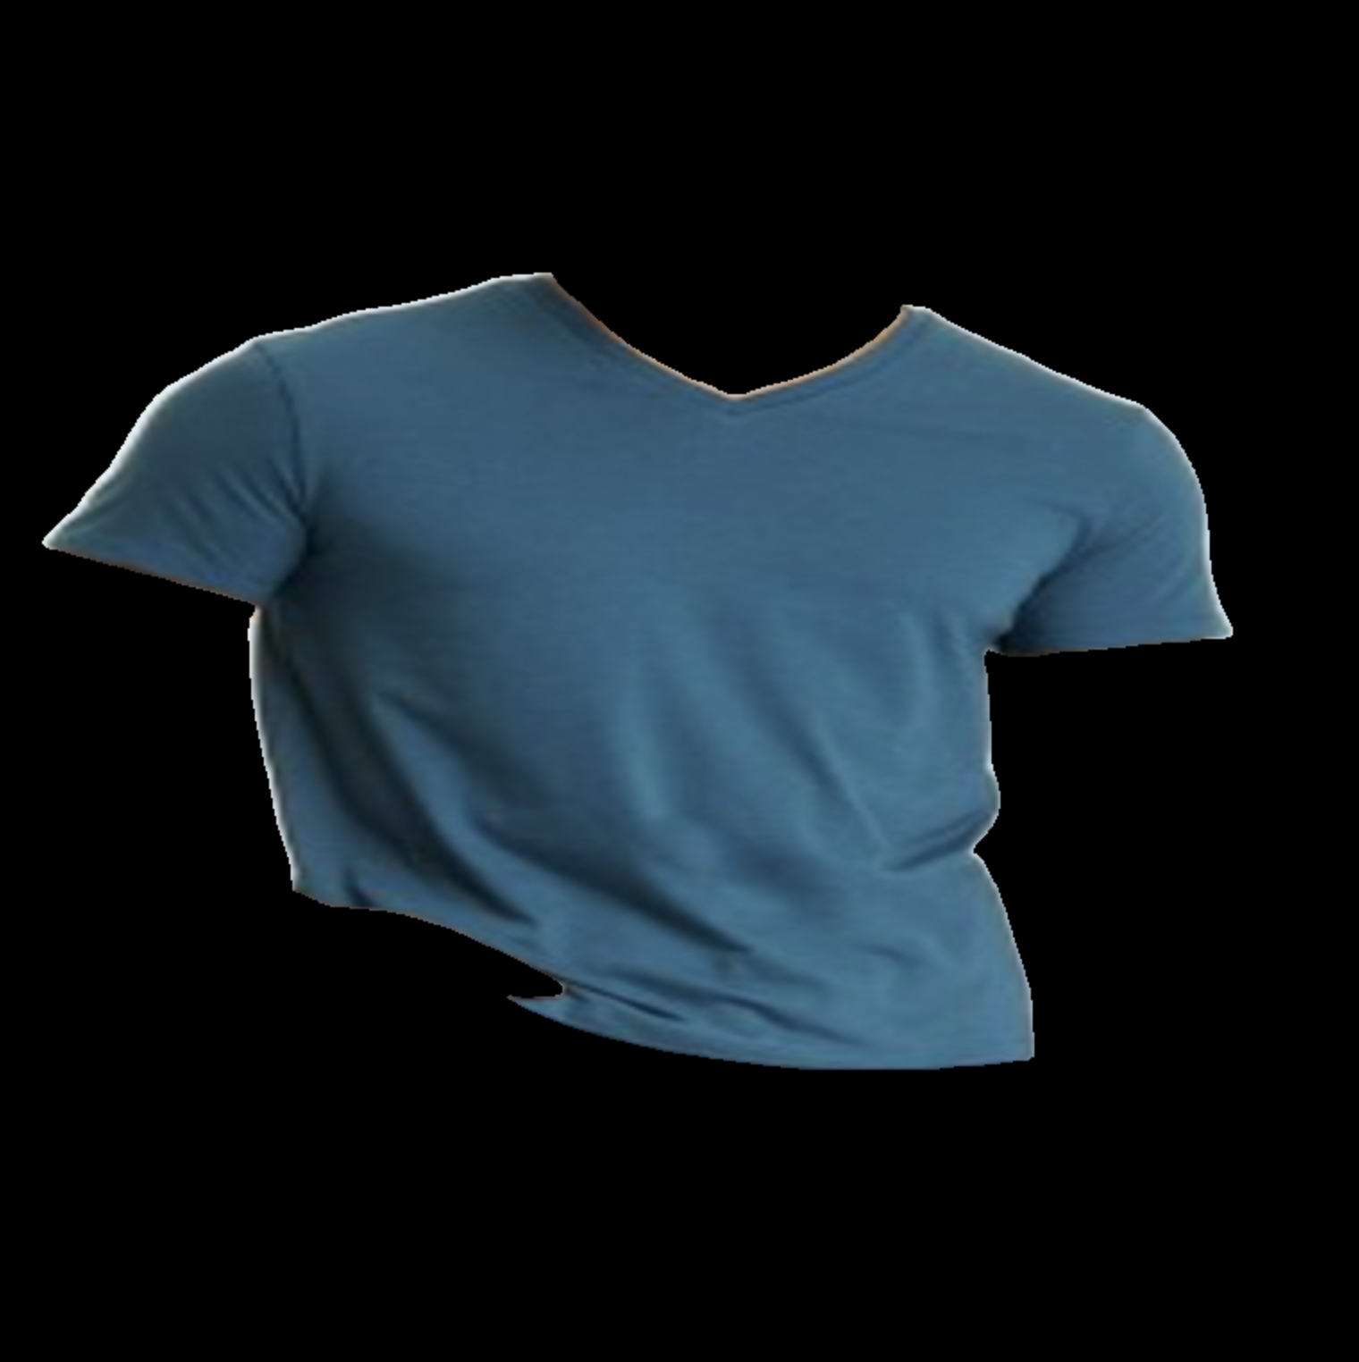
Our Solution
Increasing drivers’ attention by assessing the safety percentage derived from individuals’ attire through photographic analysis
Input Image:
Output Image:

Slide 6
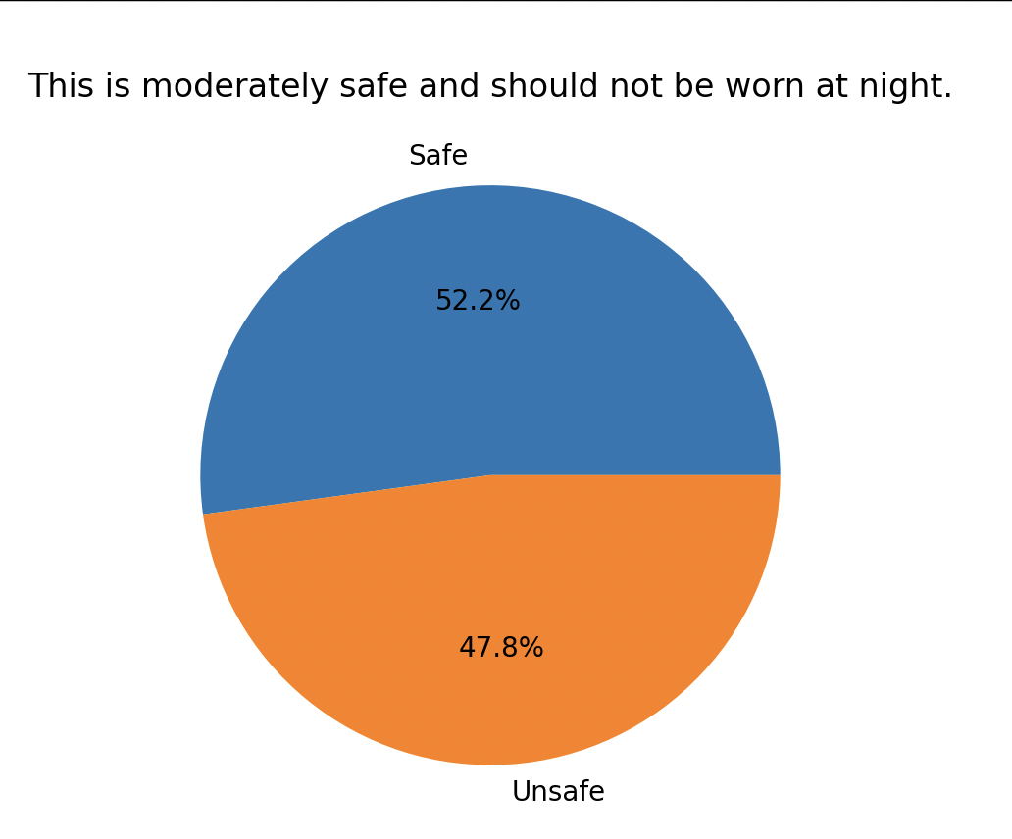
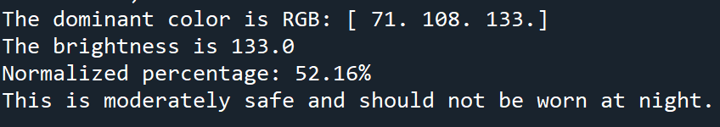
Safet Score and Output

Slide 7
Sources
Texas Pedestrian Fatalities: https://www.txdot.gov/safety/traffic-safety-campaigns/pedestrian-safety.html#:~:text=Pedestrian%20traffic%20fatalities%20increased%2030,1%2C526%20people%20were%20seriously%20injured.
Bicycle Safety:
https://www.nhtsa.gov/book/countermeasures-that-work/bicycle-safety#:~:text=From%202010%20to%202021%2C%20bicyclist,2022%3B%20Stewart%2C%202023).
Effect of yellow bicycle jackets on cyclists
https://www.sciencedirect.com/science/article/pii/S0925753517313528
Fatality Chart:
https://www.ghsa.org/resources/Pedestrians23
https://crashstats.nhtsa.dot.gov/Api/Public/ViewPublication/813458#:~:text=Pedestrian%20deaths%20accounted%20for%2017,in%20traffic%20crashes%20in%202021
https://crashstats.nhtsa.dot.gov/Api/Public/ViewPublication/813369

