Slide 1
Project Tittle: Automation Testing Framework for a Web Application
Presenter’s Name : All the team
Date : 17/5/2025

Slide 2
Problem
Most Software Testing learns don’t get to Test a real, functioning website. they usually practice on theoretical examples or small parts of systems.
Solution
Our team worked as testers on Swag Labs, a ready-made demo website. We tested it full functionality using:
Unique Value Proposition
The project offers a realistic QA experience without the need to develop a website. It helps testers focus on test design, execution, and reporting using professional tools.
Manual testing( test cases, bug reports)
Automated Testing (selenium)
API Testing

Slide 3
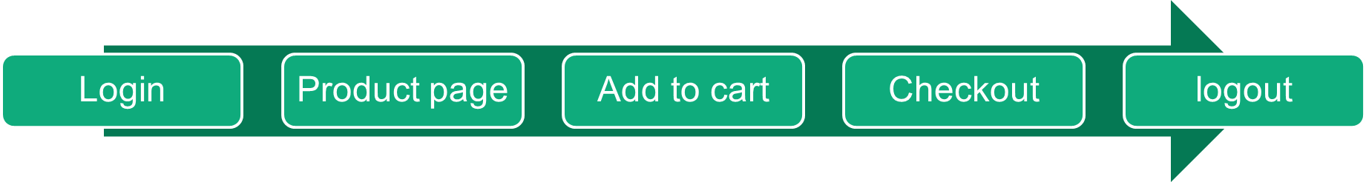
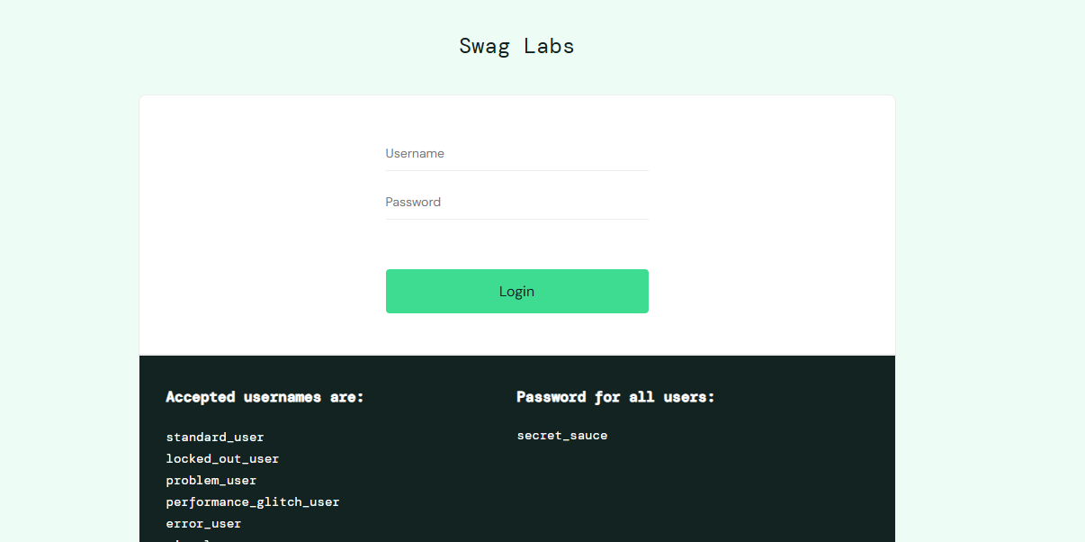
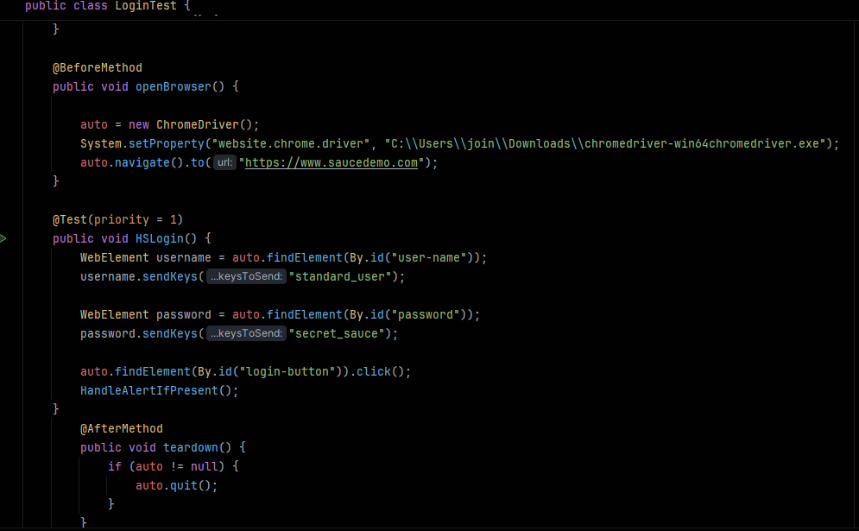

UX Elements We evaluated the user experience from a QA perspective : Clear and helpful error messages Smooth page navigation UI responsiveness and feedback Proper handling of edge cases in API responses Compatibility with automated tools

Slide 4
End Users & Key Features
Primary User Personas
Individual Shoppers: Tech-savvy buyers seeking a smooth online shopping experience.
New Users: First-time visitors needing a guided, user-friendly flow.
Returning Users: Regular users expecting fast, efficient reorders.
2.Key Features
Secure Login & Account: User authentication with locked-out protection
Product Cataloge & Search: Browse, filter, and sort by price, popularity
Shopping Cart & Saved Items: Quick add/remove, save for later
Checkout Flow: Simplifies purchase with clear steps
Fast Performance: Ensures smooth experience during peak usage.
3. How the features solve the problems of each end-user
Individuals & New Users: Benefit from simple navigation, clear checkout, and error handling
Returning Users: Enjoy fast reorders, saved items, and optimized performance.

Slide 5
Programming Languages & Frameworks
Programming Languages
Java: Used to write and execute automated test scripts.
2. Frameworks & Tools
Selenium WebDriver: For automating browser-based UI tests.
TestNG: Used for organizing and running test cases in Java.
Maven: For managing project dependencies and build lifecycle.
Postman: Used for manual API testing and validating backend endpoints.
3. Supporting Technologies
REST APIs: Interfaced with during integration testing using Postman.
GitHub: Used for version control and collaboration.

Slide 6
Live Application & Testing
Application Status
The Swag Labs application is currently running in a stable production environment. It is primarily used for shopping and showcases functional e-commerce workflows.
2. Key Testing Phases
Unit Testing: Validates core components such as login functionality, add-to-cart logic, and checkout processing .
Integration Testing: Ensures seamless interaction between modules like cart management, user sessions, and inventory updates .
User Testing: Simulates real-user scenarios to detect usability issues and inconsistencies in the flow
3. User & QA Feedback
Users highlighted the platform's clean interface and ease of navigation. We confirmed the reliability of major features and their stability

Slide 7
List of reports and documentation:
-Test Plan -Test Activity
-Test strategy for swag labs -Testing proposal
-User stories requirements -Test cases with actual results
-Test summary -Bug reports
-Automation scripts file
Timeline for deliverables:
-Test Plan -Test Activity
-Test strategy for swag labs -Testing proposal 6th of April
-User stories requirements -Test cases with actual results 12st of April
-Test summary -Bug reports29th of April
-Automation scripts7th of May

Slide 8
List the core team members and their roles:
Enjy – Manual Tester
Hazem – API Tester
Michel– Automation Tester
Mariam Ramy – Responsible for managing tasks, ensuring deadlines are met, and reporting progress.

Slide 9


