Slide 1

Introduction to Data Science
Focusing on supervised machine learning
By Michael Victor
Notes:
This is a huge topic, ad difficult for me to present something that gives some insight but is still brief enough to fit into an hour
Used sklearn for all models in the example

Slide 2
Definition of Data Science
Data science is defined as a scientific discipline that combines concepts from computer science, statistics, and machine learning to analyse and interpret data in order to understand its structure and make predictions. It operates within a data-centric framework, transcending traditional disciplinary boundaries.
Data science is asking and answering questions with data, that will improve business decisions

Slide 3
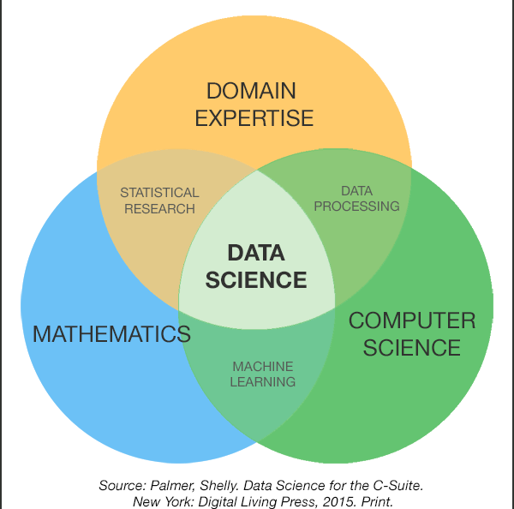
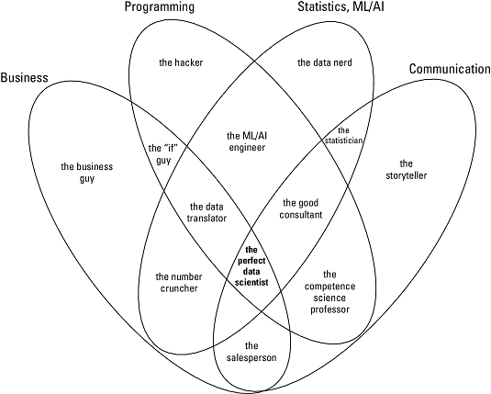
Notes:
Data science is multi-disciplinary
These are just representations because it essence its more complex that this
It contains some combination of:
- domain understanding or business understanding
- computer science

Slide 4
Types of Analytics Questions
Descriptive: "What happened?" (e.g., "What were the average sales in Q3?")
Diagnostic: "Why did it happen?" (e.g., "Why did website traffic drop by 20%?")
Predictive: "What will happen in the future?" (e.g., "Which equipment is likely to fail first based on current wear?")
Prescriptive: "What action should be taken?" (e.g., "What is the optimal dose of a medication to minimize side effects?")
Generally, realm of business analysts or data analysts
Generally, realm of data scientists
Notes:
Descriptive Analytics: Examine historical data to answer the question what happened
Diagnostic Analytics: Could be seen as a subset of descriptive analytics. Focusing on finding the root cause of past events, trends or anomalies. Bridging the gap between descriptive and predictive analytics.
Predictive Analytics: Essentially where statistical modeling and machine learning fits in, tries to predict future outcomes based on historic data and current state.
Prescriptive analytics: Recommend the best possible action based on current states and constraints. Using fields like decision science, scenario modeling, mathematical optimization and reinforcement learning

Slide 5
Methods
General data analysis
Statistics
Statistical inference
Machine learning
Simulation
Modeling and simulation
Kepler vs newton
Stats
Machine learning
AI
Renforcement learning
Since its inception, statistics has served science to guide data collection and analysis.
Kepler (Machine learning) vs Newton (Statistical inference)
Notes:
Statistics underpins machine learning

Slide 6
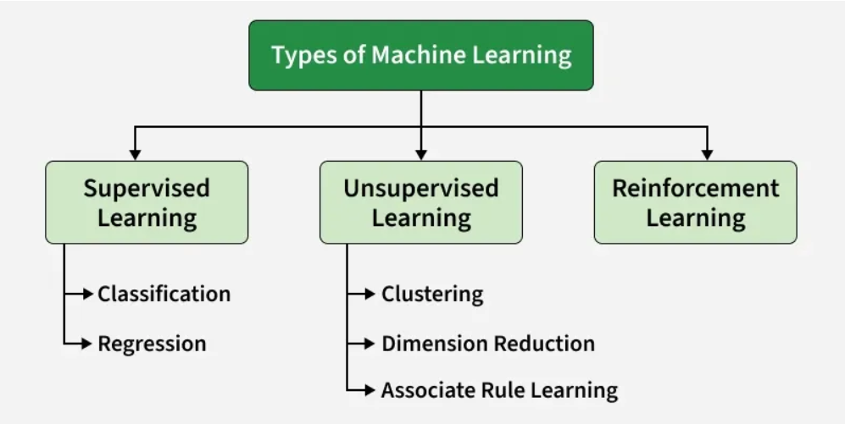
Machine Learning
Notes:
Supervised Learning: requires a set of labeled data to train the algorithms
Unsupervised Learning: no labels, used to look for patterns in the data
Reinforcement Learning: No data required, model learns by doing and being penalised for bad outcomes and rewarded for good outcomes, learning to play games etc.

Slide 7
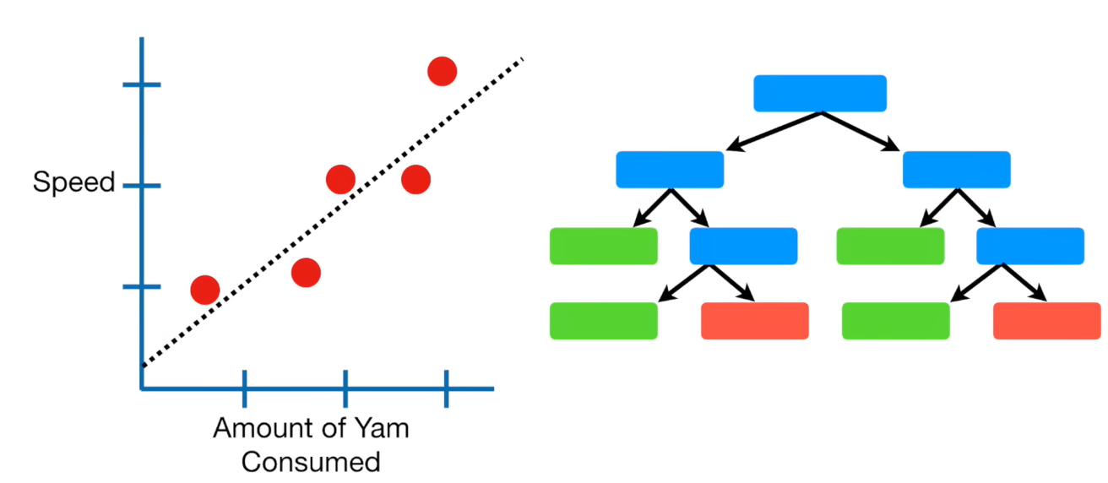
Supervised Learning
Supervised Learning
  Regression: Task of approximating a mapping function (f) from input variables (X) to a continuous output variable (y).
  Classification: The task of approximating a mapping function (f) from input variables (X) to discrete output variables (y)

Slide 8
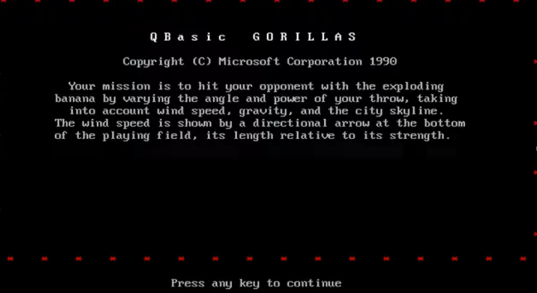
Our Example Problem
Notes:
Gorillas game
Statistical variance for the banannas, wind
Ml model that predicts the through and angle

Slide 9
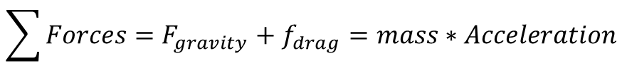
The Problem That Needs Solving
$$\sum{Forces}=F_{gravity}+f_{drag}=mass∗Acceleration$$
$$F_{gravity}=−mass∗(gravitational constant)$$
$F_{drag}=−\frac{1}{2}\left(air density\right)∗\left(drag coefficient\right)∗\left(frontal area\right)∗(relative velocity)$
$\text{(}\text{Relative} \text{velocity}\text{)}=(projectile velocity)−(wind velocity)$
Questions:
  Regression: How hard should I through the banana
  Classification: given a through, will I hit the other gorilla?

Slide 10
What Are We Trying To Do
F(X)=Y
Inputs [X]
Outputs [Y]
Model Parameters [H]
Notes:
X -> list of inputs or features
F -> Model type
H -> Model Parameters

Slide 11
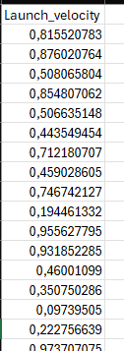
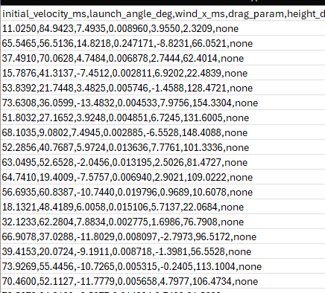
Training
Trained model
F(X)=Y
Inputs [X]
Outputs [Y]
Model Parameters [H]
DecisionTreeClassifier(*, criterion='gini', splitter='best', max_depth=None, min_samples_split=2, min_samples_leaf=1, min_weight_fraction_leaf=0.0, max_features=None, random_state=None, max_leaf_nodes=None, min_impurity_decrease=0.0, class_weight=None, ccp_alpha=0.0, monotonic_cst=None)
Notes:
X -> list of inputs or features
F -> Model type
H -> Model Parameters
Trained model is the output of the training process -> object that accepts features and outputs results
Feature engineering: There are some strategies regarding the input data
Hyper parameter tuning: way of choosing the best set of model parameters

Slide 12
Predict
Elevation = 40.0
wind_x = 15.0
Mass = 0.145
Radius = 0.037
Cd = 0.47
launch_height = 0
landing_height = 5
target_x = 60
F(X)=Y
Inputs [X]
Outputs [Y]
Launch_velocity = 40.0
Trained
Model
Notes:
Load trained model, feed features and model outputs a prediction
Show model, model has no idea of the physics of the problem besides what it learned during training

Slide 13
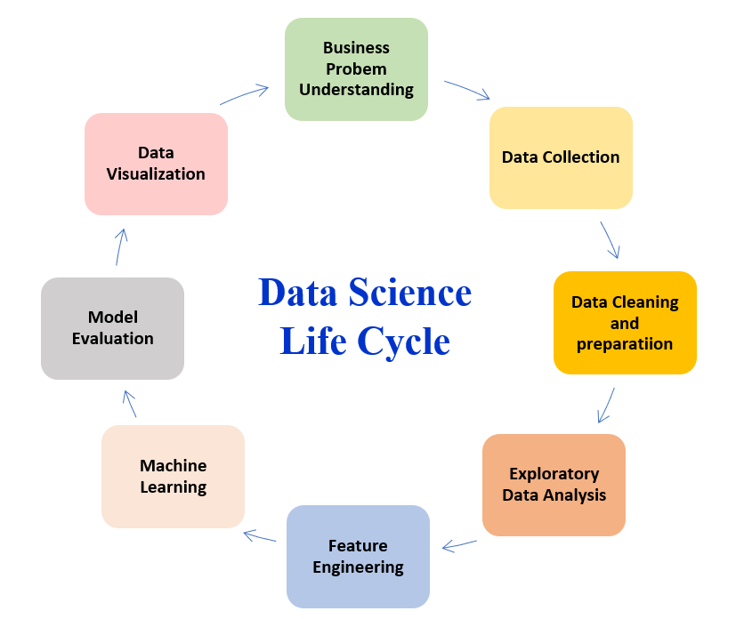
How To Sole ML Problems
Notes:
The nature of machine learning is experimental:
Understand the problem: You need to know what features would make sense to add that would assist with predicting the outcome, doesn’t make sense to use e.g. number of letters in customer name to try and predict sales
Data cleaning and preparation: this is self explanatory, data needs to be fit for use, errors duplicates, incorrect joins will generate incorrect data that will mess up the results from your ml model
Feature Engineering: Feature engineering is scaling, encoding, combining, reducing features sent to the model
Model Selection and Training: decide on what model will be used and how it will be trained, what hyperparameters will be used and against what metrics etc.
Model Evaluation: evaluate the model against testing data
Prediction: finally predict

Slide 14
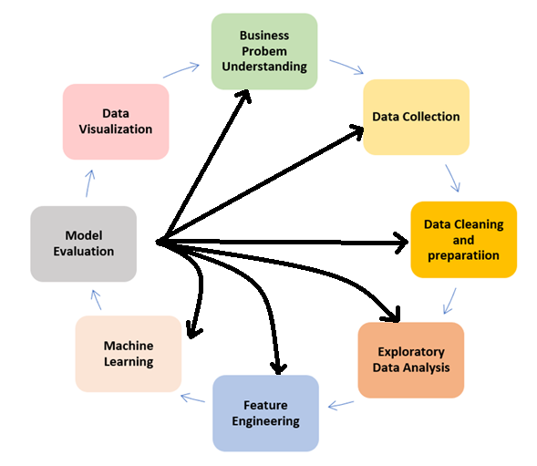
How to Solve ML Problems
Need to ultimately communicate your results
How much is enough
How Good is your model
Get data in a state that is usable
Pick your model and train it
Understand patterns in data
Decide on your model inputs
Notes:
The nature of machine learning is experimental so in reality the process can be very messy
and the results of the model and send you into several investigations and suggestions for improvement and the user can revisit may differently steps of the process completely out of order

Slide 15
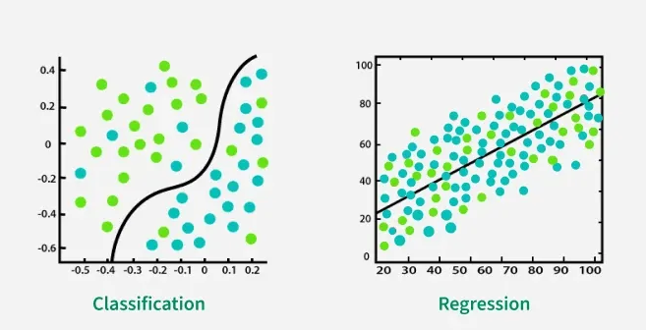
How Do I Know If a Model Is Good?
Model is accurate…
Model is generlisable…
Notes:
What does accurate mean in teams of ML?
- accuracy has different definitions based on if its classification or regression. Will discuss later
What does generalizable mean?
- Generilizability is one of the most important measures of machine learning models. means that it does not just work well on the training data but also on actual data in production

Slide 16
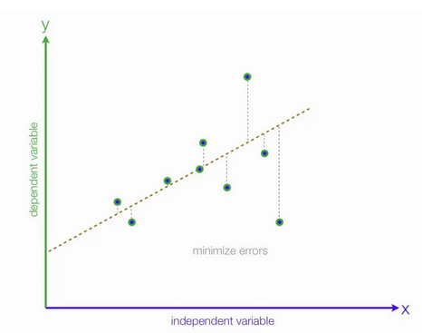
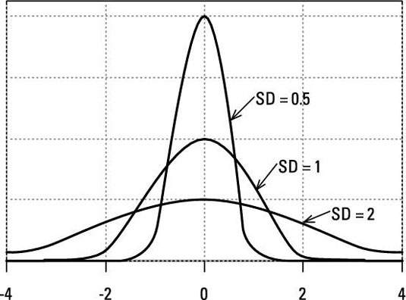
Model Evaluation Metrics: Regression
MAE: The Mean absolute error represents the average of the absolute difference between the actual and predicted values in the dataset
MSE: Mean Squared Error represents the average of the squared difference between the original and predicted values in the data set (variance)
RMSE: Root Mean Square Error is the square root of Mean Squared error. It measures the standard deviation of residuals.
Notes:
In general, regression metrics are based on the difference between the actual outcome and the predicted outcome

Slide 17
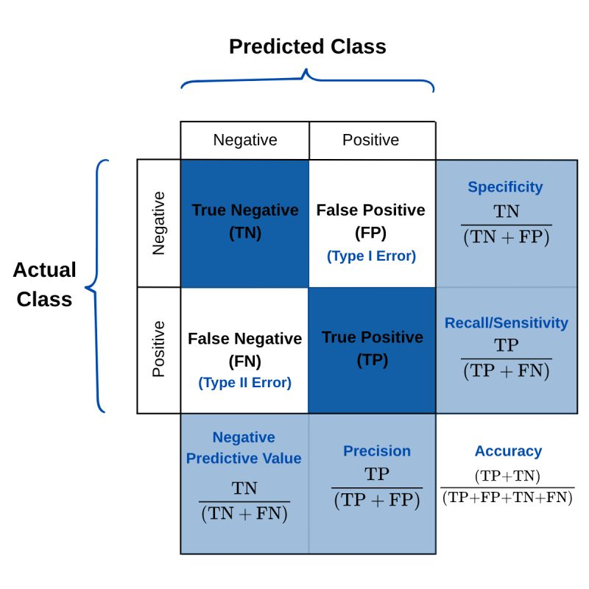
Model Evaluation Metrics: Classification
Confusion matrix
Accuracy: how many predictions the model got right out of all the predictions
Precision: how many of the "positive" predictions were actually correct
Recall: probability of detection, how good the model is at predicting positives
F1 Score: Combines precision and recall into a single metric to balance their trade-off
Notes:
Confusion matrix: gold standard for classification model evaluation
Accuracy is ok but when the dataset is imbalanced, or where one kind of mistake (FN or FP) is more costly than the other, which is the case in most real-world applications, it's better to optimize for one of the other metrics instead.
Example: data is unbalanced. E.g. fraudulent transactions other metrics like recall or precision or F1 is better
---
Precision: false positives need to be minimized such as detecting spam emails or fraud.
Recall: is essential when missing positive cases has significant consequences like in medical tests
F1 Score: For cases where precision and recall are equally important

Slide 18
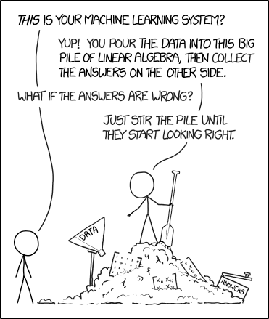
What can we do about a poor model
Notes:
Next question is can we do something about it besides just random gessing….

Slide 19
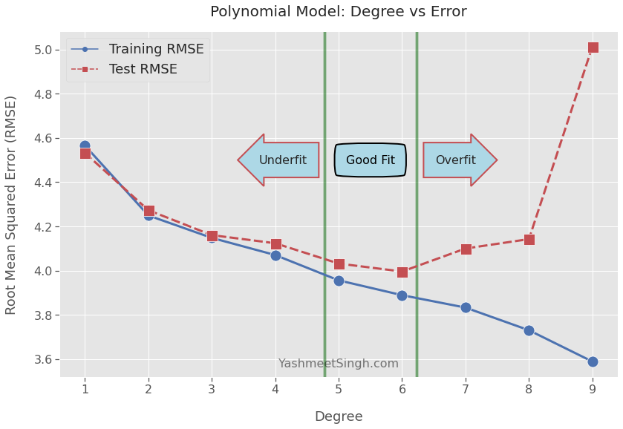
Model training/Improvement Suggestions
In general training is easy but getting good results, not always so much
Bad predictions - sources of improvement
  Overfitting/Underfitting
    Hyperparameter tuning
    train/test split
    Check for data leakage
  Skew datasets/poor data coverage
    Increase data
    Choose different model
    Reduce features/use regularization
    Use dimensionality reduction
  Unbalanced data
    Resample using methods like SMOTE
Notes:
Feature reduction: Something called the curse of dimentionality
- PCA: he most widely used technique. It transforms a large set of correlated variables into a smaller set of uncorrelated variables (principal components) while capturing as much data variance as possible
- T-SNE: reduces high-dimensional data into 2D or 3D spaces while preserving the localized groupings and structures of the original data
- Use Models with regularization methods e.g. Lasso or regression-> penalises features that do not contribute much

Slide 20
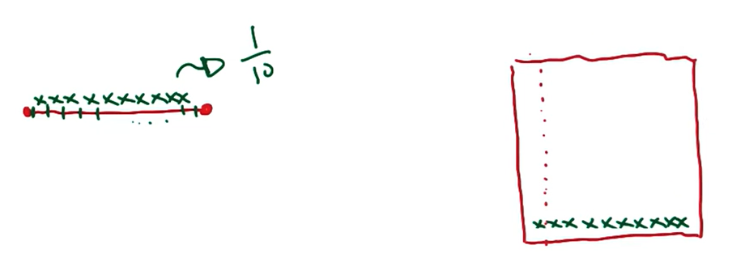
Curse of dimensionality
Notes:
Fewer, more informative features = easier for all models to learn, especially the linear one
Combine features where applicable to simplify or reduce the amount of relationships the model needs to learn

Slide 21
In Conclusion
ML is a tool in the data scientist’s toolbox that can be used to solve problems mostly of prediction
Because there is no simple way to know how well an ML model will fit the data it by nature requires lots of experimentation
It is a good idea to start small and work towards more complex models
The model just fits the data, it cannot predict anything reliably if it hasn't seen any examples during training
Be careful with ensuring that you test your model with data that it hasn’t seen during training. If not you model will look amazing but will be poor in practice
ML can be fun!

