Slide 1
Java Asymptotic Analysis static runtime analysis of Java code
Michael Lee, Phillip Huang, Irving Chen
The problem
Analyzing runtime of code can be difficult or tedious.
Both novice and proficient programmers some struggle with algorithm analysis.
We attempt to automate this process!

Slide 2
Domain Analysis
Our tool works on a subset of Java
We support…
  Types: primitive and basic object types
  Expressions: arithmetic, method calls
  Control flow: for loops, if/else statements
We don’t support…
  Generics
  Concurrency
  Mutual recursion
  While loops, infinite loops

Slide 3
Language Constructs
Our tool uses two intermediate “languages” internally
  Represented as syntax trees (no text form)
Simplified Java
  All the constructs mentioned on previous slide
  Special cases for things like array assignment
Math
  Arithmetic
  Summations
  Recursive functions (recurrences)

Slide 4
Demo
public class ArraySum {
public int sum(int[] arr) {
// Initialize sum to zero
int s = 0;
// For-each loop over array
for (int i : arr)
// Add element to sum
s += i;
// Return sum
return s;
}
}

Slide 5
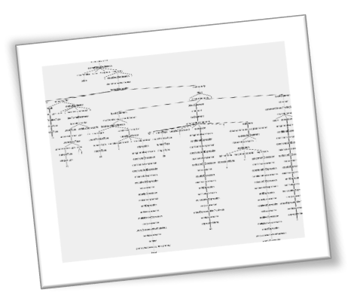
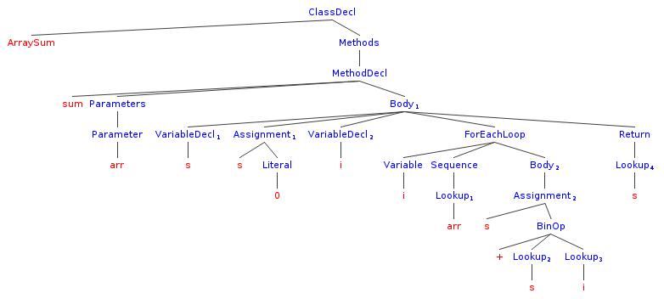
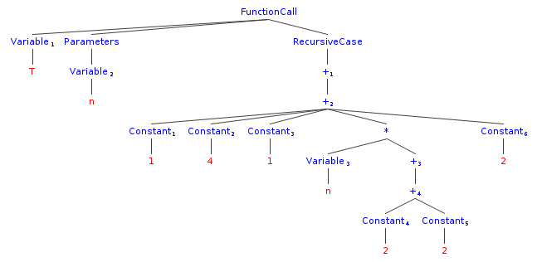
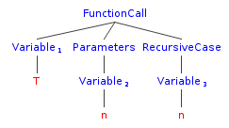
Implementation
A series of AST re-writes:
1. Generate full Java 8 AST with ANTLR
2. Translate full AST into simplified AST
(reduce depth, minor de-sugaring)
3. Translate simplified AST into “math AST” representing runtime

Slide 6
What we are proud of
Well-layered pipeline design made it easy to incrementally add features
Mistakes
Not giving enough priority to output complexity
What we would do differently
Equally prioritize output & runtime complexity analysis
Make error validation more robust

Slide 7
You have only 6 slides.
No font smaller than 28 points, please.
No crz acrnyms n odr trix

