Slide 1

Web basics

Slide 2


Lower Layers
HTTP
Application layer
HTTP
TCP
Transport layer
TCP
IPv4 / IPv6
Network layer
IPv4 / IPv6
MAC
Data link layer
MAC
Physical link

Slide 3
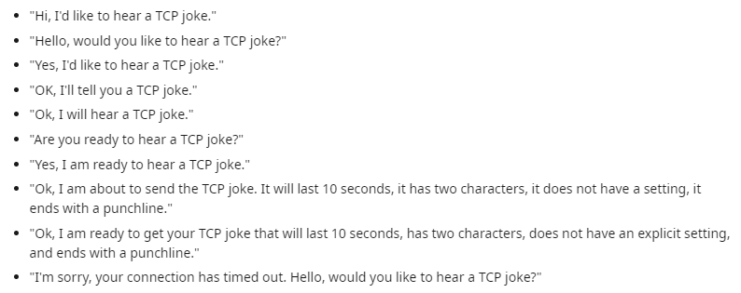
HTTP basics – TCP / IP
Notes:
HTTP/3 uses UDP.

Slide 4
HTTP basics – requests / verbs
GET – request data
POST – send data
PUT – replace data
DELETE – delete data
OPTIONS – request info
HEAD – request data (header only)
TRACE – message loop-back test
CONNECT – used for proxy

Slide 5
Browser-Server Communication
IP
Cache
Other Server
DNS
DB
Files
TCP
Request
Browser
Server
GET /index.html HTTP/1.1
[Request Headers]
[Blank Line]
[Optional content]
Response
200 OK HTTP/1.1
[Response Headers]
[Blank Line]
[Optional content]
Demo
Notes:
Show epam.com request and response headers.

Slide 6

Basic building stones of the Web
HTTP as protocol
HTML as document format
CSS as formatting language
JavaScript to run code inside the browser

Slide 7
URI, URL
URI Uniform Resource Identifier
URL Uniform Resource Locator
scheme:[//[user:password@]host[:port]][/]path[?query][#fragment]
Generic URI
URI
URL

Slide 8
Cookies
Store information on client side
Client sends back all the cookies for every request for a given site
Server may set cookies in HTTP header
Session cookie
Persistent cookie
Secure cookie
HttpOnly cookie
Third-party cookie
Supercookie
Zombie cookie

Slide 9




HTTP Server
Apache HTTP Server
Nginx
Apache Tomcat
Jetty
...
Exercise
Notes:
Exercise: implement a very simple webserver based on serversocket.

Slide 10
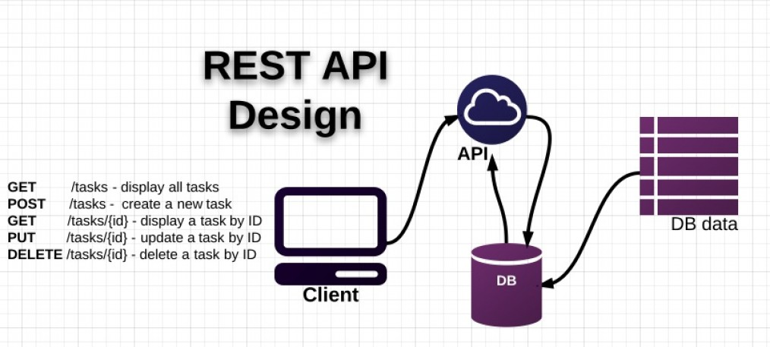
Web services
SOAP, WSDL based web service (JAX-WS)
RESTful web service (JAX-RS)

Slide 11
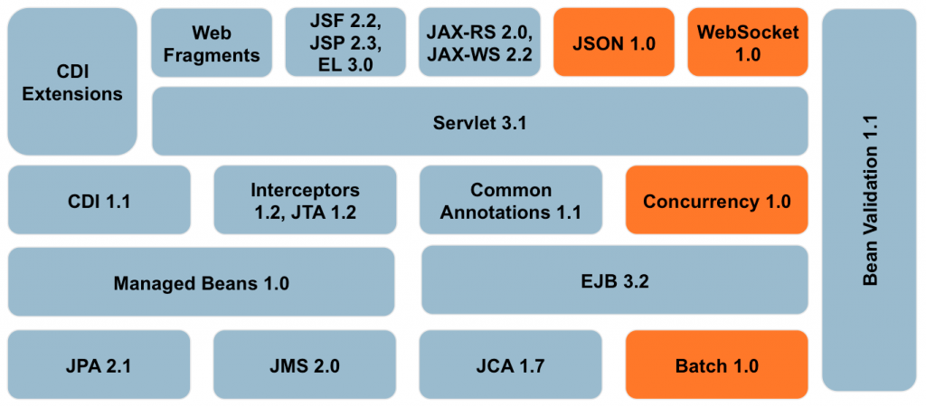
The Java EE Big Picture

Slide 12
Java Servlet

Slide 13
Container model
For cross-cutting logic
Communication
Lifecycle management
Thread management
Security
Container
Component
Indirection
Request
Component
Component
Component

Slide 14
Servlet container implementations
Tomcat
Jetty
GlassFish
WildFly
WebLogic
WebSphere
Tomcat 8
Servlet 3.1
JSP 2.3
EL 3.0
WebSocket 1.1
...
Notes:
Demo:
Start a simple webpage with tomcat
Use eclipse dynamic webapp
Use maven archetype

Slide 15
Java Servlet
Template method design pattern
Servlet
doDelete(HttpServletRequest req, HttpServletResponse resp)
doGet(HttpServletRequest req, HttpServletResponse resp)
doHead(HttpServletRequest req, HttpServletResponse resp)
doOptions(HttpServletRequest req, HttpServletResponse resp)
doPost(HttpServletRequest req, HttpServletResponse resp)
doPut(HttpServletRequest req, HttpServletResponse resp)
doTrace(HttpServletRequest req, HttpServletResponse resp)
getLastModified(HttpServletRequest req)
service(HttpServletRequest req, HttpServletResponse resp)
service(ServletRequest req, ServletResponse res)
GenericServlet
HttpServlet

Slide 16
Java Servlet deployment descriptor
<servlet>
<servlet-name>simple</servlet-name>
<servlet-class>com.epam.training.SimpleServlet</servlet-class>
</servlet>
<servlet-mapping>
<servlet-name>simple</servlet-name>
<url-pattern>/simple</url-pattern>
</servlet-mapping>
request
SimpleServlet
Notes:
Demo:
Develop a simple servlet.

Slide 17
Specification of Mappings
A string beginning with a ‘/’ character and ending with a ‘/*’ suffix is used for path mapping.
A string beginning with a ‘*.’ prefix is used as an extension mapping.
The empty string ("") is a special URL pattern that exactly maps to the application's context root, i.e., requests of the form http://host:port/<contextroot>/. In this case the path info is ’/’ and the servlet path and context path is empty string ("").
A string containing only the ’/’ character indicates the "default" servlet of the application. In this case the servlet path is the request URI minus the context path and the path info is null.
All other strings are used for exact matches only.
From Java™ Servlet Specification Version 3.0
Exercise
Notes:
Exercise
Try each configuration in tomcat

Slide 18
Servlet instances
“the servlet container must use only one instance per servlet declaration”
“for a servlet implementing the SingleThreadModel interface, the servlet container may instantiate multiple instances to handle a heavy request load and serialize requests to a particular instance”
request1
request2
s1: Servlet
request3
Exercise
Notes:
Exercise
Prove that tomcat is working according to the specification

Slide 19
Deployment descriptor (web.xml)
context-param
description
display-name
distributable
ejb-ref
ejb-local-ref
env-entry
error-page
filter
filter-mapping
icon
jsp-config
listener
login-config
mime-mapping
resource-env-ref
resource-ref
security-constraint
security-role
servlet
servlet-mapping
session-config
web-app
welcome-file-list

Slide 20
Deployment directory structure
webapp.war
|-- images/
| `-- banner.jpg
|-- index.html
`-- WEB-INF/
|-- jsps/
| |-- public/
| | `-- login.jsp
| `-- private/
| |-- application.jsp
| `-- settings.jsp
|-- lib/
| `-- some-library.jar
|-- classes/
| `-- compiled.class
`-- web.xml
Demo
Notes:
Demo
Export the war file with eclipse and examine the result.

Slide 21
MVC pattern
Request
Controller
(Servlet)
Model
Client
Model
Data
Response
View
(JSP)
Demo
Notes:
Demo
Implement the current time webpage with the MVC pattern
Exercise
List the timestamps of every page visits. Use the MVC pattern

Slide 22
Servlet API
GenericServlet
HttpServlet
ServletConfig
ServletContext
HttpSession
HttpServletRequest
HttpServletResponse
Scope | How long?
Application | Life of the deployed app
Session | User session (multiple requests)
Request | Life of the Request
Page | Within the page
Tag | Within the tag
Demo & Exercise
Notes:
Demo
Go through each class and describe each method
Exercise
Implement a simple calculator which gets it’s parameters from GET url parameters

Slide 23
Redirect mechanisms
Redirect
Redirect
Forward
Include
Servlet1
Client
Servlet Container
Forward
Include
Servlet2

Slide 24
Init parameters, deploy time constants
<context-param>
<param-name>email</param-name>
<param-value>context@example.com</param-value>
</context-param>
<servlet>
<servlet-name>simple</servlet-name>
<servlet-class>com.epam.training.SimpleServlet</servlet-class>
<init-param>
<param-name>email</param-name>
<param-value>servlet@example.com</param-value>
</init-param>
</servlet>
@Override
protected void doGet(...) {
ServletContext context = getServletContext();
context.getInitParameter("email");
getInitParameter("email");
}

Slide 25

Listeners
ServletContextListener
ServletContextAttributeListener
HttpSessionListener
HttpSessionAttributeListener
HttpSessionBindingListener
HttpSessionActivationListener
ServletRequestListener
ServletRequestAttributeListener
Demo & Exercise
Notes:
Demo & Exercise
Try each listener (tip: HttpSessionActivationListener – tomcat persists sessions between restarts, make it serializeable).

Slide 26
Session management
Store client specific information between requests
Identify the requests
Store data: memory / database / external
Client
First request
Server
Cookie with session ID
Request (cookie with session ID)
Demo
Notes:
Demo:
Show tomcat session management with a browser

Slide 27
Session management with disabled cookies
Client
First request
Server
Session ID in URL
Request (URL with session ID)
Session ID in URL
Demo
Notes:
Demo
Demonstrate url rewriting (urlencode)

Slide 28

Thread safety
Slots: 2
1:01.001
Reservation engine
1:01.001
Slots: 2
Free slots: 3
Demo
Notes:
Not safe: Servlet instance, Application scope, Session scope
Demo:
Implement a simple servlet (with sleep) which exhibits incorrect multithreaded behaviour

Slide 29
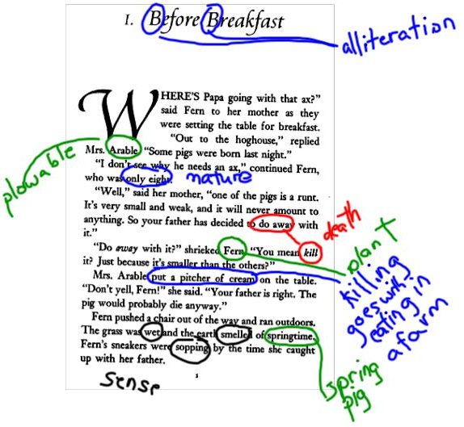
Annotation configuration
@WebServlet
@WebListener
@WebInitParam
@ServletSecurity
@HttpMethodConstraint
@HttpConstraint
@MultipartConfig
@WebFilter

Slide 30

Encoding
UTF-8 everywhere
Content-Type
Source files (Java, JSP)
Request / Response

Slide 31

Complex exercise
Implement a register and login mechanism for our Snake competition site
Store the data in a serialized file (location -> init param)
Save on contextDestroyed event
Load on contextInitialized event
Exercise

Slide 32

Remember me
Automatic login using long-living cookie with an unpredictable secret unique id
Security risks
Exercise
Notes:
Exercise:
implement remember-me functionality

